Slide 1
SugarCRM for Manufacturing Overview
Industrial Grade CRM
May 6, 2025
Name, Title/Position
Notes:
Finally, there is an industrial-grade CRM platform built for the needs of manufacturers,
It is robust, powerful & flexible – built to make the hard things easy and
designed to drive revenue growth and foster profitable customer relationships
With Sugar’s Industrial Grade CRM Platform, manufacturers can
Bridge the gap between front and back office to provide a true 360-degree view of your customers
Break the silos: support and automate business processes end-to-end.
Capitalize on their data: Leverage customer intent and demand signals to optimize revenue
This deck is focused on Manufacturing but can be used for Wholesale & Distribution (for the most part) – we will create a variation for wholesale & Distribution at a later time

Slide 2
SugarCRM for Manufacturing Overview
PRESENTER
Name, Title
DATE
May 6, 2025

Slide 3
Modernize Marketing, Sales & Service with SugarCRM for Manufacturing
Everything you need to stay ahead of the manufacturing digital transformation
Notes:
Everyday, you’re called upon to drive growth, adapt, and find new ways to innovate and create.
In the manufacturing industry, managing the impossible and navigating uncertainty is just part of the job—and with new entrants, rising expectations, and increasing competition, you have to stay on your toes. SugarCRM can help you innovate, identify new ways to drive growth, gain a competitive edge, and power into a more promising future.

Slide 4




Industrial Grade CRM
Built for Manufacturing Leaders & Champions
Generate
leads &
build pipeline
Manage
accounts,
opportunities
and pipeline
Create
quotes &
Close
deals
Deliver
service
excellence
Drive profitable revenue growth & build lasting customers relationships
4
Notes:
SugarCRM is an industrial-grade platform built for manufacturing leaders and champions that supports the entire customer journey through the customer lifecycle:
It is robust, powerful & flexible – built to make the hard things easy and
designed to drive revenue growth and foster profitable customer relationships
From generating leads and pipeline (new customers and within the installed base)
to managing accounts & opportunities
creating quotes & closing deals
All the way to delivering service excellence

Slide 5

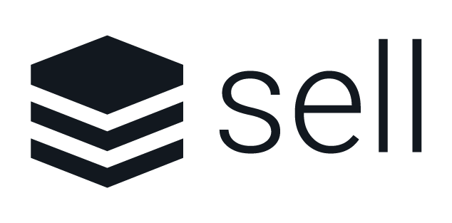

SugarCRM for Manufacturing Platform Overview
Customer Engagement Channels
Demand Generation
Lead Nurturing
Sales
Acceleration
Opportunity & Pipeline
Configure, Price, Quote
Service & Support
Field
Service
Data-Enriched Artificial Intelligence
Platform
Services
Cloud Services
Workflow & Automation
Configurability & Extensibility
Identity & Privacy
Security
Integration
Time-Aware Customer Data Platform™
SugarCRM Platform

Slide 6

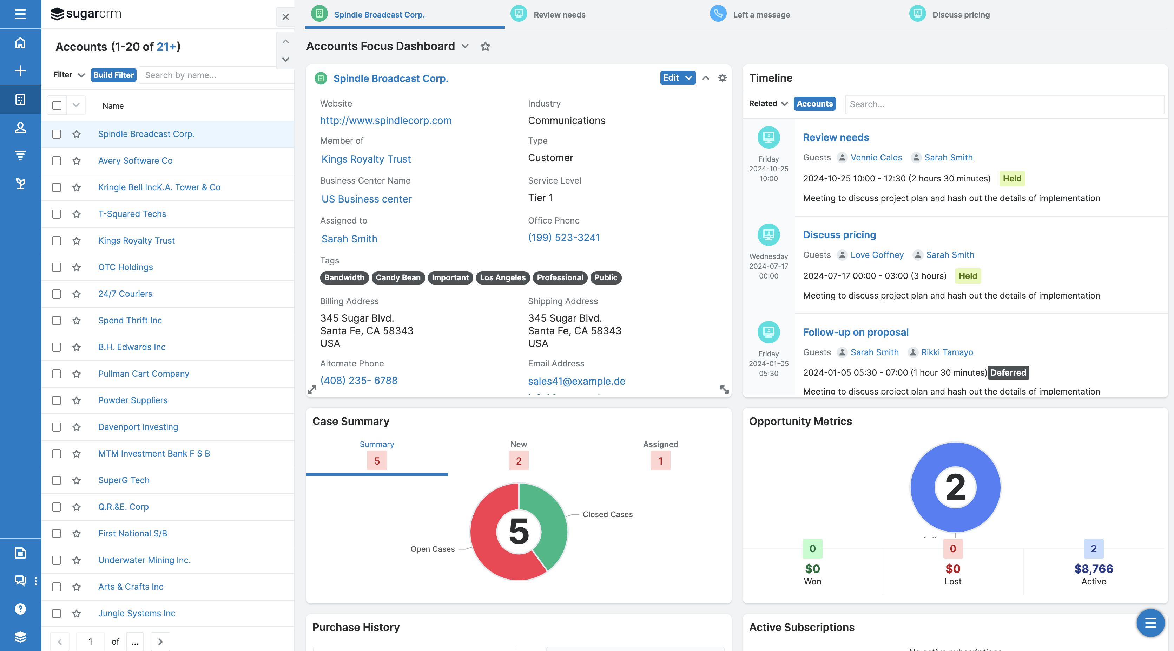
360-Degree View of the Customer
Get a full view of customer and prospect activities, opportunities, contacts, purchasing history, and more from one screen.
Have better customer conversations and achieve faster resolutions with information at your fingertips.
Save time and clicks with a full view of a customer’s sales, marketing, and service history.
Notes:
Sugar’s Focus Drawers are a fantastic feature that allow reps to get everything on one screen. No more clicking in and out of your browser or navigating around- it’s all at your fingertips!
Turn insight into action and capitalize on your data!

Slide 7
B2B Marketing Automation
Platform Built for
Marketing Mavericks

Slide 8
“54% of sales leads generated by marketing are either poorly qualified or unqualified”
The 2024 CRM Impact Report
Notes:
Our CRM impact report has revealed that generating qualified leads is a key challenge for most B2B Marketers

Slide 9






Marketing Challenges in B2B Manufacturing
Qualified
Leads
Cross-Sell Opportunities
Pipeline
Generation
Digital Marketing Transformation
Personalized
Engagement
360-Degree Customer View
Notes:
[Note to seller: This is your opportunity to establish credibility with sales leaders that you understand their job and pain points. Show the prospect you understand their issues and can solve them]
While studying trends, we’ve also zeroed in on common challenges that modern sales organizations face. They include:
Driving revenue growth: Sales is ultimately responsible for winning and retaining business and reaching company revenue goals
Inaccurate sales forecasts: Companies base their most strategic decisions on forecasts. If their forecasts are inaccurate, the outcomes of their strategic decisions will miss their objectives
No lead prioritization: Reps have a lot to do already. They could benefit from knowing where to spend their time – with prospects more likely to become raving fans
Inconsistent sales processes: Once you’ve identified a winning formula you want your reps to follow, it’s easy for them to get distracted, leading to inconsistent customer experiences and lower win rates
Too many manual tasks: Reps have a lot to coordinate – contracts, quotes, RFPs, NDAs, follow-up messages, win wires, etc. It’s all a bit tedious and takes a lot of time away from selling
Lack of preparation: the #1 predictor for winning customer trust is preparation. In a recent study, we found that “56% of sales and marketing professionals feel they are missing data to improve their marketing campaigns and sales conversions.” With the right tools, sales reps can access the right information for their customers at the right time.
Do any of these sound familiar? [now, listen carefully to what the customer/prospect has to say. Weave their challenges into how you can address those challenges within the Sugar platform!].
[Quote from Ventana Research (https://blog.ventanaresearch.com/sugarcrm-brings-the-sweetness-in-ai-driven-sales)]

Slide 10

Feed the Funnel and Build a Healthy Pipeline
Create
content &
campaigns
Engage
your audience
1 to 1
Anticipate
what your customers
want and need next
Understand
what is working
and what is not
B2B Marketing Automation
10
Notes:
B2B Marketing Automation with Sugar Market
Create content and design & execute campaigns to attract new customers
Engage your marketing audience 1 to 1 and nurture your leads over time (Social – Oktopost)
Anticipate what customers want and what they need next; act upon it and make more personalized recommendations (Sales I)
Close the Loop: understand what is working and what is not: Analyze Marketing & Sales Performance/ Service Packages (Managed Services)
Feed the funnel & work closely with your sales team to build pipeline

Slide 11
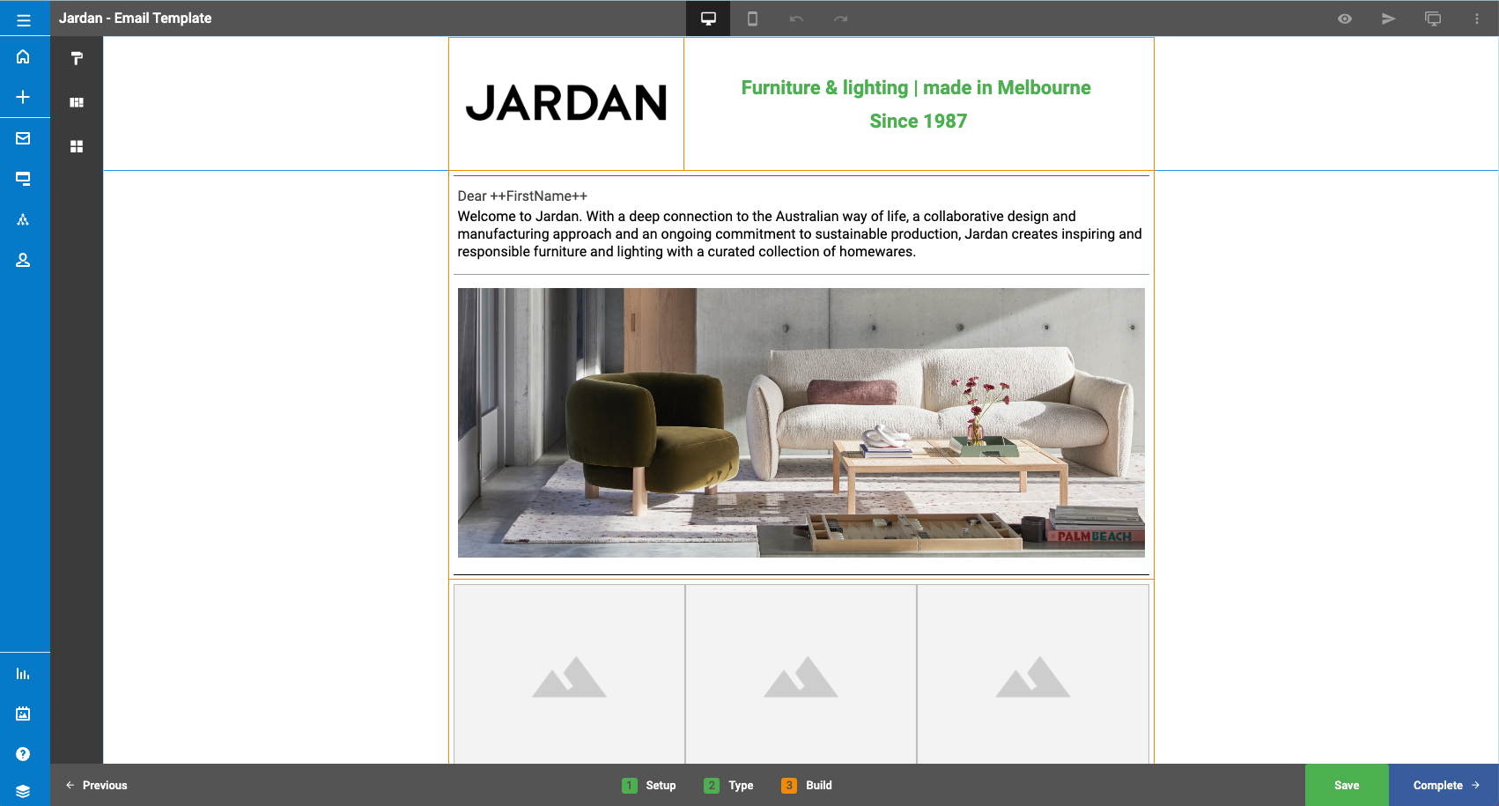
Personalized Email
Personalize marketing content and campaigns with dynamic email capabilities
Segment your audiences by creating lists (customers, prospects, or suppliers ).
Send newsletters, event invitations, and promotions, to showcase your expertise in the manufacturing sector.
Collaborate and share results with sellers and partners within your CRM.
Notes:
manufacturing marketers can develop precise and focused marketing campaigns that effectively reach their target audience and drive desired outcomes in the manufacturing sector.

Slide 12
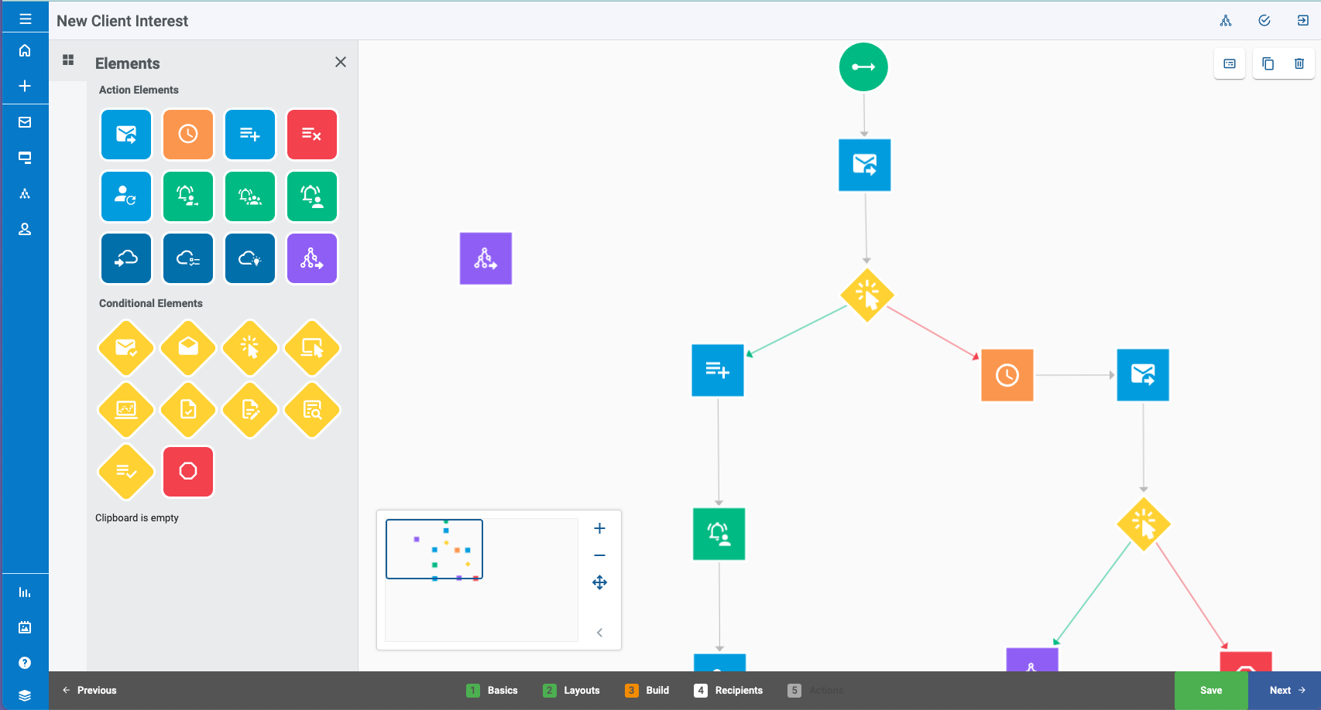
Automated Smart Workflows for Lead Generation and Nurture Campaigns
Quick setup using drag-and-drop tools.
Save time by automating email sequences based on recipient behavior, such as opens or clicks.
Automated and optimized workflows using AI-based predictive lead scores
Leverage revenue intelligence and create cross-selling campaigns.
Notes:
Manufacturing companies can easily create segmented lists and move leads closer to a deal! Information from leads who visit their website, download a case study, or fill out a form can be nurtured into a workflow designed to address their interest. Send personalized and targeted emails to the right people.

Slide 13
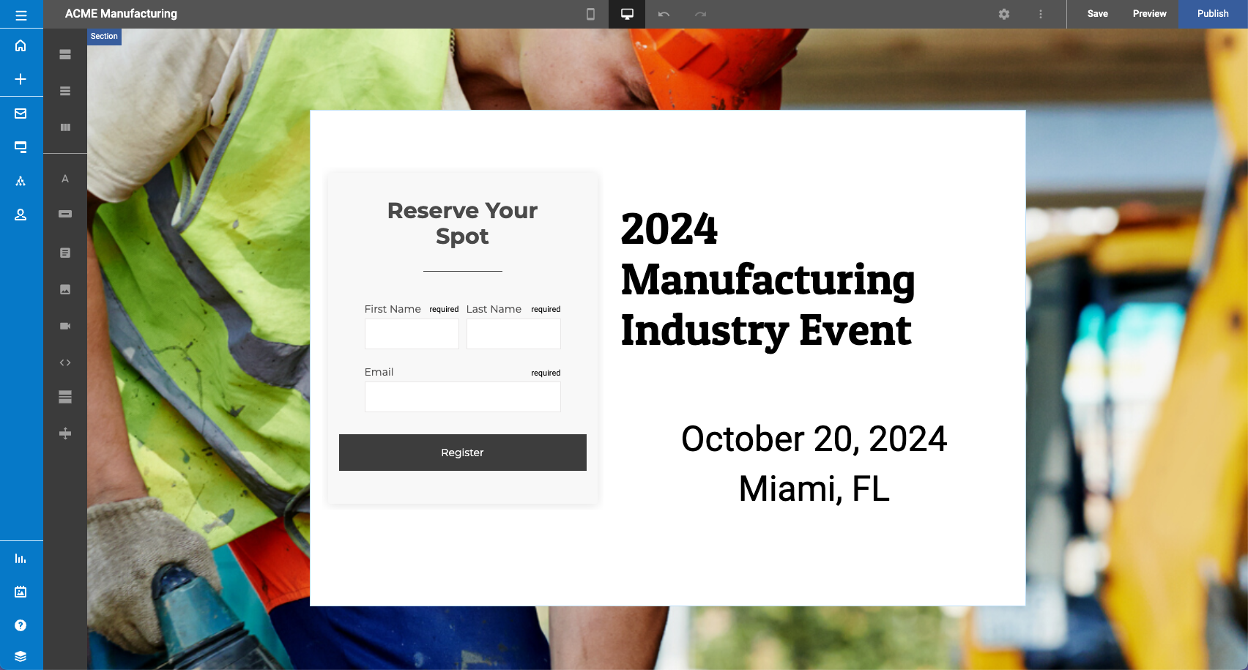
Where Events Meet Efficiency
Easily create event invitations for online and offline events.
Create engaging event registration pages with embedded smart forms
Automate follow-up based on attendance and registration.
Analyze event impact on lead generation, lead conversion, ​
and ROI.​
Generative AI-based Social Media and Employee Advocacy
Notes:
Trade shows are essential for manufacturers to showcase their products, generate leads, and build relationships with potential customers. To ensure efficiency and effectiveness is to make sure their marketing automation solution can in fact manage virtual and in person events. With Sugar Market’s event capability, marketers can easily create event invitations, registration forms, manage registration details, and have a clear view of their registrants and most importantly, their ROI. By leveraging marketing automation with events capabilities, manufacturing companies can streamline personalize follow-up interactions, deliver targeted content, and track the impact of their efforts. This ultimately leads to more efficient and effective trade show participation, driving business growth and enhancing customer relationships.

Slide 14
Sales Force Automation Platform
Built for the Modern Sales Warrior

Slide 15
“Declining quota attainment, lack of visibility into deal health and difficulty in forecasting quarterly sales remain a challenge for sales leaders.”
Ventana Research
Notes:
Our CRM impact report has revealed that generating qualified leads is a key challenge for most B2B Marketers

Slide 16


Sales Challenges in B2B Manufacturing
Account Insight
& Development
Sales Forecasting & Production Planning
Declining Quota
Attainment
Guided Selling
& Next Best Action
Accurate
Configurations & Quotes
Access to Relevant Information
Notes:
[Note to seller: This is your opportunity to establish credibility with sales leaders that you understand their job and pain points. Show the prospect you understand their issues and can solve them]
While studying trends, we’ve also zeroed in on common challenges that modern sales organizations face. They include:
Driving revenue growth: Sales is ultimately responsible for winning and retaining business and reaching company revenue goals
Inaccurate sales forecasts: Companies base their most strategic decisions on forecasts. If their forecasts are inaccurate, the outcomes of their strategic decisions will miss their objectives
No lead prioritization: Reps have a lot to do already. They could benefit from knowing where to spend their time – with prospects more likely to become raving fans
Inconsistent sales processes: Once you’ve identified a winning formula you want your reps to follow, it’s easy for them to get distracted, leading to inconsistent customer experiences and lower win rates
Too many manual tasks: Reps have a lot to coordinate – contracts, quotes, RFPs, NDAs, follow-up messages, win wires, etc. It’s all a bit tedious and takes a lot of time away from selling
Lack of preparation: the #1 predictor for winning customer trust is preparation. In a recent study, we found that “56% of sales and marketing professionals feel they are missing data to improve their marketing campaigns and sales conversions.” With the right tools, sales reps can access the right information for their customers at the right time.
Do any of these sound familiar? [now, listen carefully to what the customer/prospect has to say. Weave their challenges into how you can address those challenges within the Sugar platform!].
[Quote from Ventana Research (https://blog.ventanaresearch.com/sugarcrm-brings-the-sweetness-in-ai-driven-sales)]

Slide 17



Accelerate your Sales Cycle and
Increase your Win Rate
Focus
on the right leads
& opportunities
Manage
your accounts, pipeline & forecast
Engage
your customers
anytime, anywhere
Quote & Close
the deal
Sales Automation & Account Management
17
Notes:
We’ve built Sugar Sell to be the ultimate tool for the modern sales warriors and account managers.
With it, sellers can:
Respond quickly to every qualified sales lead and focus on the most promising opportunities leveraging AI-based predictive models
Have a clear view of your pipeline, sales forecast and quota attainment and manage your opportunities with guided selling support
Engage your customers anywhere, anytime and increase the value of your customer relationships
Deliver accurate quotes and presentation quality proposals quickly to your customer and make it easy to sign a contract in order to close the deal
→ ultimately, Sell can enable you to shorten the sales cycle and increase your win rate
[Now cut to the demo]

Slide 18
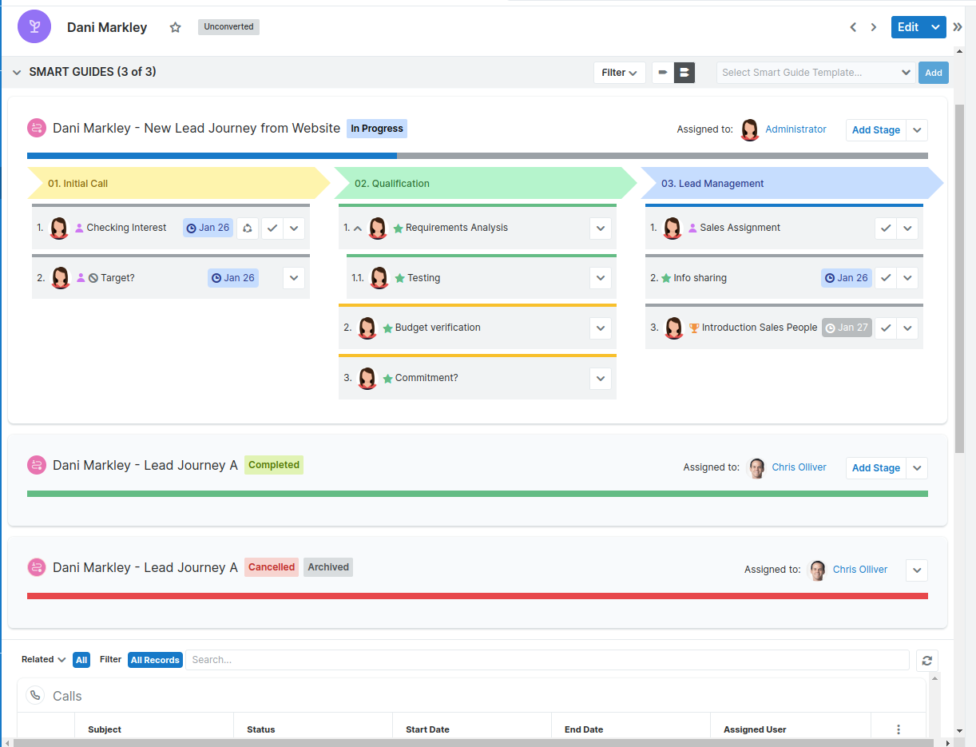
Sales Playbooks & Guided Selling
Design, visualize, and automate sales processes.
Create playbooks and templates for sales plays, sales methodologies, guided selling, lead nurturing, and more.
Standardize best practices & ways of working.
Notes:
Sugar Automate helps organizations streamline sales processes, accelerate the sales cycle, and optimize best practices with “next best action” & smart workflows to keep everyone aligned.

Slide 19
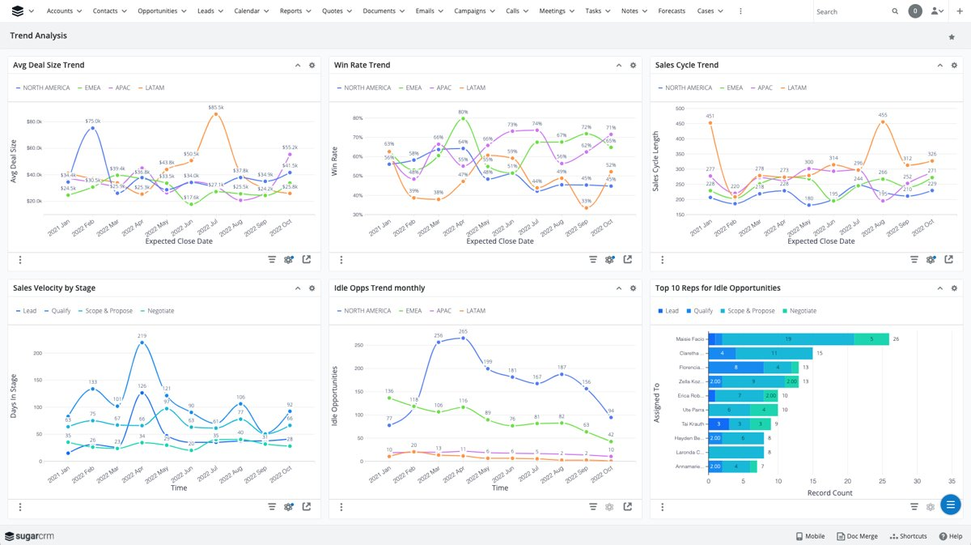
Pipeline Health & Forecasting
Take the hassle out of sales forecasting and make forecasting calls a breeze
Generate accurate forecasts for production planning with Enhanced Forecasting visualizations.
Analyze your sales and marketing metrics, and easily see changes as they happen.
Remove the need for manual reports and dozens of spreadsheets.
Notes:
With Sugar, you can ditch the spreadsheets and expensive BI tools- your key sales analytics are at your fingertips. Create custom dashboards that give reps, sales managers, and execs exactly what they need at a glance.

Slide 20

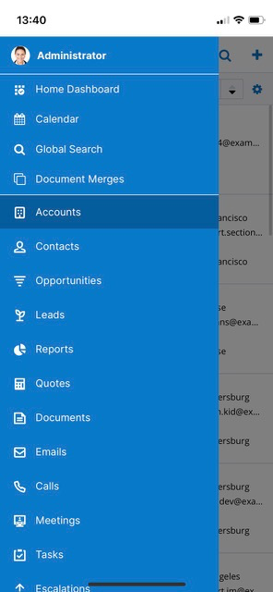
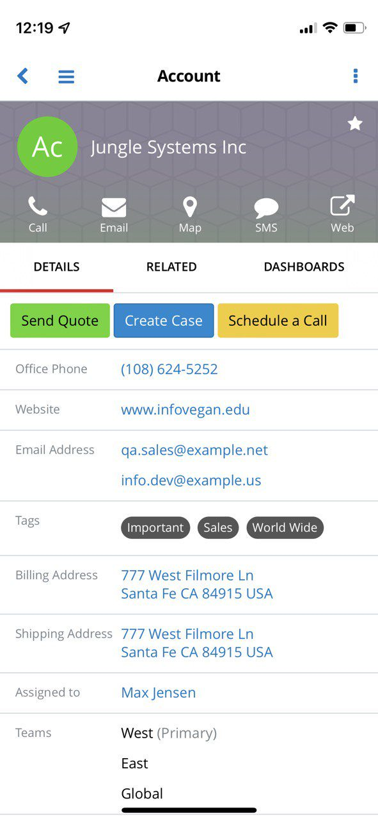
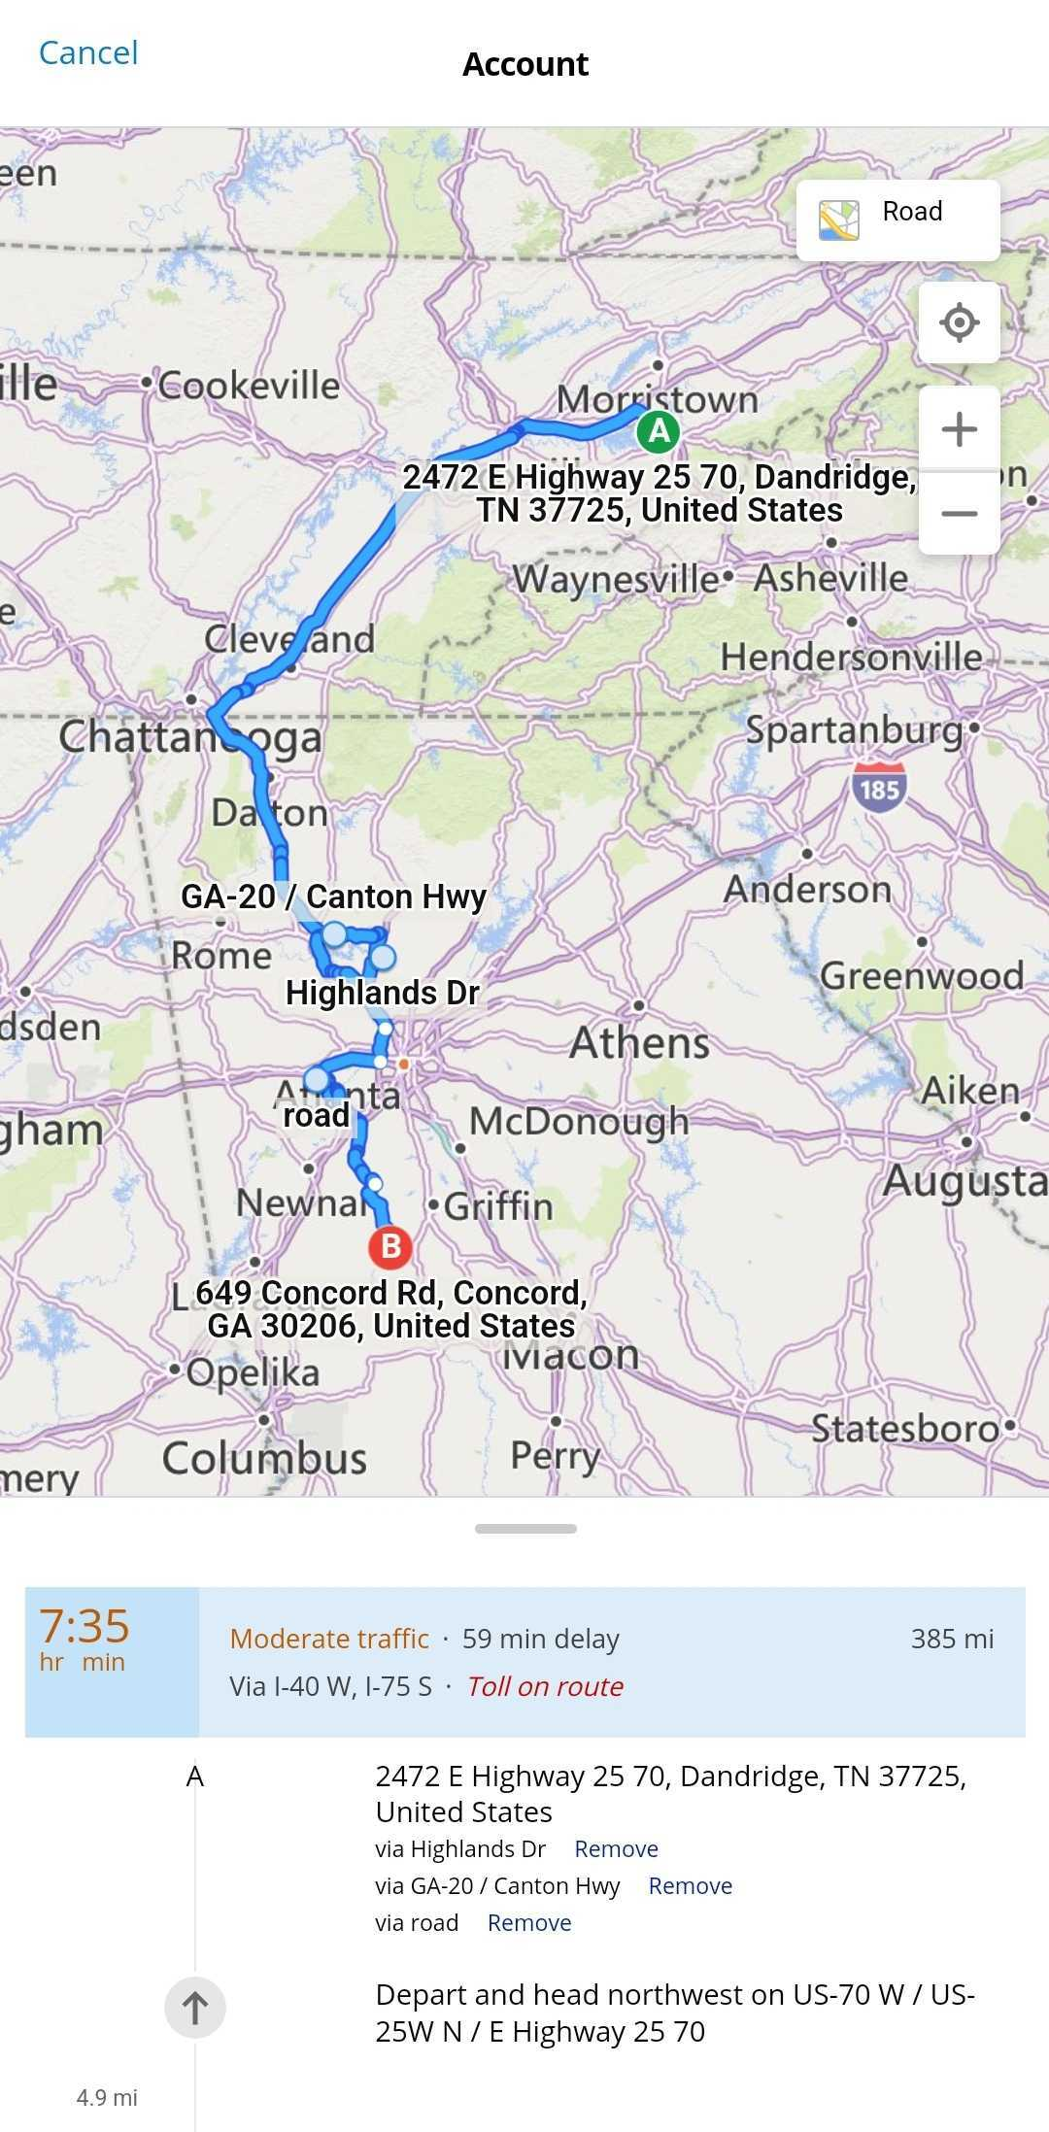
For the Road Warriors: Mobile Sales and Visits
Take sales anywhere with SugarCRM’s mobile app.
Access Offline mode to ensure you’re always ready to make the deal—wherever you are.
Use native device integrations like click-to-call or text, 3rd-party document integrations, and GPS mapping to remove busy work across devices. ​
Notes:
Sales don’t always happen in the office. When your reps are out on the road with customers and prospects they’ll have access to all of the desktop features they know and love in the SugarCRM mobile app – even if they’re offline!

Slide 21
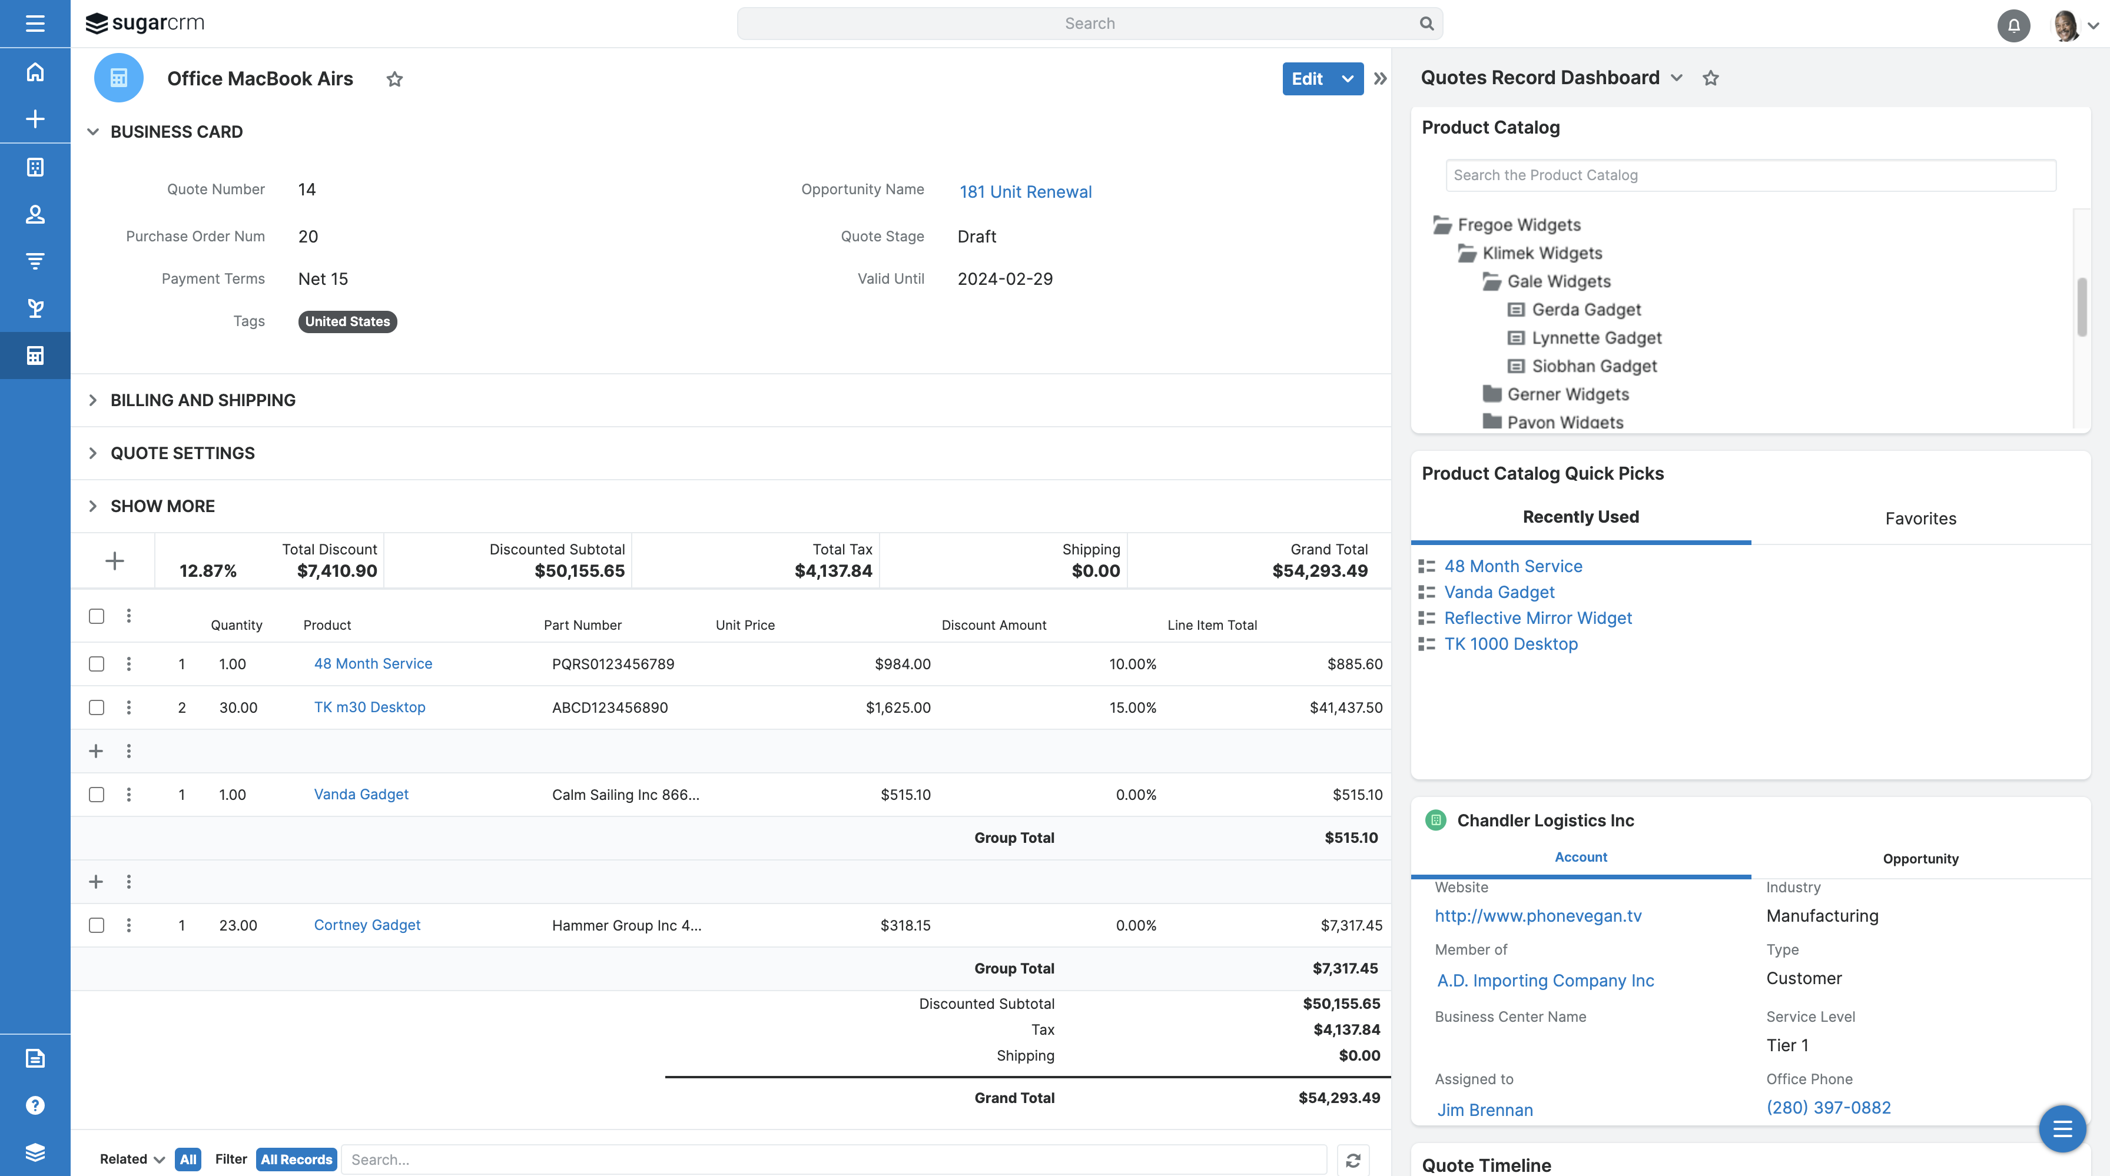
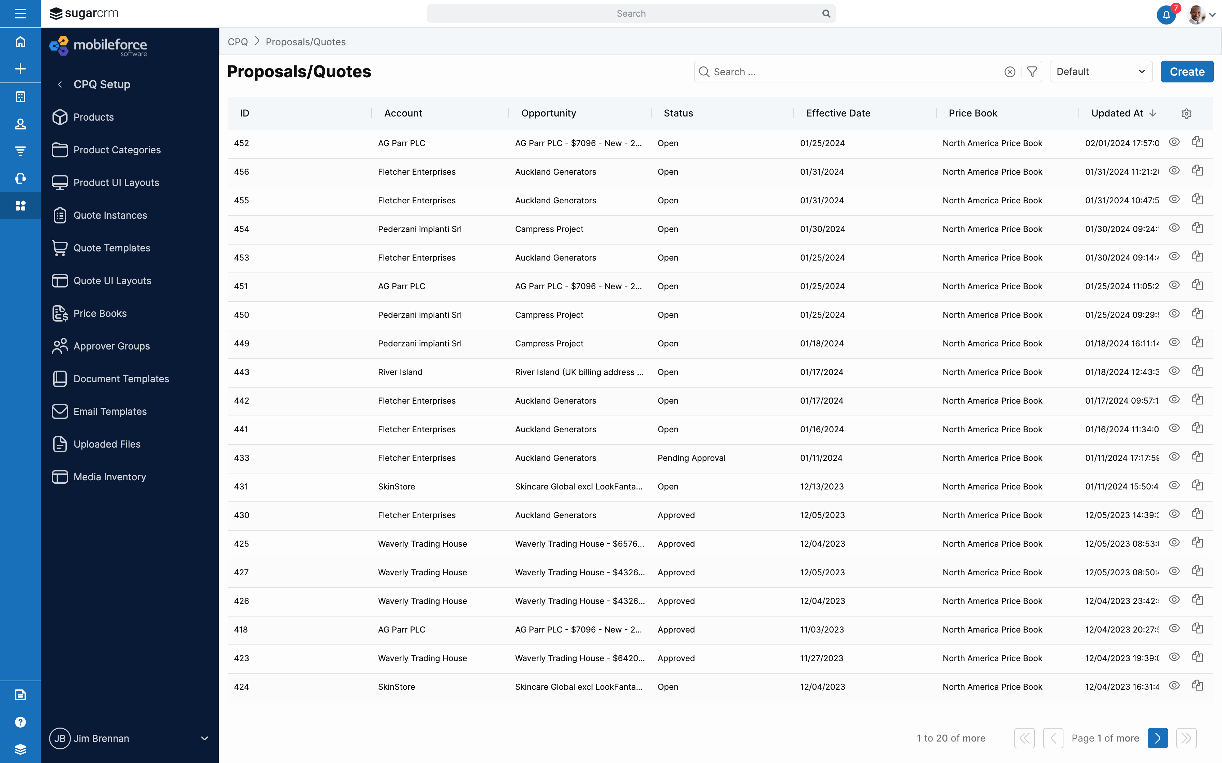
Configure, Price, Quote (CPQ)
Quickly and easily configure products, bundles & solutions and automatically generate quotes with accurate pricing
Send proposals to customers and save them to SugarCRM in an instant
Ready-to-use, customizable document layouts and templates to quickly create appealing proposals
Intelligent workflows, approval rules, and routing to streamline & accelerate quote processes
Support for multiple product configuration scenarios, dependencies, pricing and discounting combinations
Notes:
CPQ:
Speed quote to close times
Simplify quoting for complex product and pricing structures
Eliminate errors and time-consuming admin work

Slide 22
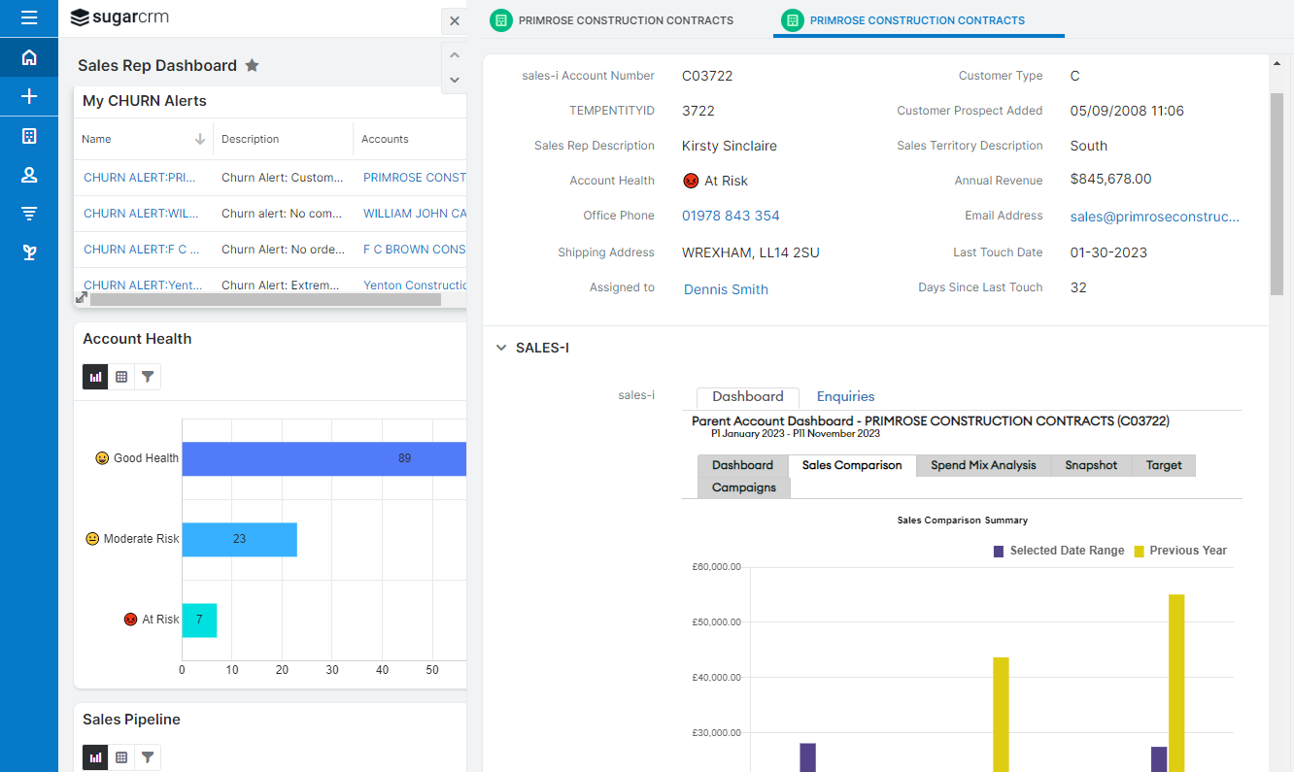
Predictive Sales Intelligence
Capture product, price, quantity, frequency and other purchase data from your ERP to provide actionable insights on purchasing trends and patterns for each account
Identify cross-sell and upsell-opportunities within your customer base with AI-driven white-space analysis
Save hundreds of hours on manually building business review docs with one-click Snapshot reports
Increase sales rep usage with an easy-to-use all-in-one solution for sales data analytics
Notes:
Optimize your sales processes and increase cross-sell/upsell revenue with AI-based sales recommendations and insights directly in the SugarCRM platform.

Slide 23
The Customer Service Platform
Built for Customer Service Heroes

Slide 24

“Manufacturing Firms
Could Do Better
With A Focus On
Customer Experience.”
Notes:
Our CRM impact report has revealed that generating qualified leads is a key challenge for most B2B Marketers

Slide 25



Customer Service Challenges in Manufacturing
Customer Service
Experience & CSAT
Product
Quality
Service Responsiveness/SLAs
Digital Service Transformation
Field
Service
After-sales Service as Source of Revenue
Notes:
[Note to seller: This is your opportunity to establish credibility with sales leaders that you understand their job and pain points. Show the prospect you understand their issues and can solve them]
While studying trends, we’ve also zeroed in on common challenges that modern sales organizations face. They include:
Driving revenue growth: Sales is ultimately responsible for winning and retaining business and reaching company revenue goals
Inaccurate sales forecasts: Companies base their most strategic decisions on forecasts. If their forecasts are inaccurate, the outcomes of their strategic decisions will miss their objectives
No lead prioritization: Reps have a lot to do already. They could benefit from knowing where to spend their time – with prospects more likely to become raving fans
Inconsistent sales processes: Once you’ve identified a winning formula you want your reps to follow, it’s easy for them to get distracted, leading to inconsistent customer experiences and lower win rates
Too many manual tasks: Reps have a lot to coordinate – contracts, quotes, RFPs, NDAs, follow-up messages, win wires, etc. It’s all a bit tedious and takes a lot of time away from selling
Lack of preparation: the #1 predictor for winning customer trust is preparation. In a recent study, we found that “56% of sales and marketing professionals feel they are missing data to improve their marketing campaigns and sales conversions.” With the right tools, sales reps can access the right information for their customers at the right time.
Do any of these sound familiar? [now, listen carefully to what the customer/prospect has to say. Weave their challenges into how you can address those challenges within the Sugar platform!].
[Quote from Ventana Research (https://blog.ventanaresearch.com/sugarcrm-brings-the-sweetness-in-ai-driven-sales)]

Slide 26



Create Better Customer Experiences in Moments that Matter
Engage
your customers
on their terms
Empower
your employees
with real-time insights
Deliver
on your promises
with operational excellence
Optimize
on-demand
field service &
maintenance
Customer Service & Support
26
Notes:
Service Moments are moments of truth
Sugar Serve has been designed to
Create better customer experiences in the moments when it matters to retain customers and drive growth
Let your customers engage with you whenever and wherever -- whether they prefer to help themselves online or need phone support from a customer service agent
Empower your employees with the tools and relevant information they need so they always see the full picture of the customer relationship
Deliver on your promises and meet your service level commitments (SLA’s) with automated service processes & workflows and flawless execution
Optimize service & maintenance schedules and empower field service technicians on-site to minimize downtime for your customers

Slide 27
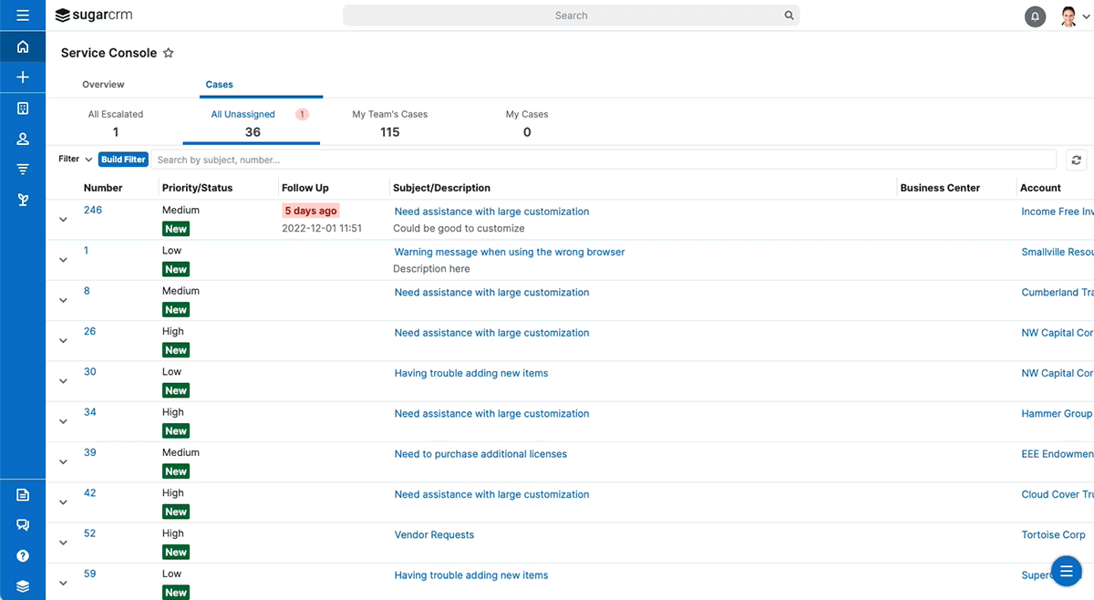
Service Ticket & Case Management
Comprehensive service ticket & case management with flexible no-code workflow design and SLA management
Scenarios can range from simple customer support scenarios to highly complex problem-resolution
Easily track and manage customer requests for assistance with products or services.
Generate detailed reports and analytics on case volumes, resolution times, and customer satisfaction metrics

Slide 28
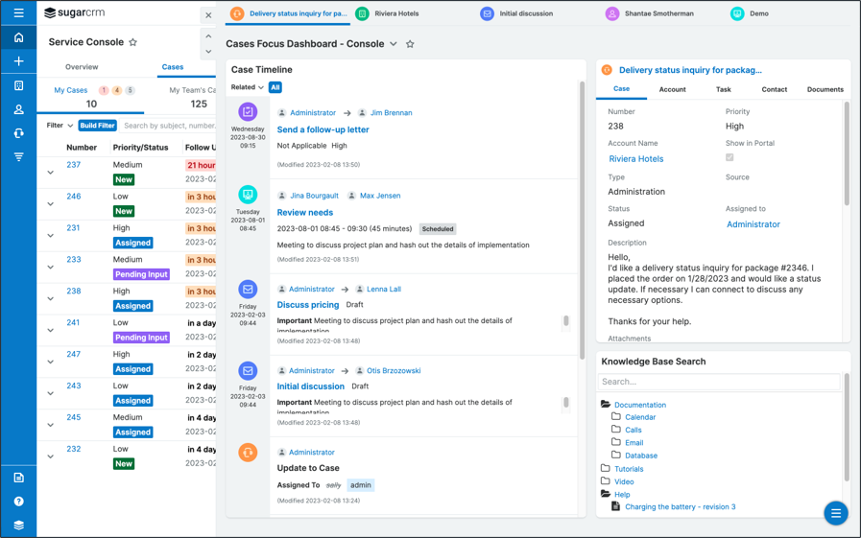
Agent Workplace
Easily assign, escalate, and track cases, ensuring faster resolution.
Empower agents with the information they need to provide personalized support
Implement workflows to ensure consistent and standardized processes and SLA compliance
Access and share knowledge base articles directly from the console

Slide 29
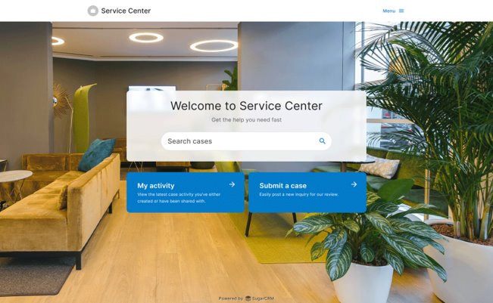
Digital Self-Service
Provide convenient and fast 24/7 access to your cases.
Customers can easily search your knowledge base, get questions answered instantly and open cases for extra assistance.
Allows your support agents to focus on more complex issues, improving efficiency and productivity.

Slide 30
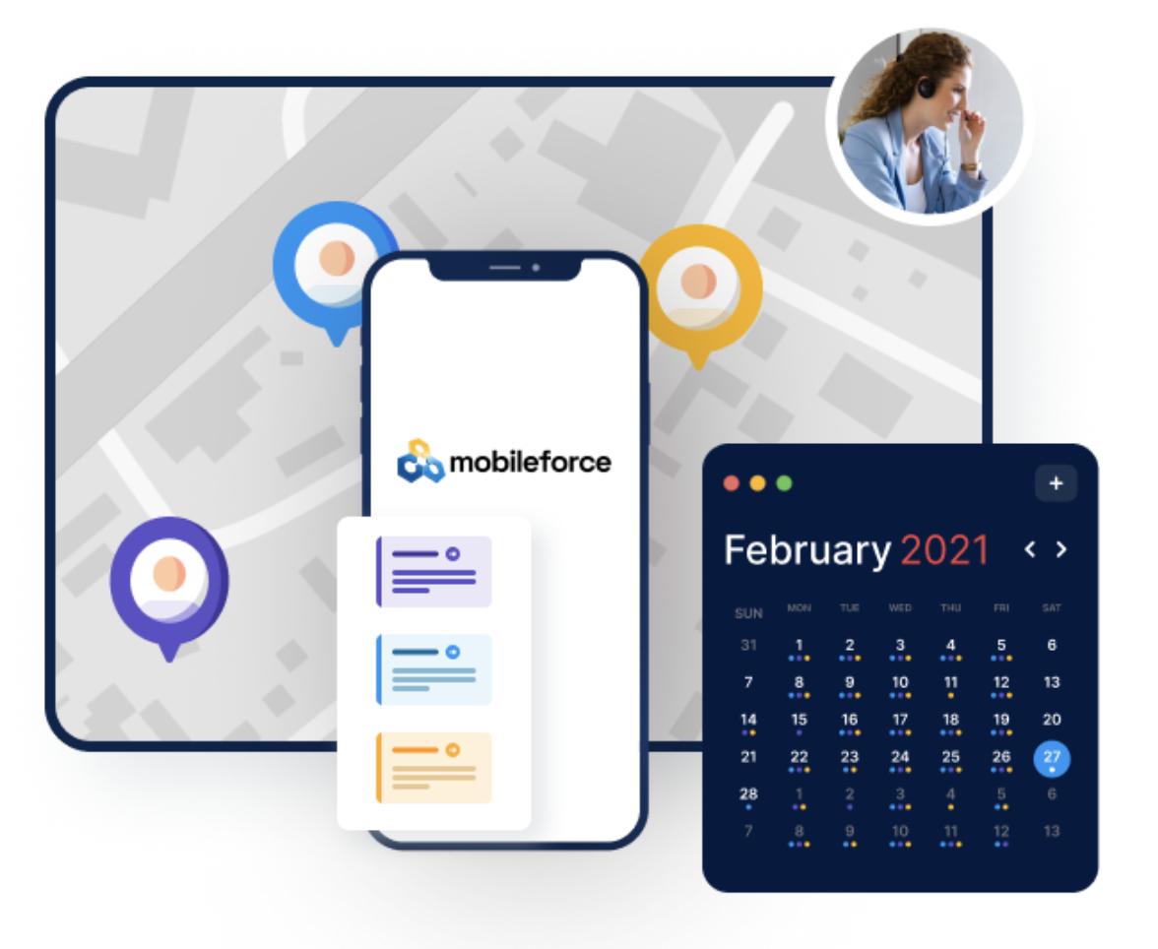
Field Service Management
Increase Response Times
Skill-based scheduling and intelligent routing
Ability to quickly schedule around last-minute cancellations or emergencies
Streamline Operations
Automate manual processes & reduce errors
Improve first-time fixes, gain valuable insights
Unified Customer View across work orders, service tickets, sales opportunities and all other CRM touch points
Increase ROI
Maximize your service capacity, generate fast quotes while in the field
Deliver a superior customer experience

Slide 31



Boost Productivity with Embedded
Generative AI for Everyone
Compose
personalized sales & marketing content
Find
answers & recommendations
Summarize
customer
data & intel
Create
ad-hoc reports
& workflows
Automate, accelerate, and optimize marketing, sales, and service
31
Notes:
Generative AI is a game changer! It will dramatically change CRM and how users interact with CRM systems.
Few things in the AI industry have more promising business use-cases than natural language processing (NLP) and large language models (LLM).
Generative AI can become a personal assistant to everyone and boost their productivity significantly.
The potential to automate, accelerate and optimize marketing, sales and customer service is enormous.
Generative AI Will Supercharge productivity: according to Bain & company, ~ 30% of the time of Marketing, Sales or Service professionals can be automated using generative AI.
Recent research from McKinsey suggests that about 40 percent of the value that generative AI use cases could deliver falls across three areas: sales, marketing and customer (service) operations
So here are four main categories of CRM use cases that we have been working on -- providing GEN AI capabilities to everyone in the front office
GAI can compose personalized sales and marketing content such as emails, sales pitches and proposals
Generative AI can find answers and provide recommendations while enabling a conversation with a user in a way that is more natural;
GAI is also really good at quickly summarizing customer data and information from both internal and external sources or at providing a quick summary of a complex case with a long service history
With GAI you can also create ad-hoc reports simply by asking, it will put together the query for you and run the report;
In the near future GAI will also be able to create workflows and even configure your SugarCRM system

Slide 32
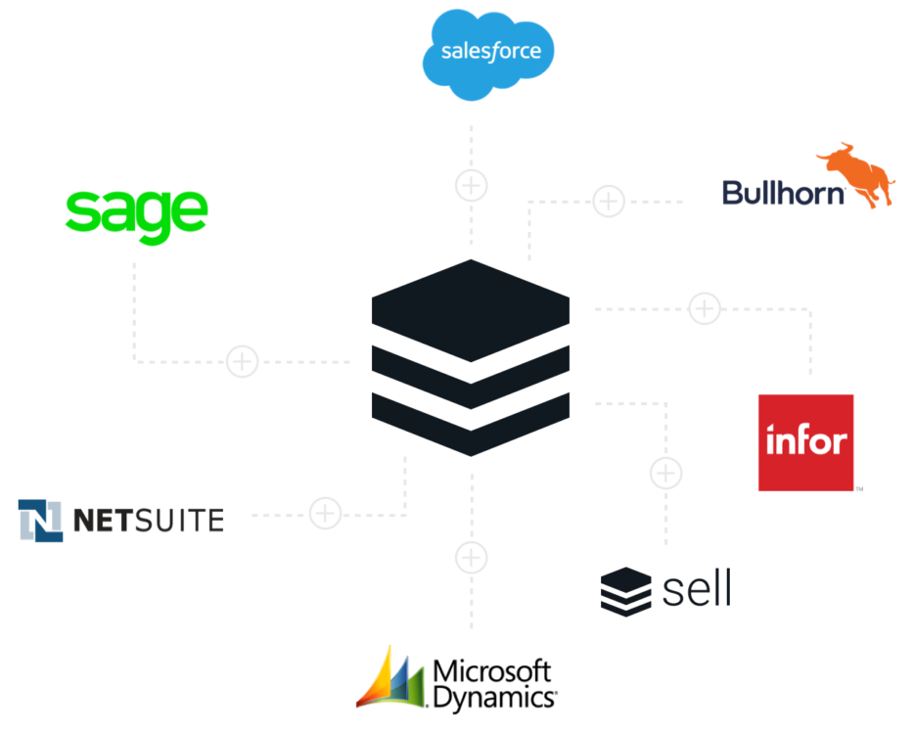





Bridging the Gap Between Front and Back Office
Integration with multiple ERPs available
Advanced business process management (BPM) and workflows…
Leveraging ERP insights in CRM
Notes:
Integrations & Connectors are available for many ERP systems from SugarCRM and our partners
We integrate with many top ERPs to ensure your data is flowing efficiently across the front and back office.

Slide 33


Fueling Growth at
“[Sugar] is a great system to manage leads and conversions so we can map our topline goal of growing revenue.”
– Jason M.
VP of Sales, Materion
Notes:
Link to Materion Case Study:
Webpage: https://www.sugarcrm.com/customers/case-studies/materion/
“Sugar had the capabilities and features to check all the boxes that we required as a company,” said Maher. “It is a great system to manage leads and conversions so we can map our topline goal of growing revenue. It has a best-in-class mobile app with real-time access to customer data so there are never any surprises for my team before they interact with customers.
“During the evaluation process, I had executive support and looped in our IT staff early on as well. Choosing SugarCRM was actually the easy part of the process. My next step was rolling this out globally and getting our team fired up about using Sugar to its fullest capabilities.”

Slide 34


Fueling Growth at
“Sugar Sell and Sugar Market allowed us to keep business moving in the midst of uncertainty.”
– Laron W.
Sales Manager, Neenah Inc.
Notes:
Neenah Paper is recognized as a world-class manufacturer of premium writing, text, cover, specialty and private watermark papers.
Headquartered near Atlanta, GA, Neenah Paper (a division of Neenah, Inc.) is entirely focused on the premium paper market. With multiple manufacturing facilities in Wisconsin, the Northeast, and abroad, prime importance is also placed on offering recycled and alternative fiber products to our customers while we continuously focus on reducing our own environmental footprint.
“Sugar Sell and Sugar Market allowed us to keep business moving in the midst of uncertainty. Although 2020 was a rollercoaster year, it really allowed us to take advantage of our internal systems, contacts, and marketing capabilities.
Being able to analyze email campaign results allowed our sales team to formulate direct and concise follow up—and generate activity that would have been forgone.”
~ Laron W., Sales Manager, Neenah Inc.

Slide 35


LET THE PLATFORM DO THE WORK
SUGARCRM FOR MANUFACTURING
Revenue
Growth
Business at the
Speed of Light
Customers
for Life
Notes:
We just showed you how SugarCRM “let’s the platform do the work”:
How it can drive revenue, accelerate business growth and win customers for life
And how marketing, sales & service work better together!
With Sugar Market you can feed the funnel & align with sales to build the pipeline needed to drive Revenue growth
With Sugar Sell you can accelerate your sales cycle and increase your win rate to scale your Business at the speed of light
With Sugar Serve you can create better customer experiences in the moments when it matters retaining Customers for life

Slide 36







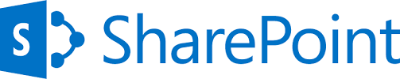



















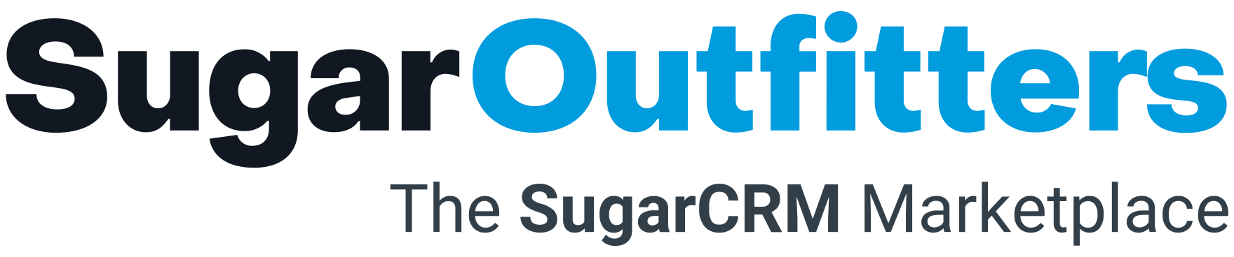































Ecosystem
Marketing
Productivity
Sales
Extensive Marketplace with 250+ Add-Ons
Customer Service
ERP
Partner Add-Ons
Notes:
https://sugarclub.sugarcrm.com/engage/b/sugar-news/posts/new-sugaroutfitters-marketplace-for-add-ons-and-integrations
Seamless integration into a variety of 3rd party applications to provide a complete view of each customer across multiple stakeholder touchpoints
Sugar is easy to connect to other common business applications. With a library of over 500 pre-built connectors, and a rich marketplace in SugarOutfitters, many applications are already available for integration and can be plugged in. However, for use cases that go beyond what is available off the shelf - Sugar natively supports REST-based APIs. These are publicly documented, free to use, and dynamically extend themselves to new fields / modules as they are designed. They use standard notations and will be recognisable to anyone who has worked with JSON over REST services before.
These APIs enable other systems to read and write data in a supported fashion, respecting any business rules and workflows defined centrally in the solution. They are commonly used alongside both point-to-point integrations, and integration Platform as a Service (iPaaS) architectures.
Integrations from Sugar to many other platforms can be accomplished throughout Sugar Integrate products as well as with popular no-code integration platforms such as Zapier, Bedrock Make, and Starfish.

Slide 37
sugarcrm.com

