Slide 1
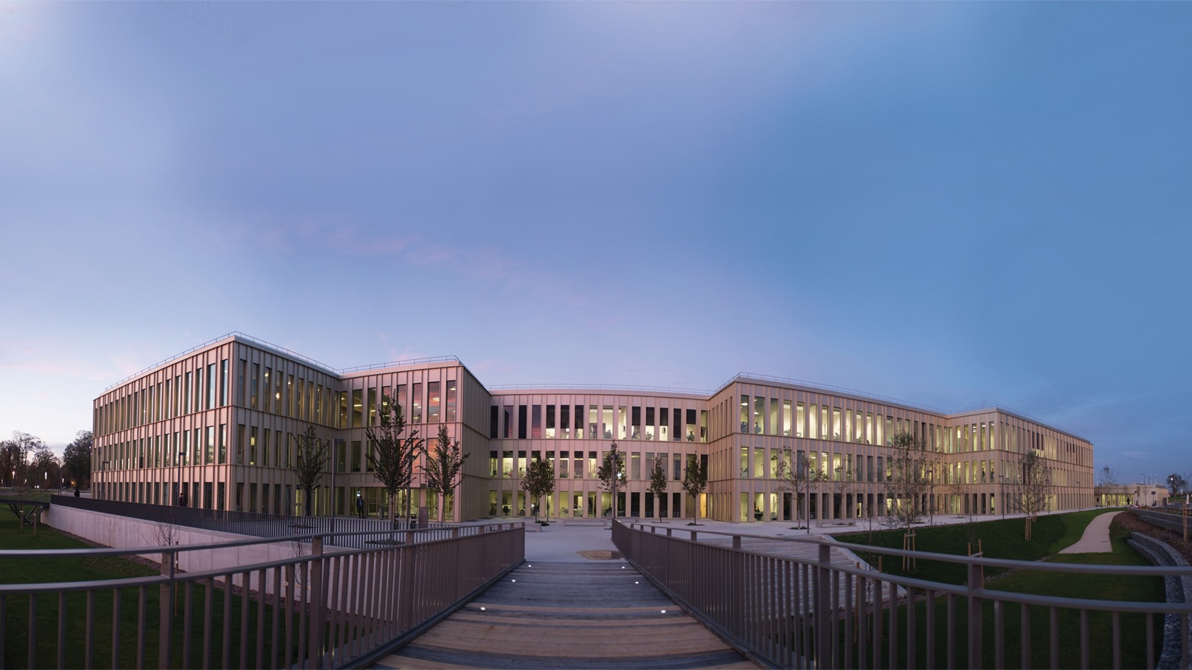
2023
WELCOME TO
HEC PARIS
2023

Slide 2
AN AMBITION BUILT UP OVER
140 YEARS
1881
1969
1985
2018
1881
1969
1975
2018
‘École des Hautes Études Commerciales’ (HEC Business School) is founded
Launch of the ‘Institut Supérieur des Affaires’ (current MBA program)
Creation of the PhD Program
The first fully online Masters program is launched
1964
1972
2012
1964
1972
2012
2021
Jouy-en-Josas campus inaugurated by Charles de Gaulle
Creation of the HEC Foundation
Campus extension (Designed by architect David Chipperfield)
HEC Paris redefines its values and purpose with the help of its entire community

Slide 3
VISION, MISSION & VALUES
SHARED
VISION
We IMPACT business and society through research, education, and action, to contribute to a more inclusive, prosperous, and sustainable world
HEC PARIS MISSION
We THINK and push the boundaries of knowledge
We TEACH, learn and grow together
We ACT,
to unleash human potential
EXCELLENCE
SHARED VALUES
Driven by our European roots and a 140-year-old history, our core values are
ENTREPRENEURIAL SPIRIT
CURIOSITY
HEC ALUMNI MISSION
We SHARE, grow and create memories together
We DARE with our vision and actions
We CARE for our community and beyond
DIVERSITY
RESPONSIBILITY

Slide 4
FOUR KEY AREAS TO FOSTER SYNERGIES
THOUGHT-LEADERSHIP
TALENT
INNOVATION
IMPACT
Nurture your strategic thinking and share your expertise
Push the boundaries of knowledge by producing the highest quality research, disciplinary and cross-disciplinary with a unique combination of scientific excellence & business relevance
Create a Chair or join one of our Centers of expertise
Influence & visibility
Conferences, alumni clubs: a vibrant ecosystem of decision- and policy-makers, incl. the HEC Alumni community worldwide
HEC is a media (HEC Stories, L’Entretien with BFM Business…)
Development: accompany your major cultural & business transformations
Executive Custom or in-company programs
Engagement & Recruitment
Build your employer branding and presence on campus (career fairs, job board) with HEC Talents (students) & within the community (HEC Alumni Life Project (graduates). HEC Paris is a one-stop talent place with 4,500 students (135 nationalities, various backgrounds)
Connect - sponsor students’ associations
Vibrant entrepreneurial ecosystem
Students: ~100 start-up projects every academic year
HEC Incubator is the largest entrepreneurial space within Station F (world’s largest start-up campus)
Ignite & Accelerate
A dedicated team for your innovation portfolio or for your intrapreneurial projects (“excubation” - acceleration)
Bring your strategic topics to benefit from students’ fresh look (Business Projects with final year students, MBA projects)
Increase collective impact
Give talent perspective: HEC Paris is involved with several French high-schools (PACE program to help students gain confidence in their abilities, reflect on choices of studies whatever the field + Eloquentia@HEC program, the 1st national public speaking competition dedicated to high school students)
Scholarship programs for talent from under-privileged background (France + International (EMEA))
Stand Up Women entrepreneurship program
Acceleration for social & solidarity-based companies
4

Slide 5
HEC PARIS’ FACTS & FIGURES

Slide 6
KEY FIGURES
8,000
Participants in Executive Education programs
73,000
Alumni
4,500
Students in degree programs
167
Full-time faculty
OUR GLOBAL NETWORKS

Slide 7
HEC PARIS AROUND THE WORLD
125
Academic Partners
135
Nationalities represented
2/3
International Professors
85+
International Alumni chapters
SUBSIDIARIES & INTERNATIONAL OFFICES
DOHA
LONDRES
BERLIN
PÉKIN
NEW-YORK
TOKYO
ABIDJAN

Slide 8
HEC PARIS RANKINGS
#1 European Business Schools (2022)
#1 Executive Education (2023)
#2 Master in International Finance (2023)
#1 Master in Management (2023)
#7 Global Executive MBA (2023)
#17 MBA (2023)
#4 Trium Global Executive MBA – EMBA Ranking joint Programs with LSE and NYU Stern (2023)
#1 Master in Marketing (2023), Master in Strategic Management, Master in International Finance (2023)
#1 Global Executive MBA (2023)
#3 Master Data Science for Business X-HEC (and #1 in Europe) (2023)
#1 Trium Global Executive MBA – EMBA Ranking joint Programs with LSE and NYU Stern (2022)
#5 Global MBA (2023)
#1 Le Point (2023)
#1 Le Figaro Etudiant (2023)
#1 L’Etudiant (2023)
#1 Le Parisien (2023)
8

Slide 9
RESEARCH AT HEC PARIS

Slide 10
HEC PARIS AS A LEADING BUSINESS SCHOOL IS KNOWN FOR ITS RESEARCH QUALITY AND CAN ORCHESTRATE THE ECOSYSTEM
Independent and non-for-profit academic institution
Profound expertise in business, technology & regulation
Location at heart of Europe & quality of local regulator
Clear focus on high quality of research
Existing network within academia, regulation & business
Access to highly skilled students as talent of tomorrow
10

Slide 11
KEY FIGURES ABOUT HEC PARIS’ FACULTY
167
66%
International Professors
Professors
56
PHD Students
30
Different Nationalities
445
950
TOP 5
Research
Articles
Presentations at
International Conferences
in Europe for Research
Management
11

Slide 12
3 CENTERS / INSTITUTES
INNOVATION & ENTREPRENEURSHIP INSTITUTE
Grow with ambition, efficiency and impact!
S&O INTITUTE
Society & Organizations Institute
Hi! PARIS CENTER
Paris Artificial Intelligence for Society & Business
in partnership with Institut Polytechnique de Paris (IP Paris)

Slide 13
PROGRAMS AT HEC PARIS

Slide 14
PROGRAMS AT HEC PARIS
PRE-EXPERIENCE
POST-EXPERIENCE
POST-EXPERIENCE
PHD PROGRAM
General management and/or expertise in a specific area of management
Management, Finance, Marketing, Strategy, Digital, Innovation, Leadership, Social Business…
General management
8 areas of specialization:
Accounting and Management Control, Economics & Decision Sciences, Finance, Information Systems & Operations Management, Management & Human Resources, Marketing, Law & Regulation, Strategy and Business Policy
MIM / GRANDE ÉCOLE
SPECIALIZED MASTERS & MSc
SUMMER SCHOOL & YOUTH PROGRAMS
EXECUTIVE MASTERS
EXECUTIVE CERTIFICATES
CUSTOM PROGRAMS
EXECUTIVE SHORT PROGRAMS
MBA FULL TIME
EXECUTIVE MBAs / TRIUM

Slide 15
PRE-EXPERIENCE PROGRAMS
Grande Ecole
MIM Master In Management

Slide 16
PRE-EXPERIENCE PROGRAMS
Dual-Degree Programs
M2M
Yale, FGV, HKUST
MIM & Public Affairs
Freie Universität Berlin
Master in Management & Innovation
TUM
MIM & Business Law Paris 1
MSc Entrepreneurs
Ecole polytechnique
MSc Data Science for Business
Ecole polytechnique

Slide 17
PRE-EXPERIENCE PROGRAMS
MS/MSc in 1 year
AFM
Master in Accounting, Finance & Management
MIF
Master in International Finance
DMI
MS LLM Droit et Management lnternational
MKG
Master in Marketing
MAC
MS Médias, Art et Création
SASI
Master in Sustainability & Social Innovation
MFE
Master in Economics & Finance
STRAT
Master in Strategic Management

Slide 18
SUMMER SCHOOL
10 SUMMER SCHOOL PROGRAMS
YOUTH PROGRAMS
FULL TIME
2 WEEKS
FULL TIME
1 WEEK
ENGLISH
ENGLISH
For current students and young professionals of all backgrounds
For 15 to 18-year-old high school students who wish to develop their potential

Slide 19
PhD PROGRAM
56 students
86%
international students
+300 Alumni
45%
women
8 FIELDS OF STUDY
ACCOUNTING AND MANAGEMENT CONTROL
ECONOMICS AND DECISION SCIENCES
FINANCE
INFORMATION SYSTEMS & OPERATIONS MANAGEMENT
MANAGEMENT AND HUMAN RESOURCES
MARKETING
LAW AND REGULATION
STRATEGY AND BUSINESS POLICY
Placed in the best institutions worldwide: Harvard, MIT Sloan, Princeton, Wharton, LSE, LBS…

Slide 20
MBA PROGRAMS
EXECUTIVE MBA
MBA
TRIUM
PART TIME
FULL TIME
ENGLISH AND/ OR FRENCH
PART TIME
ENGLISH
15-18 MONTHS
ENGLISH
12-16 MONTHS
2 PROGRAMS
18 MONTHS
300 STUDENTS EACH YEAR
4 INTAKES
41 PARTICIPANTS EACH YEAR
93 % INTERNATIONAL INTAKE
7 MAJORS / 15 SPECIALIZATIONS
50 NATIONALITIES

Slide 21
EXECUTIVE ONLINE PROGRAMS
MSC IN INNOVATION & ENTREPRENEURSHIP
EXECUTIVE ONLINE CERTIFICATE
CERTIFICATE
IN INNOVATION & ENTREPRENEURSHIP
18 MONTHS
6 MONTHS
6 MONTHS
ENGLISH
ENGLISH & FRENCH
ENGLISH
20 MODULES
CORPORATE FINANCE, STRATEGY, ADVANCED FINANCE
2 SESSIONS EACH YEAR
10 MODULES
100 PARTICIPANTS EACH YEAR
1000+ PARTICIPANTS EACH YEAR
125 PARTICIPANTS PER SESSION

Slide 22
EXECUTIVE PROGRAMS
EXECUTIVE MASTERS
EXECUTIVE
CERTIFICATES
SHORT PROGRAMS
CUSTOM PROGRAMS
PART TIME
PART TIME
PART TIME
DIAGNOSTIC
13-16 MONTHS
10-30 DAYS
1-8 DAYS
ADAPTATION
ENGLISH & FRENCH
ENGLISH & FRENCH
ENGLISH & FRENCH
LEARNING
MORE THAN 300 PARTICIPANTS
ACTION
FRANCE, CHINA, IVORY COAST, MOROCCO GREAT BRITAIN, QATAR, FRENCH OVERSEAS TERRITORIES
IMPACT

Slide 23
HEC PARIS’ ECOSYSTEM

Slide 24
THE HEC FOUNDATION
IN 2022
More than14,000
alumni have already made at least one donation to the HEC Foundation
36
corporate partners mobilized at our side
1,600+
students supported each year (scholarships based on social criteria, scholarships for excellence, mentoring...)
€12,8M
Contribution to the development of HEC Paris in 2022
€200M
Fundraising objective
for the 2019 - 2024
« Impact tomorrow » campaign
4 STRATEGIC PRIORITIES SUPPORTED BY THE HEC FOUNDATION
KNOWLEDGE PRODUCTION
INCLUSION AND DIVERSITY
SOCIETY AND INNOVATION
CAMPUS
(Research, grants for doctoral students …)
(Scholarships, student services ...)
(Social responsibility, S&O, Entrepreneurship ...)
(Renovation, digital transformation ...)

Slide 25
HEC ALUMNI
ONE ASSOCIATION TO BRING TOGETHER ALL HEC GRADUATES
73,000 Alumni in 150 Countries
1,000+ Events per year
85+ Chapters
worldwide
1,200 Volunteers

Slide 26
CORPORATE PARTNERS

Slide 27
HEC Paris Corporate Partners
Transfo. Gifts
Chairs & Corporate Initiatives
Institutes & Centers
Members
Society & Organizations Institute
Hi! PARIS
by HEC Paris & Institut Polytechnique de Paris
Innovation & Entrepreneurship Center
Impact Finance Center
Oct.23

Slide 28
2023
2023

