Slide 1
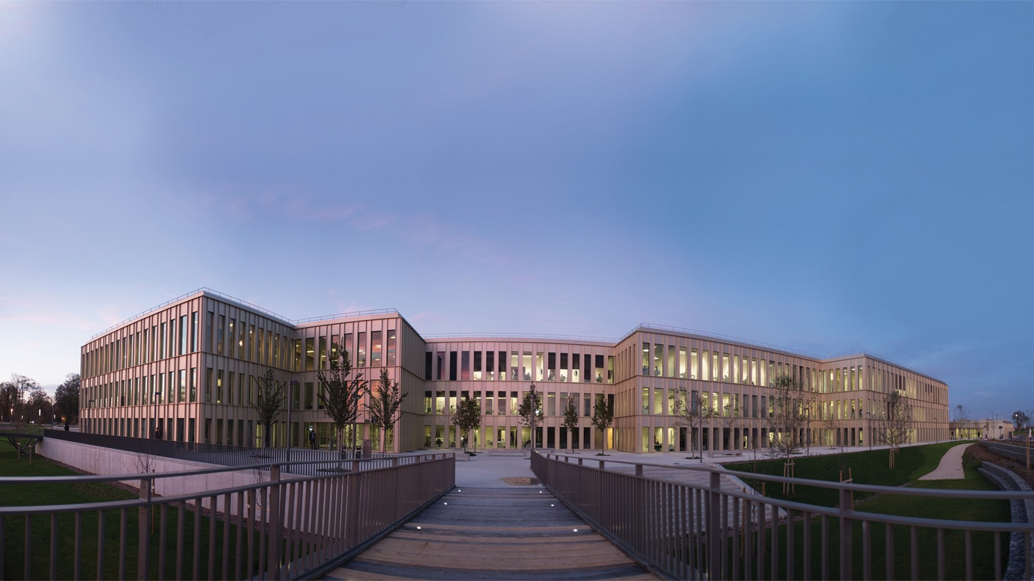
2022
WELCOME TO
HEC PARIS
2022

Slide 2
AN AMBITION BUILT UP OVER
140 YEARS
1881
1969
1975
2018
1881
1969
1975
2018
‘École des Hautes Études Commerciales’ (HEC Business School) is founded
Launch of the ‘Institut Supérieur des Affaires’ (current MBA program)
Creation of the PhD Program
The first fully online Masters program is launched
1964
1972
2012
1964
1972
2012
2021
Jouy-en-Josas campus inaugurated by Charles de Gaulle
Creation of the HEC Foundation
Campus extension (Designed by architect David Chipperfield)
HEC Paris redefines its values and purpose with the help of its entire community

Slide 3
KEY FIGURES
8,000
Participants in Executive Education programs
70,000
Alumni
4,500
Students in degree programs
150
Full-time faculty
#1
European Business School (Financial Times)

Slide 4
VISION, MISSION & VALUES
SHARED
VISION
We IMPACT business and society through research, education, and action, to contribute to a more inclusive, prosperous, and sustainable world
HEC PARIS MISSION
We THINK and push the boundaries of knowledge
We TEACH, learn and grow together
We ACT,
to unleash human potential
EXCELLENCE
SHARED VALUES
Driven by our European roots and a 140-year-old history, our core values are
ENTREPRENEURIAL SPIRIT
CURIOSITY
HEC ALUMNI MISSION
We SHARE, grow and create memories together
We DARE with our vision and actions
We CARE for our community and beyond
DIVERSITY
RESPONSIBILITY

Slide 5
HEC PARIS AROUND THE WORLD
125
Academic Partners
111
Nationalities represented
2/3
International Professors
85+
International Alumni chapters
OUR GLOBAL NETWORKS
SUBSIDIARIES & INTERNATIONAL OFFICES
DOHA
LONDON
BERLIN
BEIJING
NEW-YORK
TOKYO
ABIDJAN

Slide 6
FACULTY & RESEARCH
PLACED IN THE EUROPEAN TOP 3 FOR RESEARCH QUALITY
120
Research Professors
35
Affiliate Professors
55
PhD students
30
Nationalities
17
Research Chairs
200
Publications in the best academic journals
(5 years)
3 CENTERS
INNOVATION & ENTREPRENEURSHIP CENTER
Grow with ambition, efficiency and impact!
S&O INSTITUTE
Society & Organizations Institute
Hi! PARIS CENTER
Paris Artificial Intelligence for Society & Business
in partnership with Institut Polytechnique de Paris (IP Paris)

Slide 7
PROGRAMS AT HEC PARIS
PRE-EXPERIENCE
POST-EXPERIENCE
POST-EXPERIENCE
PHD PROGRAM
General management and/or expertise in a specific area of management
Management, Finance, Marketing, Strategy, Digital, Innovation, Leadership, Social Business…
General management
8 areas of specialization:
Accounting and Management Control, Economics & Decision Sciences, Finance, Information Systems & Operations Management, Management & Human Resources, Marketing, Law & Regulation, Strategy and Business Policy
MIM / GRANDE ÉCOLE
SPECIALIZED MASTERS & MSc
SUMMER SCHOOL & YOUTH PROGRAMS
EXECUTIVE MASTERS
EXECUTIVE CERTIFICATES
CUSTOM PROGRAMS
EXECUTIVE SHORT PROGRAMS
MBA FULL TIME
EXECUTIVE MBAs / TRIUM

Slide 8
PRE-EXPERIENCE PROGRAMS
Grande Ecole
MIM Master In Management

Slide 9
PRE-EXPERIENCE PROGRAMS
Dual-Degree Programs
M2M
Yale, FGV, HKUST
MIM & Public Affairs
Freie Universität Berlin
Master in Management & Innovation
TUM
MIM & Business Law Paris 1
MSc Entrepreneurs
Ecole polytechnique
MSc Data Science for Business
Ecole polytechnique

Slide 10
PRE-EXPERIENCE PROGRAMS
MS/MSc in 1 year
AFM
Master in Accounting, Finance & Management
MIF
Master in International Finance
DMI
MS LLM Droit et Management lnternational
MKG
Master in Marketing
MAC
MS Médias, Art et Création
SASI
Master in Sustainability & Social Innovation
MFE
Master in Economics & Finance
STRAT
Master in Strategic Management

Slide 11
SUMMER SCHOOL
9 SUMMER SCHOOL PROGRAMS
YOUTH PROGRAMS
FULL TIME
2 WEEKS
FULL TIME
1 WEEK
ENGLISH
ENGLISH
For current students and young professionals of all backgrounds
For 15 to 18-year-old high school students who wish to develop their potential

Slide 12
PhD PROGRAM
55 students
84%
international students
+300 Alumni
44%
women
8 FIELDS OF STUDY
ACCOUNTING AND MANAGEMENT CONTROL
ECONOMICS AND DECISION SCIENCES
FINANCE
INFORMATION SYSTEMS & OPERATIONS MANAGEMENT
MANAGEMENT AND HUMAN RESOURCES
MARKETING
LAW AND REGULATION
STRATEGY AND BUSINESS POLICY
Placed in the best institutions worldwide: Harvard, MIT Sloan, Princeton, Wharton, LSE, LBS…

Slide 13
MBA PROGRAMS
EXECUTIVE MBA
MBA
TRIUM
PART TIME
FULL TIME
ENGLISH AND/ OR FRENCH
PART TIME
ENGLISH
15-18 MONTHS
ENGLISH
12-16 MONTHS
2 PROGRAMS
18 MONTHS
300 STUDENTS EACH YEAR
5 FORMATS
60 PARTICIPANTS EACH YEAR
90 % INTERNATIONAL INTAKE
7 MAJORS / 15 SPECIALIZATIONS
50 % INTERNATIONAL INTAKE

Slide 14
EXECUTIVE ONLINE PROGRAMS
MSC IN INNOVATION & ENTREPRENEURSHIP
EXECUTIVE ONLINE CERTIFICATE
CERTIFICATE
IN INNOVATION & ENTREPRENEURSHIP
18 MONTHS
6 MONTHS
6 MONTHS
ENGLISH
ENGLISH & FRENCH
ENGLISH
20 MODULES
CORPORATE FINANCE, STRATEGY, ADVANCED FINANCE
10 MODULES
2 SESSIONS EACH YEAR
100 PARTICIPANTS EACH YEAR
1000+ PARTICIPANTS EACH YEAR
125 PARTICIPANTS PER SESSION

Slide 15
EXECUTIVE PROGRAMS
EXECUTIVE MASTERS
EXECUTIVE
CERTIFICATES
SHORT PROGRAMS
CUSTOM PROGRAMS
PART TIME
PART TIME
PART TIME
DIAGNOSTIC
13-16 MONTHS
10-30 DAYS
1-8 DAYS
ADAPTATION
ENGLISH & FRENCH
ENGLISH & FRENCH
ENGLISH & FRENCH
LEARNING
MORE THAN 300 PARTICIPANTS
ACTION
FRANCE, CHINA, IVORY COAST, MOROCCO GREAT BRITAIN, QATAR, FRENCH OVERSEAS TERRITORIES
IMPACT

Slide 16
THE HEC FOUNDATION
IN 2021
More than14,000
alumni have already made at least one donation to the HEC Foundation
36
corporate partners mobilized at our side
1,200
students supported each year (scholarships based on social criteria, scholarships for excellence, mentoring...)
€14,2M
Contribution to the development of HEC Paris in 2021
€200M
Fundraising objective
for the 2019 - 2024
« Impact tomorrow » campaign
4 STRATEGIC PRIORITIES SUPPORTED BY THE HEC FOUNDATION
KNOWLEDGE PRODUCTION
INCLUSION AND DIVERSITY
SOCIETY AND INNOVATION
CAMPUS
(Research, grants for doctoral students …)
(Scholarships, student services ...)
(Social responsibility, S&O, Entrepreneurship ...)
(Renovation, digital transformation ...)

Slide 17
HEC ALUMNI
ONE ASSOCIATION TO BRING TOGETHER ALL HEC GRADUATES
70,000 Alumni in 150 Countries
1,000+ Events per year
85+ Chapters
worldwide
1,200 Volunteers

Slide 18
CORPORATE PARTNERS & MEMBERS OF THE HEC PARIS FOUNDATION
TRANFORMATIONAL GIFTS
CHAIRS & CORPORATE INITIATIVES
INSTITUTES & CENTERS
MEMBERS
Society & Organizations Institute
Hi! PARIS
(by HEC Paris & IP Paris)
Innovation & Entrepreneurship Center

Slide 19
2022
2022

