Slide 1
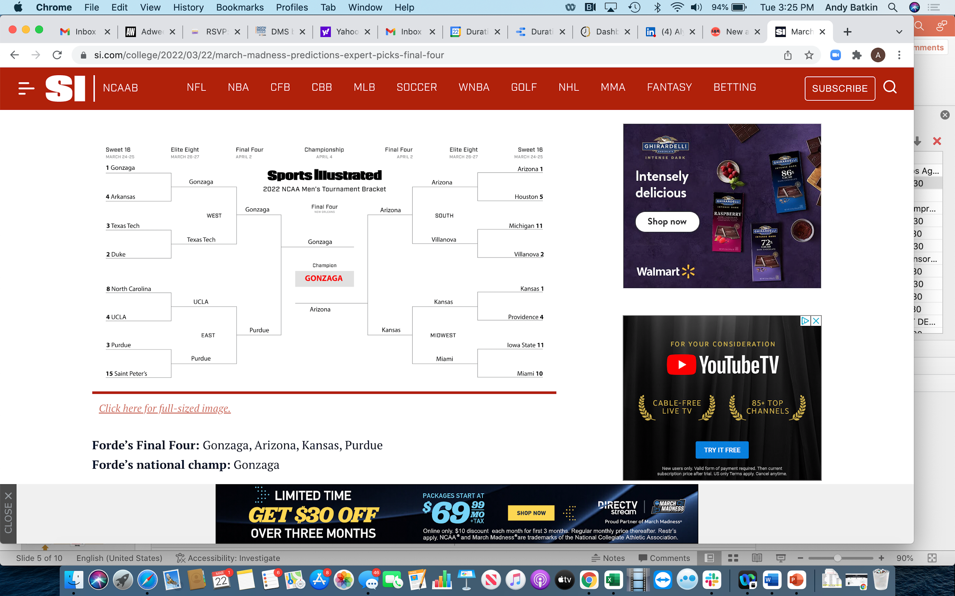
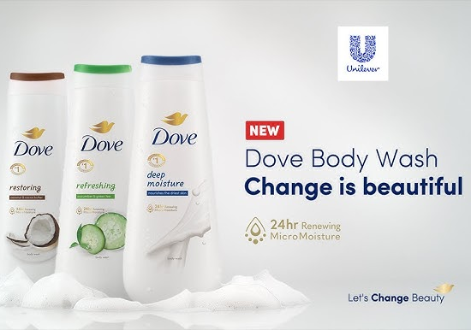
Sequency™
For Publishers
Carbon Reducing Advertising
U.S. Patent No. 11,195,210
What is Sequency™ for Publishers?
Sequency™ enables publishers to create highly viewable, incremental inventory without unnecessary bid requests and cookie syncs.
Publishers use Sequency™ for direct demand, PMP or PG deals, creating highly viewable inventory and increasing eCPMs, while providing a “green” media solution for buyers demanding low carbon advertising, controlled all within the publisher’s instance of GAM.
Sequency™ reduces the estimated emissions of a programmatic display campaign by an average of 36.4%, while generating 48%-61% additive highly viewable impressions.
How Sequency™ for Publishers Works
1
5
Publisher sets up Sequency™ in GAM
(no code on page required)
Up to 3 incremental ads served without wasteful
bid requests, all highly viewable
2
4
Winning creative is wrapped with Sequency™ framework for signaling realtime viewability
Publisher Controls Ad Refresh
Sequency™ measures the % pixels & duration in view, then signals ad server for delivery of incremental ads
3
Sequency™ settings are set:
% pixels & duration in view
How Sequency™ Creates Publisher Value
Incremental Inventory
Increased Revenue
Green Media Solutions
Sequency ™ creates a pod of highly-viewable display ad impressions, increasing publisher inventory 48%-61%
Sequency™ creates an incentive for buyers to purchase direct-sold inventory, helping publishers increase revenue
Sequency™ gives publishers a green media solution for buyers looking to reduce the carbon emissions of their media buys
To learn more & get started, contact us at info@durationmedia.net

Slide 2
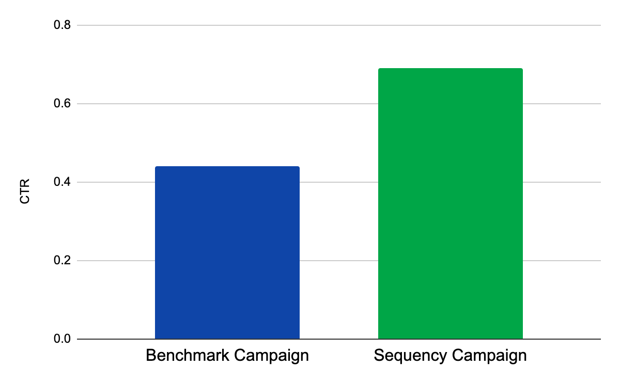
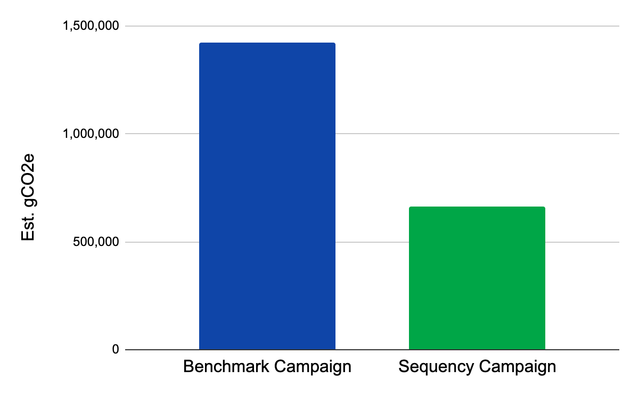
Case Study:
How Sequency™ Drives
Performance for Advertisers
& Revenue for Publishers While
Reducing Carbon Emissions
A leading publisher in the Home & Garden category leveraged Sequency™ to create 3 million incremental, highly viewable impressions that drove a 56% increase in CTR and a 54% reduction in estimated carbon emissions.
Publisher Category: Home, Garden & Property
Advertiser Category: National Utilities Provider
Impressions Purchased: 5,600,000
CPM: £4.00
1st Imps Served: 2,600,000
Sequency™ Imps Served: 3,000,000
Total: 5,600,000
Pixels In-View: 90%
Duration: 10 seconds
Benchmark CTR: .44%
Sequency™ CTR: .69%
Est CO2e Reduction: 54%*
Increase Performance
Reduce Emissions
+56%
-54%
.44%
.69%
1,421,280
gCO2e
665,520
gCO2e
To learn more & get started, contact us at info@durationmedia.net

Slide 3
Sequency™
For Publishers
Sequency™ Publisher Campaign Set Up Direct Demand & PMP
Sequency™ for Publishers Onboarding
Prerequisites
Required: Publisher utilizing GAM Ad Server - We need to know Publisher’s GAM Network ID
Required: DM to get GAM API access - Administrator (Ad Manager Only)
Automated GAM API Setup - Action steps
Creation of Core components used for Sequency™
GAM SERVICE ACCOUNT
Create a Sequency™ GAM Service Account for Automation of Sequency™ Integration
Duration will push 3 unique Sequency™ GAM ad units through API
Duration will export 3 corresponding GAM passback tags
Duration will build Sequency™ backend linkage to those ad units.
CREATIVE TEMPLATE
Publisher will Import Custom Creative template for use in Sequency™ Campaigns
SETUP COMPLETE
*Manual GAM Implementation Available
Sequency™ for Publishers
Pricing
Duration Media charges a SaaS fee for measuring each impression. Charging is triggered when the first sequential impression is generated and then applies from the first impression and to all subsequent impressions.
To learn more & get started, contact us at info@durationmedia.net

