Slide 1
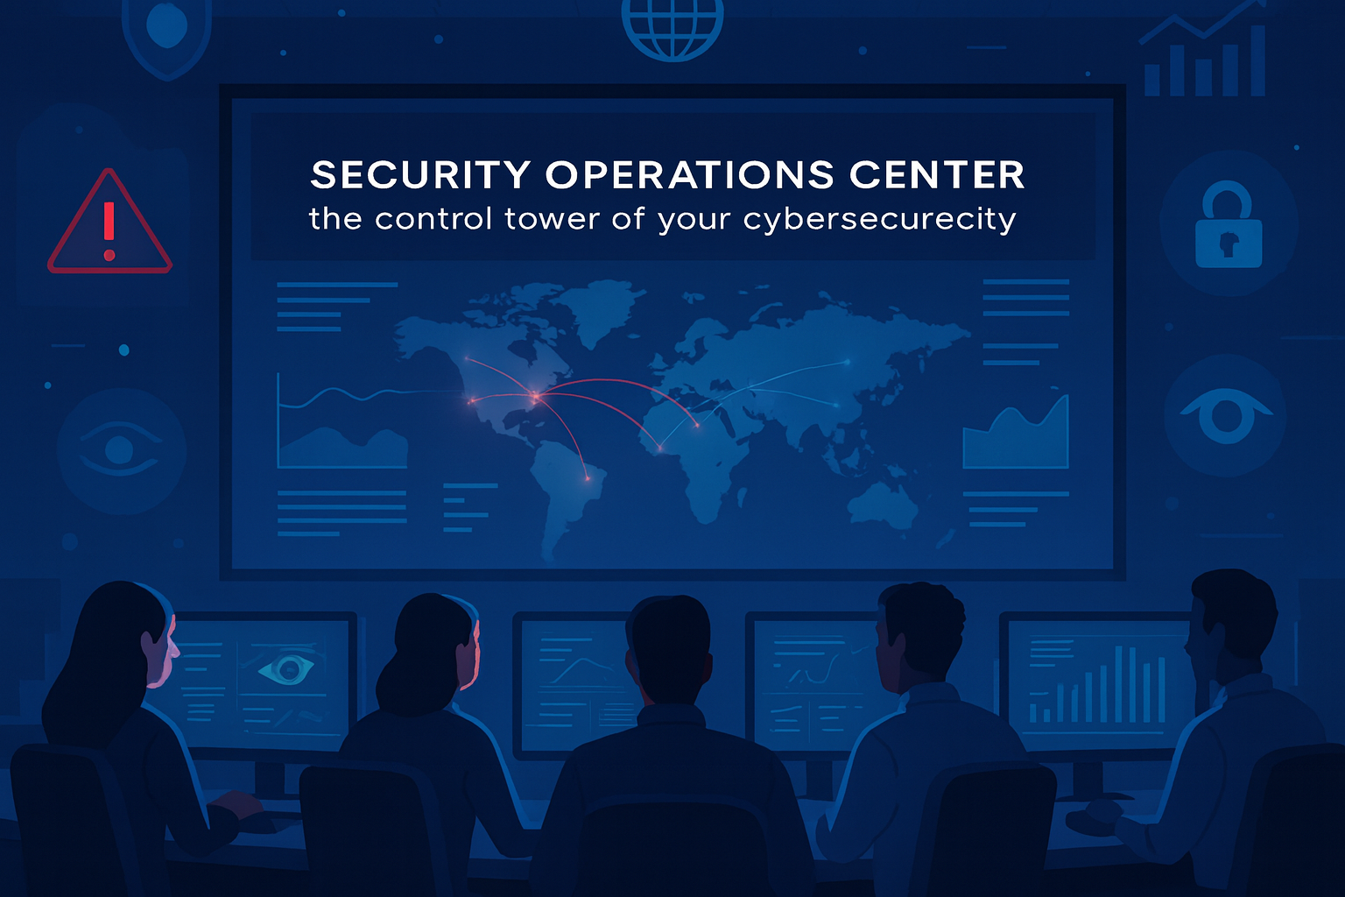
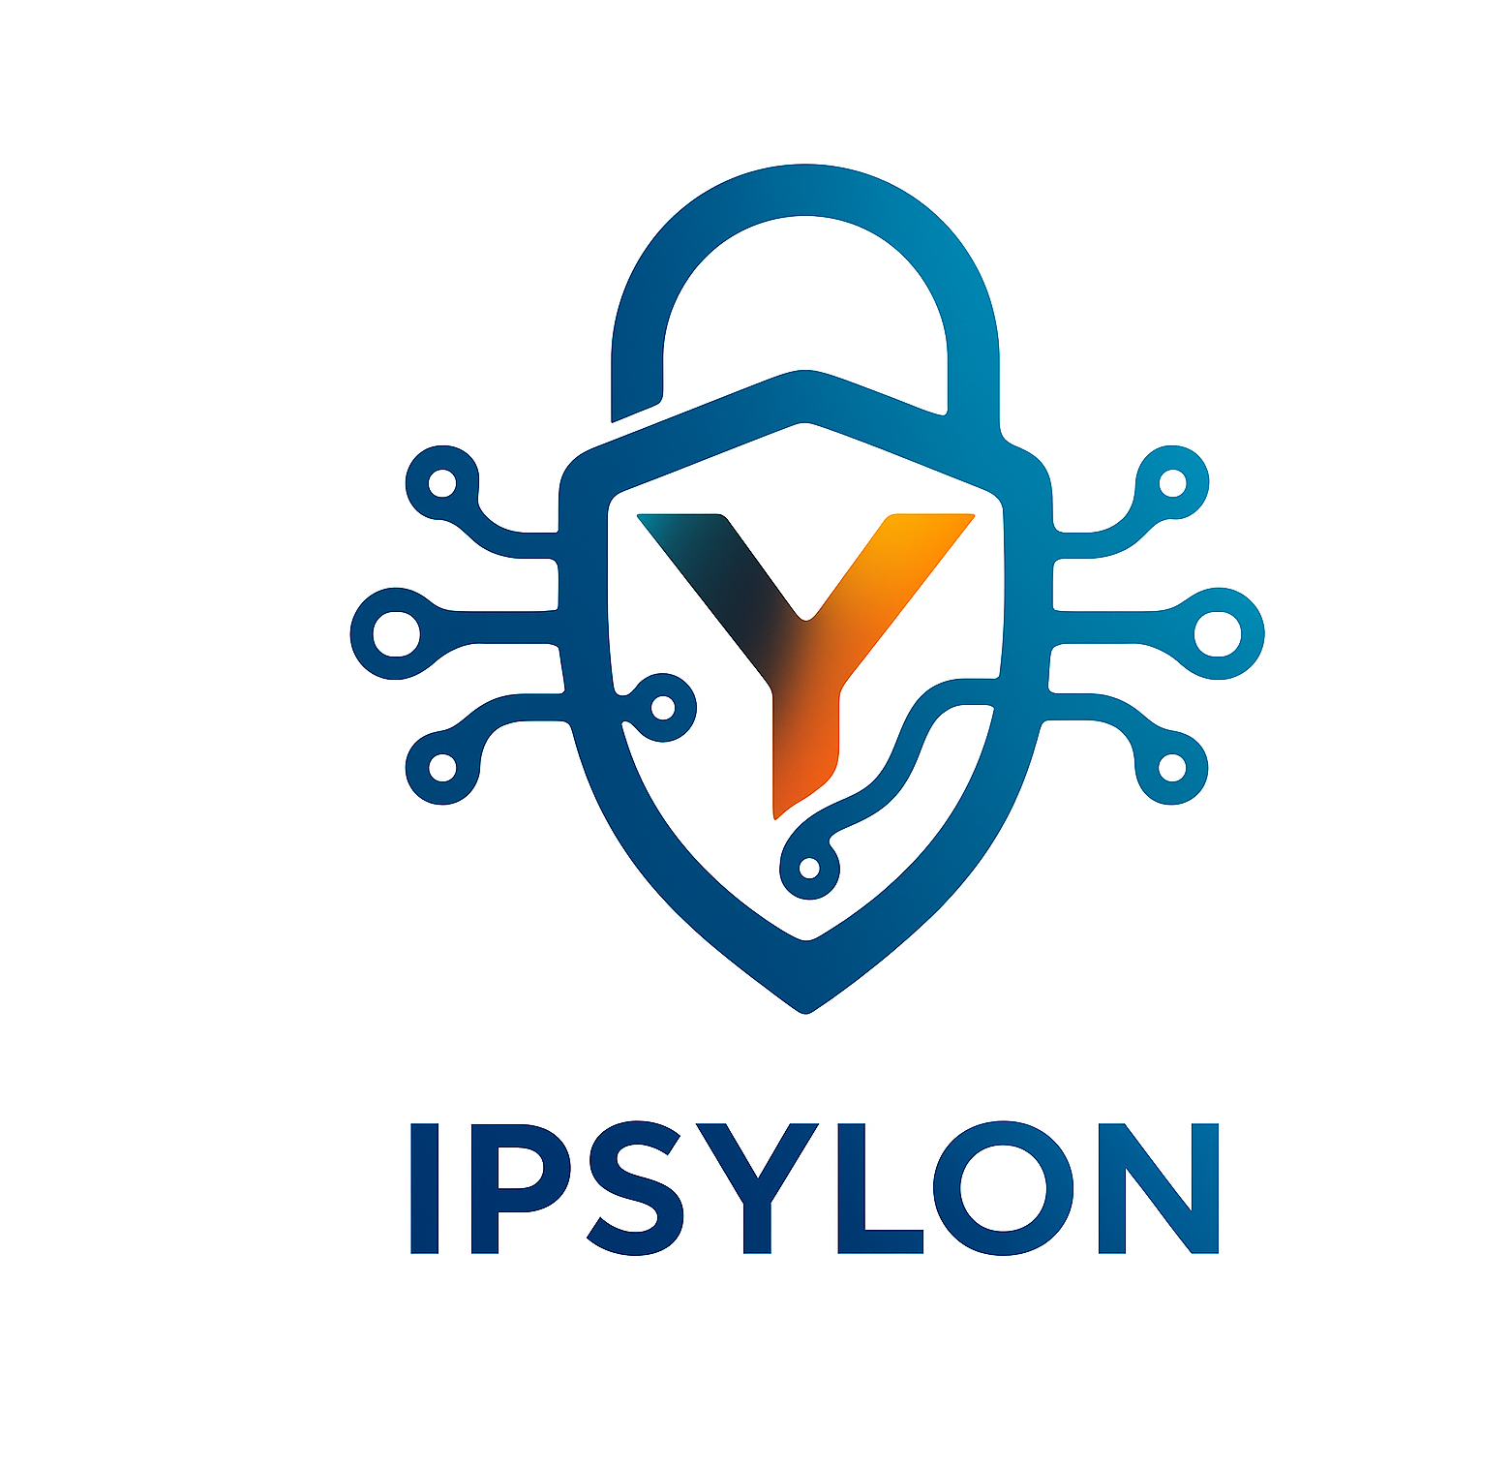

Slide 2
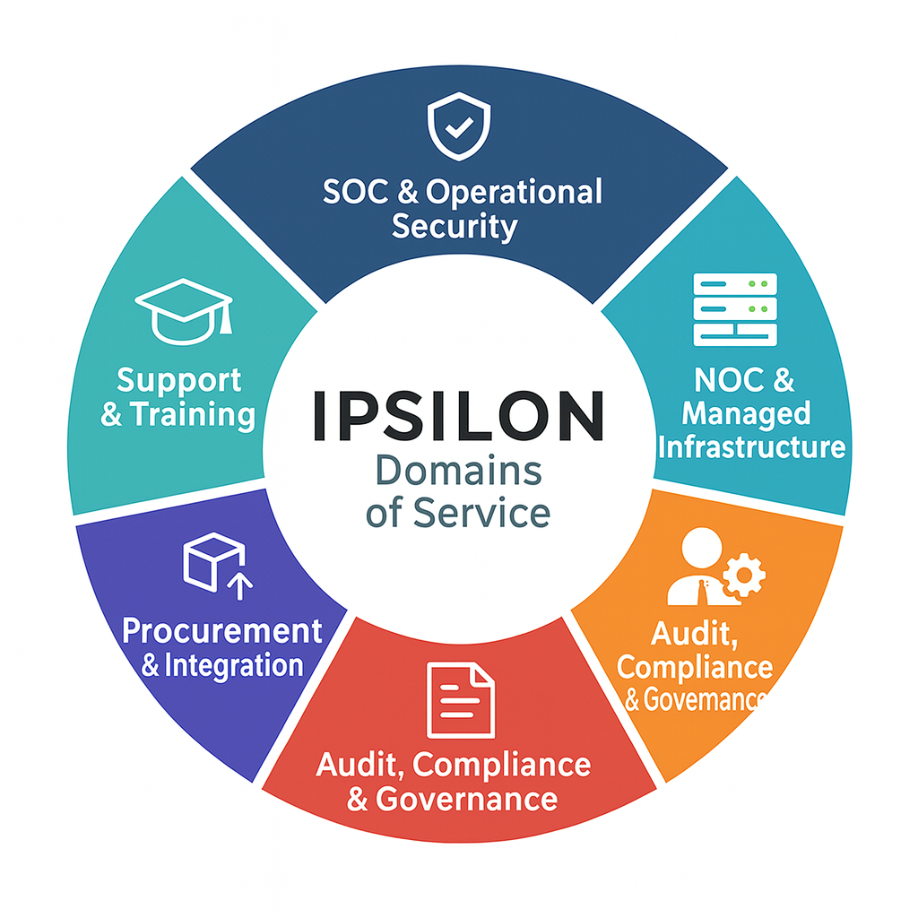
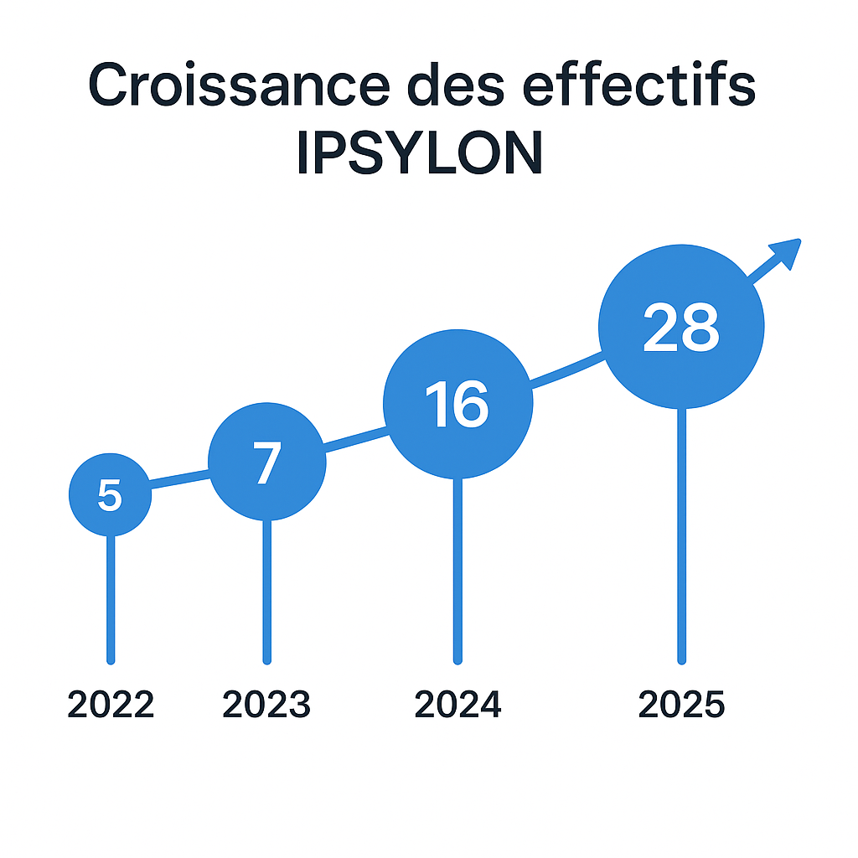

A trusted Partner
IPSYLON is an independent player that supports organizations in securing, managing, and developing their information systems.
Revenue growth
Staff growth

Slide 3
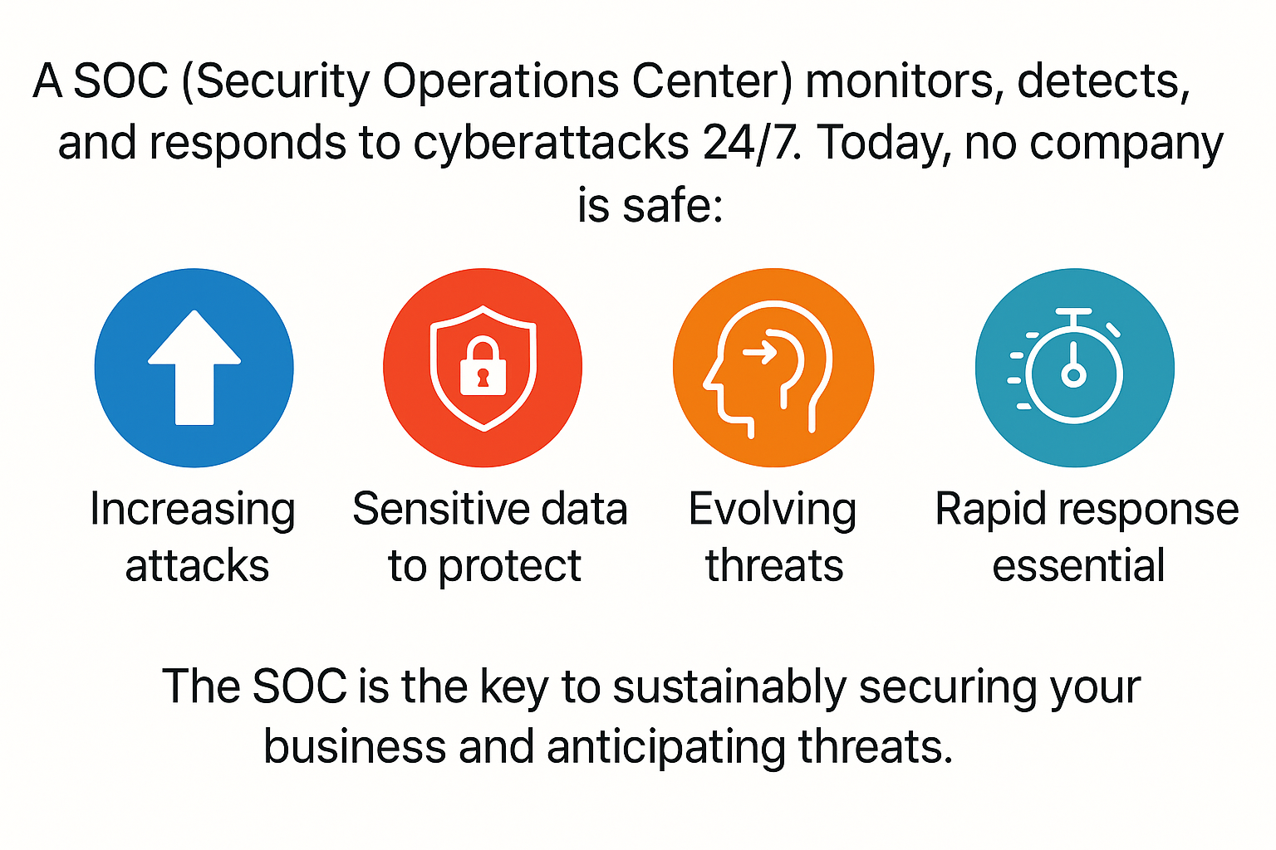
Security Operation Center : Why ?

Slide 4
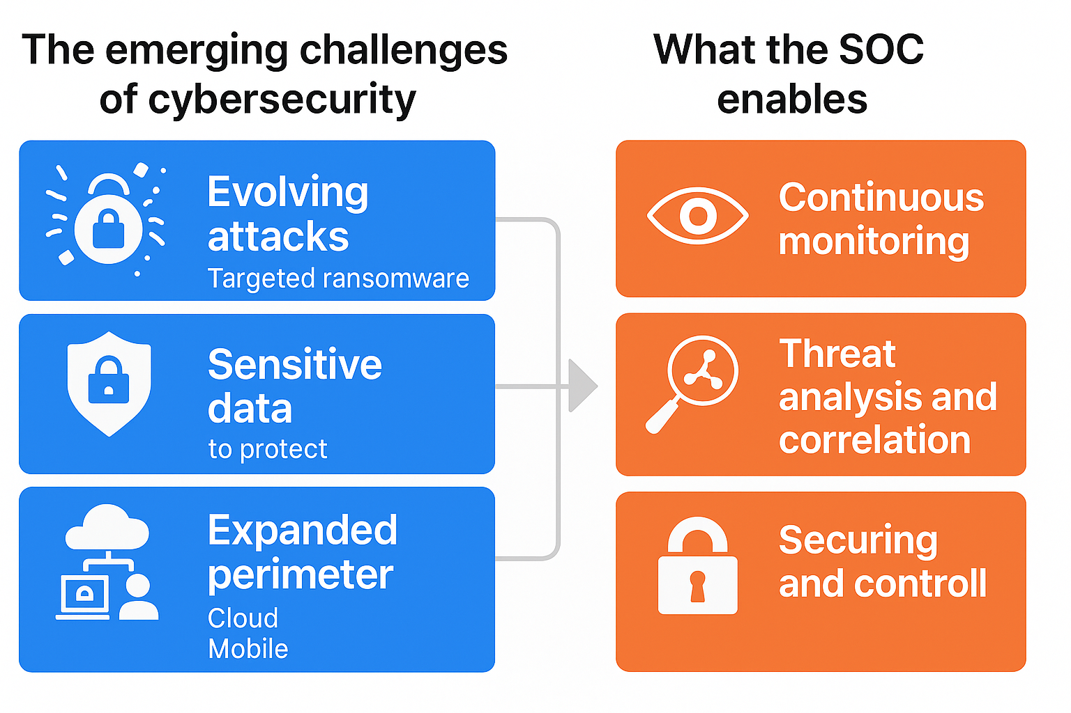
Security Operation Center : Why ?
As cyber threats become ever more sophisticated, the SOC redefines security management by providing continuous monitoring, in-depth analysis, and proactive protection for IT environments.

Slide 5

Security Operation Center : Services Levels
Custom Services matching your needs :
( Advanced & Custom )
SOC Beyond
SOC 360
SOC Core
Penetration Testing
Vulnerability Audits
User Behavior Assessment and Awareness (Phishing Campaigns, Social Engineering)
Risk Management
Diagnostic Flash
SOC Firstwatch
Full Environnement
Network Security, Routeurs, firewall, switchs, vpn, proxy…
Server Security, Storage, databases, Backup, stockages, Software.
User desktop and laptop, mobile device
User Behavioral Monitoring and Management
Network Security, Routeurs, firewall, switchs, vpn, proxy…
Server Security, Storage, databases, Backup, stockages, Software.
One time Security log analysis
One time report of Anomalies and Malicious Attempts
Flash Risk Report

Slide 6

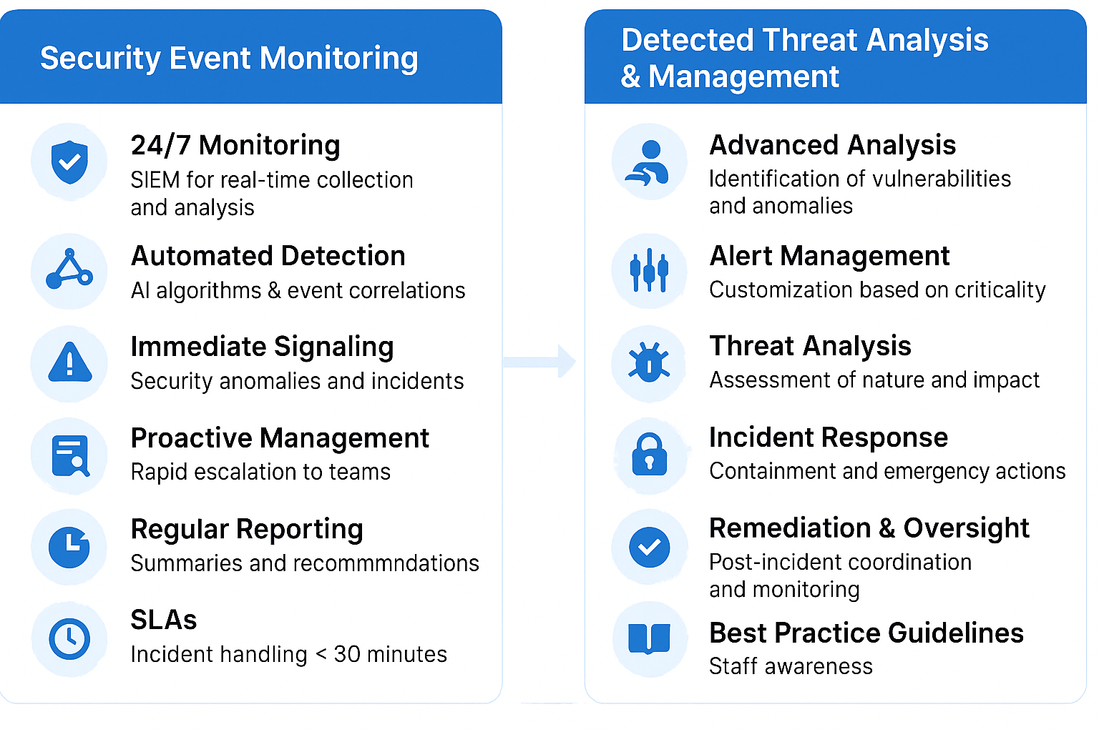
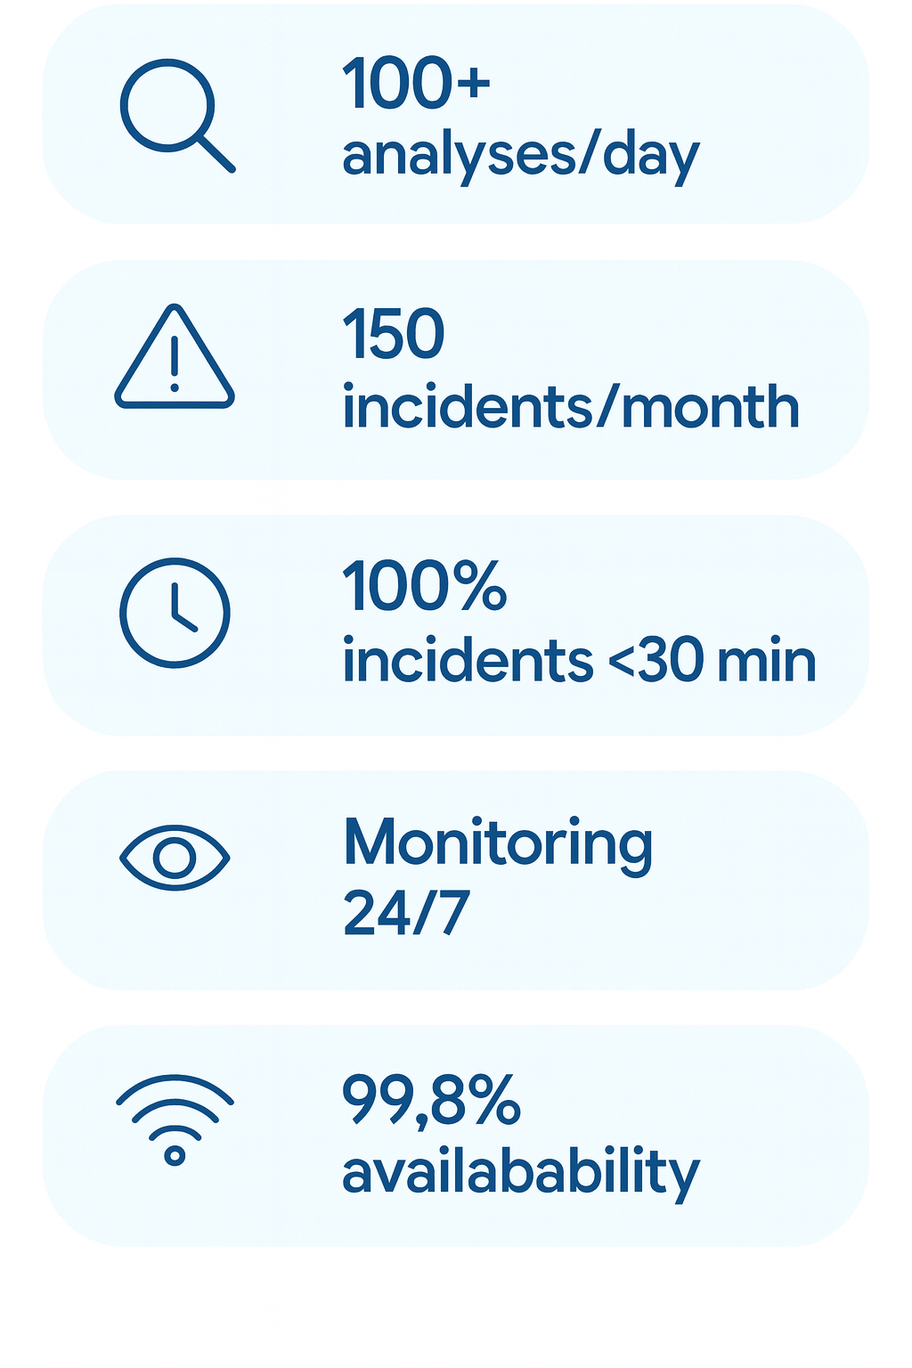
Security Operation Center : Current Services
Services

Slide 7
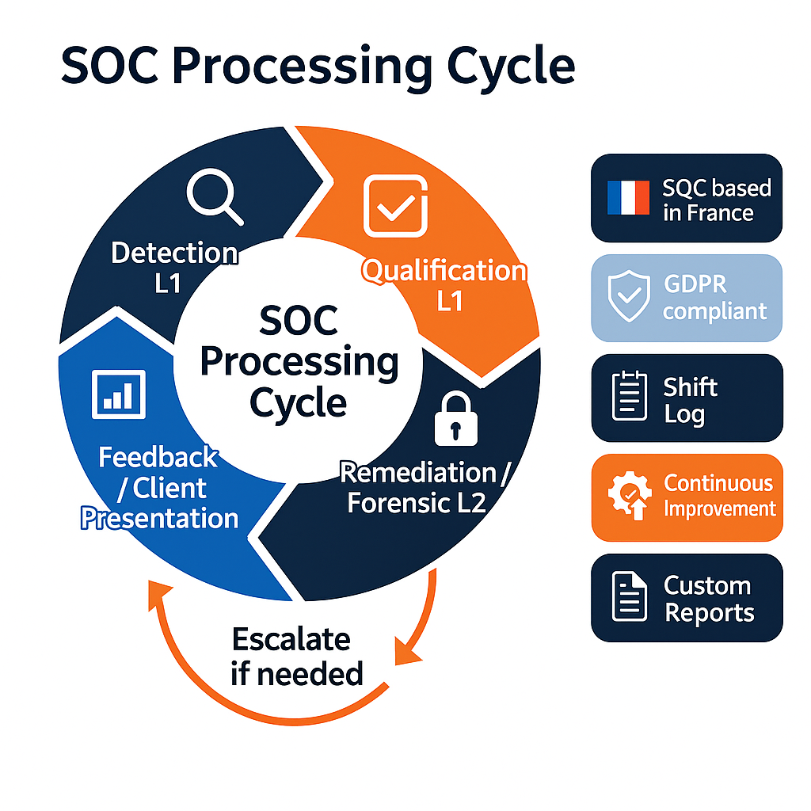
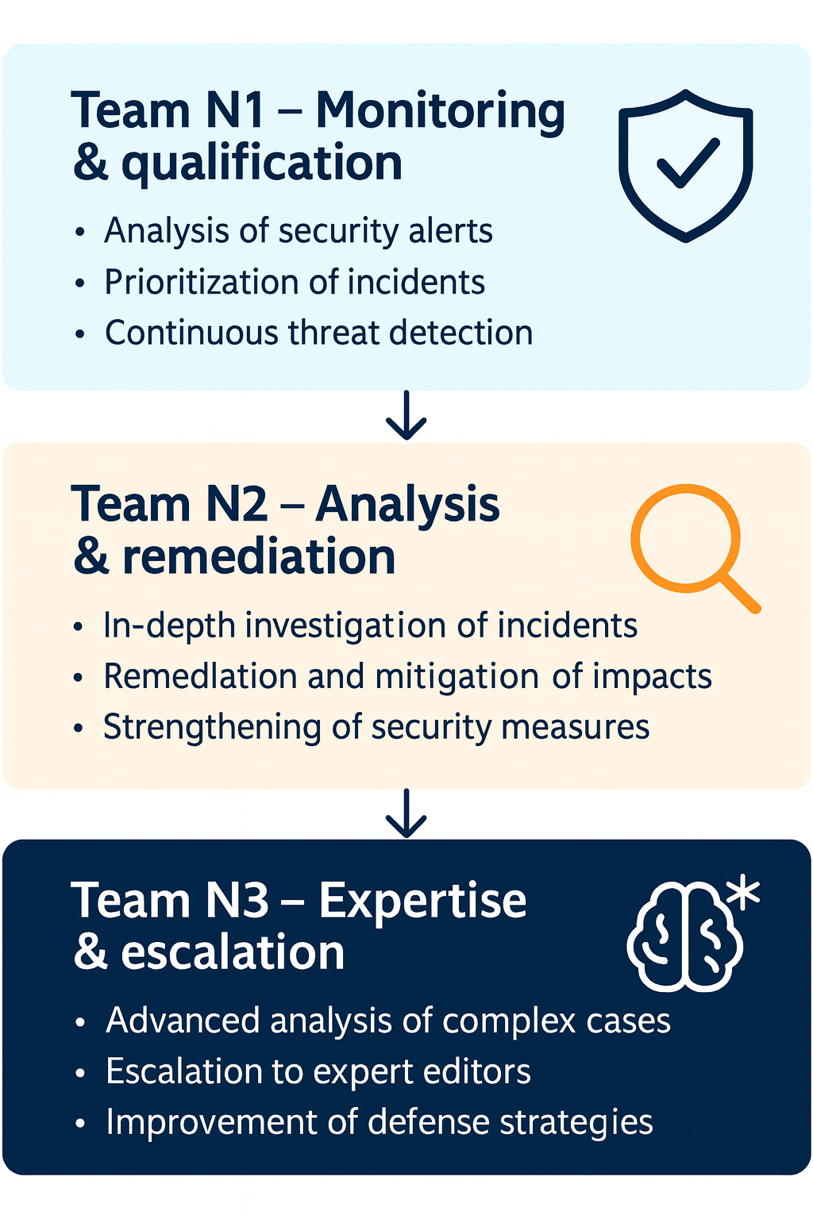
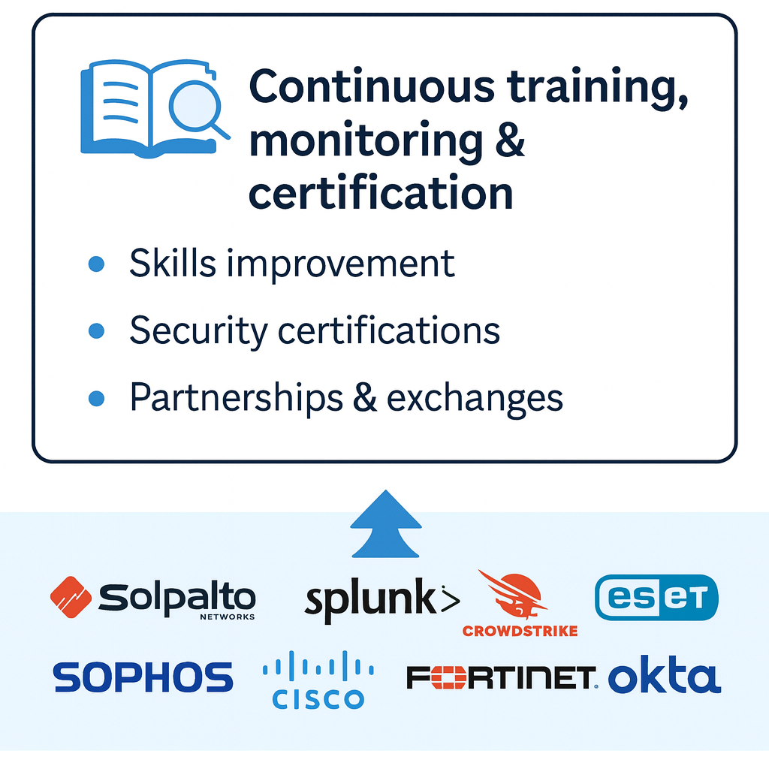
Security Operation Center : Processing
Teams

Slide 8
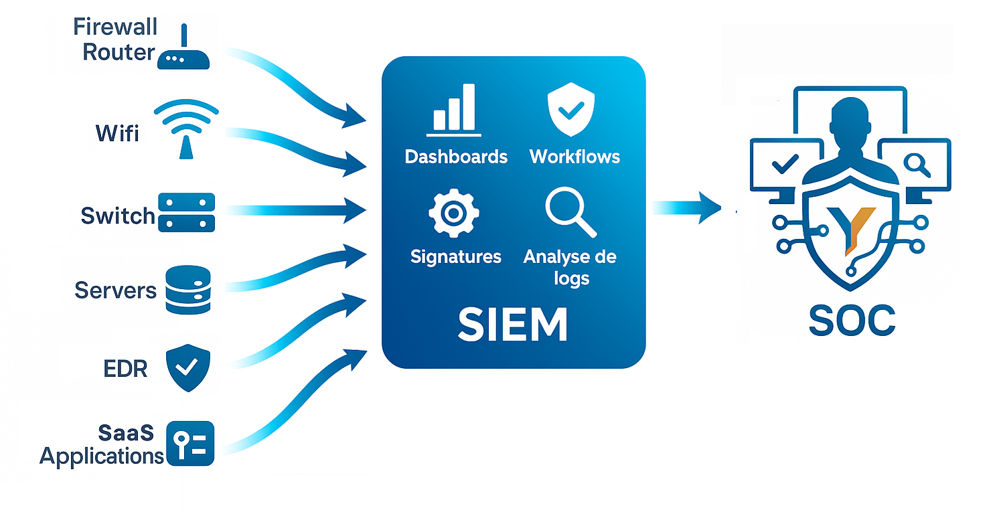
Security Operation Center : Solutions
A service powered by SIEM technologies with advanced, customized configurations.

Slide 9
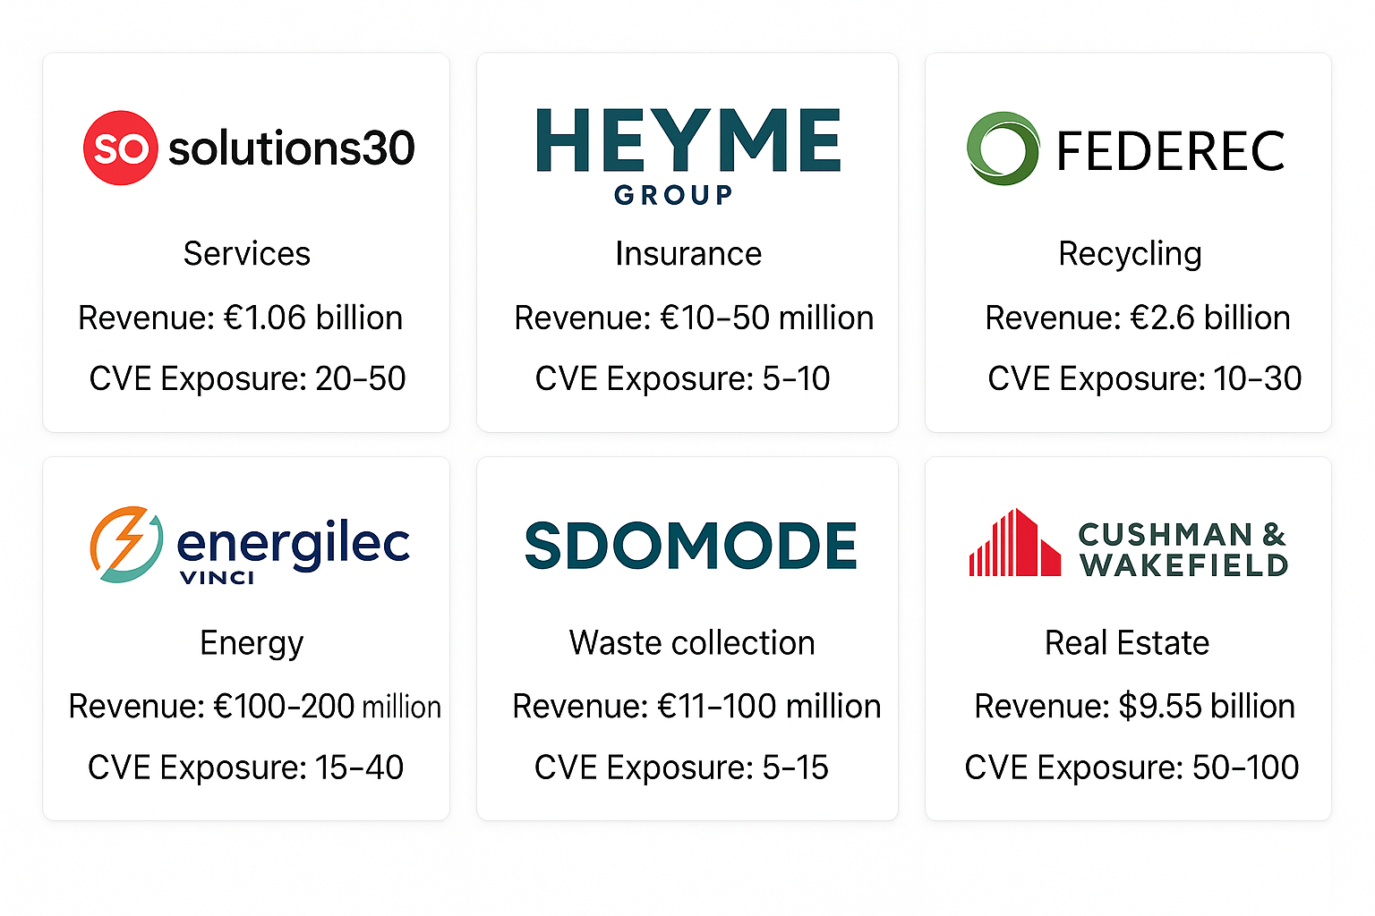
Trusted by

Slide 10

Questions

Slide 11

Contacts

