Slide 1
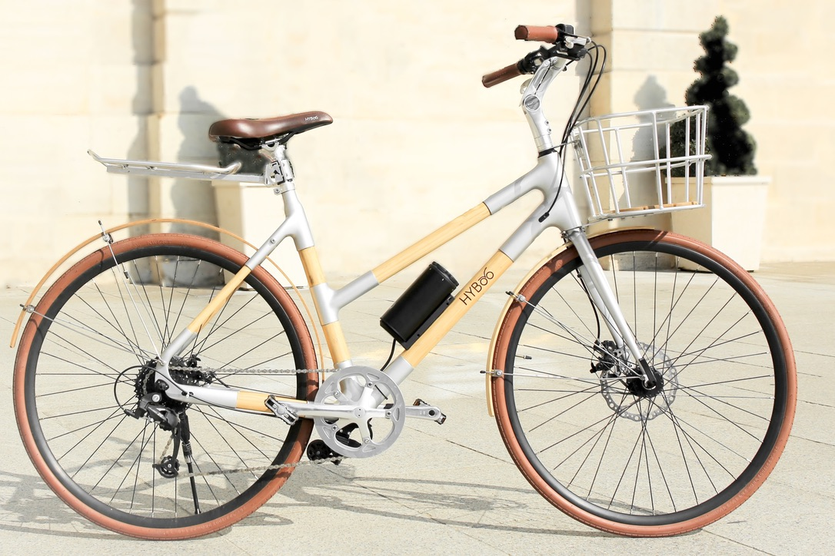
Hyboo by
TRIPBIKE

Slide 2
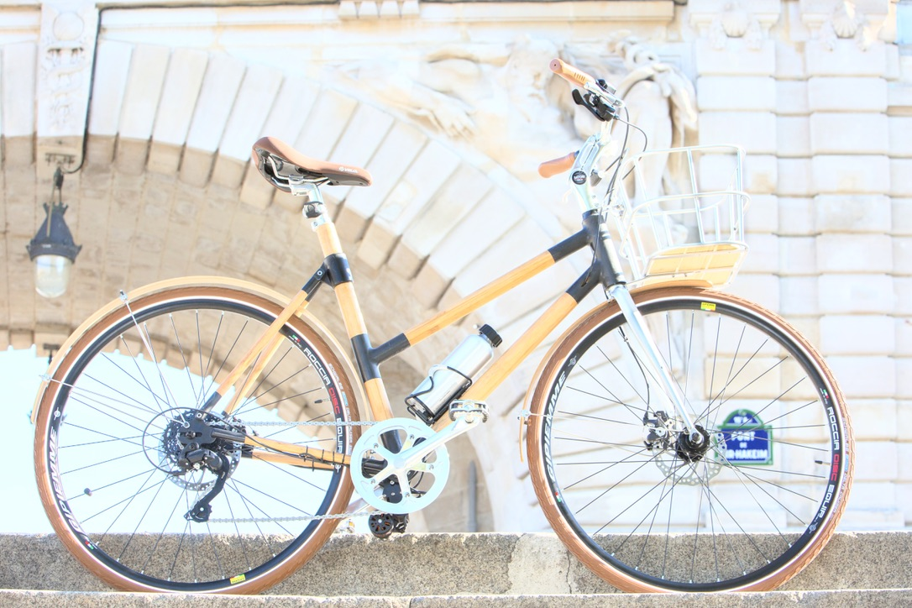
Our Concept
Hyboo bike, the eco-friendly bamboo bicycle
We aim to build the first community of green and ethical mobility users
We had a crush for Bamboo, a trendy, fully renewable and fast-growing raw material. Bamboo is the start of all our products
&
We are Made in France, with a positive social impact, manufactured by disabled persons, contributing to their integration in the society
Hyboo by
TRIPBIKE

Slide 3
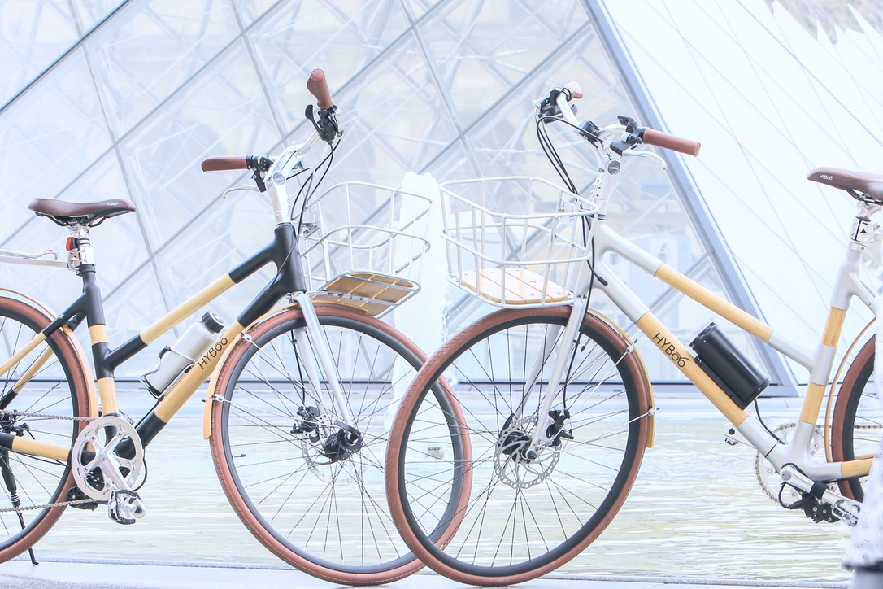
Our Bikes
HYbrid
Electrically Assisted Bicycle (EAB) that can be removed
Adapted to daily journey & sport sessions on cities & countryside roads
BamBOO
Green, bio-sourced and quickly renewable material (mature in 6 months time) Carbon Negative Plant (absorb CO2) Strong, resistant, does not swell over time
TECHNOLOGY & PERFORMANCE
Hand-crafted and Industrial Patented Production
High scale and high standard homogenize production
(unique for bamboo bike)
Powerful electric battery made in Austria (70 km)
Super light electric bicycle (15kg VS. 23kg in avg.)
Hyboo by
TRIPBIKE

Slide 4
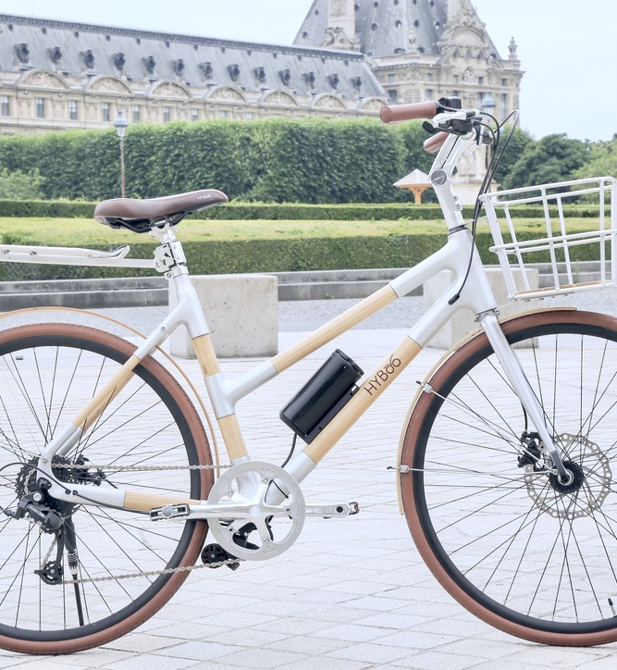
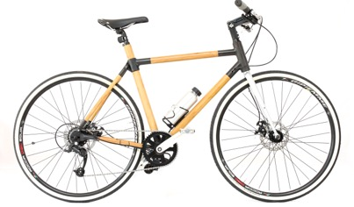
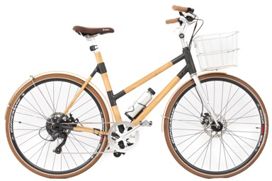
Our Bikes
Market Positionning
Unique high standards bamboo bike
- Hand Crafted & Industrial Processes
for high-scale production
- Patented technology for homogenized production
- Worked, treated and crash tested
bamboo
Leisure Bike
Noble & Performant materials
Trendy Bamboo is 70% of the bike rest of the bike being Carbon - Light materials, bike is only 15kg
- Long autonomy battery
City Bike
Competitive Pricing
- Competitive pricing among premium bikes (industry between 3000 to 7000 EUR)
Accessories fully Personalized
-All accessories are fully personalized in size and color
Hyboo by
TRIPBIKE

Slide 5
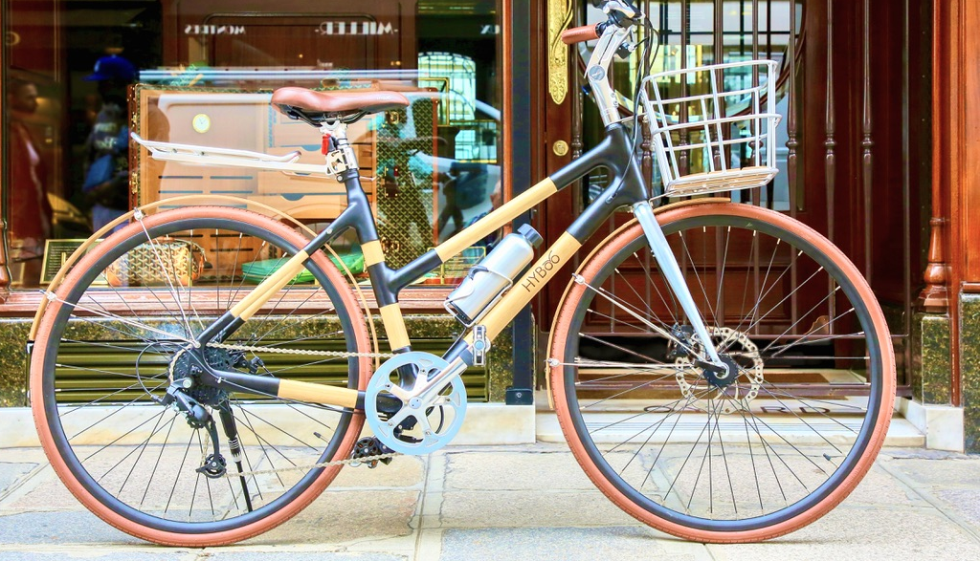
Our CEO wor(l)d
Ride green ! From our conception to your utilization !
Hyboo by
TRIPBIKE

Slide 6
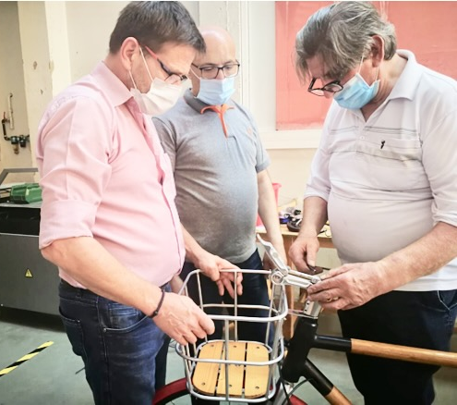
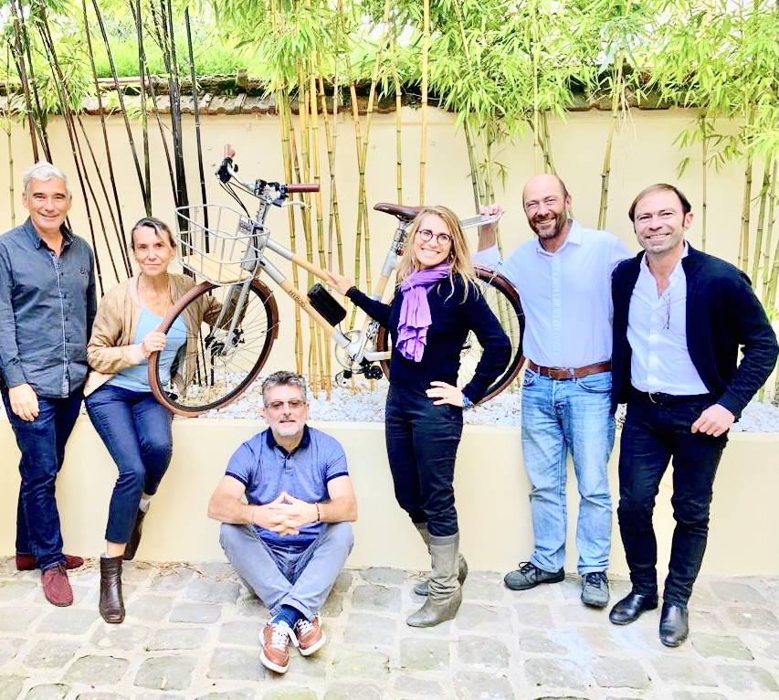
Our Community
Our Ingeniors & Crafters
Our Hyboobikers
Hyboo by
TRIPBIKE

Slide 7
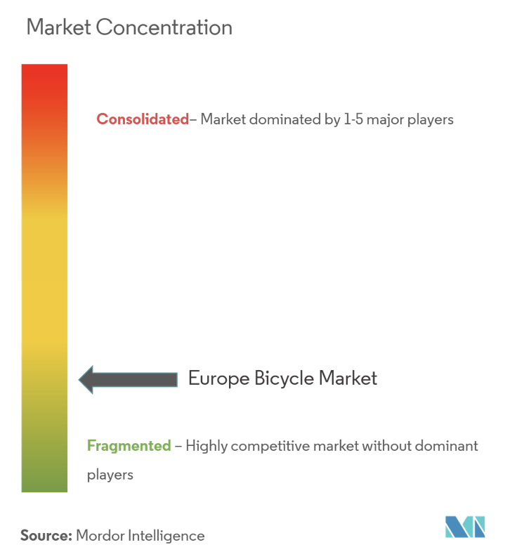
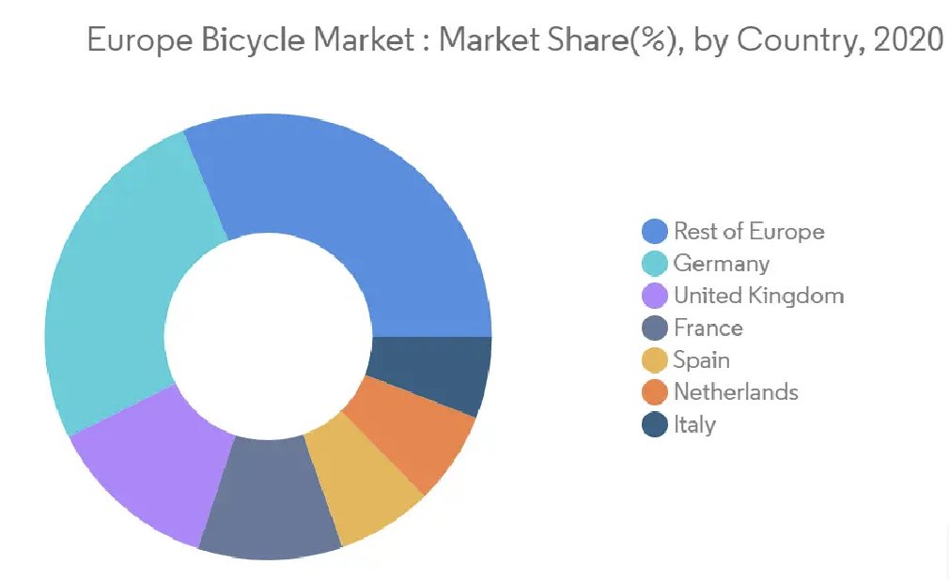
The European market
A trendy and continuously increasing market in Europe led by Germany
Market open to competition !
*Figures for Europe
Hyboo by
TRIPBIKE

Slide 8
THANK YOU!
Hyboo by
TRIPBIKE

