Slide 1
THE LUXURY OF CONVENIENCE
CONFIDENTIAL FOR INTERNAL PURPOSES ONLY

Slide 2
TOSHI DEFINES LAST MILE DELIVERY FOR
LUXURY BRANDS AND THEIR CLIENTS
CONFIDENTIAL FOR INTERNAL PURPOSES ONLY
2

Slide 3
OUR CORE VALUES
THE HUMAN TOUCH
CONVENIENCE
OPTIMISATION
SUSTAINABILITY
3

Slide 4
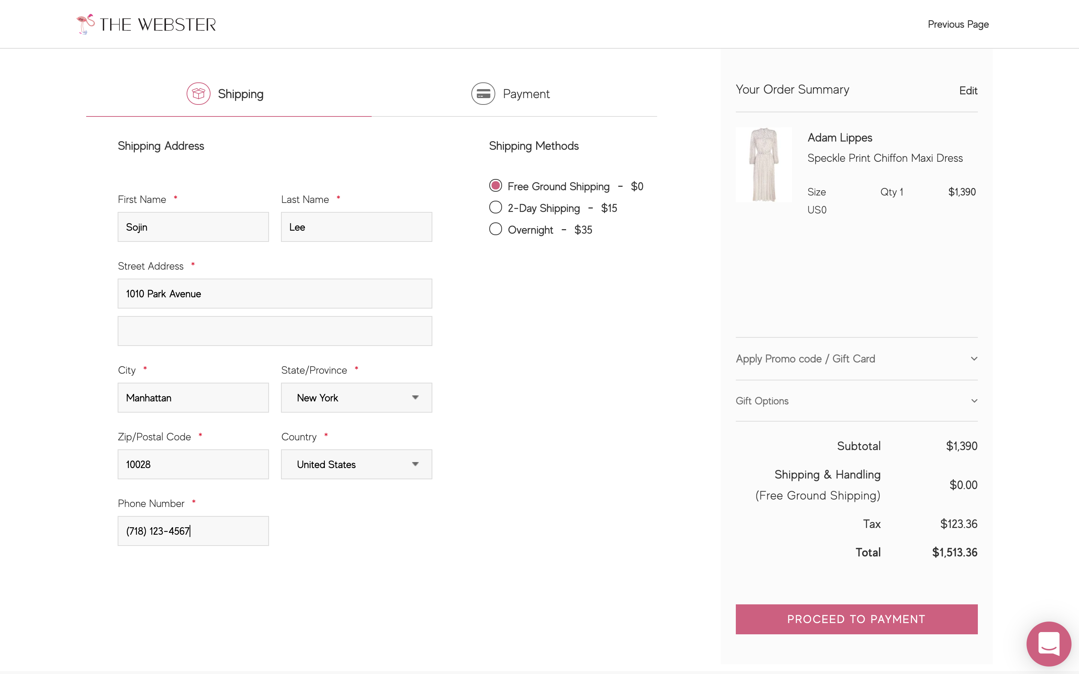
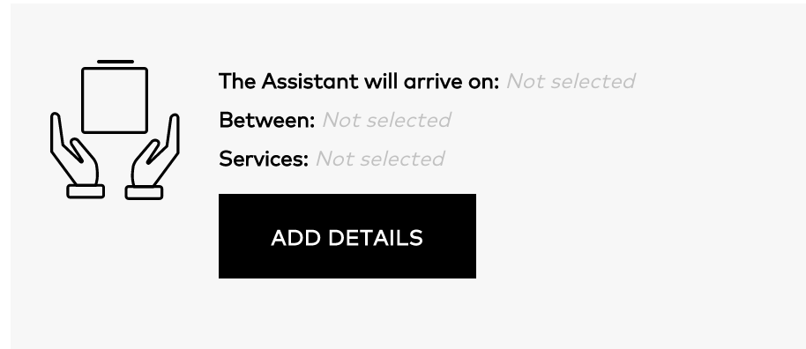
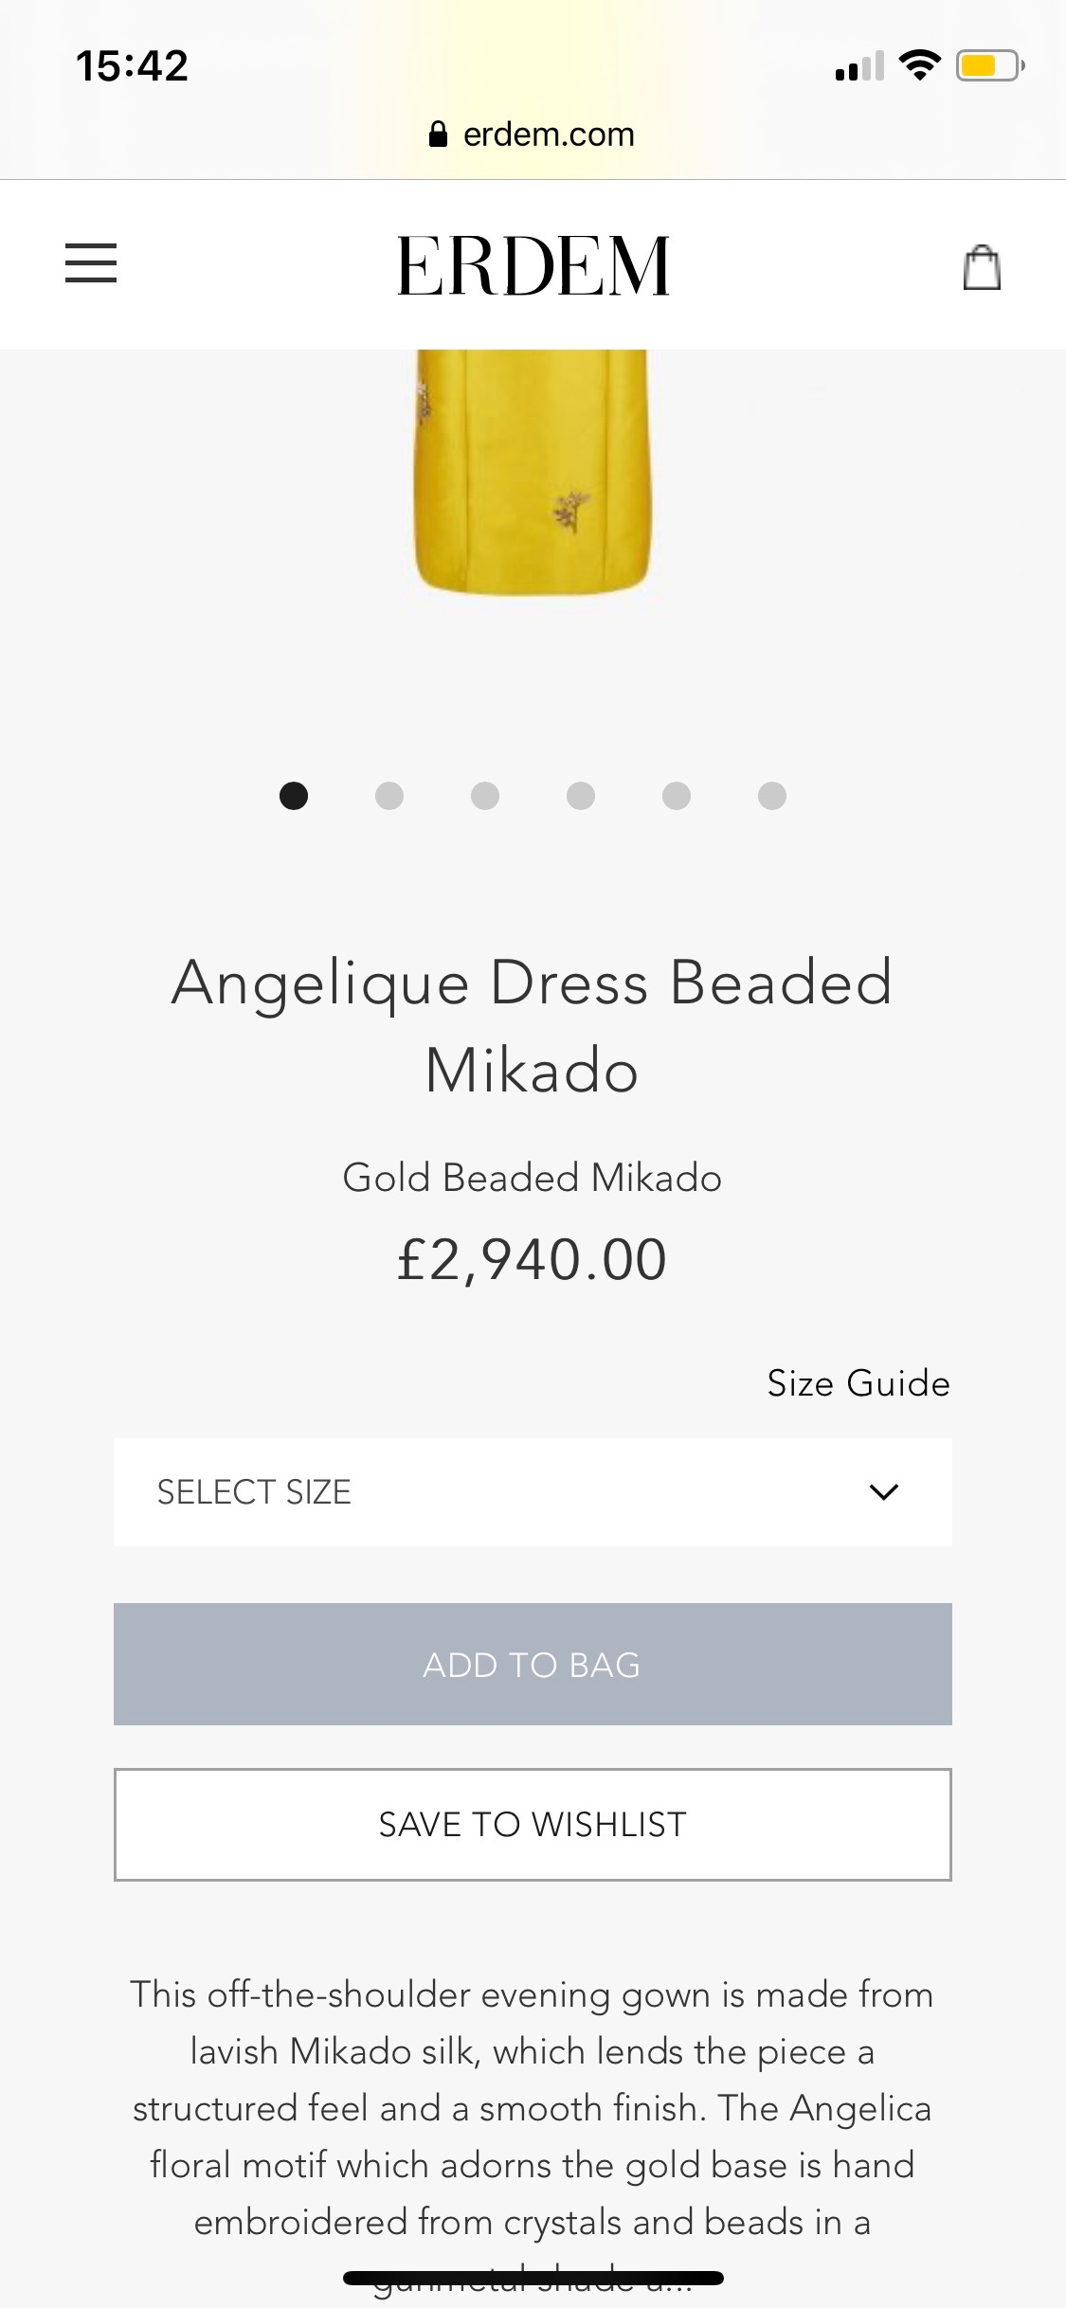
TOSHI IS THE MARKET LEADER FOR THE LUXURY LAST MILE – FOR ECOMMERCE AND RETAIL
ACTIVATION ROUTES
FULFILMENT METHODS
SERVICE OPTIONS
WAREHOUSE TO DOOR
SCHEDULED DELIVERIES
CLIENT
ECOMMERCE
Try before you buy
CLIENT-SCHEDULED, ON-DEMAND DELIVERY
30-60 MINUTE DELIVERY SLOTS
7 DAYS A WEEK
MY TOSHI CLIENT DASHBOARD (TRACK, RETURN AND RESCHEDULE)
FIRST MILE
MIDDLE MILE
LUXURY LAST MILE
STORE TEAM IN-STORE INTERFACE (I.S.I)
3PL CAPABILITIES
ADDITIONAL MODULAR SERVICES:
STORE TO DOOR
WAIT & TRY
TRY BEFORE YOU BUY (PAY AT DOOR)
SIZE UP / SIZE DOWN
BESPOKE CLIENTELING APPS, DIRECT LINK, INSTAGRAM, ETC.
INSPIRE ME (CROSS-SELL / UPSELL)
LIVE IN LONDON & NEW YORK
CONFIDENTIAL FOR INTERNAL PURPOSES ONLY
4

Slide 5
Toshi SOLUTIONS ARE DESIGNED SPECIFICALLY TO MEET THE NEEDS OF LUXURY
MARKET LEADER IN LUXURY DELIVERY AND SERVICES – ACROSS FASHION, ACCESSORIES, FRAGRANCE AND BEAUTY, WATCHES AND JEWELLERY, SKINCARE, HOMEWARE
COMPREHENSIVE EXPERIENCE IN INDUSTRY-DEFINING COMPANIES WITHIN THE LUXURY SECTOR
A COLLABORATIVE APPROACH TO ADDRESS BOTH LUXURY BRAND AND LUXURY CLIENT DEMANDS
ELEVATED SERVICE IN LINE WITH LUXURY BRAND REQUIREMENTS
TOSHI NETWORK FOCUSED ON PROVIDING AN EXCELLENT CLIENT DELIVERY EXPERIENCE
5
CONFIDENTIAL FOR INTERNAL PURPOSES ONLY

Slide 6
CLIENT SCHEDULED DELIVERY: MORE THAN JUST A DROP-OFF
30-60 MINUTE DELIVERY SLOT – SAME / NEXT / NOMINATED DAY
10AM TO 8PM – 7 DAYS A WEEK – 362 DAYS A YEAR
SCRIPTED CUSTOMER SERVICE
TOSHI INSURANCE FOR EACH ORDER
FLEXIBLE RESCHEDULING & CANCELLATIONS
OVERNIGHT STORAGE
RETURNS MANAGEMENT
* ADDITIONAL CHARGES APPLY
* ADDITIONAL CHARGES APPLY
6

Slide 7
TOSHI HOME SERVICES
TOSHI PROVIDES A RANGE OF CLIENT SERVICES FROM SCHEDULED DELIVERY TO REMOTE SELLING AND CONSIGNMENT CAPABILITIES FOR BOTH RETAIL AND ECOMMERCE
FASHION: ADDITIONAL STYLES OR COLOURS
BEAUTY: TESTERS/SAMPLES
TRY BEFORE YOU BUY
(CONSIGNMENT)
SEND ALL ITEMS ON CONSIGNMENT - ADDITIONAL SIZES, COLOURS & STYLES
WAIT & TRY
TOSHI ASSISTANT WILL WAIT 20 MINUTES WITH THE CLIENT
CROSS-SELL/UPSELL
SIZE UP / SIZE DOWN (CONSIGNMENT)
TOSHI ASSISTANT WILL BRING ADDITIONAL SIZES FOR PERFECT FIT
INSPIRE ME
(CONSIGNMENT)
BRAND TO SEND ADDITIONAL ITEMS FOR CROSS-SELL / UPSELL
CROSS-SELL/UPSELL
CROSS-SELL/UPSELL
CONFIDENTIAL FOR INTERNAL PURPOSES ONLY

Slide 8
THE TOSHI EXPERIENCE ASSISTANT
TRAINED FOR RETAIL AND ECOMMERCE ORDERS
SALARIED ASSISTANTS with retail, customer service and fashion backgrounds
UNBRANDED BLACK UNIFORM AND PROTECTIVE TOTE
HAIR, JEWELLERY AND MAKEUP GUIDELINES
NO COMMISSION
DIGITAL REAL-TIME TRAINING PLATFORM WITH A DETAILED TRAINING PROGRAMME
ASSISTANTS SEGMENTED BY ABILITY TO PROVIDE BASIC CUSTOMER SERVICES AND THE FULL TOSHI WHITE GLOVE SERVICE
PROVIDE QUALITATIVE FEEDBACK
CONFIDENTIAL FOR INTERNAL PURPOSES ONLY

Slide 9
BENEFITS FOR THE BRAND
Increase revenue
&
other KPIS
ELEVATED CUSTOMER EXPERIENCE
DRIVE INCREMENTAL SALES
REDUCE RETURNS
CUSTOMER RETENTION
INVENTORY OPTIMISATION
STAFFING COST
EFFICIENCIES
CUSTOMER DATA
(QUAL + QUANT)
SEAMLESS SUPPLY
CHAIN SOLUTION
9

Slide 10
CITY ROLLOUT PLAN
COVERS 40% OF GLOBAL LUXURY GOODS MARKET
LONDON
GREATER LONDON
NEW YORK
MANHATTAN & BROOKLYN
UK CITIES MILAN ROME LOS ANGELES
PARIS DALLAS MUNICH TORONTO
MIAMI CHICAGO HONG KONG
CONFIDENTIAL FOR INTERNAL PURPOSES ONLY

Slide 11
THE LUXURY OF CONVENIENCE
CONFIDENTIAL FOR INTERNAL PURPOSES ONLY

