Slide 1
Young professionals, managing radioactive waste, and the role of IAEA
27 – 31 May 2024
Busan, Republic of Korea
7th International Conference on Geological Repositories (organized in cooperation with the IAEA)
Presented by:
Karina Lange Radioactive waste disposal specialist, Waste Technology Section, IAEA
Notes:
Engineering design = technical design
Review of design process showing the relationship between the design phases and the design aims, assessment, information input and implementation

Slide 2
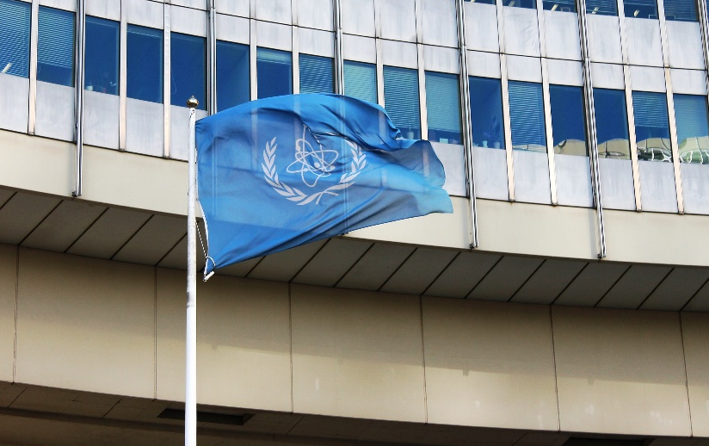
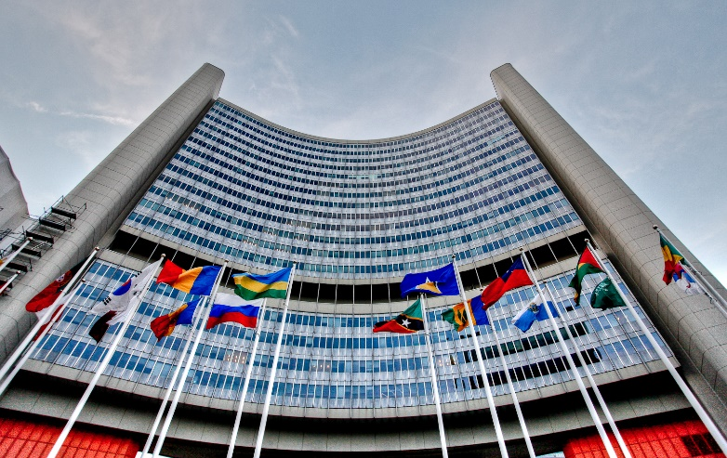
IAEA at a glance
178 Member States
(as of April 2024)
HQ in Vienna
Laboratories in Seibersdorf, Monaco, Vienna
Regional offices in Toronto and Tokyo
Liaison offices in New York and Geneva
2,500+staff
from
over 100 countries
Widely known as the world’s “Nuclear Watchdog”, IAEA is also the global center for cooperation on peaceful uses.
Under Article III 2 the Agency is authorized to foster the exchange of scientific and technical information on peaceful uses of atomic energy.

Slide 3
Supporting the future of young professionals in the nuclear field
Junior Professional Officers
Internship programme
Projects encouraging youth in STEM

Slide 4
Attracting and supporting women students to pursue advanced studies and career in the nuclear field
Lise Meitner Programme (LMP)
Retention and career development for women in the nuclear field
Marie Sklodowska-Curie Fellowship Programme (MSCFP)

Slide 5
(Cumulative)
Impact in Numbers
2020-2023
Application and Selection
2271
72
Studying in
Fields of Study
Applications Received
Nuclear Energy
Nuclear Sciences & Applications
Nuclear Safety
Nuclear Security
Safeguards/Non-Proliferation
Nuclear Law
Countries
194
236
50
36
36
8
121
560
Students Selected
Nationalities
Notes:
•Currently in its 3rd year of implementation, MSCFP has received 1563 applications since its inception. In the first round, 100 students from 71 nationalities were selected, studying in universities across 40 countries. •The second round of applications closed on October 8, 2021, resulting in an additional 110 selected students (10 more vs. the previous cycle) from 77 nationalities, studying in 41 countries. •The third round of applications closed on September 30, 2022, resulting in an additional 150 selected students (50% more vs. the 1st cycle) from 91 nationalities, studying in 48 countries. •MSCFP is envisaged to grow each year to ensure more women have an opportunity to pursue post-secondary education in nuclear related fields.
•6

Slide 6
Science and engineering solutions for managing radioactive waste

Slide 7
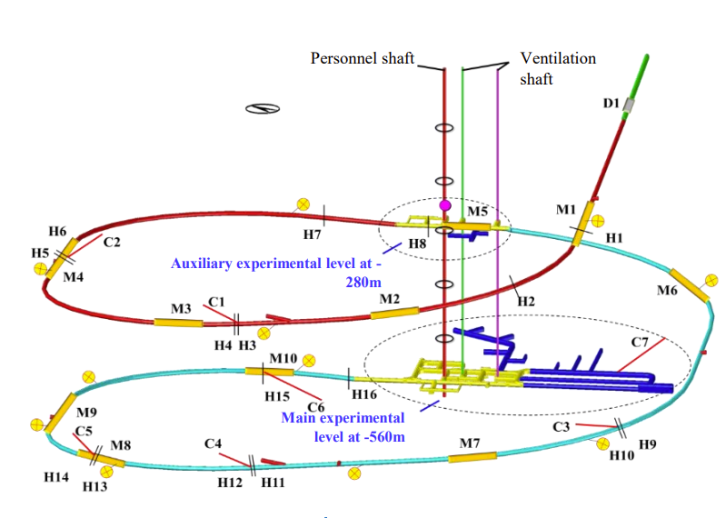
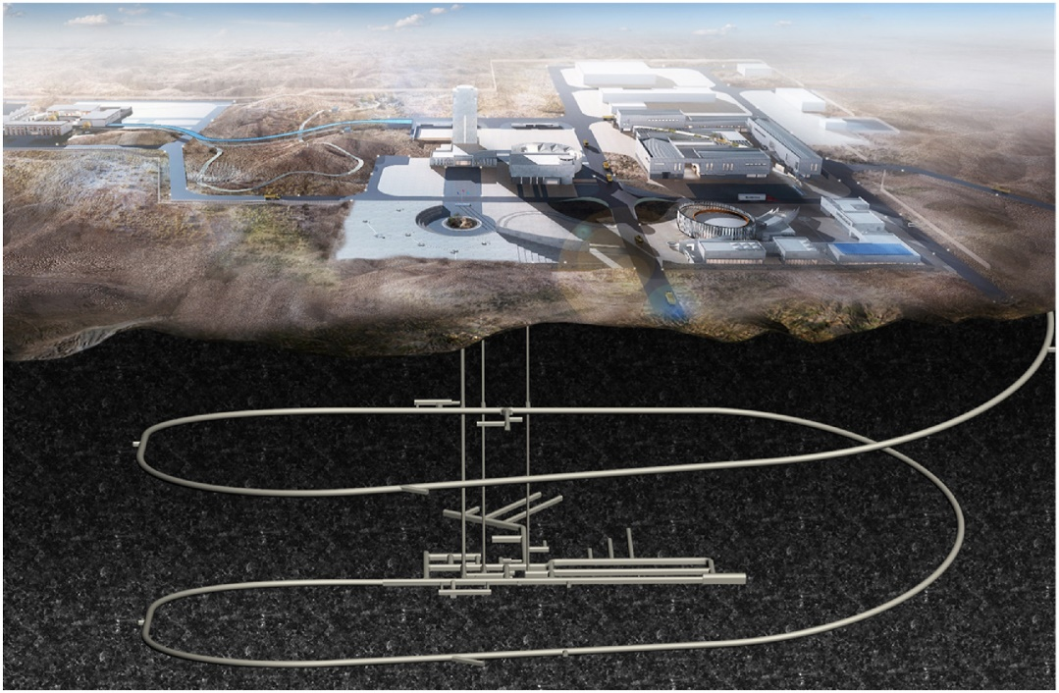
Beishan URL, PRC

Slide 8
New challenges and future work

Slide 9
1. Jordan (Phase 1) | 2009
2. Indonesia (Phase 1) | 2009
3. Viet Nam (Phase 1) | 2009
4. Thailand (Phase 1) | 2010
5. UAE (Phase 2) | 2011
6. Bangladesh (Phase 1&2) | 2011
7. Jordan follow-up | 2012
8. Belarus (Phase 1&2) | 2012
9. Viet Nam (Phase 2) | 2012
10. Poland (Phase 1) | 2013
11. South Africa (Phase 2) | 2013
12. Türkiye (Phase 2) | 2013
13. Jordan (Phase 2) | 2014
14. Viet Nam follow-up | 2014
15. Nigeria (Phase 2) | 2015
16. Kenya (Phase 1) | 2015
17. Morocco (Phase 1) | 2015
18. Bangladesh follow-up | 2016
19. Poland follow-up | 2016
20. Kazakhstan (Phase 1) | 2016
21. Malaysia (Phase 1) | 2016
22. Ghana (Phase 1) | 2017
23. Niger (Phase 1) | 2018
24. UAE (Phase 3) | 2018
25. Saudi Arabia (Phase 2) | 2018
26. Sudan (Phase 1) | 2018
27. Philippines (Phase 1) | 2018
28. Ghana follow-up (Phase 1) | 2019
29. Egypt (Phase 2) | 2019
30. Belarus (Phase 3) | 2020
37 INIR Missions Conducted in 25 Member States (2009-2024)
Estonia
Kazakhstan
Poland
Belarus
Morocco
Türkiye
Jordan
Uzbekistan
Bangladesh
Egypt
Niger
UAE
Viet Nam
Thailand
Philippines
Saudi Arabia
Ghana
Sudan
Sri Lanka
Nigeria
Kenya
Malaysia
Uganda
Indonesia
31. Uzbekistan (Phase 2) | 2021
32. Kenya Follow-up (Phase 1) | 2021
33. Uganda (Phase 1) | 2021
34. Sri Lanka (Phase 1) | 2022
35. Kazakhstan Follow-up (Phase 1) | 2023
36. Estonia (Phase1 / SMR) | 2023
37. Poland (Phase 2) | 2024
South Africa
Planned INIR Missions
Philippines (Phase 1 Follow Up)
Bangladesh (Phase 3)
Türkiye (Phase 3)
Zambia (Phase 1)

Slide 10
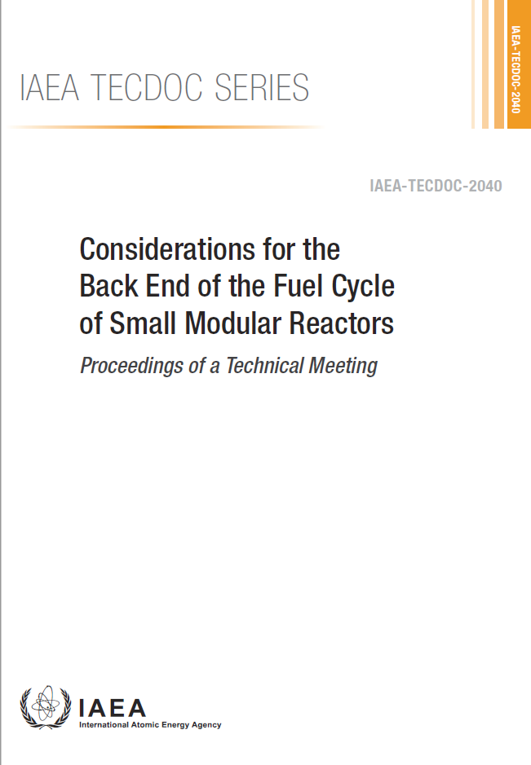
Overview of Back End of the Fuel Cycle Implications for SMR Technologies
Water-cooled SMRs | High temperature gas-cooled SMRs | Liquid-metal FR - SMRs | Molten-salt SMRs
Up to 5% enrichment (land based) Up to 20% enrichment (HALEU) (marine based) | Pebble Beds Prismatic | 15-20% enriched uranium in U-(Pu)-Zr alloy (sodium cooled) (U-Pu)N (lead/lead-bismuth-cooled) | Th, U, Pu, MA fuel salt
IAEA-TECDOC-2040
Dec 2023

Slide 11
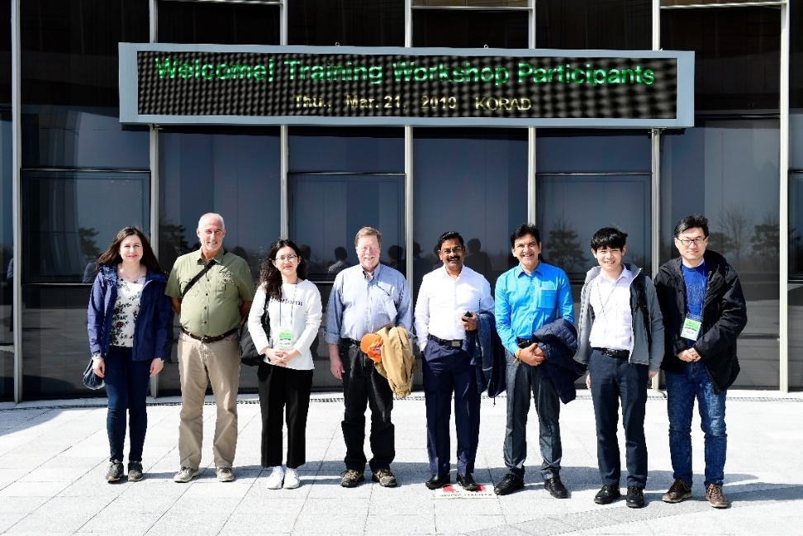
Conclusions
Take advantage of opportunities to connect internationally
New generation of underground research facilities: a major opportunity for hands on science and engineering
New NPPs, SMRs, can not progress without solutions for radioactive waste
Exciting time in radioactive waste: Young professionals will see the operation of the first DGRs in their career!
IAEA Roadmap to a deep geological repository training course – Korea, 2019

Slide 12
Thank you! And Stay Connected !
Videos:
Two minute - link
Ten minute – link
Nuclear Communicators’ Toolbox - link
Professional Networks – link
eLearning – link
Notes:
Thank you!

