Slide 1
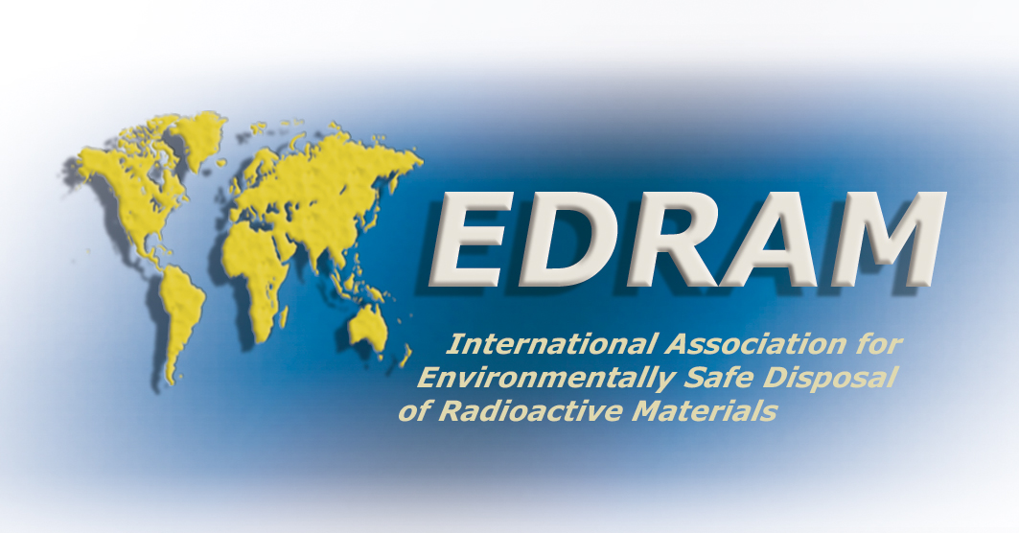
EDRAM Focal Session
May 30, 2024
ICGR-7, Busan, Korea

Slide 2
Who we are
The International Association for Environmentally Safe Disposal of Radioactive Materials (EDRAM) is an association of well-established organizations with with responsibility for management of radioactive wastes in their respective countries

Slide 3
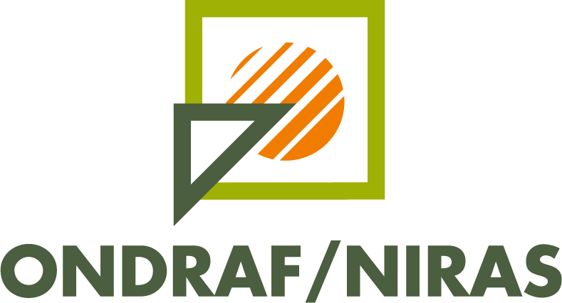
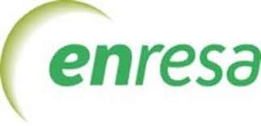
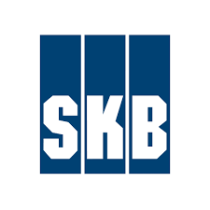
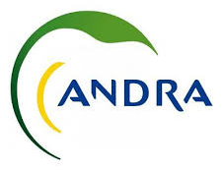
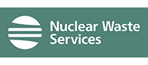
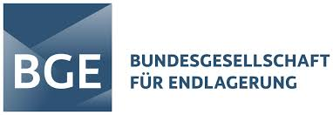
Members
Belgium - ONDRAF
Canada - NWMO
Finland - Posiva
France - ANDRA
Germany - BGE
Japan - NUMO
Spain - ENRESA
Sweden- SKB
Switzerland - NAGRA
United Kingdom - NWS
United States - DOE

Slide 4
Objectives
To create a forum where strategic questions can be discussed among implementers with a view to supporting their individual approaches on policy issues, particularly as these relate to demonstrating safety and environmental protection to both the general public and to regulatory organizations.
To support national efforts towards site selection and implementation of long-term disposal strategies and to promote a common understanding of waste management issues and the internationally recognized principles which apply thereto.
To stimulate and promote coordinated research and development activities, particularly in underground research laboratories.
To define positions and coordinate actions, where appropriate, in dealing with international organizations (e.g. OECD, IAEA, EU), whilst recognizing the value of open discussions with national governments and regulators initiated by such organizations.
To discuss technical and management matters, particularly with a view to benchmarking and establishing optimum practices, without disrupting existing mechanisms for cooperation on specific projects.

Slide 5
EDRAM Principles
The burdens and responsibility for taking care of radioactive waste should not be passed on to future generations.
Radioactive waste management is a social and technical issue.
There is a need for flexibility and open and ethical involvement of stakeholders in decision making.

Slide 6
EDRAM Position Papers
Suitable depth for geologic disposal
Cost estimation for long term disposal program
Small Modular Reactors and existing disposal programs

Slide 7
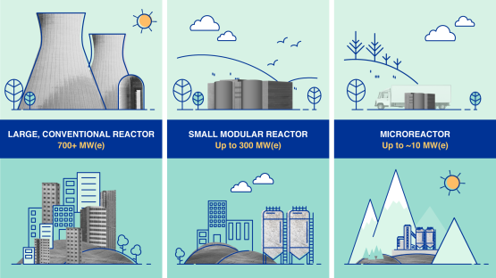
A Changing Landscape
Historically, 1-2 fuel types per country
SMRs are changing this
Close to 80 designs currently under development
Image source: IAEA

Slide 8
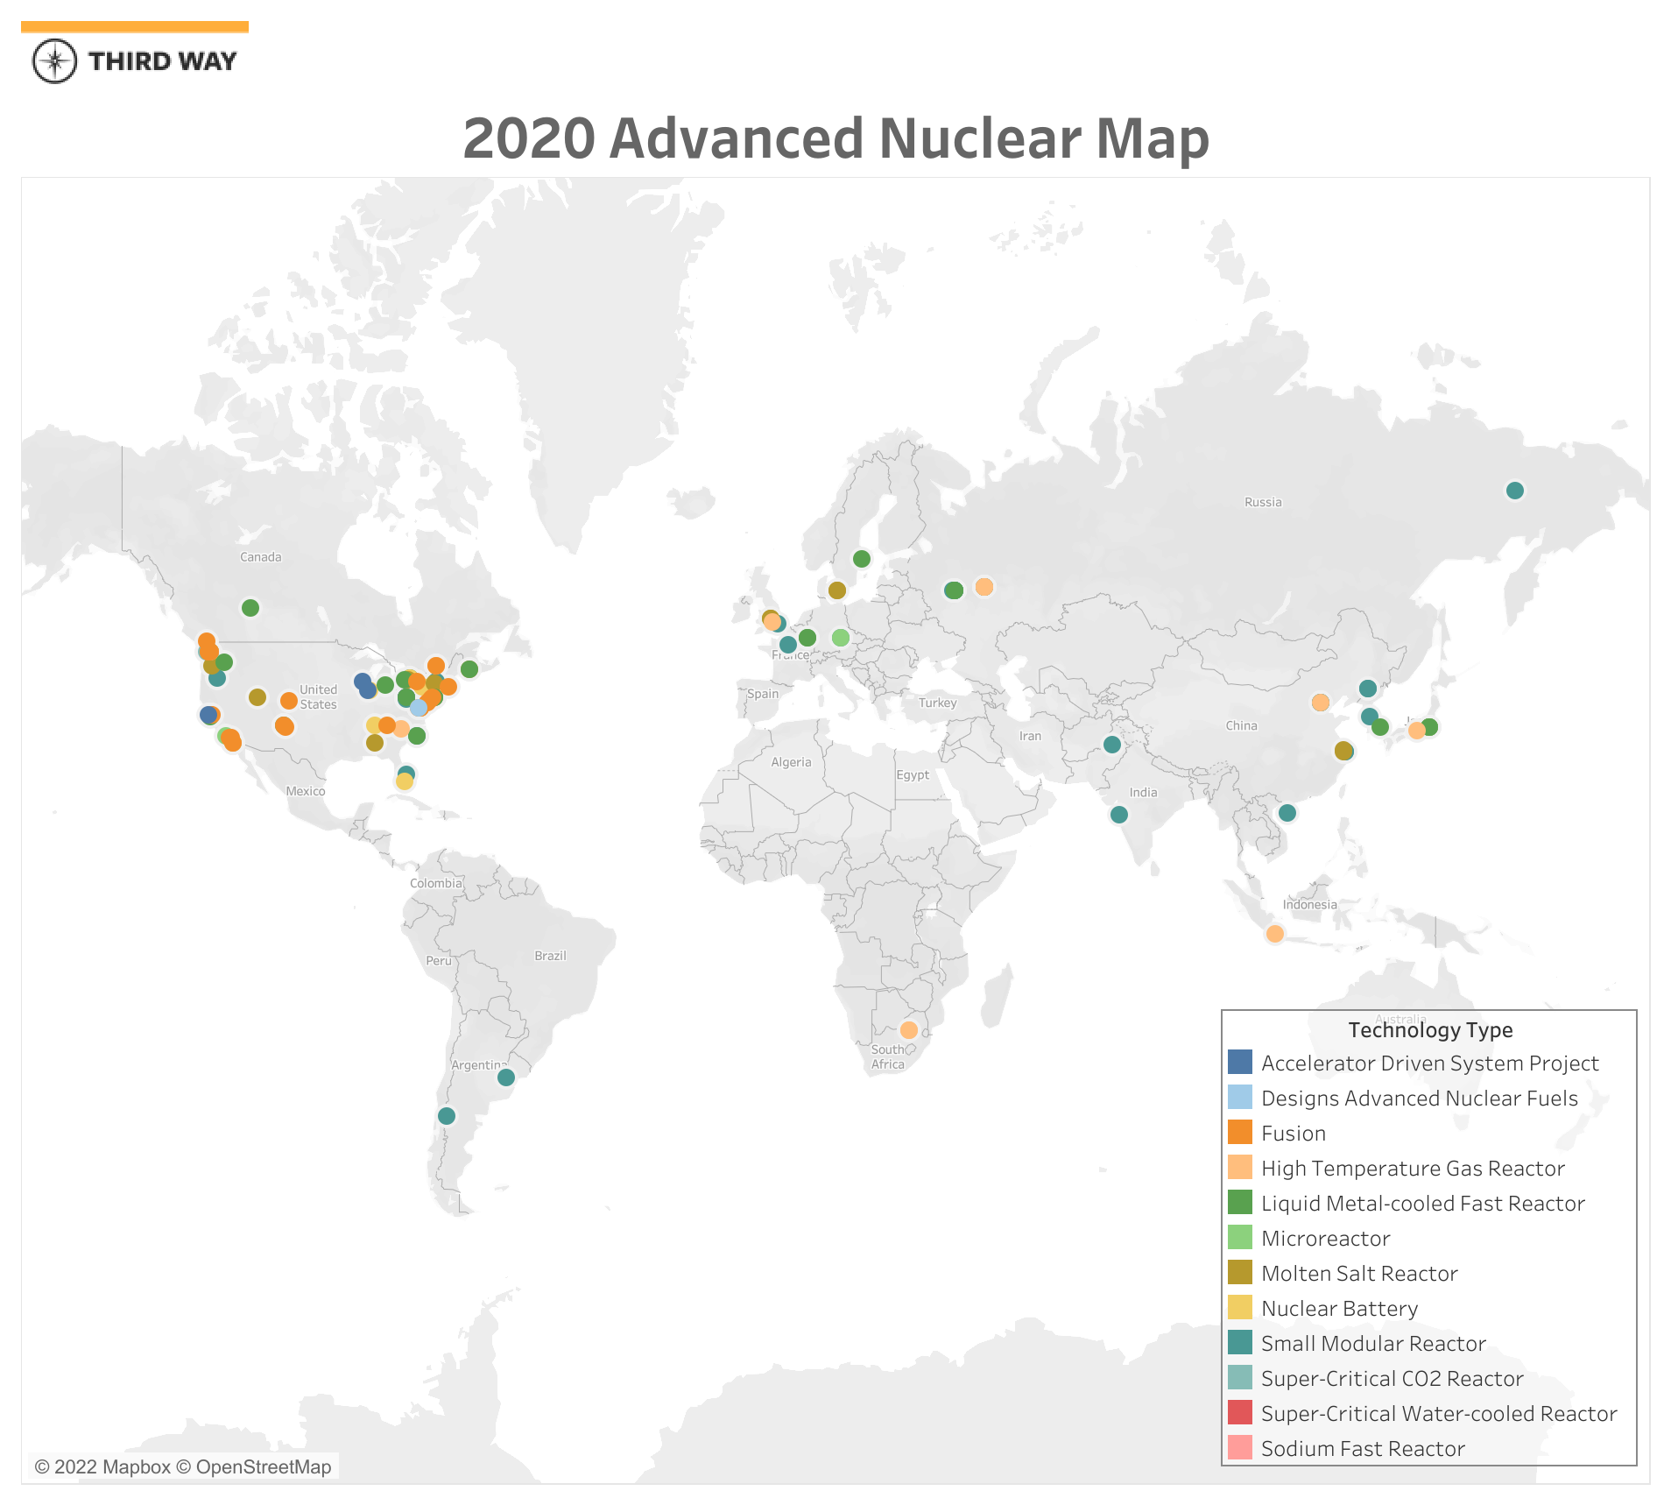

Slide 9
Challenges of Novel Fuel Wastes
Uncertainty regarding waste type, volume and timing of waste generation
No generic Waste Acceptance Criteria exists today
Insufficient characterization of the potential waste

Slide 10
Additional challenges for existing waste management organizations
Mandate
Funding
Status of the program

Slide 11
Nuclear Industry Collaboration
Used Fuel Disposal programs are needed, but likely only one in each Nuclear Nation
Strength of Nuclear is to share and learn from each other
Ensuring every country has robust disposal programs will strengthen nuclear safety around the world
Organizations like EDRAM have enabled participant nations to move forward

