Slide 1
The SINGLE partner who saves
ALL your products LOCALLY
Elodie ÖZEN - Grégoire SALVAN - Florine BARRY
November 2021 - Women Entrepreneurs 4 Good

Slide 2
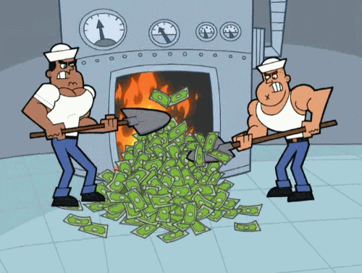
ALARMING WASTE vs POVERTY
€ 630M
Unsold non-food destroyed
by retailers per year in France*
12M people
BELOW THE POVERTY LINE**
* ADEME
** Post Covid Estimations

Slide 3
GAME CHANGER : New law
February 10th, 2020
Anti waste and Circular Economy LAW
>>>>>>>
Ban on destroying unsold items

Slide 4
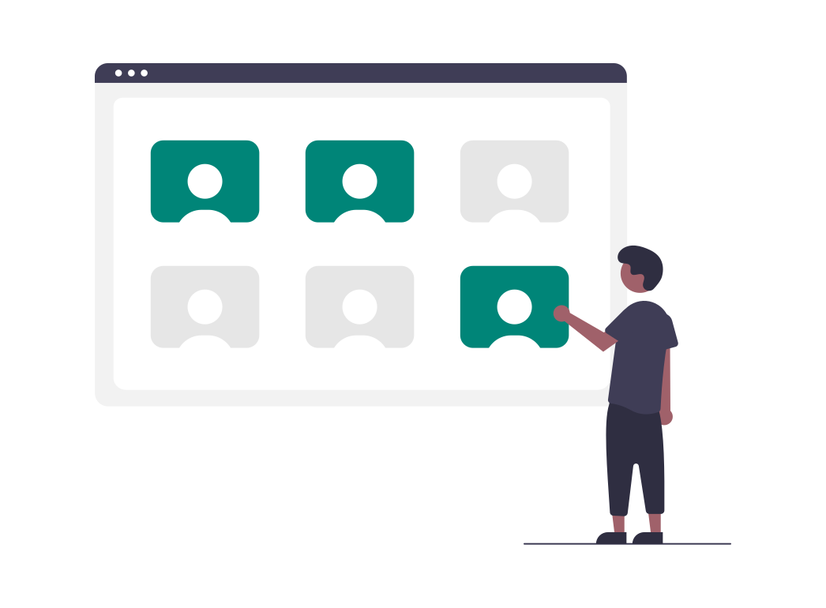
ISSUES RELATED TO WASTE RECOVERY
After meetings with several retailers, we observed 3 major issues related to the recovery of unsold products (vs destruction):
TIME-CONSUMING
NO SINGLE LOGISTIC SUPPLIER
LACK OF
TRACEABILITY

Slide 5
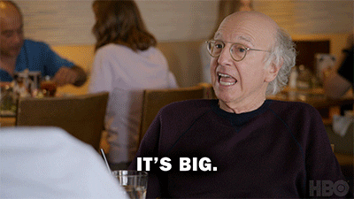
THE MARKET
FRANCE
630 M €
Of unsold products
Destroyed
In France
What about worldwide ?!
WORLDWIDE

Slide 6
OUR MAIN MARKETS
Sectors targeted by the new AGEC law (ban on destruction of products from January 1, 2022)
SPORTS & LEISURE
186,400 tons/year
are put on the market in France
TEXTILE & FOOTWEAR
600,000 tons/year
are put on the market in France
TOYS
75,000 tons/years
are thrown in France
Notes:
Source :
Sport :
Etude préalable à la mise en place de la filière REP ASL - Synthèse
TLC :
https://www.ecologie.gouv.fr/textiles-usages
JOUETS :
https://www.ecologie.gouv.fr/economie-circulaire-lancement-concertation-collecte-reemploi-et-recyclage-des-jouets-des-articles

Slide 7
VALUE PROPOSITION
With Umains, you can quickly save all of your products, by having only one interlocutor who ensures :
local reuse proposals
logistics (with solidarity and inclusive actors)
traceability

Slide 8
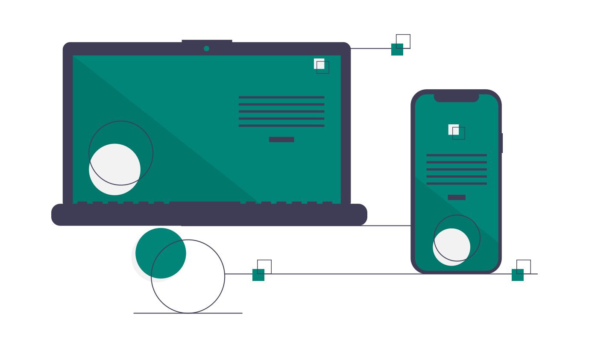
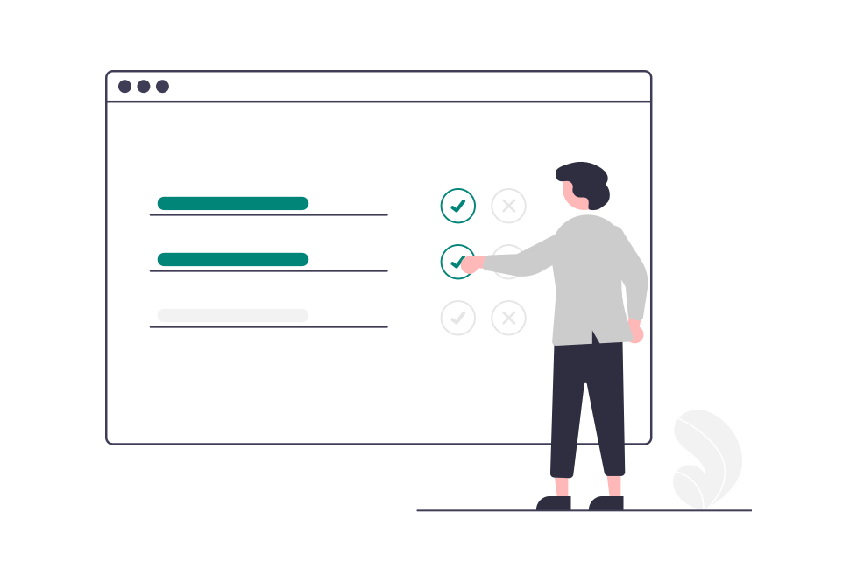
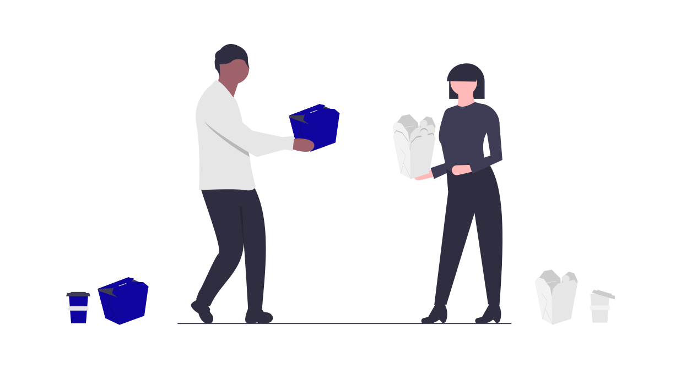
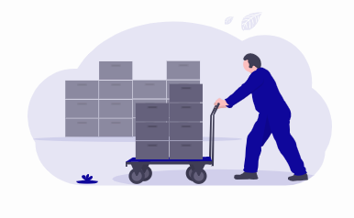
HOW IT WORKS
PRODUCTS TO BE SAVED
UMAINS SAVING SOLUTIONS REQUEST FORM
ALL POSSIBILITIES OF LOCAL REUSE
DONATION, UPCYCLING, RECYCLING
INCLUSIVE LOGISTICS

Slide 9
CURRENT SOLUTIONS ARE NOT TACKLING THE RIGHT CHALLENGES
Collection logistics provided
Solutions in France
Solutions all over the world
Collection logistics not provided

Slide 10
Income Model
DONATORS
BENEFICIARIES
COLLECTION PACKAGE
MATERIAL BOYBACK ( below market price)*
HANDLING PACKAGE
*The associations get the product for free
REUSE PACKAGE

Slide 11
GO TO MARKET & FIRST ACHIEVEMENTS
PARTNERS
FIRST CLIENTS
Our ecosystem is growing day by day :
We have already received saving solution requests for :
Companies employing people with disabilities or in rehabilitation
NGOs, Upcyclers, Recyclers
+80 Inclusive collectors
50 000 products
+400 Beneficiaries

Slide 12
FORECAST
 | 2021 | 2022 | 2023
Customers | 10 | 70 | 150
Number of products saved | 15 millions | 100 millions | 200 millions
TURNOVER | 150 K€ | 1 M€ | 2 M€
Expenses | 50 K€ | 400 K€ | 900 K€
EBITDA | (100 K€) | (600 K€) | (1 100 K€)

Slide 13
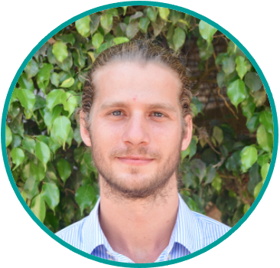
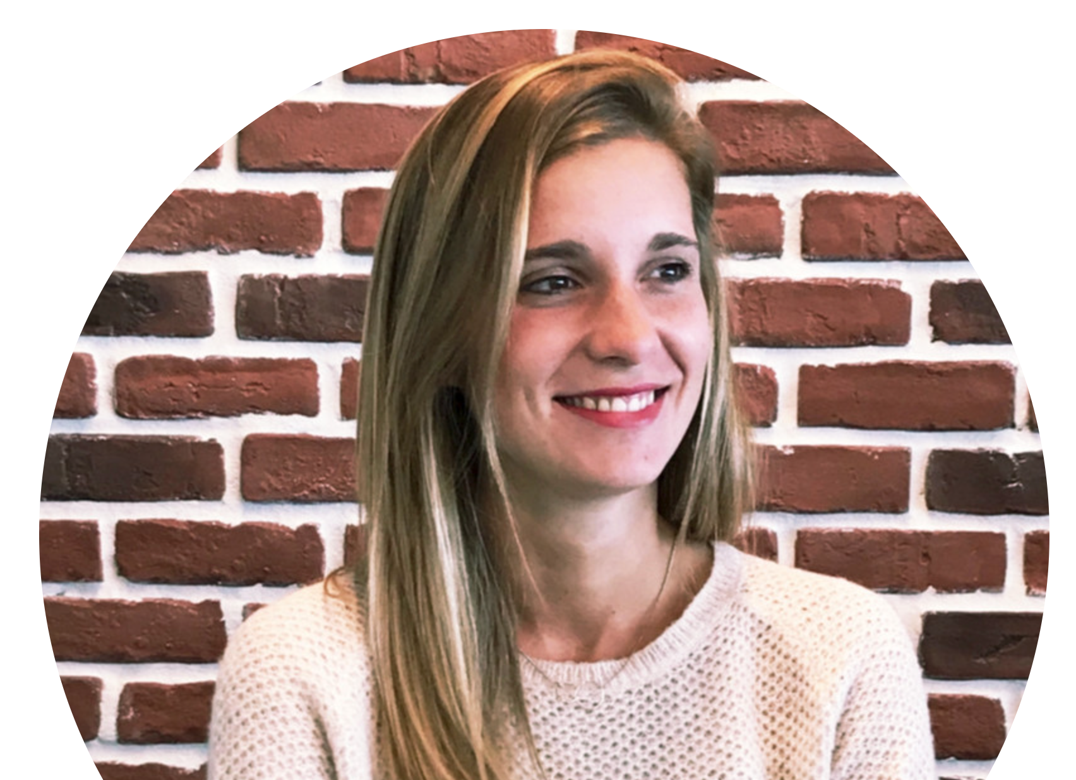
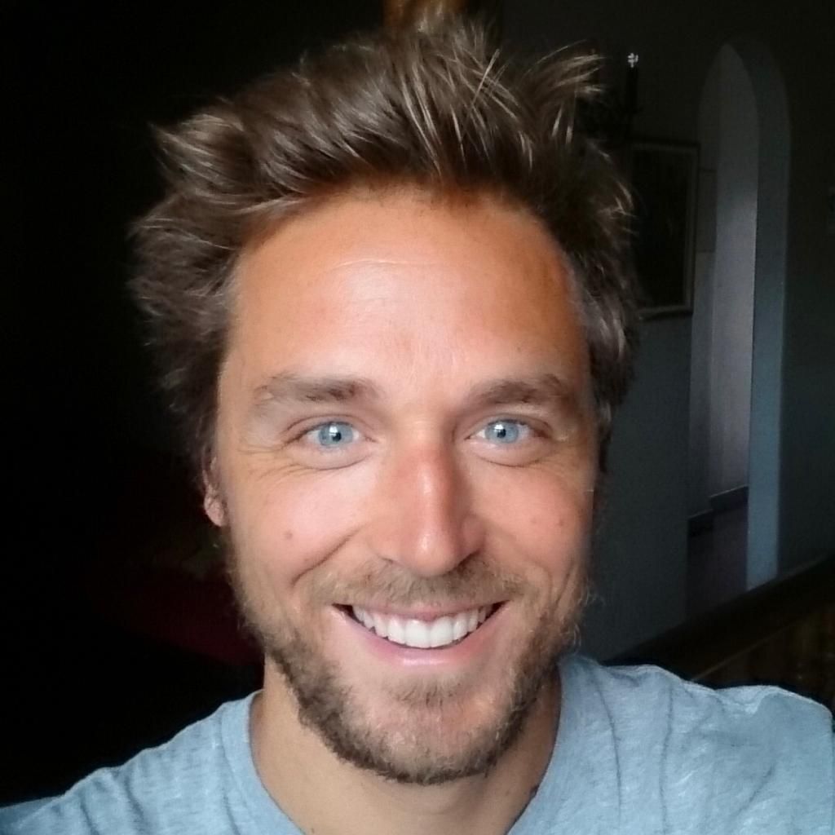
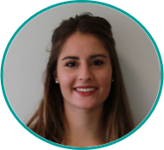
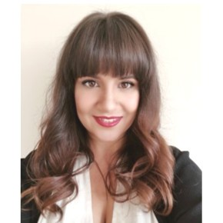
The Dream team & freelances
Elodie ÖZEN
Fondounder & CEO
Grégoire SALVAN
COO
Guilhem JEANNIN
Product Owner
Charlotte PENLOUP
Financial Partner
Florine BARRY
CMO
Catia RIBEIRO
Business Developer

Slide 14
They trust us & are waiting for us !

Slide 15
APPENDIX

Slide 16
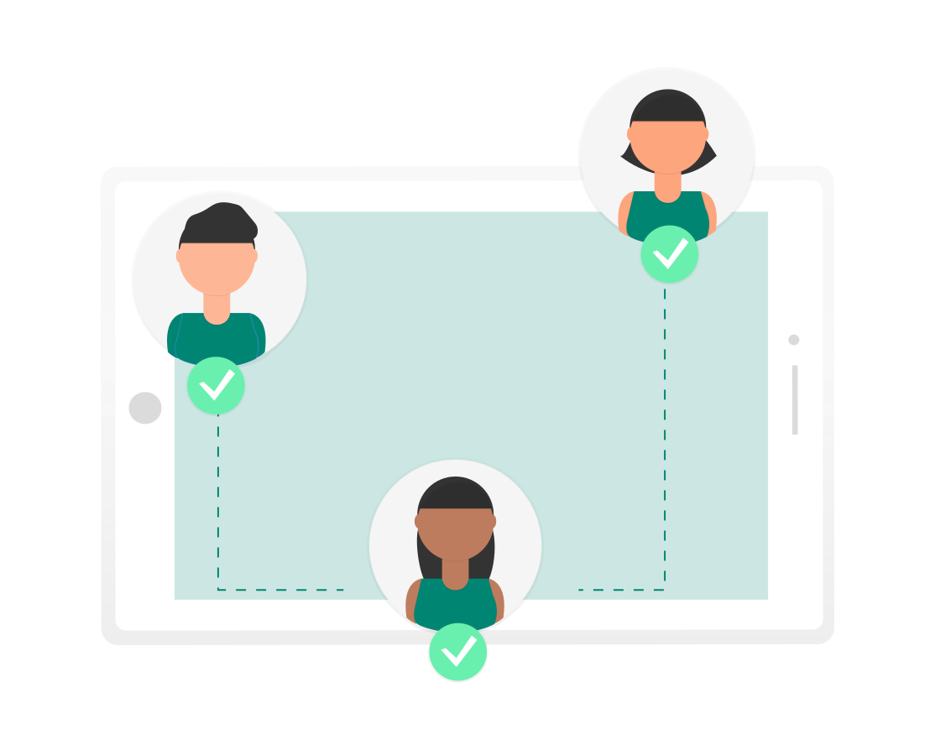
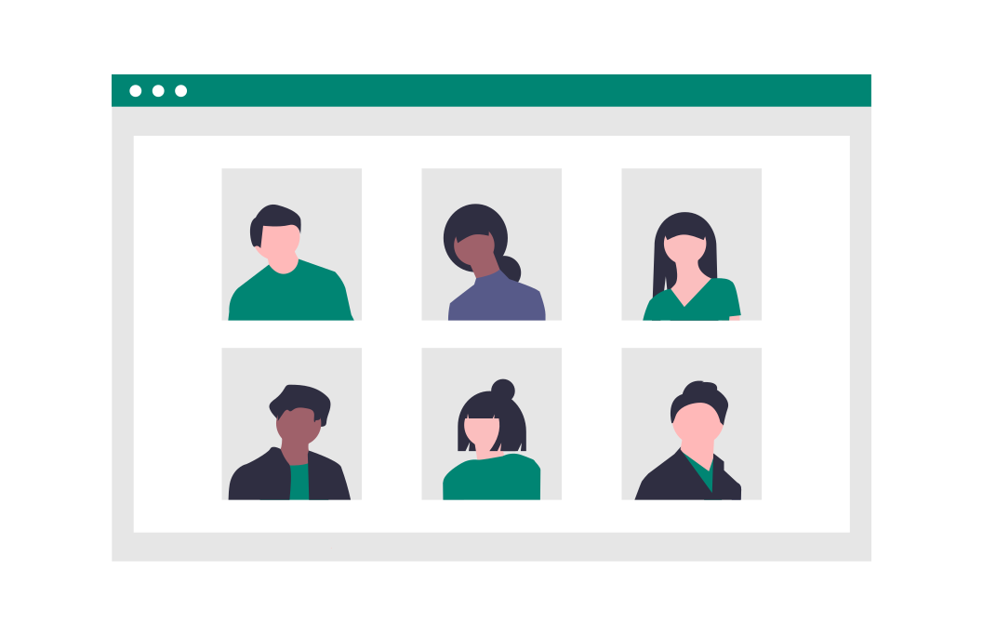
Our differentiation
Smart software :
meet supply and demand
in real time
100% of local valorization
Creation of inclusive and local jobs

Slide 17
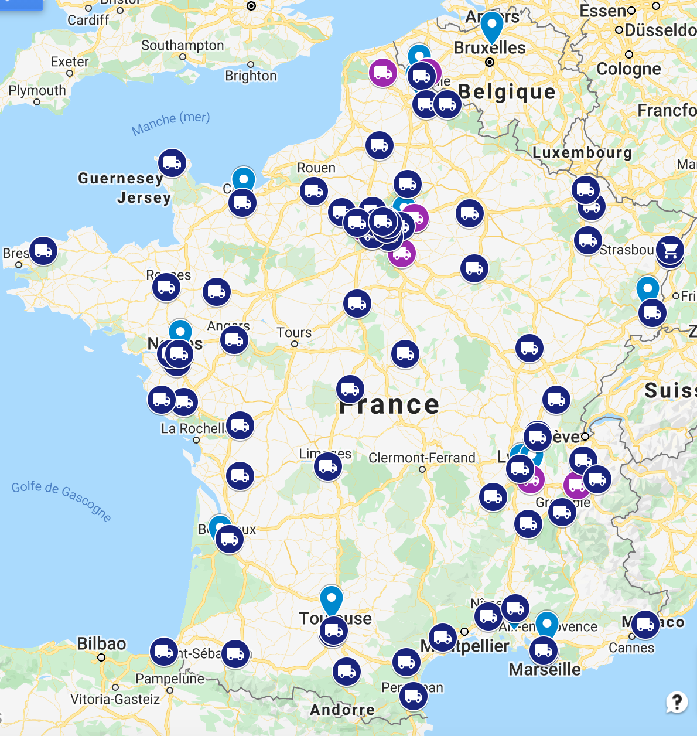
LOGISTICS COLLECTORS
Collectors

