Slide 1
GENTLE VEHICLES FOR LIVABLE CITIES

Slide 2
8,2 BILLION
dedicated to the purchase of green vehicles by La Poste, Amazon & DHL
29 MILLION VANS TO REPLACE IN EUROPE
1.5 MILLION
vans sold per year in Europe
95%
diesel
0,6 % electric
2030
restricted traffic in Europe's 247 largest cities
20 % CO2 emissions from road transport
50 % Fine particles in the city
58 MtCO2/year
POLLUTING NOISY BANNED

Slide 3
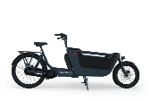
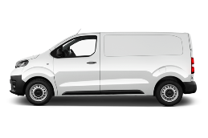
NO AVAILABLE
ALTERNATIVE
E-bike
Economical
Diesel & petrol
DIESEL & PETROL
PROGRESSIVE BAN
E-CARGO BIKE
CAPACITY/3
Clean
Capable
E-VAN
EXPENSIVE & EXPENDABLE
Electric
AVERAGE LIFETIME
IN YEARS
CO2 FOOTPRINT
IN TCO2eq
FINE PARTICLES
IN MG/KM

Slide 4
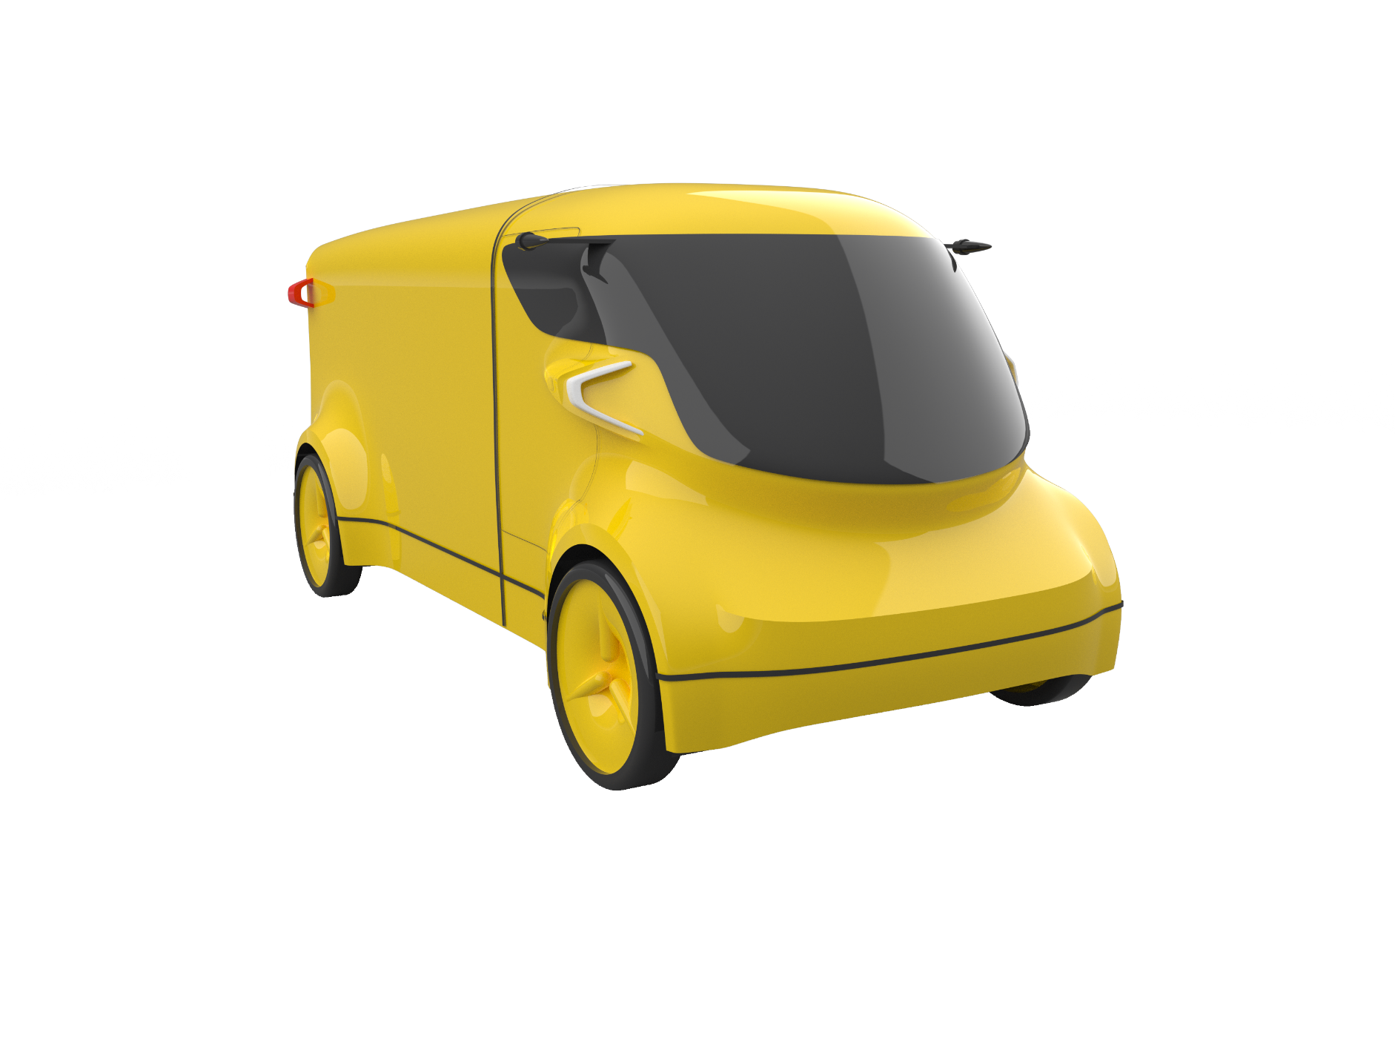
SIMPLY USEFUL
0 EMISSION
2 X LESS EXPENSIVE
3 X LESS CO2eq
COMPARED TO AN ELECTRIC VAN

Slide 5
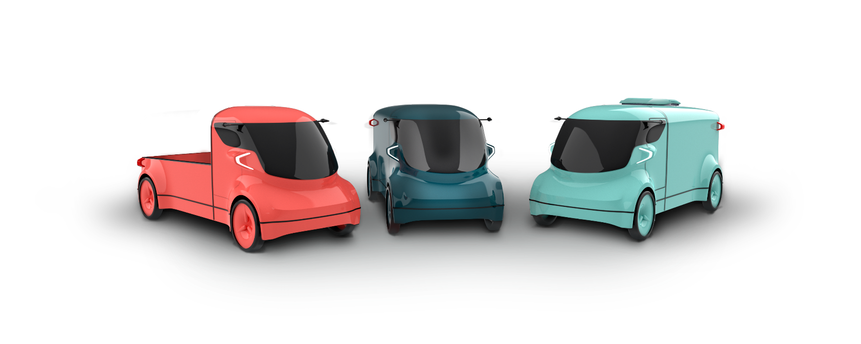
The
1 ton payload – 5 to 20 m3 volume – 80 kph ﬂanged
Instant charge & battery extension from 100 to 350 km
0 emission – Euro 7+ ready
CO2 footprint divided by 4 vs an e-van
Low maintenance, reparable, upgradable
From 20 000€ – without incentives
A green van at a cargo bike cost
pickup
box
refrigerated

Slide 6
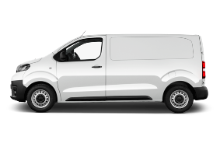
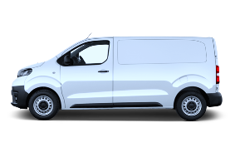
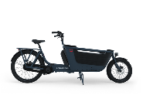
BENCHMARK
 |  | Cargo Bike | Diesel van | E-van | VIKE
ECONOMICAL | Purchase price (k€) | 6-14 | 25-35 | 40-70 | 20-35
 | Consumption (€/1000 km) | 2-4 | 120 | 48 | 14
 | Drivers (per 1000kg) | 3 | 1 | 1 | 1
 | Lifespan (years) | 3-5 | 15-20 | 10-15 | 15-20
GREEN | CO2 footprint (CO2eq) | 0,5-2 | 40 | 22 | 7
 | NoX emission | No | Yes | No | No
 | Emissions of fine particles including tyres (mg/km) | 0,5 | 50 | 40 | 8
CAPABLE | Payload (kg) | 150-300 | 1200 | 1100 | 1000
 | Usable volume (m3) | 1-2 | 5-6 | 5-6 | 5-6
 | Batteries (kWh) | 0,4 | X | 50-75 | 6-30
 | Urban autonomy (km) | 40 | 1300 | 300 | 80-350
 | Charging time - standard socket 10A (h) | 5 | X | 24-35 | 5-13

Slide 7
Patented propulsion
Efficient, modular, eco-designed, scalable
THE ELECTRIC REVOLUTION
2 LAYERS of clean Propulsion
3 TO 12 BATTERIES removable by hand
Assisted crankset <30km/h
Full electric
=> 80km/h
charge
swap
add
ECONOMICAL
Consumption divided by 2 Battery size tailored to needs Repairable by design
Predictive use & maintenance
ECO DESIGNED
Weight divided by 2 Regenerable battery modules Doubled service life Eco-sourced materials
SCALABLE
Combination of mature technologies ; majority of off-the-shelf parts ; compatibility with all battery chemistry ; modularity

Slide 8
A SOLUTION
FOR EVERY PRO
the offer
DELIVERY COMPANIES
managing B2B or B2C fleet
DIRECT MARKETING
Large Fleet Operators
LEASING
SERVICES
Insurance
Finance
Maintenance
Route Optimization
Battery Fleet Management
Batteries
BIG RETAILERS
with in-house fleets
SME
& Independent
PRODUCTION AND SALE OF CARBON CREDITS

Slide 9
Sponsors & Partners
A COLLECTIVE PROJECT
Nicolas Goursot
Engine Engineer
Ex Stellantis
Industrialization support
LOI logistics development & Testing
Dynamic testing and braking
Founder & Manager of the Electric Powertrains department @Stellantis OLI Carbon Neutral Vehicle Project Manager @Citroën
Co-development of the crankset
Chassis calculations
Modular, repairable batteries
Prospects et beta testers
Léon de Perthuis
Public Affairs
Ex Bona fidé
Board
10 years of consulting in institutional communication, influence and public affairs in mobility and urban planning.
Jean-Philippe Ollier
(Michelin)
Vice-president
Manufacturing Engineering
Catherine Le Floch
(Ex La Poste)
Director
Strategy & sales
Alexandre Meyer
(Ex Peugeot)
Designer
Industrial entrepreneur
Robert Zarader
(Bona fidé)
Economist
Spin doctor

Slide 10
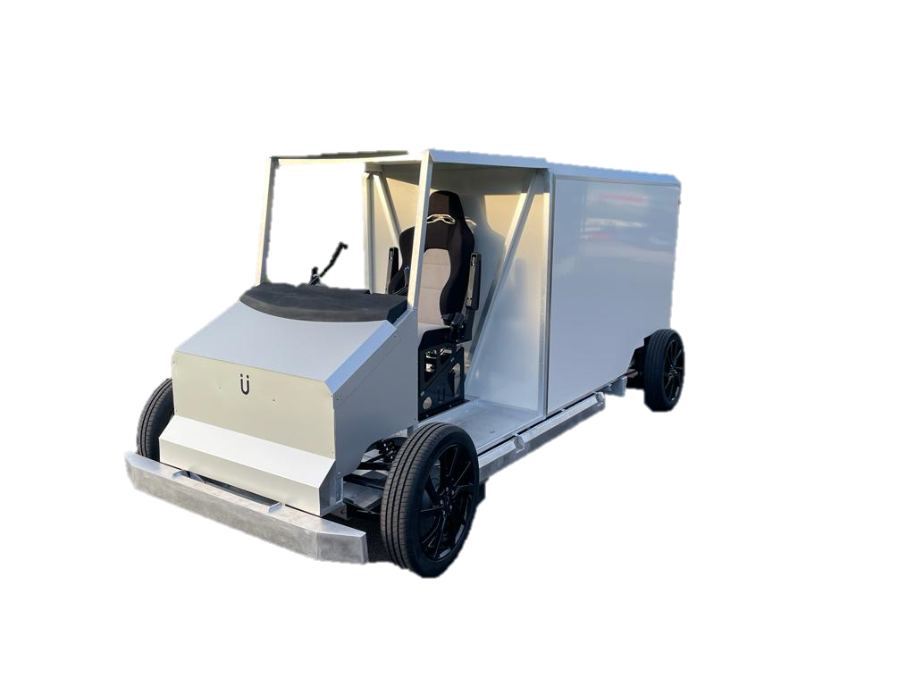
A PROGRESSIVE PATH
Q1 24
Serie A
Q2 25
Serie B
Q2 26
Serie C
Sept 23
Gen1 VIKE
Nov 25
Gen2 VIKE
March 26
Pre-serie
September 27
Mass production
December 28
Capacity doubling
VIKE N1
POC
Prototypes
N1 KS
Development
Prototypes
Homologation
Small production
Industrialization
Mass production
1 unit
50 units
1 500 units
5,000 then 10,000 units

Slide 11
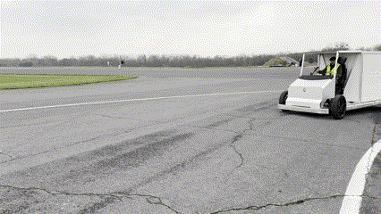
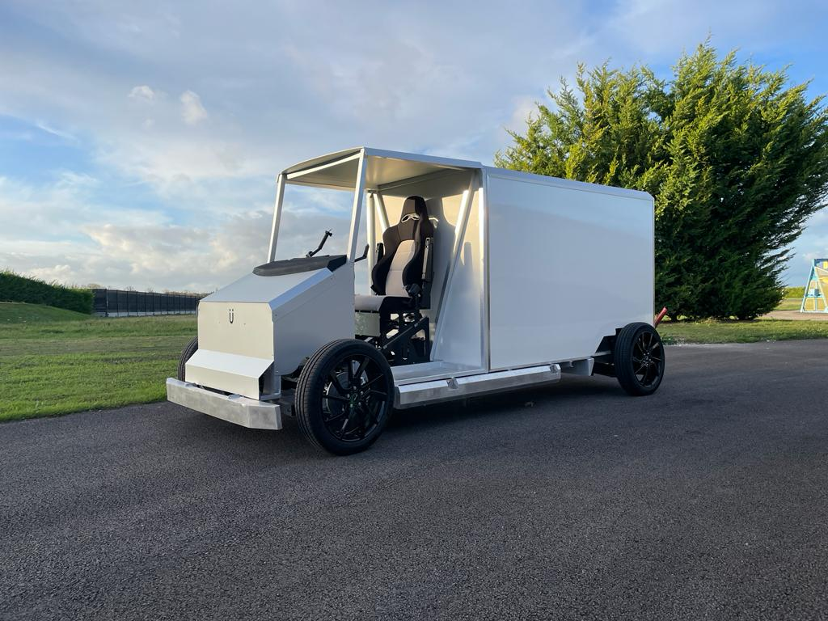
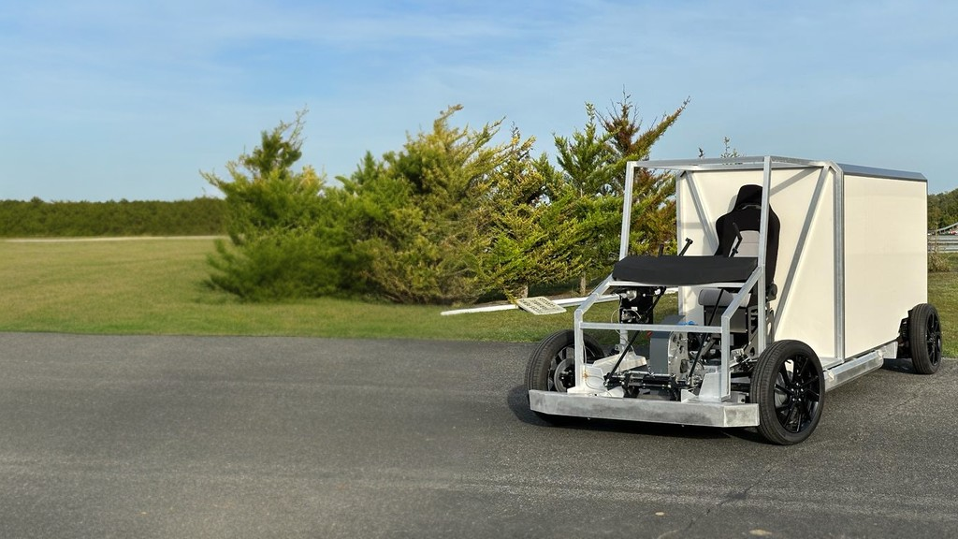
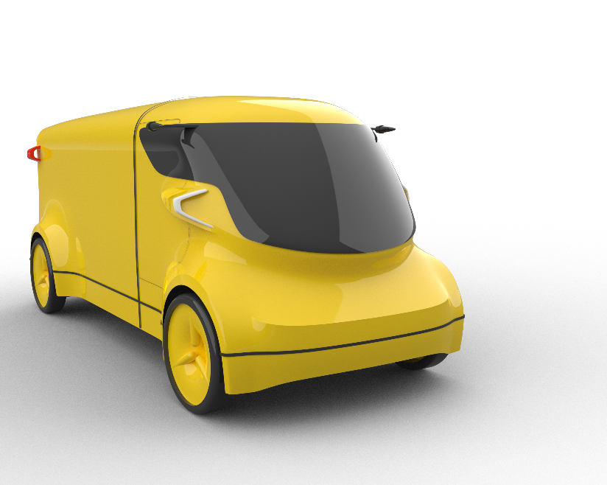
A CONCRETE AMBITION
DYNAMIC POC

Slide 12
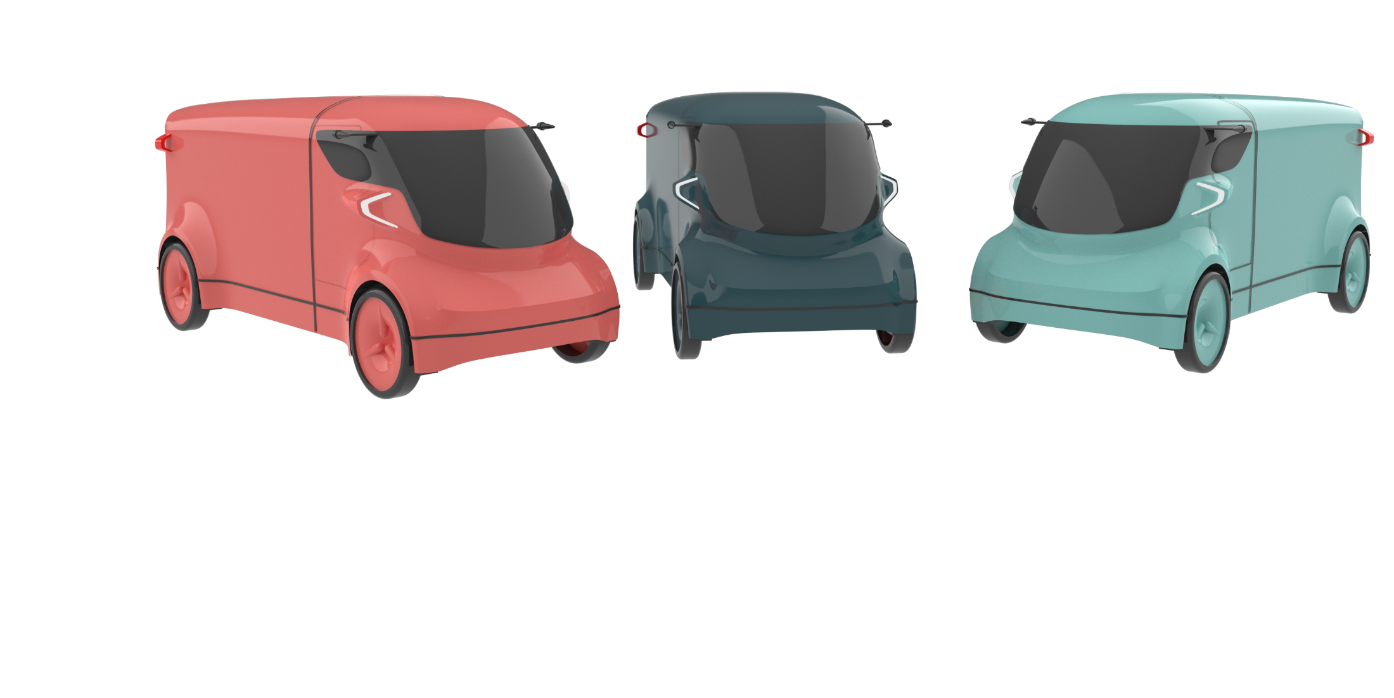
GENTLE VEHICLES FOR LIVABLE CITIES
hello@umotion.tech

