Slide 1


Diagnose Better. Treat Smarter.

Slide 2


The Challenge
Diagnosing Microsatellite Instability - MSI,
a tissue-agnostic predictive biomarker
A crucial insight in guiding therapy decisions towards immunotherapy
Recommended to be screened in newly diagnosed cancer patients
  ~ 13 millions patients eligible
Applied in hereditary cancer predisposition screening
  ~200 millions people at risk (Lynch Syndrome), only 5% under surveillance
6x increase in testing needs
Current standard tests fall short (PCR, IHC,…) and are not sufficiently accurate*
2
* As shown in André et al. NEJM (2025), 391, 21

Slide 3
Our Ambition
Tackling critical gaps in MSI cancer care
Early Stage
Cancer Stage
Treat
ment
Early detection of familial predisposition to MSI cancers
MSI diagnosis in patients with a cancer
Therapeutic response prediction and monitoring
Patient journey
Lynch syndrome
CMMRD syndrome
Pan-cancer
Tissue & liquid biopsies

Slide 4

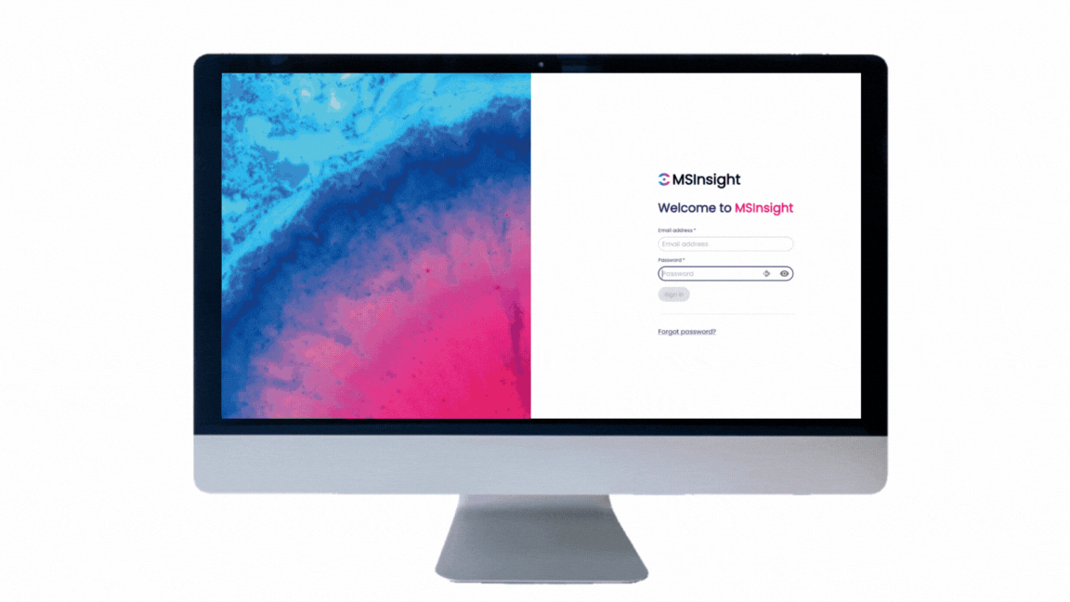




The Solution
MSIcare, a novel bioinformatics platform designed to accurately detect MSI in patients from genomic data
Leveraging NGS genomic data with best-in-class algorithms and AI solutions
Enlarged diagnostic scope, with an improved precision
Streamlined workflow with an end-to-end cloud-based interface
Based on 20 years of data collection and research expertise in the field
Not yet CE-marked
For Research Use Only, not for diagnostic use

Slide 5


They trust us
Chosen by leading research and clinical partners
MD Anderson
Cancer Center

Slide 6

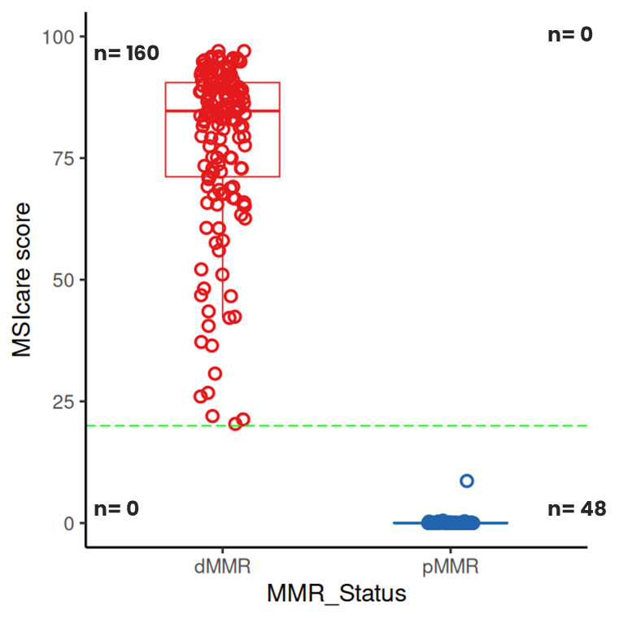
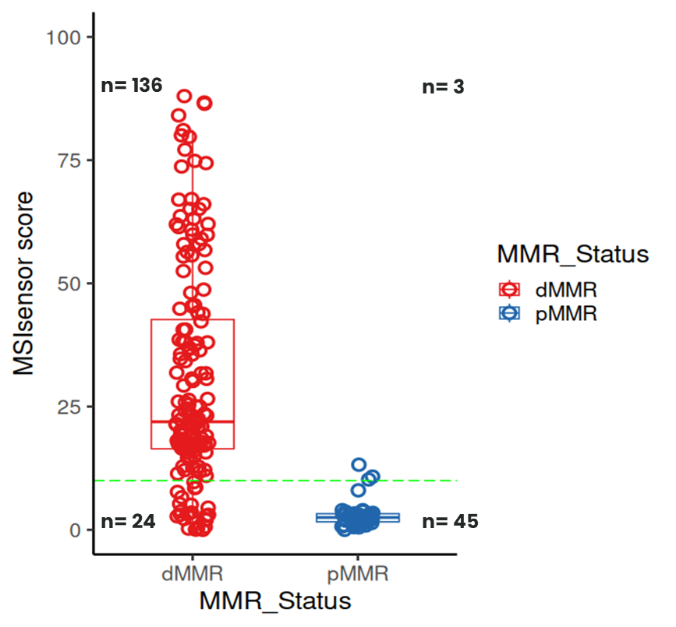
Proven Performance (Sample Results)
MSIcare shows superior performance compared to existing bioinformatic solutions
Colorectal cancer cohort
Additional validation conducted across multiple cancer types**
Sensitivity: 100%
Specificity: 100%
Sensitivity: 85%
Specificity: 93%
*Full results published in Ratovomanana et al. Gastroenterology, 2021, Patented method WO2022162162
** Publications in preparation focusing on validation in gastric, endometrial, small intestine cancers, and glioblastoma. Data under embargo.

Slide 7


MSIcare’s Features
Unlocking new insights from your raw data
MSICare Unique Strenghts
✔ User-friendly, no bioinformatics expertise required
✔ Automated workflow – drag & drop, get results fastly
✔ Platform-agnostic – works with WES, targeted panels, or custom designs
✔ Integrated data quality control
✔ No matched normal sample required
✔ Robust even with low tumor content
Your raw genomic data
(FASTQ, BAM)
Full comprehensive report
Designed to meet CE-IVD requirements

Slide 8


Collaboration Opportunities
Partner with MSInsight to advance genomic diagnostics
NGS labs
Clinicians,
researchers, biotech
Pilot MSIcare in your lab – deploy and test locally
Seamless integration – with our expert support
Optimize your panels – verify and enhance MS coverage
Investigate on challenging cohorts – retrospective or rare cases, DNAseq, RNAseq
Enhance your studies – support for preclinical & clinical trials
Advance discoveries – leverage MSIcare for biomarker research
Drug response prediction - access comprehensive models for predicting therapeutic response

Slide 9





Optimizing Your Panel for Accurate MSI Detection
Step-by-step support to integrate MSIcare into your workflow
1. Share your bed file
2. Identify MS distribution
3. Select relevant MS
4. Perform a downsampling from private WES data
5. Provide comprehensive results and suggest panel optimization
Notes:
4’20’’

Slide 10


Get your MSI identification with our end-to-end, cloud-based software
Flexible Delivery Options
Cloud Service
On-Premise Integration
Integrate our bioinformatic pipelines into your own system
Whether you prefer a turnkey cloud software or a locally integrated solution, we accommodate both – whichever suits your data governance and workflow.

Slide 11



Case Study
Optimizing MSI Detection via in-house NGS Panel Design
Client description
Challenge
Insights
Outcome
A French university hospital wanted to integrate MSI testing into its NGS workflow. Using an in-house panel, they needed to confirm whether the design was suitable for accurate MSI evaluation.
Selecting the right microsatellite markers is complex, and internal validation was limited by the small number of available samples.
MSInsight analyzed the client’s BED file to map microsatellites, identified the most informative markers using our expertise in mutation-prone loci, and ran downsampling simulations on our private reference exome cohort to replicate the client’s sequencing conditions.
The study guided the hospital to optimize its panel for MSI detection, leading to the addition of 40 microsatellite markers and a stronger NGS assay for diagnostics and research. MSIcare has been deployed locally.

Slide 12
Case Study
Evaluating MSI in challenging cohorts
Client description
Challenge
Insights
Outcome
A leading comprehensive cancer center sought support to better characterize Microsatellite Instability (MSI) in sarcoma patients, where standard methods lacked sensitivity.
The challenge was to leverage NGS data to identify MSI as a clinically relevant biomarker in sarcoma, and to benchmark detection accuracy against conventional diagnostic approaches.
MSInsight processed genomic and anonymized clinical data using MSIcare. Exome sequencing data (BAM files) were analyzed locally, enabling streamlined and standardized MSI detection.
Our team delivered:
1. Reliable MSI classification across sarcoma samples
2. Comparative benchmarking against standard diagnostic methods

Slide 13







MSInsight at a glance
Located in Paris, France
Built by a team of experts in genomic, bioinformatic, and MSI cancer research
Dedicated to advancing MSI diagnostics for precision oncology
Based on the work of a worldwide-renowned research team in MSI cancer genomics
Arnaud Cutivet, PhD
CEO
Toky Ratovomanana, PhD
CTO
Alex Duval, MD-PhD
Scientific advisor
Florence Renaud, MD-PhD
Medical advisor
Ada Collura, PhD
Scientific advisor

Slide 14

Watch The Story Behind MSInsight
14

Slide 15

Interested to get a demo ?
Interested in collaboration ? Let’s talk
Arnaud Cutivet, PhD
CEO
ac@msinsight.tech
Ali HAFIZI
Partnerships Officer
ali@msinsight.tech

