Slide 1
Roadmap
March 2022

Slide 2

Who said this?
"Yes, excessive automation … was a mistake.
To be precise, my mistake.
Humans are underrated…"
Humans are key in factory performance!

Slide 3



TEEPTRAK adresses three main pain points
90% of the performance losses are related to the context
and not the machine itself thus requiring the operators’ input
By not monitoring precisely performance & associated losses,
industrials are negatively impacting productivity between 5% to 30%
Important workforce is lost in data collection, consolidation, analysis and reporting representing easily over millions per year for large factories

Slide 4
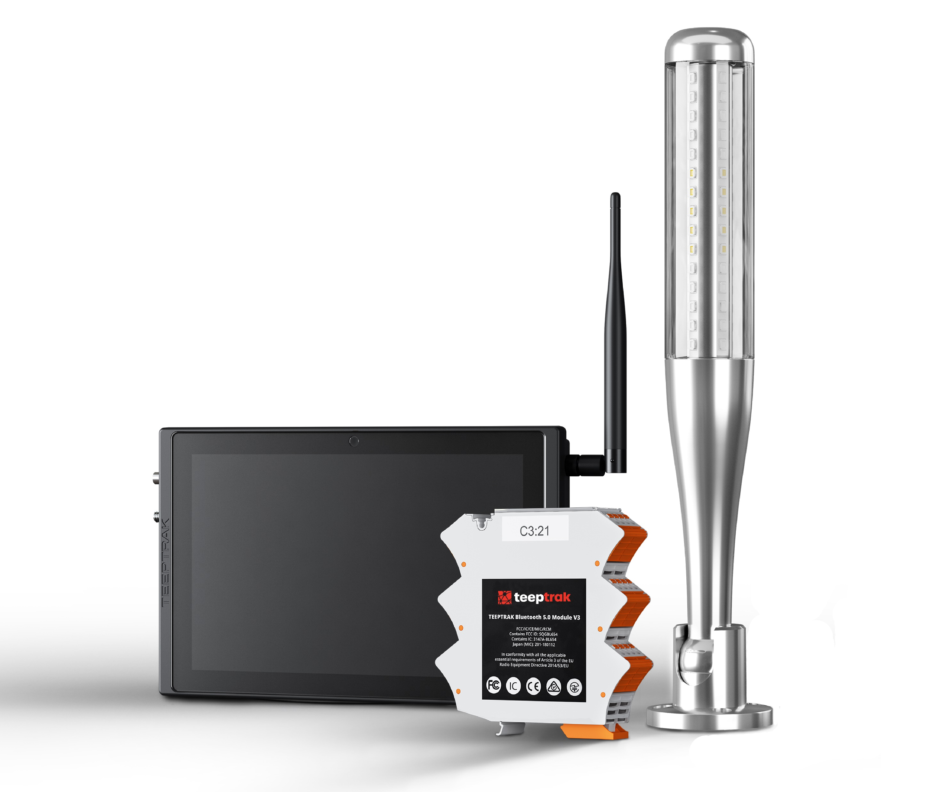
What TEEPTRAK do?
We design, build and distribute « ready-to-use »
solutions to increase industrial performance

Slide 5
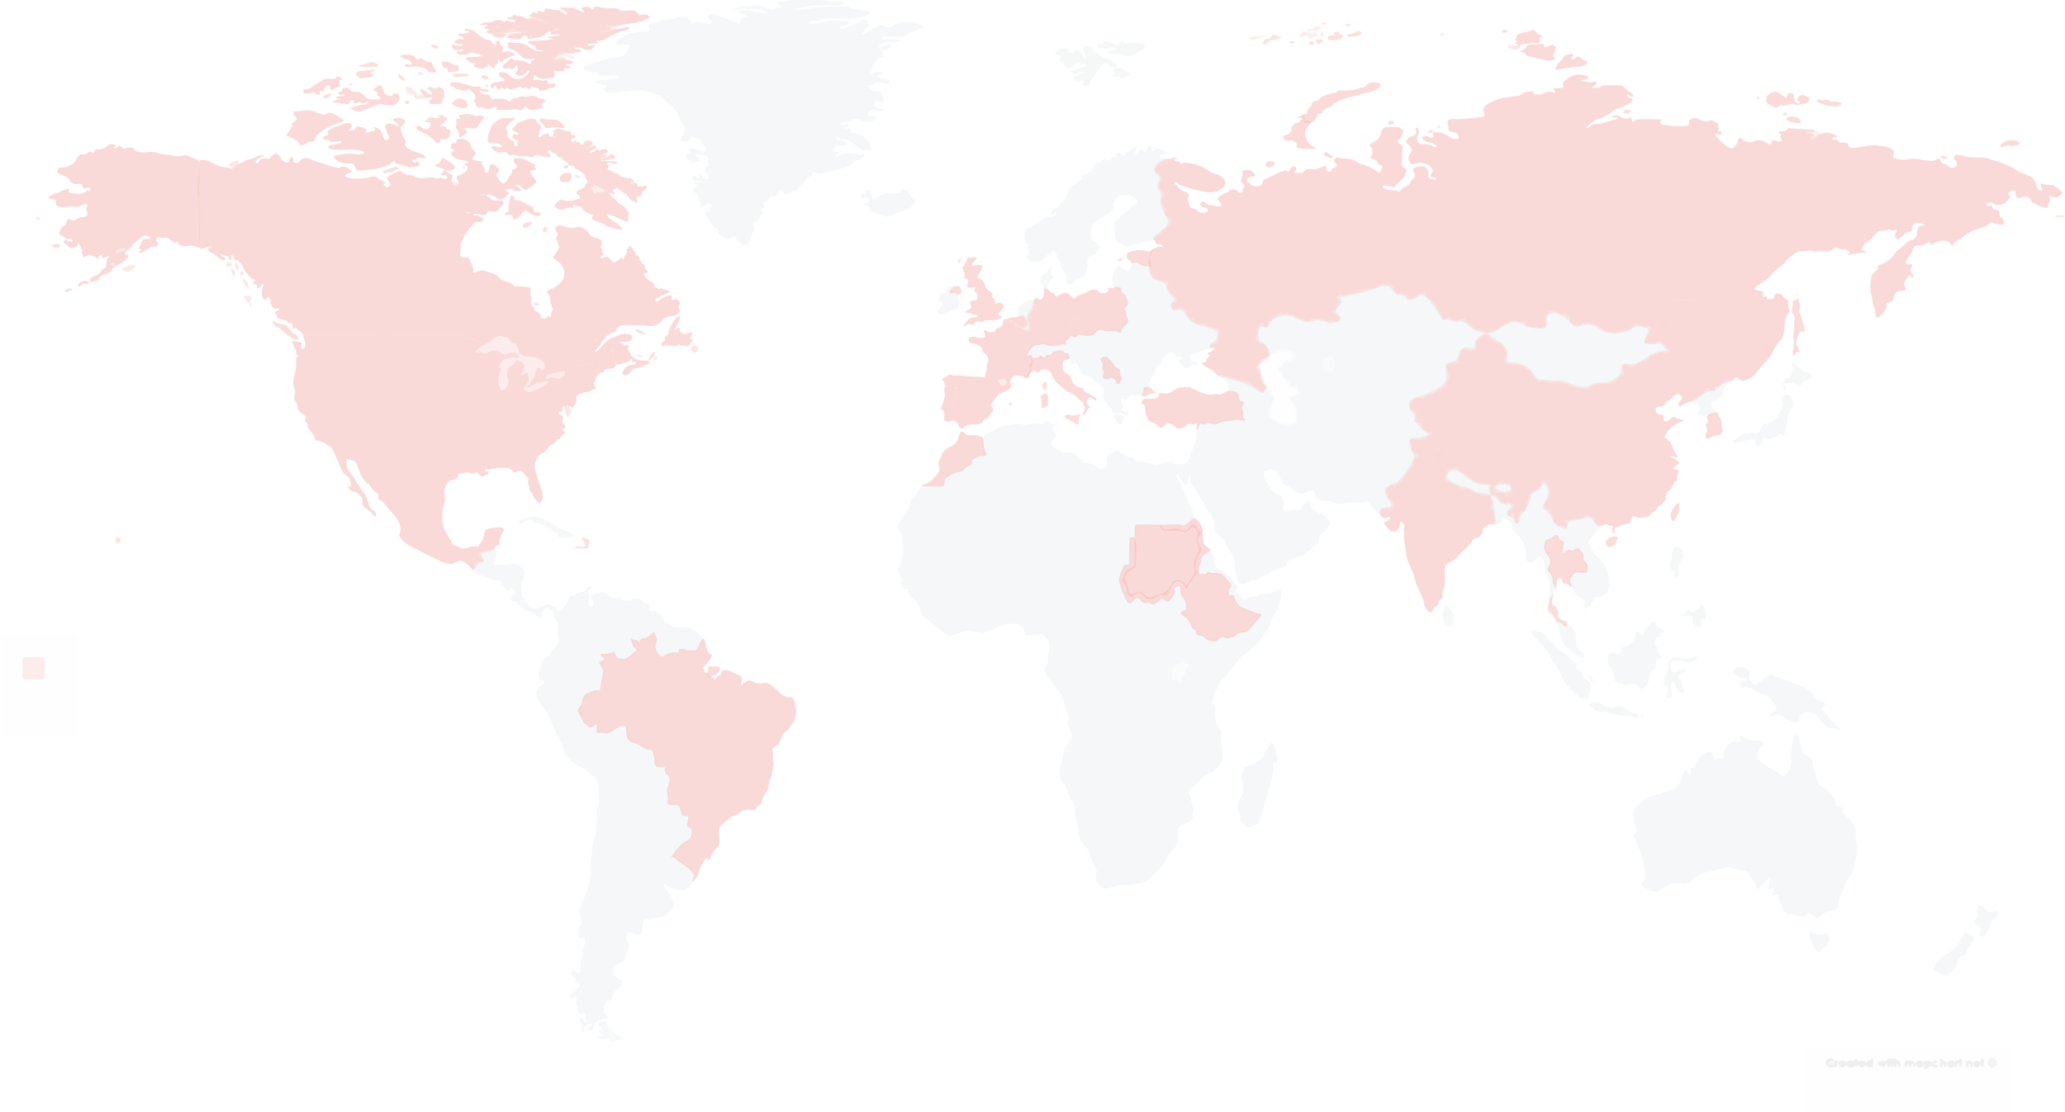






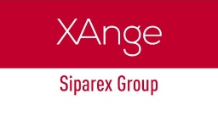
TEEPTRAK today
1
2
3
4
Founded in 2014
On the market
since 2016
35 employees
4 offices
France (2016)
China (2019)
Belgium (2022)
Netherlands (2022)
Growth
200% YOY
Over 3.5 million raised

Slide 6



Overview of funding rounds
COVID
Cores products development
Seed A
Seed B
Grow the France market, profitable excl. R&D
Enter the Chinese Market, make it profitable
Global scale-up
Serie A
Advanced analytics (Machine Learning)

Slide 7


Objectives of this €5.0M A Series round
Open offices / build or strengthen internal and external sales team in North America, Europe and Asia
➔ Benelux (ongoing), Spain (ongoing), Germany & Eastern/Central Europe (Q3 2022) and USA (Q3 2022)
Continue developing key partnerships and distribution networks (Middle East)
Continue developing products portfolio: leverage growth and upselling opportunities
Launch marketing campaigns, invest in communication: get known globally!
Ability to grab new investment/development opportunities
Increase Data Science, R&D and Development teams: Improve current products, launch energy monitoring
Connect to your industrial potential

Slide 8
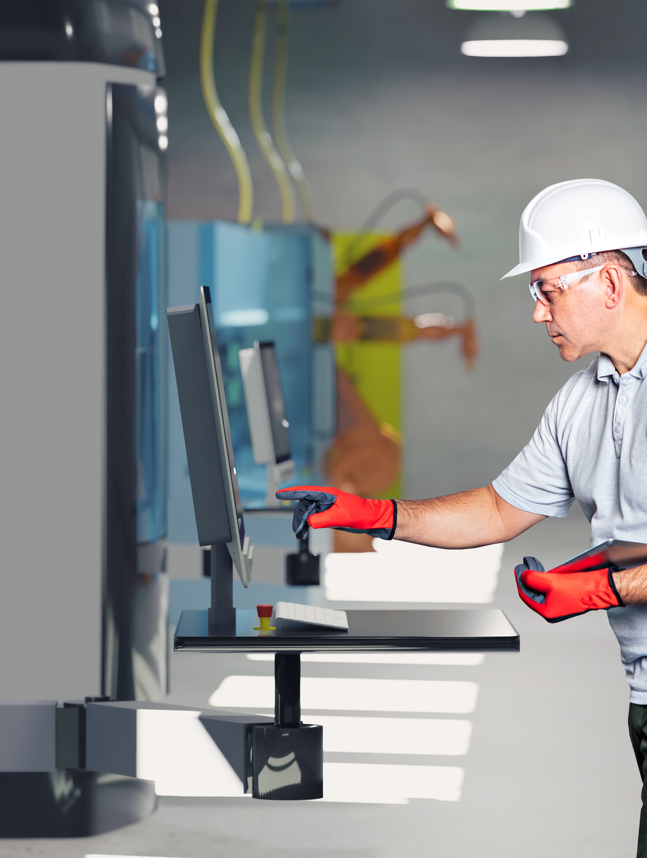
Current Products
and Technologies

Slide 9
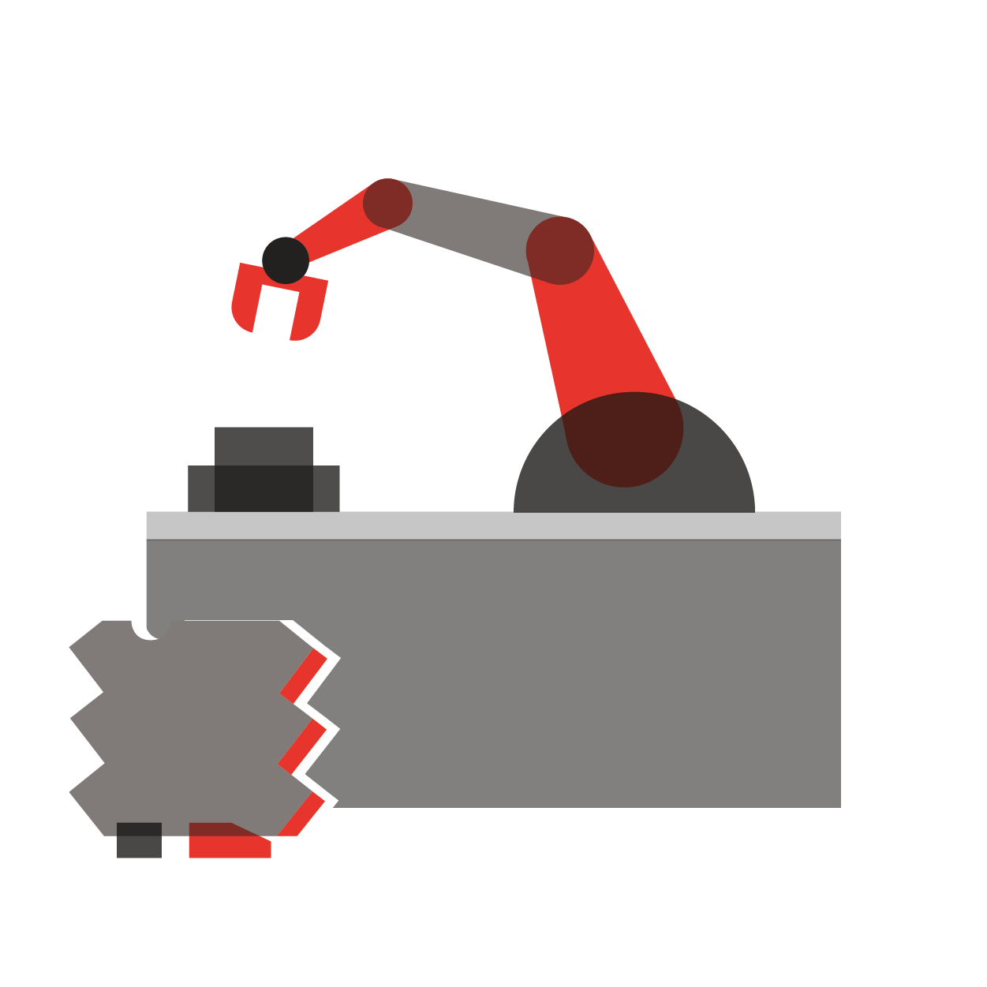



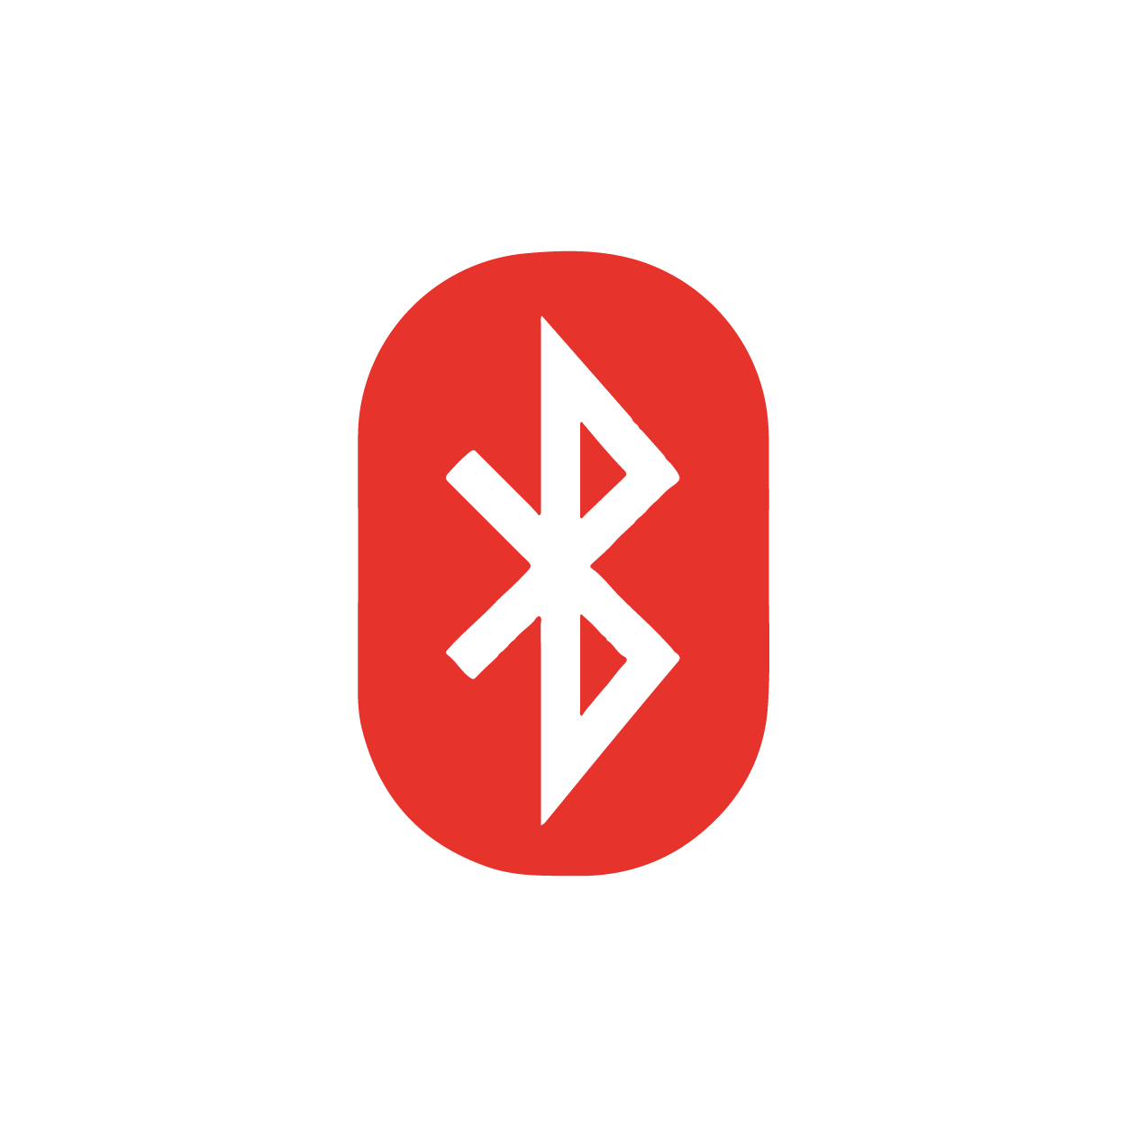

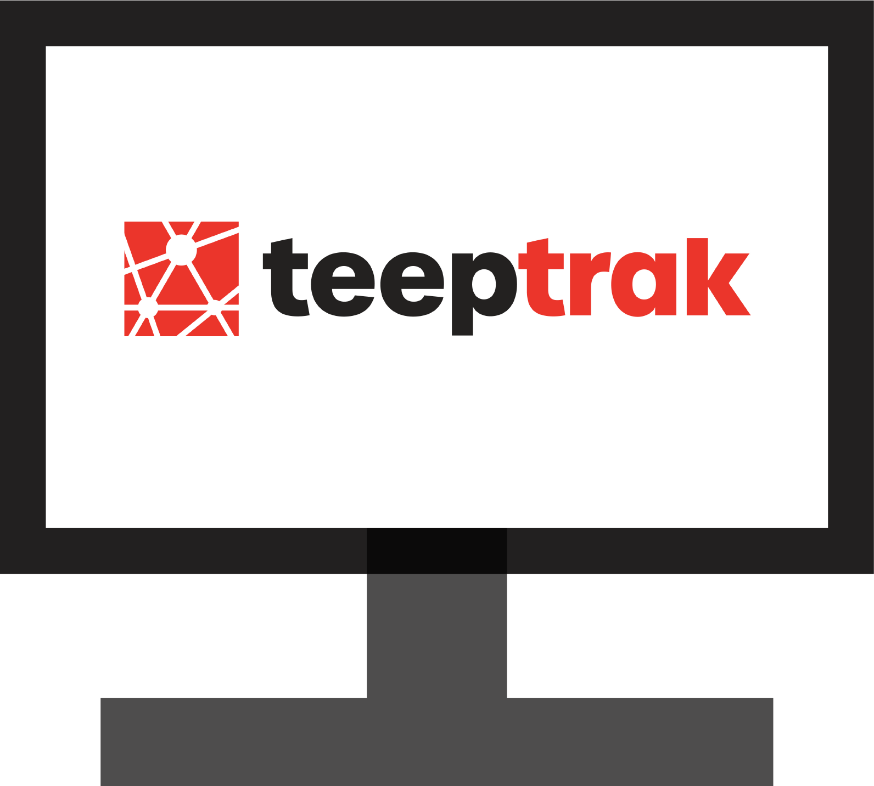




4 core Performance Monitoring Solutions
A
B
C
Data acquisition
with our module
Rugged industrial tablets
Web-based platform
Data analysis
Performance machine
Manual tasks
SSL Encrypted
Quality
Process control

Slide 10




Fast “Plug & Play” integration
1
2
3
4
Signal Reception
Through an external sensor or by an electrical signal
20 minutes
Module Connection
Connect the module to the sensor / signal
10 minutes
Tablet Connection
Attach the tablet to the operator station
10 minutes
Website Configuration
Set up “virtual factory”
on the website
10 minutes

Slide 11

TEEPTRAK competitive advantages
« Big players »
« Specialists »
« Direct
competitors »
Price (TCO)
Software quality / maintainability
Ease of Deployment
Shop Floor Experience
(ease of use for production teams)
Retrofitting Capabilities
(old machines, non PLC equipped)
Integration Costs
Low
High
Medium/High
Low/Medium
Product Scalability
High
None
None
Variable
Big players: Large MES manufacturers (Dassault Systems, Schneider Electric, etc. )
Specialists: Custom IT developments by local/national firms (Astree Software, Ordinal Software)
Direct competitors: Other “tablet” based systems (Lean Cure, Worximity, Usitab)

Slide 12
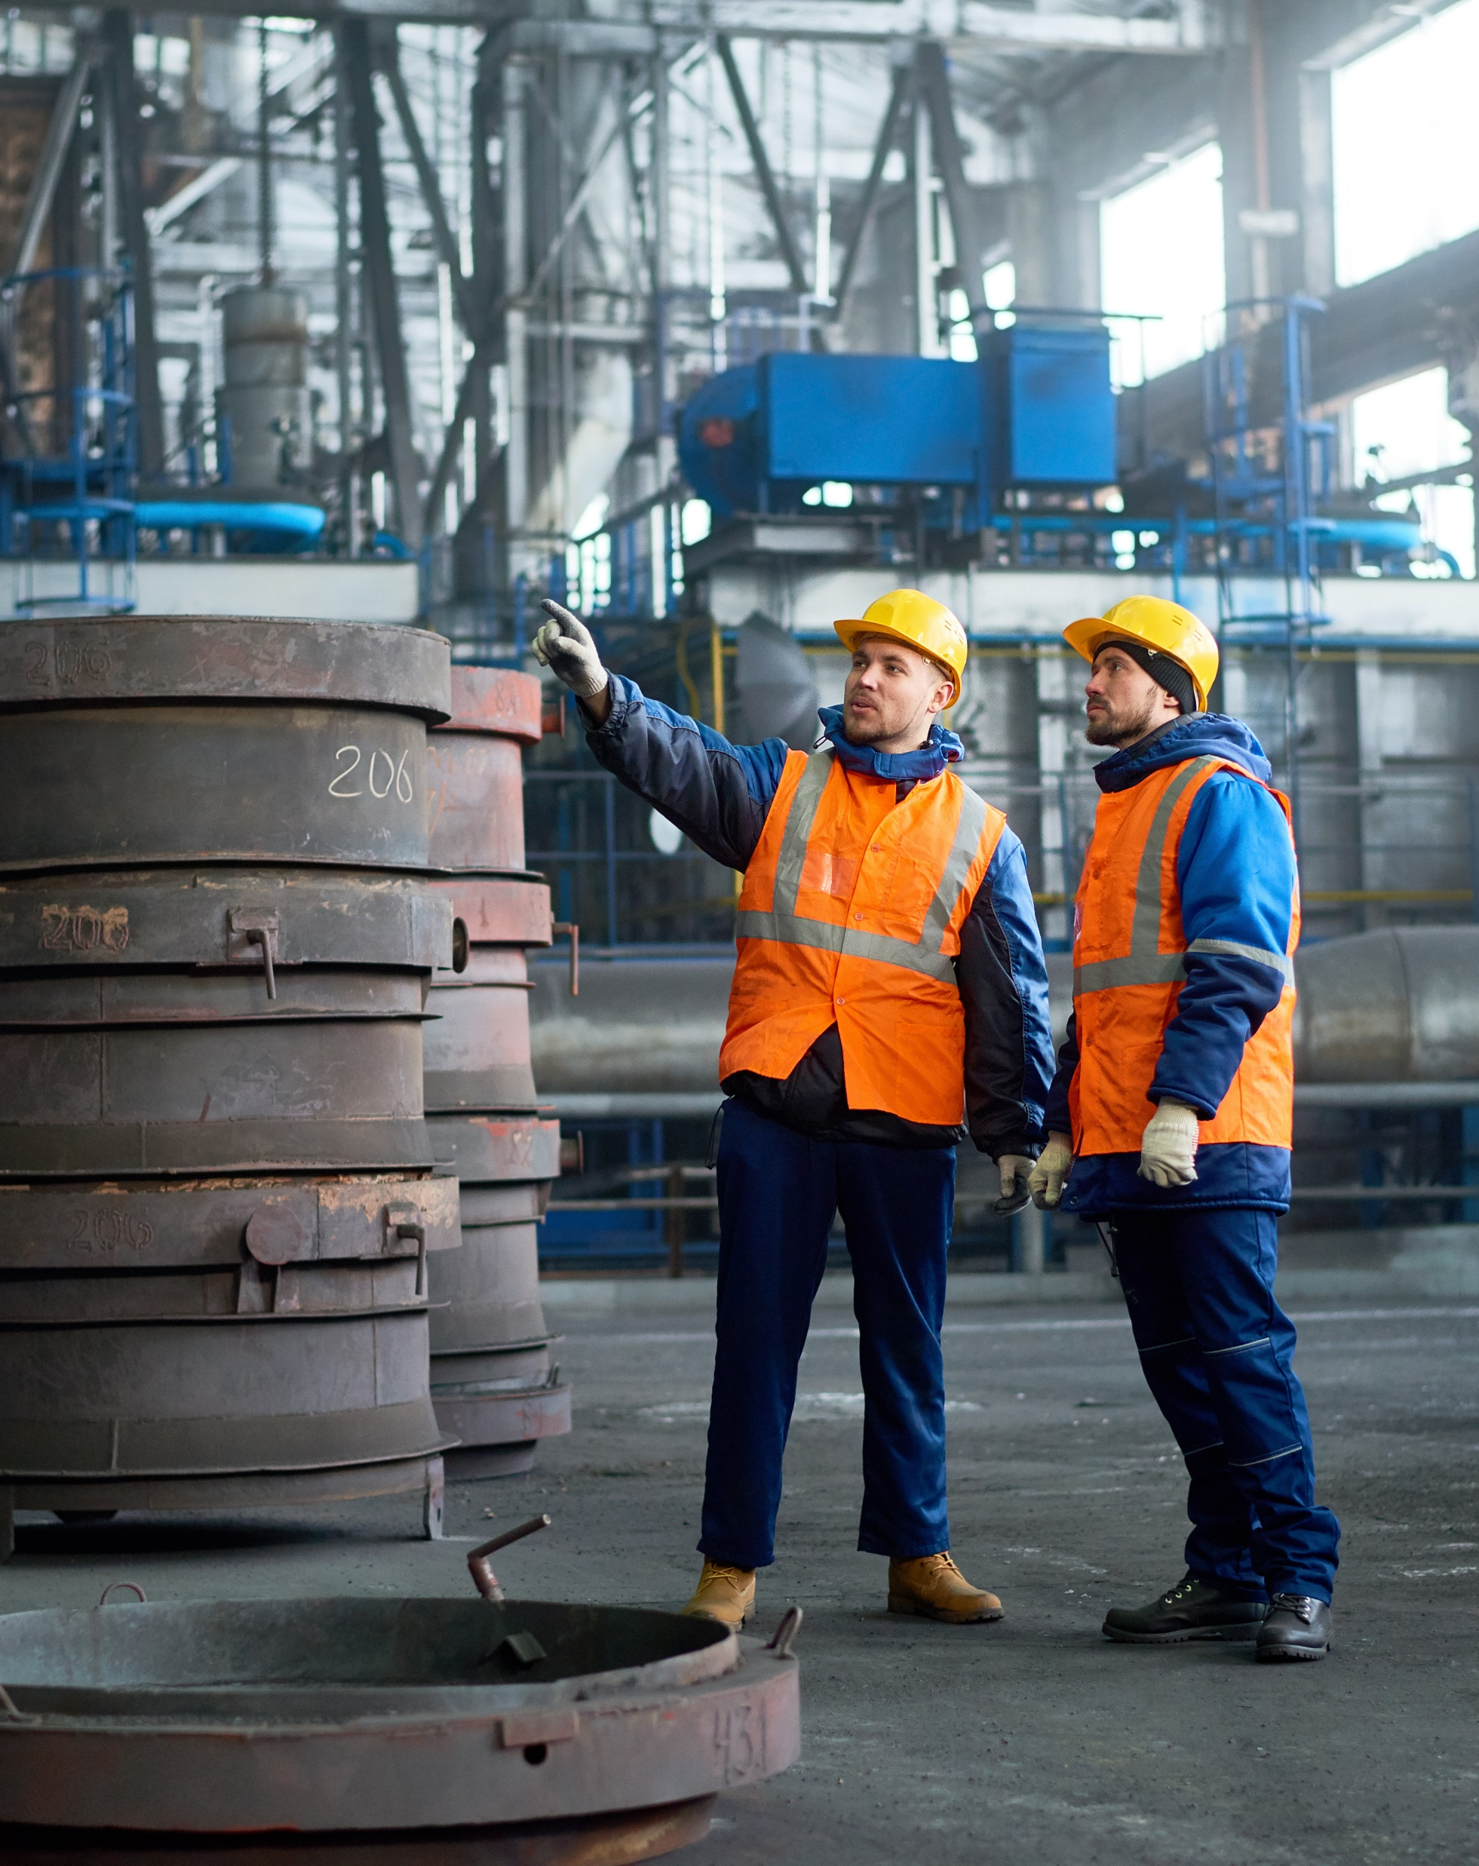
Our Ambition for 2025

Slide 13


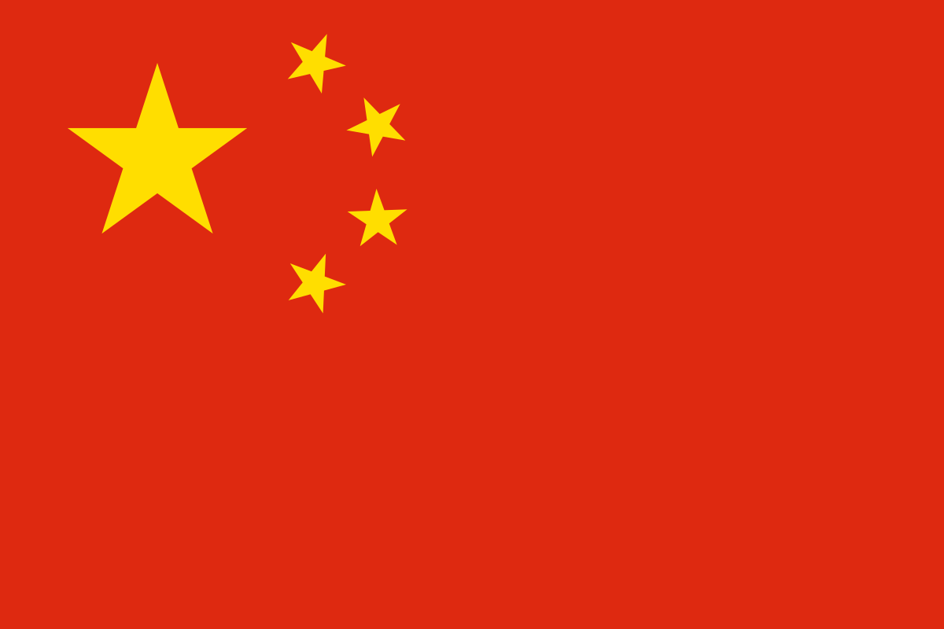
































Clients
A strong track record over the past years
First product sold to
Seed Round
1M€ - led by
XANGE SI
Office opened
in China
A Series Round
3M€
Internationalisation
Scale-up
R&D Phase
2014
2016
2017
2018
2019
2020
2021
Inception of
First POCs signed
Second wave
[28] deals
[30] deals
[33] new clients
[44] new factories
Connect to your industrial potential

Slide 14
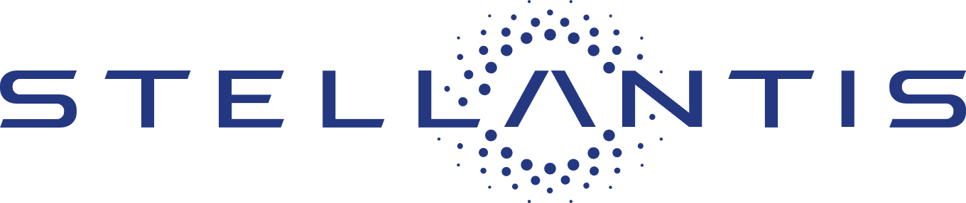

Clients
What our clients say?
« If we only consider the cost of people that were manually doing the data collection, consolidation and reports, the TEEPTRAK systems have an instant ROI.»
Christophe Pasquet
Monozukuri, PRF (Costing) and Factory of the Future
« We have seen a 29% increase in production volume in pieces per hour after installing PerfTrak on a single machine. This represents >19k€ par year in additional revenue.»
C.M. Ropiot
Production & maintenance manager
Continuous improvement manager
Filec
Connect to your industrial potential

Slide 15


Our clients are satisfied!
>80% of POCs lead to deployment
When clients try our solutions, they want to keep them
Churn: Less than one factory per year on average. The most important reason is because the factory switch to an « internal » solution

Slide 16


The market is nearly endless
McKinsey’s Global Institute predicts IoT will have an economic impact of between $4 trillion and $11 trillion by 2025.
IIoT and Industry 4.0 … holds the key to unlocking drastic reductions in downtimes, new business models, and a better customer experience.
“Industrial IoT (IIoT) Market Worth $263.4 Billion by 2027 - Market Size, Share, Forecasts, & Trends Analysis Report with COVID-19 Impact by Meticulous Research”
“With a strong focus on machine-to-machine (M2M) communication, big data, and machine learning, the IIoT enables industries and enterprises to have better efficiency and reliability in their operations.”
https://www.globenewswire.com/news-release/2021/09/30/2306043/0/en/Industrial-IoT-IIoT-Market-Worth-263-4-Billion-by-2027-Market-Size-Share-Forecasts-Trends-Analysis-Report-with-COVID-19-Impact-by-Meticulous-Research.html

Slide 17
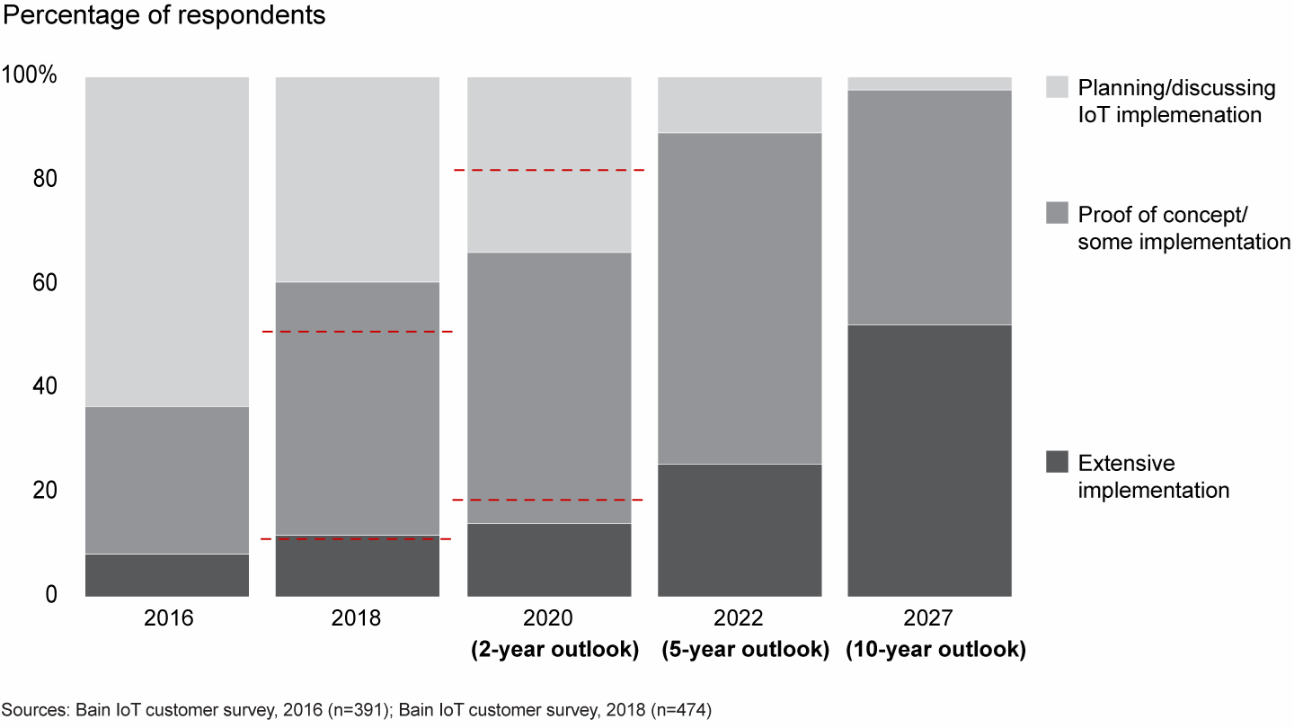
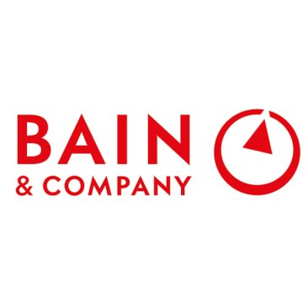
Bain Consulting Beyond Proofs of Concept: Scaling the Industrial IoT
“The IoT outlook for 2020 has dampened, but long-term targets remain bullish”
Source: https://www.bain.com/insights/beyond-proofs-of-concept-scaling-the-industrial-iot/#

Slide 18
We will focus on the most significant regions
Rank | Economy | Manufacturing output in 2020 (trillion of USD) | % of global manufacturing output | Objectives with this A round funding
1 | China | 3,9 | 28,9% | 
2 | US | 2,3 | 17,0% | 
3 | Japan | 1 | 7,4%
4 | Germany | 0,7 | 5,2% | 
5 | Korea | 0,4 | 3,0%
6 | India | 0,35 | 2,6%
7 | Italy | 0,28 | 2,1% | TBD
8 | France | 0,25 | 1,9% | 
9 | United Kingdom | 0,24 | 1,8%
N/A | Benelux | 0,17 | 1,3% | 
Continue Accelerate Enter/Develop
Source: https://data.worldbank.org/indicator/NV.IND.MANF.CD?most_recent_value_desc=true
Connect to your industrial potential

Slide 19
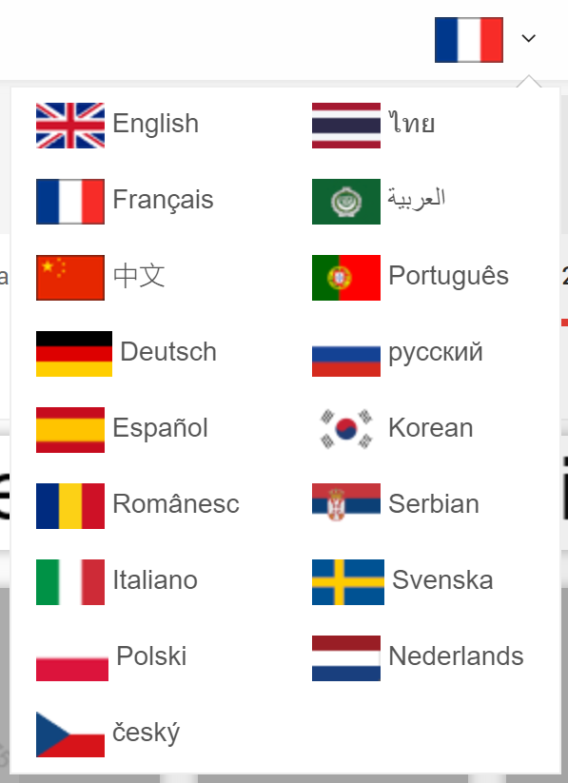
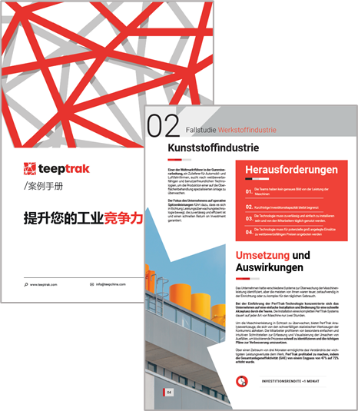
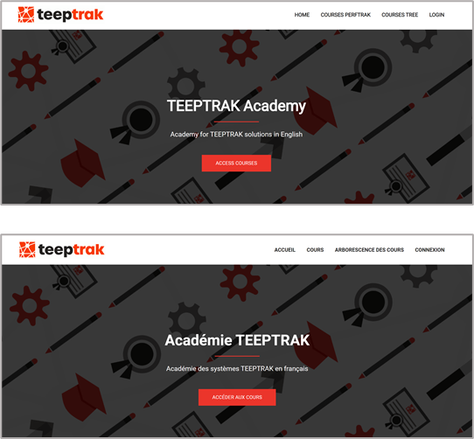
Everything is ready for massive scale-up
Our on-boarding and sales processes are also digital allowing us to create teams anywhere in a timely manner.
Web platform and applications are available in 19 languages
Sales and marketing material can be translated in 2 weeks

Slide 20
Our 2025 Ambition in numbers
Detailed finance perspectives to be discussed later
> 8X

Slide 21
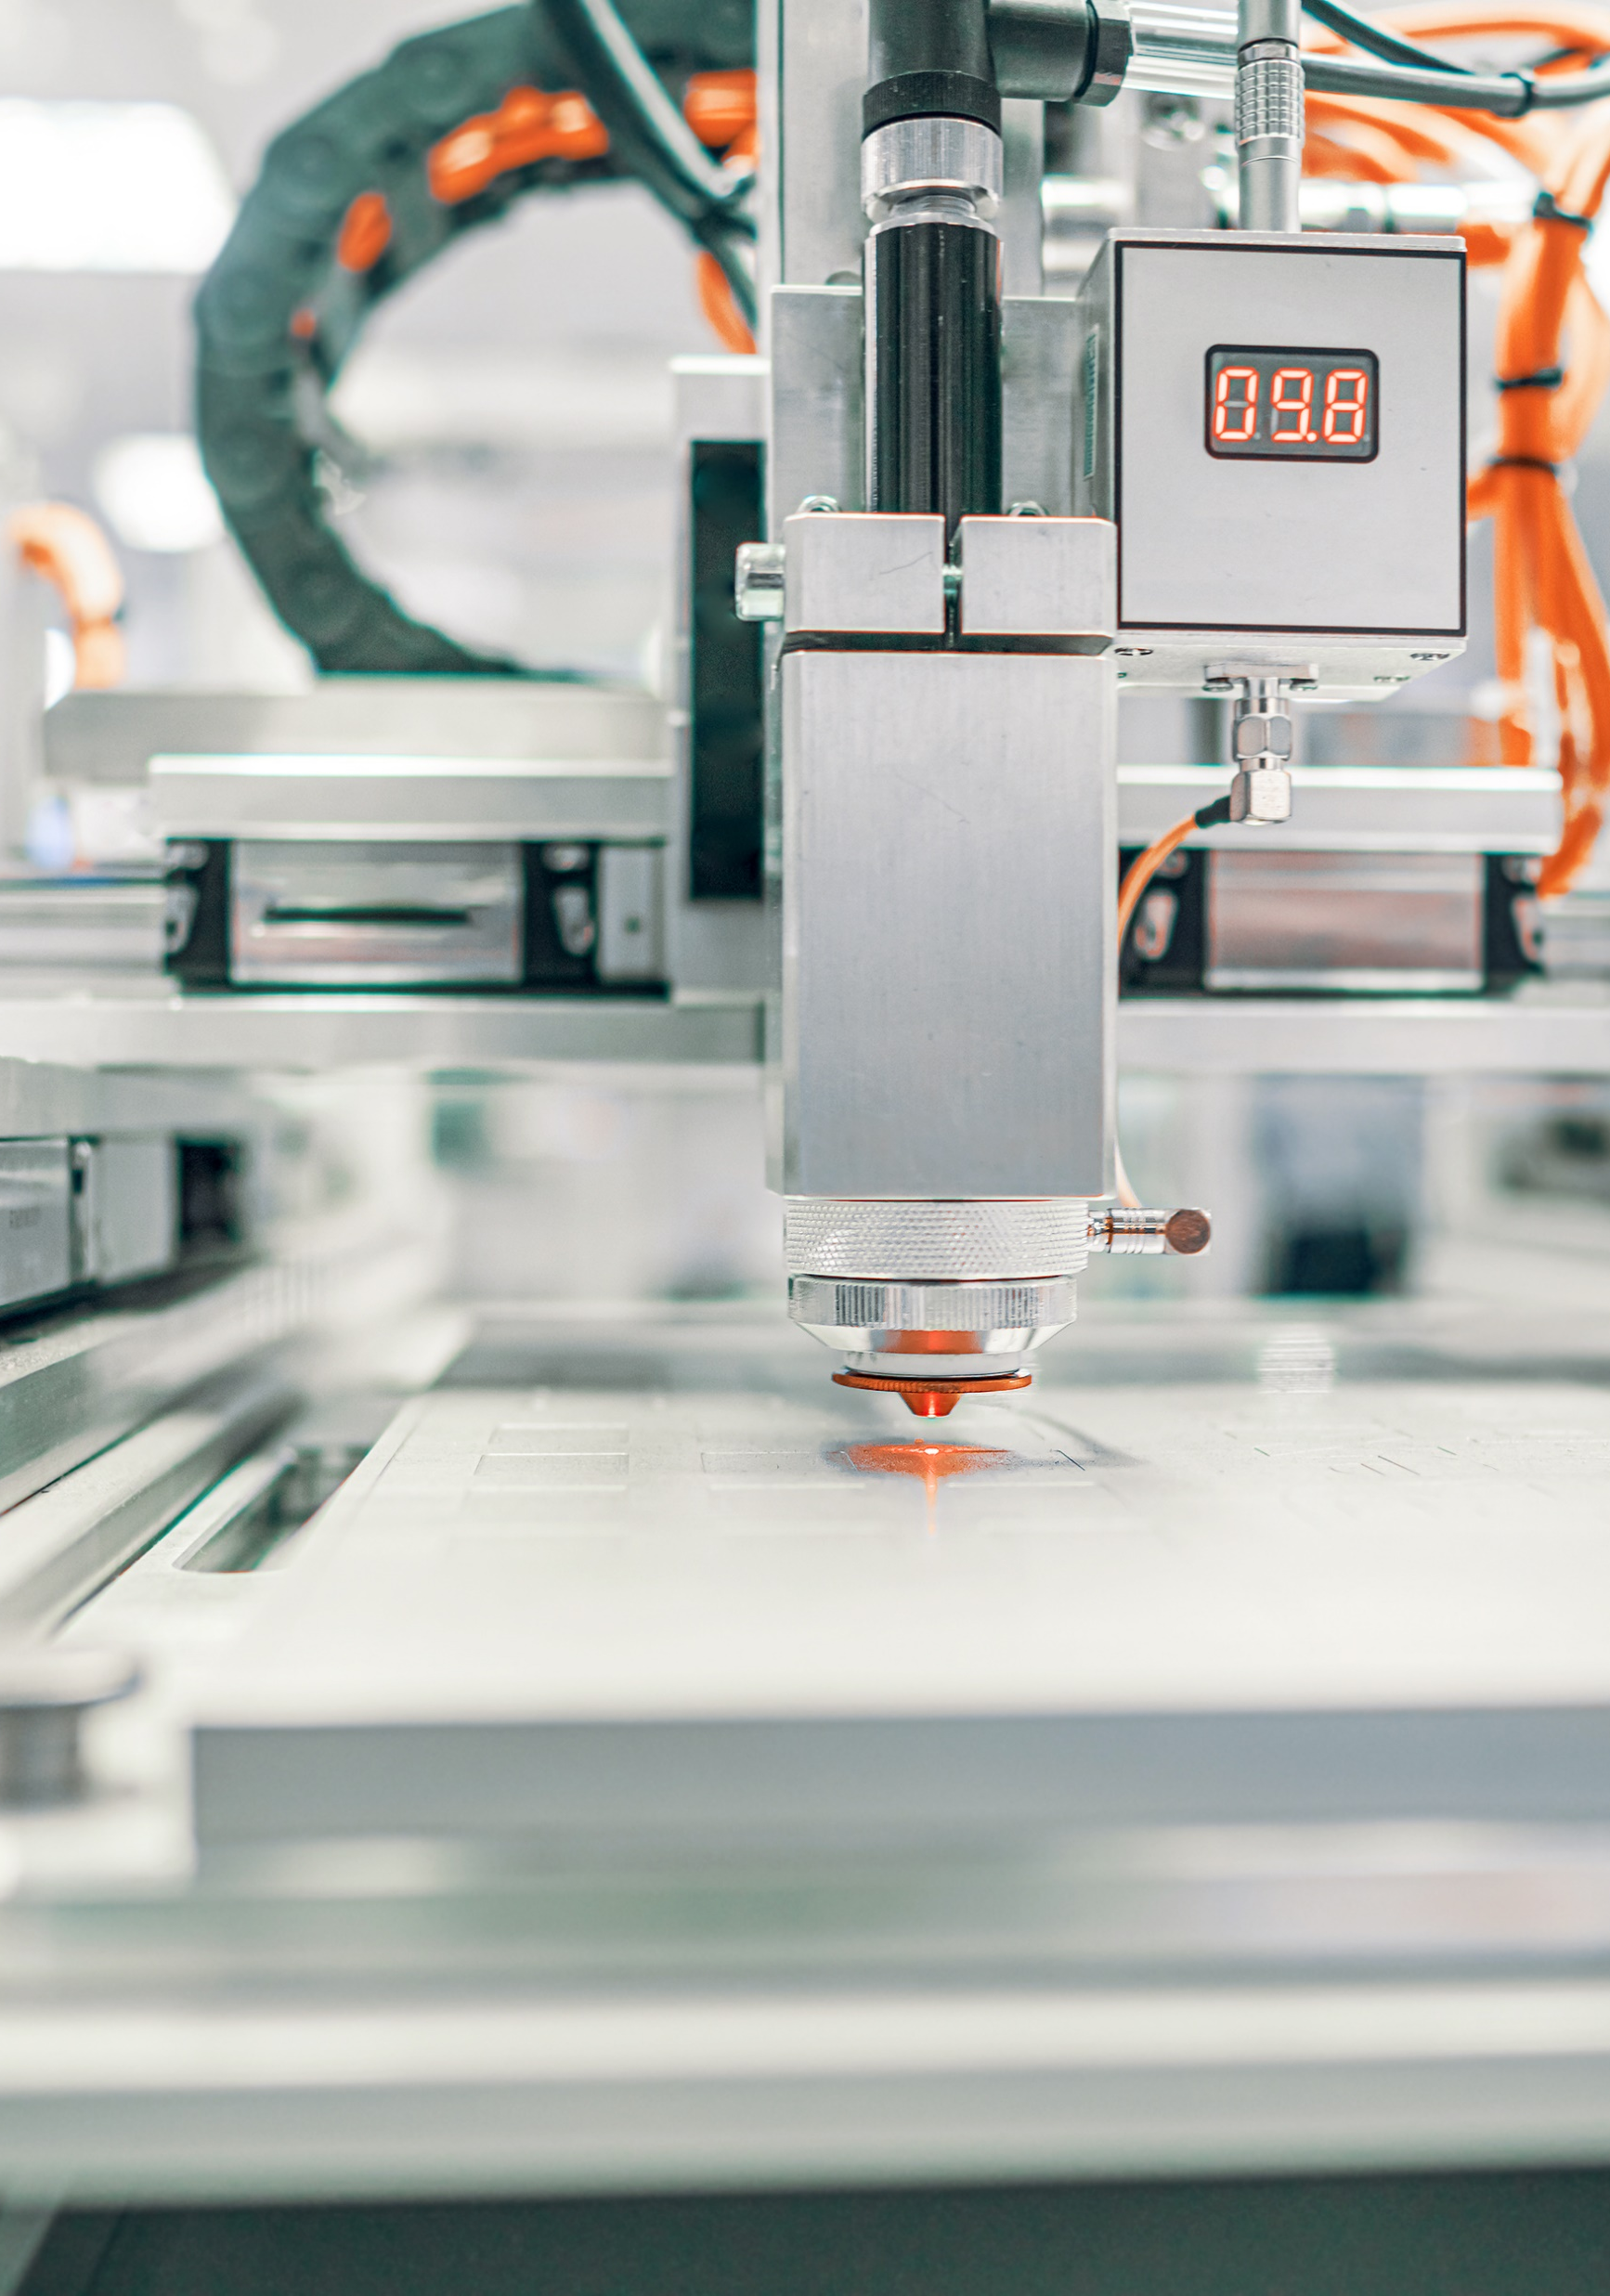
Our techno roadmap

Slide 22
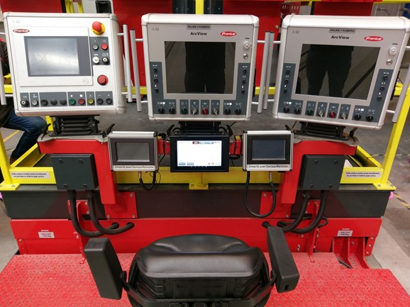
Full control over Software and Hardware
A strong barrier to entry for any competitor
Hardware
Software
Acquisition Module
100% designed by TEEPTRAK
Produced and assembled in France
100% coded by TEEPTRAK
Remote update fully operational
Android
Tablet
Rugged Waterproof shell
100% designed by TEEPTRAK
Special power filters for
challenging industrial environment
Full control over OS
Remote OS update
App 100% coded by TEEPTRAK
Online
platform
High availability infrastructures
- OVH for EU clients
- Alibaba Cloud for CN clients
- On premise on-demand
100% coded and maintained
by TEEPTRAK (DevOps included)
TEEPTRAK system on Alstom welding machine

Slide 23
Our technological streams are well defined and will open a broad range of opportunities
New in 2022!
Hardware
TEEPTRAK proprietary rugged tablet
New generation ready!
1
Core ADC module (BT and soon WIFI)
New 24 bit ADC to be ready by end of april 2022
Core interface modules
Compatibility with all standard sensors and +++
Software
Android application
Incremental improvements
2
Web based application
Incremental improvements
MoniTrak
Incremental improvements
3
Data
Advanced and automated data analysis
Launch of our first product by the end of the year
4
Training
Online trainings: Our academies
Incremental improvements, translations

Slide 24
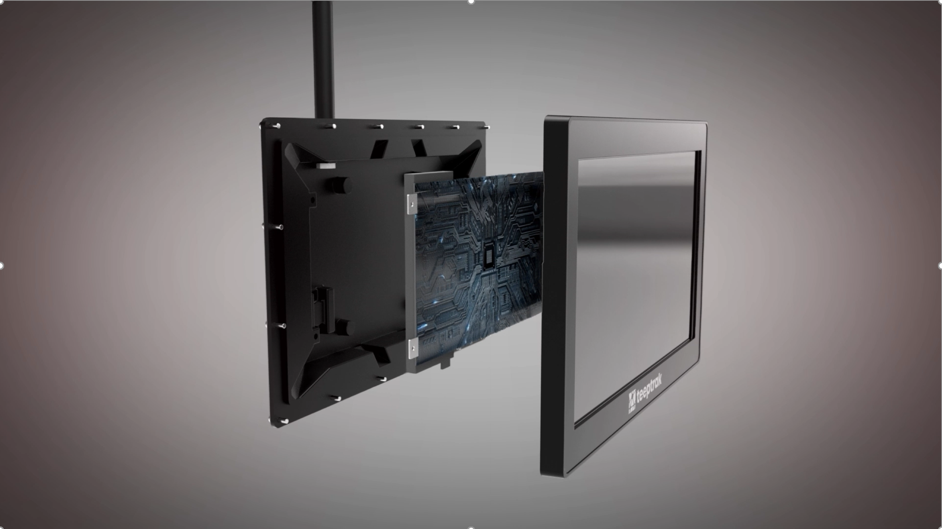
Tablet video

Slide 25

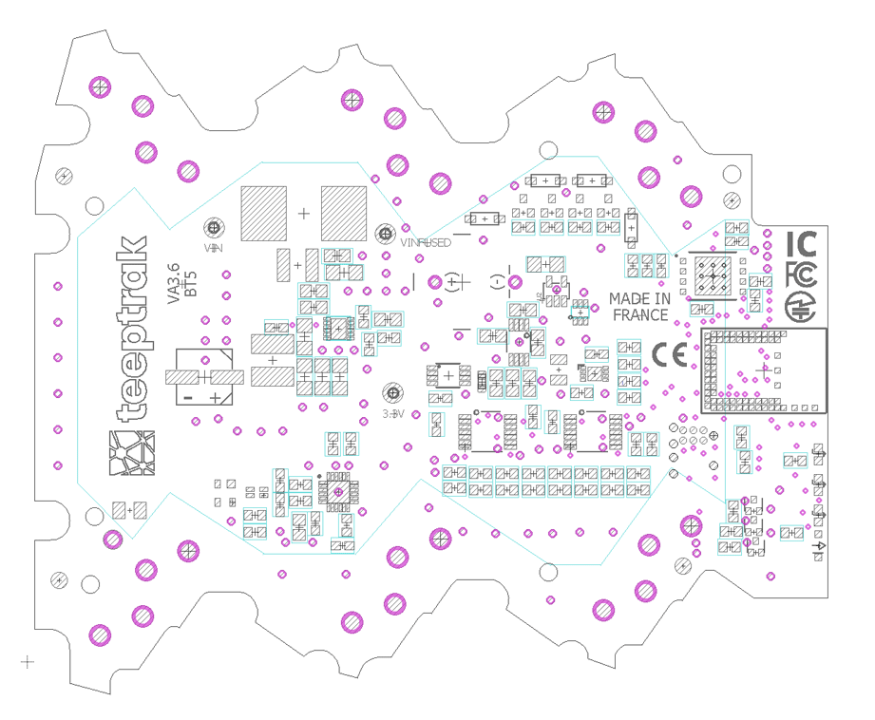


We are building a broad range of cost effective modules to increase our capabilities and acquire several signal
High precision high speed 24v
24 bit ADC acquisition module
Energy metering module
(current measurement operational, High precision high speed
with current and voltage metering ready by June 2022)
Vibration analysis software
(first generation by June 2022, edge computing)
0-10v high precision conversion module
(first generation operational, second generation by June 2022)
4-20 mA high precision conversion module
(first generation operational, second generation by June 2022)

Slide 26




Disruptive Machine Learning approach: we want to change the way industrials launch Machine Learning projects
Input Data
TEEPTRAK
Machine Learning
Output
TEEPTRAK Indicators
Quality
OEE
Availability
Etc.
1
Client configurable
web-based platform
Identify meaningful / impactful
process variables
Optimization
2
ProcessTrak
(any type of sensors)
Suggest ideal settings on « Actionnable » variables
3
External / client data
(uploaded on our platform)
2 algorithms to start
Optimization
Anomaly detection
Anomaly
Alarms

Slide 27
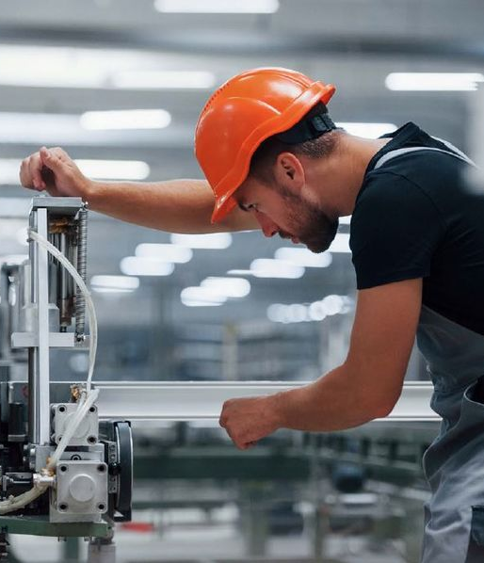
Our clients

Slide 28



Three contexts - three clients
White label
(Partnership)
Early stage
(Direct sales)
Late stage
(Direct sales)
Exclusive distributor in Saudi Arabi of
PerfTrak under the KmOEE brand
Represented by Mr. Bin Dos
CEO Meta 2i
Dedicated, on-premise, OEE monitoring system with OPC UA connectivity.
Represented by Romain Bruniaux
Industrial VP, Powertrain Systems
Presentation of TEEPTRAK as core IT solution, progressive deployment in their 110 plants.
Over 20 equipped.

Slide 29
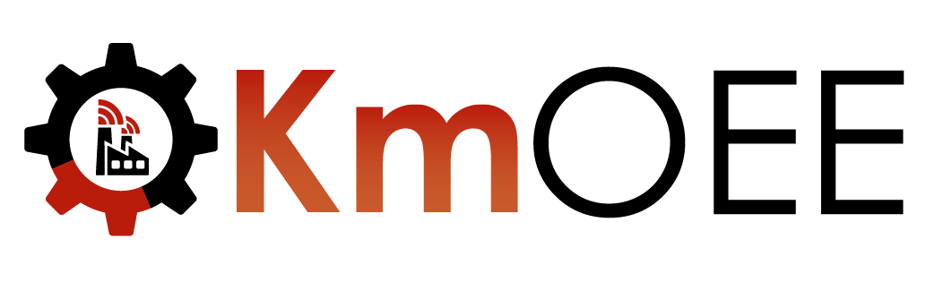
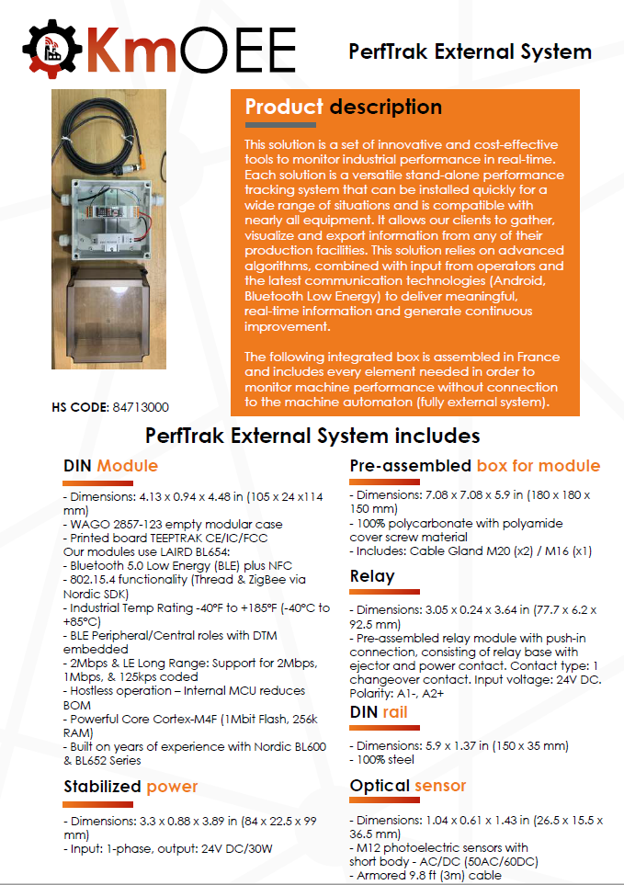
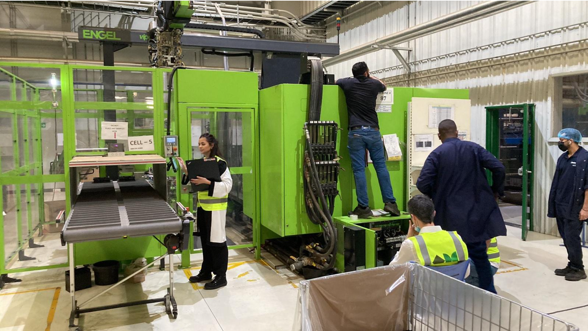
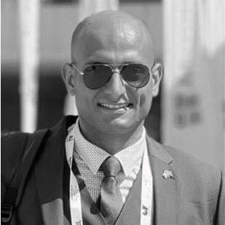
KmProd as exclusive distributor of PerfTrak
Faisal Bin Dos
Meta 2i CEO

Slide 30
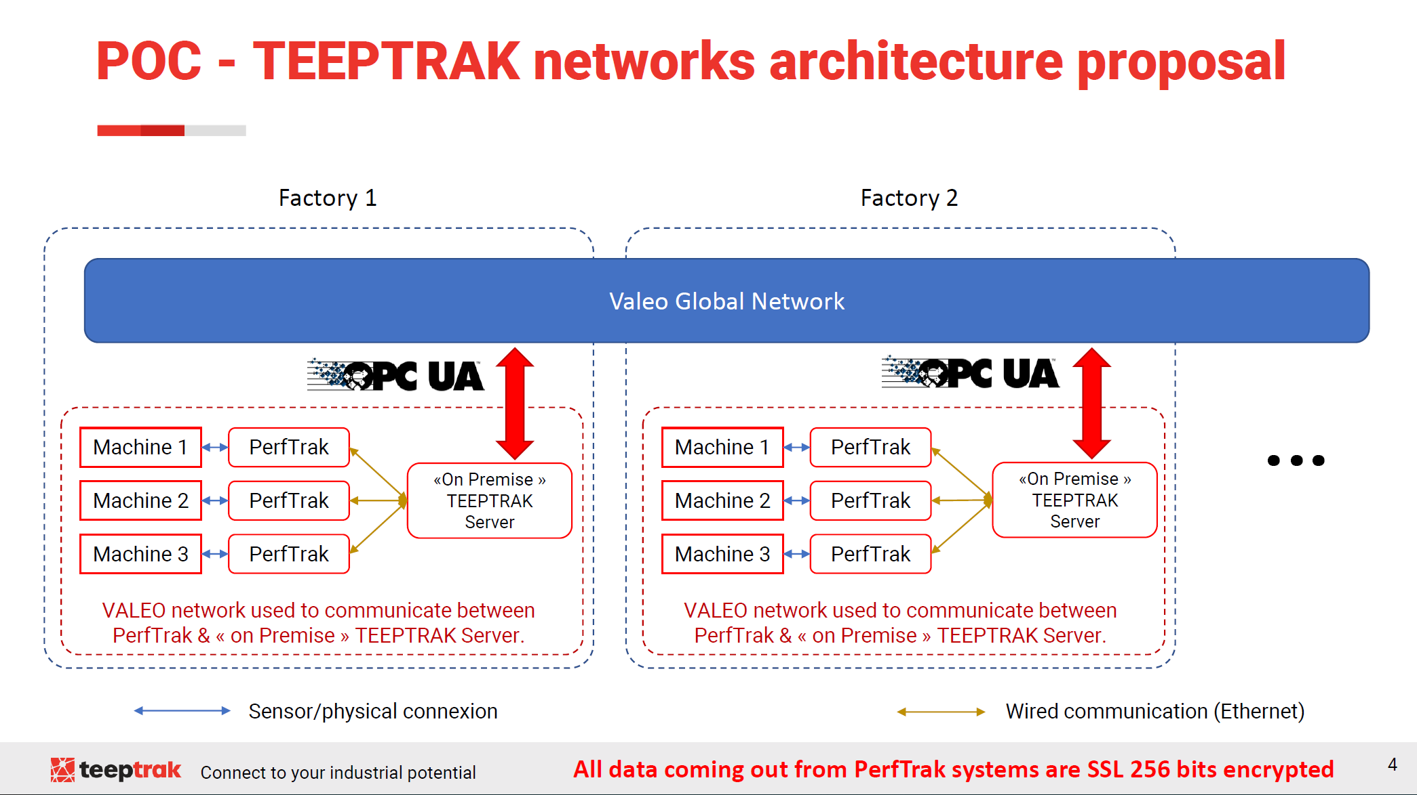

Early stage client with OPC UA capabilities
Romain Bruniaux
Industrial VP
Powertrain Systems

Slide 31




Deployment phase with Savencia
TEEPTRAK and Savencia working together since 2016
TEEPTRAK as « core » IT solution for the group since 2022
Over 20 factories already connected
Over 100 factories in total
24 000 employees throught the world
5.7B€ net sales
Few brand examples
Industry 4.0 project leader

