Slide 1
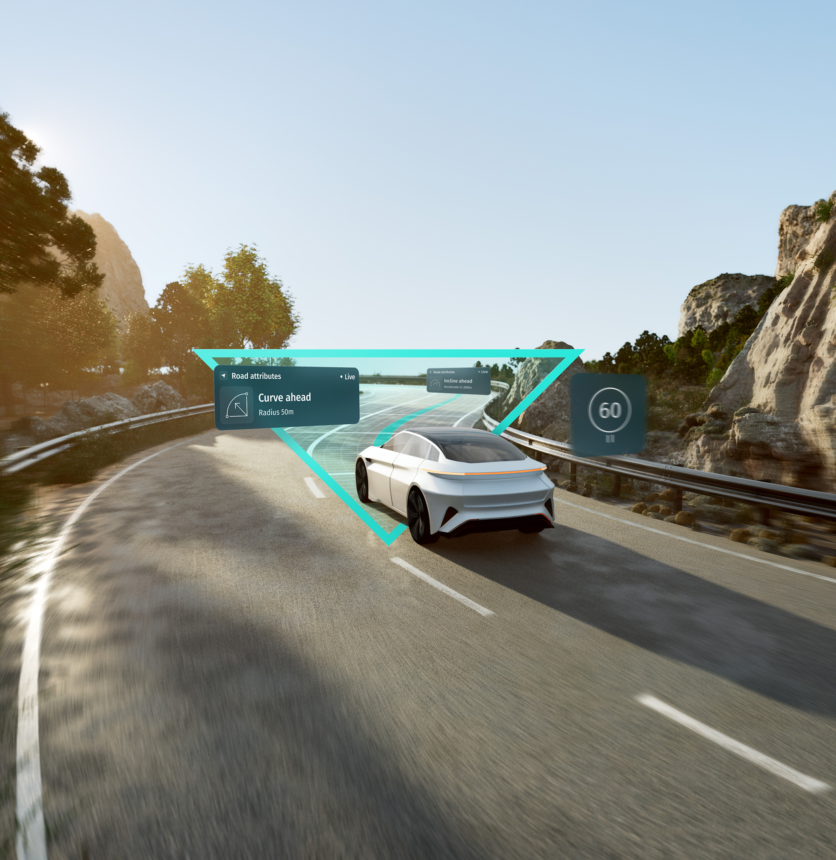
Welcome to HERE Technologies
Revealing the promise in every path
Notes:
Maps have applications in so many spheres of life.
Drivers need them to navigate safely
Automated vehicle systems use them to know the road ahead in precise detail
Logistics companies use maps to deliver 5,000 parcels every second globally.
There are countless ways in which map data can be used today.
And HERE Technologies is in the business of helping organizations get access to the best maps and technology available
So, let me briefly introduce the company.

Slide 2
Our live map is standard in every moving vehicle by 2035
Our vision
Forty years ago, we started with a digital map of San Francisco. Today, we set the standard for automotive-grade maps globally.
Our customers are leading automakers, logistics firms, mobility providers and technology brands. Our map is powering the next generation of vehicle automation and safety, enabling innovation and efficiency, and driving sustainable growth across industries.
Notes:
HERE is a map data and technology platform.
Our vision is bold: we want to be the map of choice
Businesses and organizations come to us to....access our industry-leading map data covering 200 countries....use and adapt location services like routing and transit algorithms....create private maps using their data from their own fleets and IoT devices.
The platform is effectively a large toolkit – in fact, one of the largest toolkits – with which you can create or build practically anything you like.

Slide 3


A platform operating at scale
40
years of experience in map-making and location technology
166bn
API calls per month
1.5k
Enterprise customers – from auto-makers and tech leaders to global logistics and telecoms brands
222m+
vehicles shipped with HERE data and solutions
600k
direct developers
70+
Automakers use HERE data and solutions
Notes:
It doesn’t matter where in the world you operate.
HERE is a global platform and one operating at scale.
During our 40 years in the business, we have built maps and services for all major markets and territories – and these are used today by some 1,400 customers, resulting in some 166 billion API calls per month. That’s a lot of calls to our services.
An important of our role as a location platform is keeping the HERE map up to date: we use 100,000 sourced datasets to do that, as well as probe and sensor data from vehicles, smartphones and IoT devices.
To give you an example, there are currently 40 million vehicles on the road today that are supplying us with real-time data which we use to understand traffic flow, to detect road changes and hazards, to know when a speed limit has changed and so on.
With so much data to work through, we have even built a new mapping technology to handle it all. This technology sits at the heart of our platform. More on that later.

Slide 4


















2017-18
HERE shareholder structure broadens, with Intel, Bosch, Pioneer and Continental as new investors
1987
Karlin & Collins, Inc becomes NAVTEQ
DriverGuide provides printed driving instructions at countertop kiosks in around the San Francisco Bay Area
1996
First company patent (5,543,789) issued for online route guidance on user interfaces like mobile devices – the precursor to basic navigation guidance on phones
2001
Patent 6,253,151 allows users to select a feature in a map and report an error – today, virtually every navigation app available has this pioneering feature
2008
NAVTEQ is bought by Nokia
2012
We rebrand to become HERE.
2017-18
HERE welcomes Mitsubishi Corporation and NTT as new investors
2024
HERE launches new corporate purpose, vision, and strategy; finishes year with 5,930 patents
1985
Barry Karlin and Galen Collins launch Karlin & Collins, Inc. to develop navigational software using an electronic map
1990s
We offer the first in-car sat nav systems
1999
Patent 5,999,878 granted covering the method of driving the roads and collecting accurate GPS data for creating maps
2004
Our location data is used to create maps for mobile devices such as phones
Our technology is used in the first advanced driver-assistance systems
2011
NAVTEQ forms core of Nokia’s broader location business
Patent 7,970,749 lets video game creators use our map data to showcase specific locales in games
2015
BMW, Audi and Daimler acquire HERE to develop high-definition mapping for self-driving vehicles and other applications
2018
Mercedes-Benz Drive Pilot brings HERE HD Live Map to L2-L3 driving systems
2022
HERE powers hands-free driving in BMW 7 series across Germany, California and Nevada
2025
HERE & AWS sign $1B collaboration to accelerate software-defined vehicle development
Notes:
Our journey to where we are today has been an interesting one.
Many of our customers have worked with us since the days of Navigation Technologies or NAVTEQ, when we pioneered digital mapping for in-car satnavs.
Over time, digital maps branched into new areas, one of course being smartphones.
After being part of Nokia for several years, in 2015 we were acquired by leading automotive brands who recognized the critical importance of location technology in the future of transportation.
On the one hand, they – like us – saw that location technology would be needed to help vehicles drive themselves.
On the other hand, they saw how logistics businesses and supply chains would need access to a rich and up-to-date representation of the world as they move goods and people around.
In recent years, we have welcomed more investors into the fold – which I think has further reinforced the message that location technology has broad application across all kinds of markets like telecoms, urban mobility and infrastructure planning too.
I can tell you – it really is an exciting business to be in!

Slide 5


















































Today we work with
Notes:
Our customer and partner base also reflects the diversity of our business today.
Here are some of those partners.
We count almost every major car company as a customer, plus many automotive tier 1s (like Bosch) and solution providers (like Mitsubishi Electric)
We also work with
- consumer brands like Garmin
- cloud service providers like Amazon Web Services
- numerous national, state and regional transportation agencies and traffic management centers (e.g. Several U.S. states such as Colorado; as well as across EU)
- fleet and on-demand companies like Timocom
- telco companies like Verizon and Vodafone

Slide 6









HERE solutions support use cases across many industries
Monetizable services
EV routing & charging
Professional navigation
Automated driving
Streamline operations
Digital cockpit
Fleet routing
Asset tracking
Location analytics
Notes:
And if you look at where we play today, it’s a broad spectrum of industries and markets.
Our maps and services support a number of use cases across industries

Slide 7







Enhance assisted and automated driving systems
Build resilient assisted and automated driving systems that are more reliable, safe and comfortable across all levels of automation.
Customers and partners like …
… use HERE to improve
Road safety & awareness
Advanced Driver Assistance Systems (ADAS)
Highly Automated Driving (HAD)

Slide 8








Deploy digital navigation experiences
Deploy electric and mixed fleets for middle- and last-mile operations with a fleet solution that includes EV-aware routing and charge point predictions.
Customers and partners like …
… use HERE to improve
Electric vehicle services
Connected vehicle navigation
Connected vehicle services
Notes:
In the vehicle, location technology is being used to power new kinds of experiences.
Now that vehicles are connected, carmakers and app developers are delivering services over the air. These range from knowing where electric charging points are, calculating battery range, to providing rich search and real-time multiple waypoint routing and ETA predictions for drivers.
VinFast: VinFast’s VF8 and VF9 electric SUVs rely on HERE EV Charge Points and EV routing (Source: https://www.here.com/about/press-releases/en/VinFast-taps-HERE-to-accelerate-in-car-navigation-for-its-smart-electric-cars)
Lotus: The Lotus ELETRE electric SUV uses HERE Navigation for predictive EV routing and a growing databased of charge points (Source: https://www.here.com/about/press-releases/en/here-powers-lotus-eletres-digital-cockpit-with-ev-navigation-and-range)
Bosch: Bosch Mobility Solutions and HERE developed joint solutions around EV charging (https://www.here.com/learn/blog/electric-vehicle-navigation)
SCANIA: https://www.here.com/about/press-releases/en/here-powers-scania-trucks-connected-navigation-solution
what3words: Jaguar Land Rover integrated what3words addresses into its infotainment system, together with HERE’s navigation services.

Slide 9





Optimize EV routing and charging
Prevent charge and range anxiety, improve battery consumption and increase range estimation accuracy.
Customers and partners like …
… use HERE to improve
EV charging
EV routing
EV range optimization

Slide 10







Plan complex tours and route fleets
Deploy electric and mixed fleets for middle- and last-mile operations with a fleet solution that includes EV-aware routing and charge point predictions.
Customers and partners like …
… use HERE to improve
Tour planning
Route optimization
Last mile efficiency

Slide 11





Provide professional drivers with navigation and safety information
Reduce costs, delivery time, travel distance and emissions with relevant information for specific vehicle types, routes and cargo.
Customers and partners like …
… use HERE to improve
Electric vehicle services
Connected vehicle navigation
Connected vehicle services

Slide 12






Enable asset tracking
Streamline operations, reduce costs and improve end-to-end supply chain visibility, performance and resilience.
Customers and partners like …
… use HERE to improve
Asset tracking
Shipment visibility
Transport insights and analytics

Slide 13






Build location-aware monetizable services
Grow new revenue streams by creating custom services with high quality location data, tools and APIs.
Customers and partners like …
… use HERE to improve
On-demand experiences
Customer loyalty
Brand experiences

Slide 14




Streamline operations with location intelligence
Unlock operational efficiency and precision by contextualizing decisions with real-time data from the #1 location platform.
Customers and partners like …
… use HERE to improve
Decision making
Resource management
Customer engagement

Slide 15







Derive insights from location data
Accelerate business growth and stand out with precise, scalable and reliable mapping services.
Customers and partners like …
… use HERE to improve
Control over mapmaking
Site selection
Predictability

Slide 16
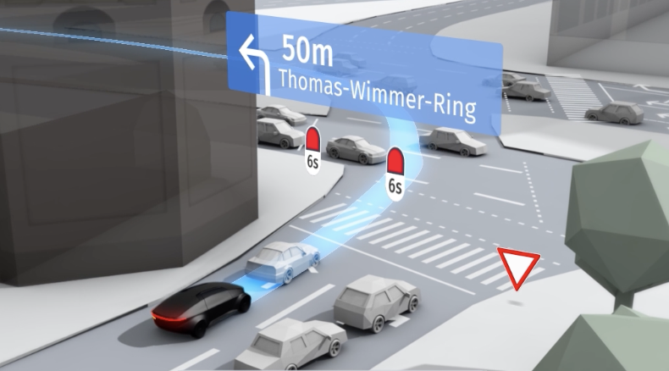
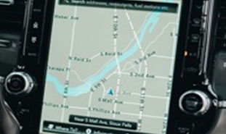
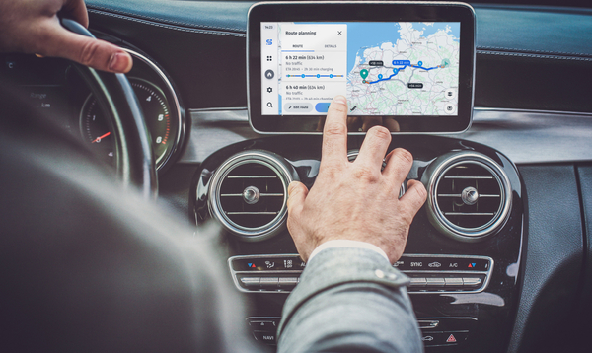
Next-generation mapmaking
Gen 1
Download era
Manual updates required
Driven by vehicle production
Stand alone functionality
Customized for each OEM
Gen 2
Streaming era
Updates available, but delayed
Became standard across OEMs
Heavy inspired by mobile UX
Gateway to a map in every car
Gen 3
AI live map era
Unified map for human and machine use
A learning map through feedback loop
Many new use cases pre- and post-production
Where we have been
Where we are going

Slide 17
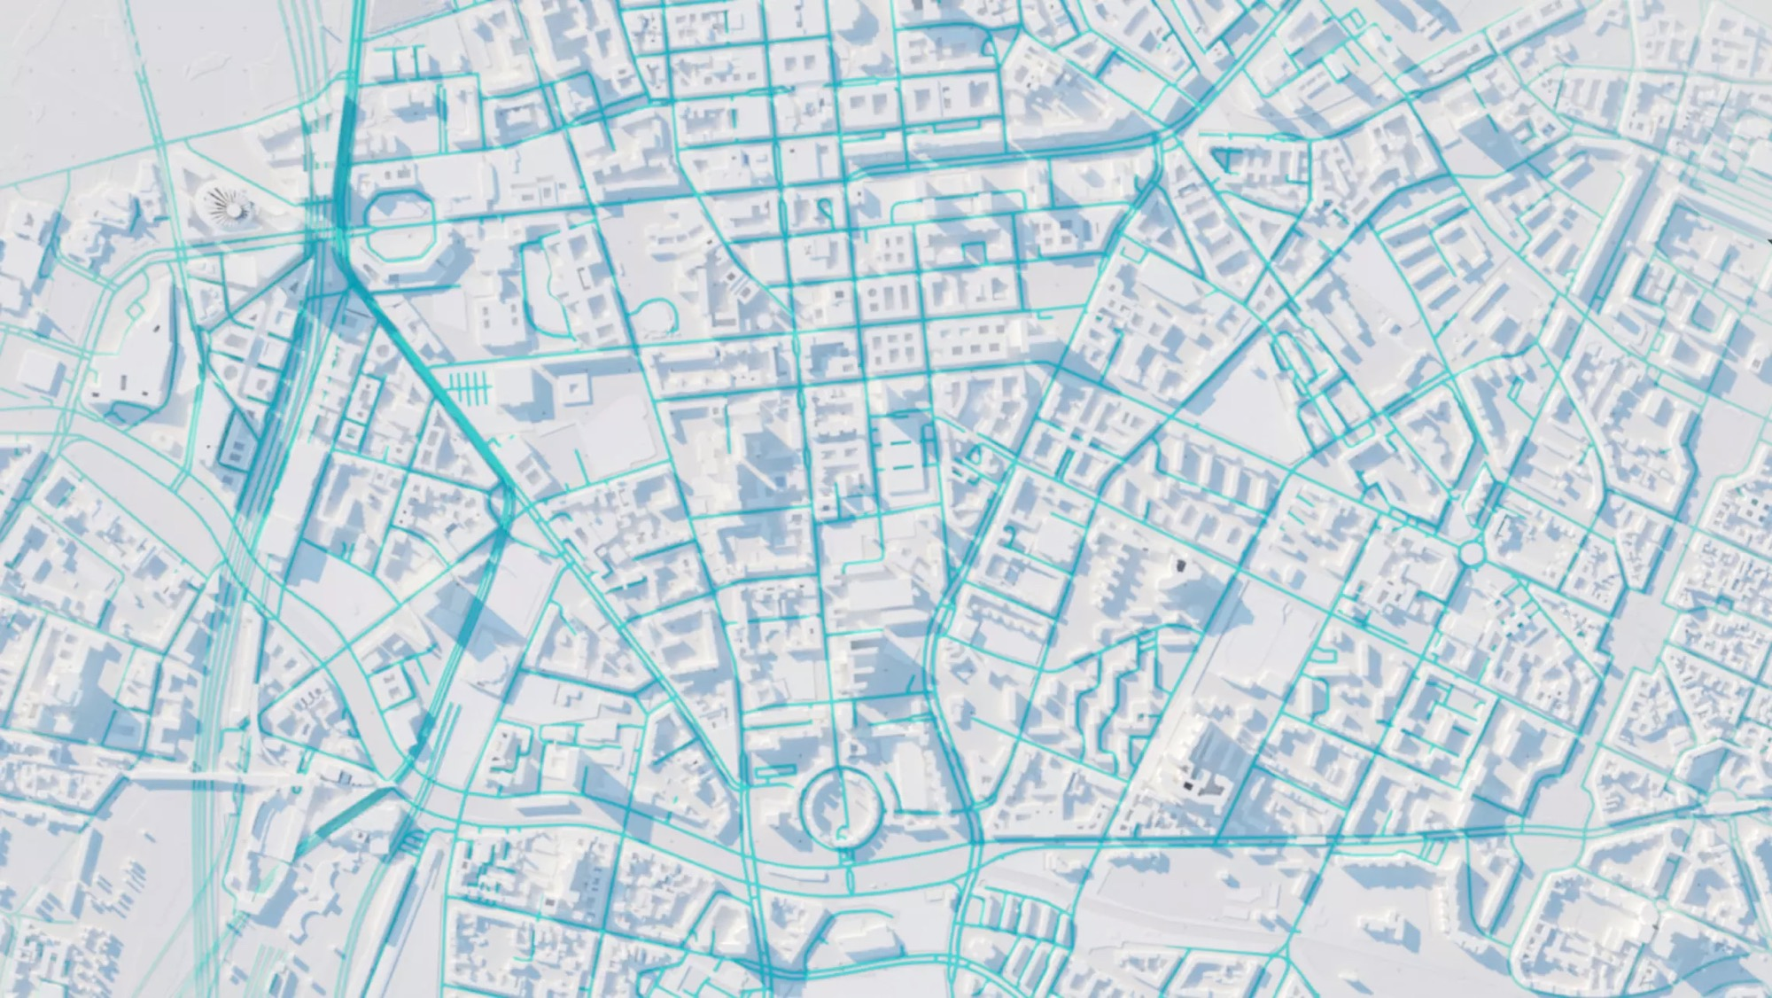
Next-generation mapmaking
HERE’s automated mapping system revolutionizes how maps are created, updated and used.
Unified
HERE fuses large quantities of data from diverse sources – including vehicle sensors, industrial lidar and satellites – into one fully aligned, unified global map.
Live
Our maps have moved from static snapshots closer to dynamic "live maps." Some changes can now be detected and updated within 48 hours.
Learning
We constantly receive and validate human and machine feedback about where our map might differ from reality. This feedback helps keep our map accurate and fresh.
Artificial intelligence & machine learning are key enablers
Notes:
Unified: A unified, semantically aligned mapping architecture ensures a consistent reference for map attributes across diverse platforms. This alignment is critical for seamless integration across use cases, whether it’s navigation, automated driving, logistics or urban planning. (Source: Damandeep Kochar, “The transformative power of artificial intelligence in mapmaking and geospatial technologies”)
Live: Map updates used to take weeks or months. Now with AI and ML, we can detect and update some map changes – such as places – within 48 hours. We’ve harnessed high-performance cloud infrastructures to deploy AI and ML models at scale, enabling near real-time updates to digital maps. These live maps reflect real-world changes in real-time, making them indispensable for next-generation passenger and commercial vehicle navigation and automated driving systems. (Source: Damandeep Kochar, “The transformative power of artificial intelligence in mapmaking and geospatial technologies”)
Learning: HERE processes tens of millions of kilometers of vehicle sensor data per hour.

Slide 18
Next-generation mapmaking
HERE’s automated mapping system revolutionizes how maps are created, updated and used.
Unified
HERE fuses large quantities of data from diverse sources – including vehicle sensors, industrial lidar and satellites – into one fully aligned, unified global map.
Live
Our maps have moved from static snapshots closer to dynamic "live maps." Some changes can now be detected and updated within 48 hours.
Learning
We constantly receive and validate human and machine feedback about where our map might differ from reality. This feedback helps keep our map accurate and fresh.
Artificial intelligence & machine learning are key enablers
Notes:
Unified: A unified, semantically aligned mapping architecture ensures a consistent reference for map attributes across diverse platforms. This alignment is critical for seamless integration across use cases, whether it’s navigation, automated driving, logistics or urban planning. (Source: Damandeep Kochar, “The transformative power of artificial intelligence in mapmaking and geospatial technologies”)
Live: Map updates used to take weeks or months. Now with AI and ML, we can detect and update some map changes – such as places – within 48 hours. We’ve harnessed high-performance cloud infrastructures to deploy AI and ML models at scale, enabling near real-time updates to digital maps. These live maps reflect real-world changes in real-time, making them indispensable for next-generation passenger and commercial vehicle navigation and automated driving systems. (Source: Damandeep Kochar, “The transformative power of artificial intelligence in mapmaking and geospatial technologies”)
Learning: HERE processes tens of millions of kilometers of vehicle sensor data per hour.

Slide 19
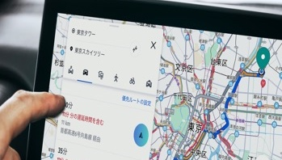

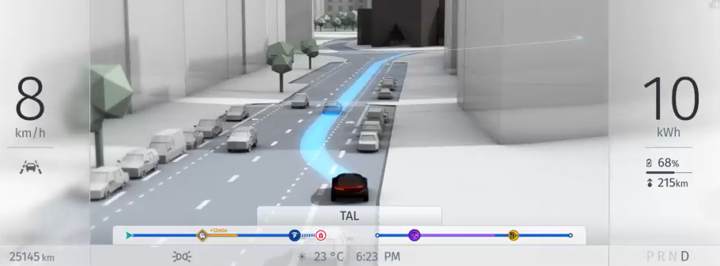
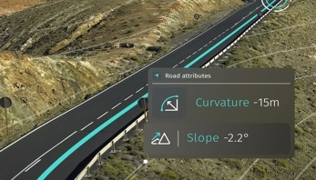
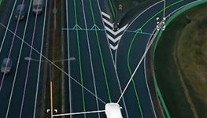

A map for the era of software-defined vehicles
Human driving
Build branded & differentiated UX
Support & simplify the (EV) driving experience
Drive consumer trust & desire for software
Develop safe & resilient ADAS
Extend ODD of automated driving
Machine driving
One unified, live, learning map
supports multiple SDV use cases with the following benefits for OEMs
Simplification and quality
Lower total cost of ownership
Innovation and
brand differentiation
Faster deployment

Slide 20
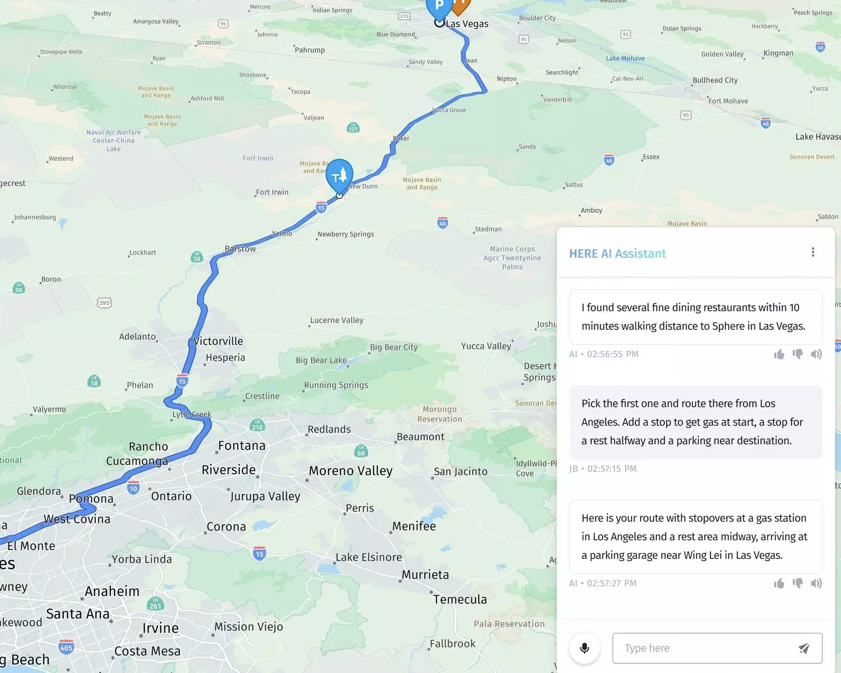
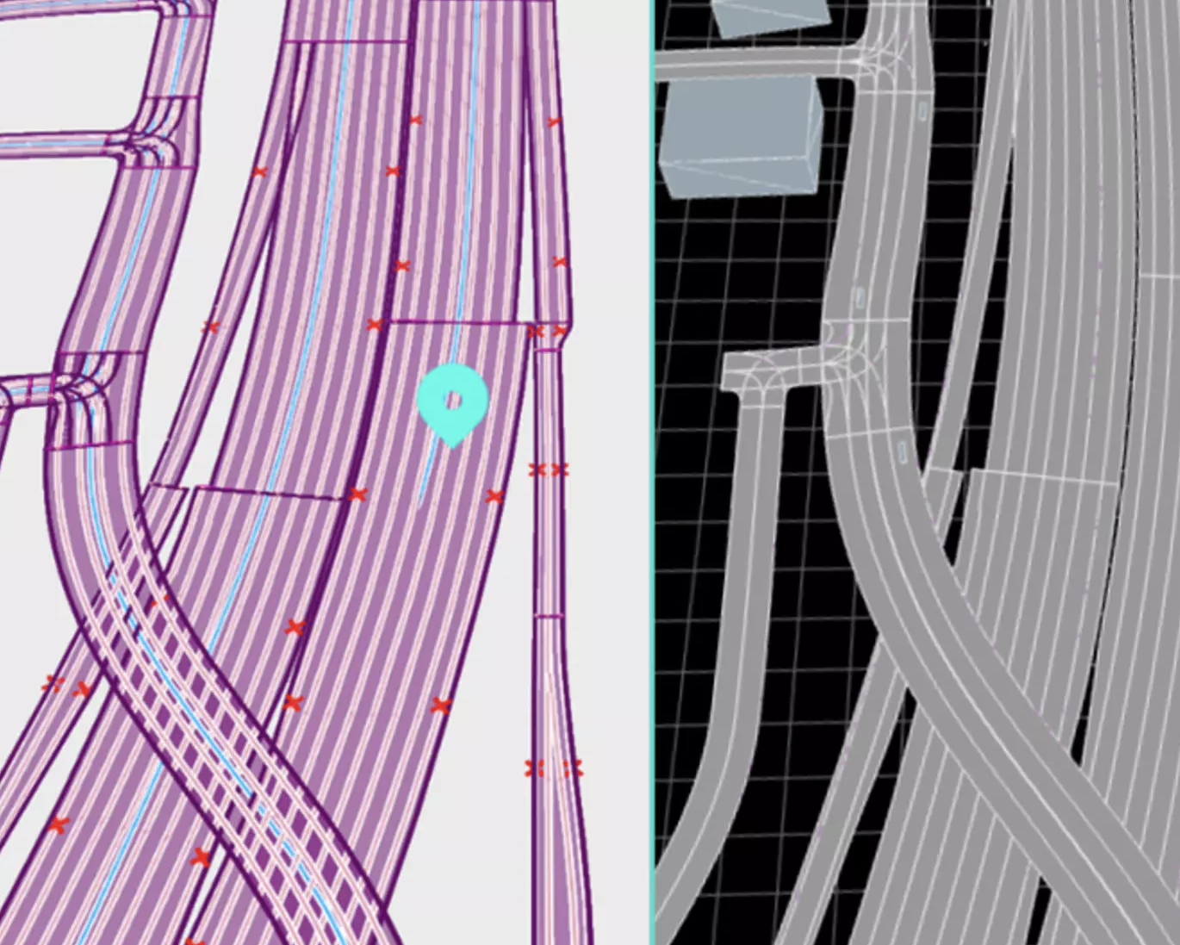
HERE has used artificial intelligence for over a decade
Two recent applications
AI in our mapmaking We use high-performance cloud infrastructure and proprietary artificial intelligence (AI) and machine learning (ML) models to process map data faster at a larger scale.
HERE AI Assistant
An intuitive companion for contextual, real-time and predictive location-aware interactions. It leverages generative large language models for an optimized total cost of ownership.
SceneXtract
Built with AWS, this software tool helps unlock new possibilities
for automotive developers by recreating real-world environments for ADAS and automated driving simulation.
AI in our products Some of our commercial applications use AI. We also work with customers and partners to deliver AI-powered innovation for vehicle automation, safety and digital cockpits.

Slide 21
Our product portfolio
Software
Automotive applications
HERE Navigation
HERE Automated Driving Zones
Logistics applications & Enablers
HERE Tracking⁴
HERE WeGo Pro
Consumer applications
HERE WeGo
Services
Advisory
Solutioning workshop
Health check
Consulting block
Acceleration
Migration
Dedicated program manager
Onboarding
Implementation
Custom implementation
ISA implementation
Navigation (passenger, commercial, 2-wheeler)
Custom location services
Mobile app development
Custom Mapping
Road asset inventory
Custom map development
Managed Services
Managed on-prem services
Custom managed service
Support
Support plans
Customer success manager
Location services¹
HERE Routing
HERE Tour Planning²
HERE Geocoding & Search
HERE Map Rendering
HERE Transit
HERE Positioning
Development enablers
HERE Navigation SDK³
HERE SDK
HERE SDK for Web
HERE Data SDK for C++, Python, TypeScript
HERE Style Editor
HERE Anonymizer¹
Content
Spatial data
HERE Probe Data
HERE Lidar Data
Static content
HERE Maps
HERE HD Live Map
HERE ISA Map
HERE ADAS Map
HERE Navigation Map
Static content cont.
HERE Areas & Boundaries
HERE Buildings & Structures
HERE Imagery & Topography
HERE Guidance & Routing
HERE Places & Points
HERE Road Infrastructure & Usage
HERE Road Rules & Regulations
HERE Spatial Relationships
HERE Lanes
Dynamic content
HERE Destination Weather
HERE Map Attributes
HERE Safety Cameras
HERE Traffic
HERE Parking
HERE EV Charge Points
HERE Fuel Prices
HERE Road Alerts⁵
Platform Foundation
¹ Certain HERE Location Services and HERE Anonymizer are also offered as Self-Hosted
² We also offer a Fleet Optimization package which includes HERE Tour Planning, HERE Routing, HERE Geocoding & Search and HERE Map Rendering
³ launch expected Q3 2025
⁴ Application Enabler
⁵ In Controlled Introduction (CI) with select customers
Notes:
Reflects changes as of March 2025

Slide 22




Our commitment to location privacy
4 ways it helps your enterprise
Stay in control of your data
Unlike with other map providers, our customers always stay in full control of their data, maximizing value and differentiation.
Avoid data misuse
HERE’s privacy-first approach means we only collect the minimum data necessary. We balance privacy protection with preserving data value and accuracy.
HERE Privacy
Charter
Go beyond compliance
Our 30+ patents for privacy-enhancing technology help keep our customers ahead of today's regulatory privacy standards - and prepared for tomorrow's.
Build trust with customers
HERE’s vast portfolio of attestations and certifications confirms our ongoing commitment to data security and privacy.
Notes:
We’ve designed the HERE platform to serve the needs of customers.
And something our customers value highly is of course data privacy and in particular, location data privacy.
We have architected the platform with privacy in mind.
That means a number of things:
You and your business are in control of your data at all times.
The HERE platform supports realm separation, and gives you full control on data visibility and sharing.
You determine to whom you expose your data and how it is consumed by others, including HERE itself
You benefit from strong data security processes.
We use strong and effective measures to protect your data against unauthorized access, use, modification or loss
We provide strong encryption methods to protect customer and consumer information, while preserving its utility in personalized services.
We practice data minimization and don’t collect data we don’t need.
And we always promote pseudonymity for data subjects wherever a service does not require personal information to function.
Privacy by design is integral to every service we develop.
We’ve also got an eye on the future. We have several privacy-enhancing technologies in development.
These include technologies in the areas of user-friendly consent management, anonymization, differential privacy and federated machine learning.

Slide 23











Meet our global leadership team
Denise Doyle
Chief Product Officer
Stuart Ryan
SVP, GM – AMER
Denise Doyle
Chief Product Officer
Jason Jameson
Chief Customer Officer
Gino Ferru
SVP, GM – EMEA
Damandeep Kochhar
Chief Platform & Technology Officer
Werner Buskermolen
Chief Human Resources Officer
Mike Nefkens
Chief Executive Officer
Deon Newman
SVP, GM – APAC
Adeel Manzoor
Chief Operating & Financial Officer
David Kenzer
Chief Legal & Compliance Officer
Bart Sweerman
SVP, Services & Support

Slide 24





Our Purpose Principles
Rise to the challenge
Welcoming debate, testing assumptions and exchanging ideas is how we achieve our best thinking and arrive at the brightest answers.
Channel curiosity
Always learning while listening, we build close relationships and broaden our knowledge to help our people and customers go further.
Chart new frontiers
We have the vision to see what doesn’t yet exist, the courage to do what's never been done and the grit to get there.
Advance by listening
Welcoming debate, testing assumptions and exchanging ideas is how we achieve our best thinking and arrive at the brightest answers.
Earn trust at every turn
We focus on details and protect our customers' information like our own, with a passion for precision and empathy in every action.
Who we are when we are at our best

Slide 25





Our Purpose Principles
Rise to the challenge
Welcoming debate, testing assumptions and exchanging ideas is how we achieve our best thinking and arrive at the brightest answers.
Channel curiosity
Always learning while listening, we build close relationships and broaden our knowledge to help our people and customers go further.
Chart new frontiers
We have the vision to see what doesn’t yet exist, the courage to do what's never been done and the grit to get there.
Advance by listening
Welcoming debate, testing assumptions and exchanging ideas is how we achieve our best thinking and arrive at the brightest answers.
Earn trust at every turn
We focus on details and protect our customers' information like our own, with a passion for precision and empathy in every action.
Who we are when we are at our best

