Slide 1
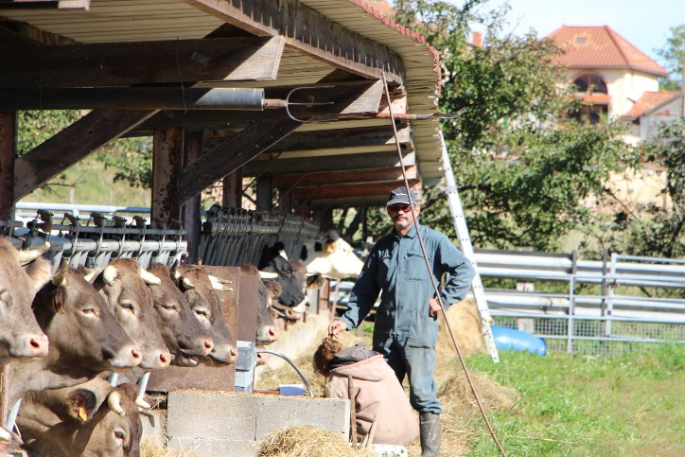
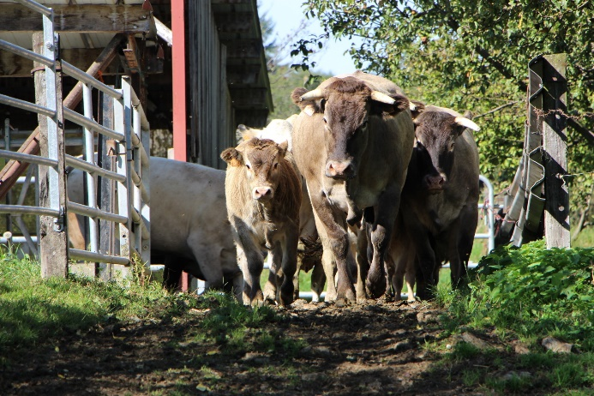

BAZADAIS FARM VISIT – Thierry GARDON (42)
Introduction to the farm
Location, Cremeaux in the département of the Loire
Height above sea-level, 560 m
1 full-time farmer & 45 ha of farmland - 10 ha of mixed forage cereals (rye, triticale, wheat), 20 ha of temporary pasture & 15 ha of permanent pasture
Rearing of Bazadais cattle, poultry and oils
Background
1st February 1993, Thierry sets up as a farmer taking on his parents-in-law’s farm of 22 Holstein cows and 28 ha of farmland
1995, Increase in the farmland
2000, Begins poultry production
2009 : Conversion of the farm to organic and start of oil production with off-farm purchase of seeds
2012, Purchase of first Bazadais heifers
2013, Purchase of more Bazadais heifers, plus cows and a bull, becomes a member of the Herd-Book Bazadais, signing up for Performance checking
2014, Stops milk production
Herd breakdown
Males,
1 Bazadais bull for natural service, replaced every 3 years
2 bullocks in 2020
6 bullocks in 2021
3 bullocks in 2022
Females,
15 cows
4 heifers in 2021
7 heifers in 2022
PEDIGREE ONLY
The objective is to increase the number of breeding cows to between 15 and 20
Herd Management
Building, a loose covered yard with straw-bedded area
Ration, haylage + 1kg of cereals in winter, summer grazing
EXCELLENCE BAZADAISE – Bazadais breed selection organisation
2, La Jardiasse Est – 33430 BAZAS Tél : +33 (0)5 56 25 11 67
excellence-bazadaise@orange.fr www.bazadaise.fr

Slide 2
BAZADAIS FARM VISIT – Thierry GARDON (42)
Selection
Average maternal ancestry indexes of the
herd for 2022 (source : BGTA 2022)
 | Farm 2022 | Breed
Herd | 13 | 2531
Easy-calve | 98.0 | 100.4
Growth index | 100.1 (+0.1 kg) | 98.6
Muscle index | 97.8 (-1.0 pt) | 99.0
Skeletal index | 99.3 (-0.3 pt) | 98.8
Fine bone index | 99.5 | 100.0
Wean Index | 96.6 | 98.0
Calving index | 97.8 | 100.4
Milk index | 99.3 (-0.9 kg) | 100.3
MATERNAL index | 94,6 | 98,6
Sales
Several young stock sold as breeding stock
Finishing of 6 to 8 bullocks/year, slaughtered at 3 years old (470 -480 kg average carcass weight)
Finishing of 4 to 6 cull cows/year(400 – 420 kg average carcass weight)
Slaughted at the abattoir in Charlieu (42) and sold direct to butchers in Lyon and Clermont-Ferrand mainly (at a price varying between 6.50 and 7.20 € kg)
Other production, oils sold in 75cl bottles or 5 litre cans and sold to AMAP, Organic farmers' shops for direct sale. Poultry (chicken, guineafowl, geese, turkeys, ducklings and old breeds of poultry) are marketed in the same way, but also directly to butchers and restaurateurs. All other males are castrated and reared as bullocks.
In brackets, indexes expressed as physical values
Calf performance
Calf performance accounted for in indexing (source : BGTA 2022)
Performance | Herd | Race | Breed
Effectif | Numbers | Average
Weight at birth | 13 | 39.2 kg | 41.4 kg
120-day weight | 9 | 153.6 kg | 159.3 kg
210-day weight | 9 | 209.3 kg | 247.6 kg
Muscle Dev. | 9 | 59.5 pt | 60.3 pt
Skeletal Dev. | 9 | 64.0 pt | 57.1 pt
“I discovered the Bazadais while working as a farm manager near Bazas between 1989 and 1991. For me, it's the only breed adapted to climate change that can withstand hot, dry summers. My selection choices are based on the milking aptitudes of the dams, morphology and bone fineness” Thierry GARDON
EXCELLENCE BAZADAISE – Bazadais breed selection organisation
2, La Jardiasse Est – 33430 BAZAS Tél : +33 (0)5 56 25 11 67
excellence-bazadaise@orange.fr www.bazadaise.fr

