Slide 1
Connecting Physical and Digital Worlds together Key enablers for Smart Buildings
Generic presentation

Slide 2
5G-A
Incorporated in Luxembourg in February 2022 by the founders of: 5ABox (Be, 2014) and Giga-Concept (Fr, 2003).
Combined we propose the expertise of a team of 26 people with a consolidate turnover of € 7.2mio and more than 1000 customers across the world.
Giga provides the right expertise in Hardware, Radio Networking, Audit and Integration 5A develops Software’s running on Giga Hardware's that simplify dramatically large IoT deployments for Smart buildings, Cities and Smart Mobility.
Based on LoRa (LPWAN) 5G-A proposes Reliable, Cost effective , Large Scale wireless IoT deployments good for the citizen and for the planet. We propose unmatched skills in protocols, data transport, integrations, Tier One references.

Slide 3
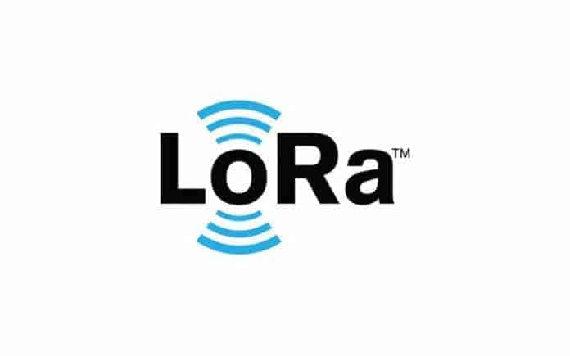
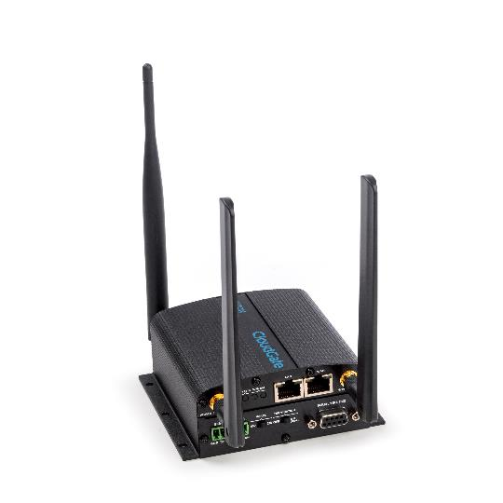
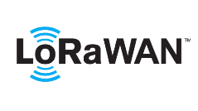
High Level Architecture
LOOPBACK
INPUT
GPIO
Vendor’s controllers
CLOUDS
& PLATFORM’S

Slide 4
Why the CloudWizzard?
Configuring input and output in LuvidRED (programming language embedded in the gateway) is not easy
The CloudWizzard is an abstraction software allows quick and easy configuration –> no programming skills required
Remove the need for in-depth knowledge of protocols :sensors protocols doesn’t talk with industrial protocols, integration is made plug and play
1000+ LoRa sensors in library

Slide 5
Why the CloudWizzard?
Pre-integrate with major platform providers; cloud like for Amazon, AWS, specialized monitoring platforms and local loopbacks like Building Management Systems and controllers
Simultaneous multiprotocol output (BACnet, Modbus, MQTT)
Verify the behavior at every step of the way (logging)
Tailor the interface to the requirements of the customer
=> Make the physical deployment easy for any kind of technician

Slide 6
Cloudwizzard Interface
A web-based interface with input and output applications
Input from different protocols depending upon the hardware or interface
Output to various cloud platforms or local loopback to Modbus and/or BACnet

Slide 7
Why the SRAS?
SRAS Stands for Secure Remote Access Service a SW developped by 5G-A on the CloudGate.
With SRAS you can access your devices remotely as if you were on-site.
SRAS is a L2 VPN solution based on OpenVPN and L2TP over IPSec.
The solution is segmented in virtual switches that connect one or more CloudGates to your device(s).

Slide 8
Why the SRAS?
It is different from a traditional VPN solution that it does not require a VPN concentrator to connect to multiple CloudGates.
Because of the virtual switch technology, you can group your CloudGates on a per customer basis.
Since January 2023 5G-A proposes the SRAS 2 (Layer 3 Virtual Wire) enabling to connect remotely on Local BMS controllers (JCI, Honeywell, Sauter, PRIVA, Distech, Siemens, Schneider….) opening a new world of possibility for tele maintenance, remote services, Security…

Slide 9
High level data flow chart
Sensor
Gateway
Cloud
Sensors
LoRa
LoRa gateway
ModBus
ModBus gateway
BLE
BLE gateway
IoT Platform
CAN
CAN gateway
Connected objects
Command
Command
Bidirectional Gateway
Notes:
What is Option’s added value to T-Systems ? A smart gateway, called CloudGate.
Let’s take the same picture, and let’s see how Option’s innovations is transforming the IoT connectivity.

Slide 10
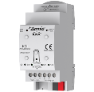
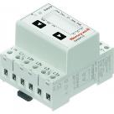
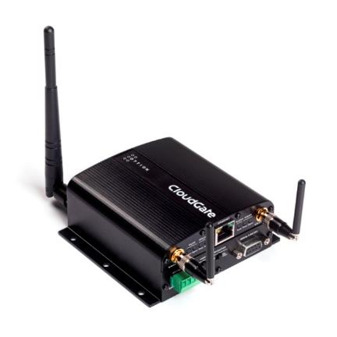
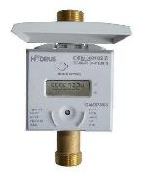
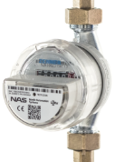
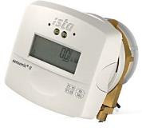
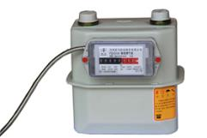
Connected to any kind of meters
Electricity meters
Remote monitoring of meters
To improve understanding of consumption pattern
To allow focused energy saving
CloudGate is connected to a meter, monitored via wired/wireless interface
The 5G-A CloudWizzard flow will readout and gather data from meters converted from several protocols. Normalized data are send to the information to the SCADA, Building Management System, Building controller or cloud platform of choice
KNX
Modbus
M-Bus
LoRa
Water meters
Heat meters
M-Bus
LoRaWAN
M-Bus
Gas meters
M-Bus

Slide 11
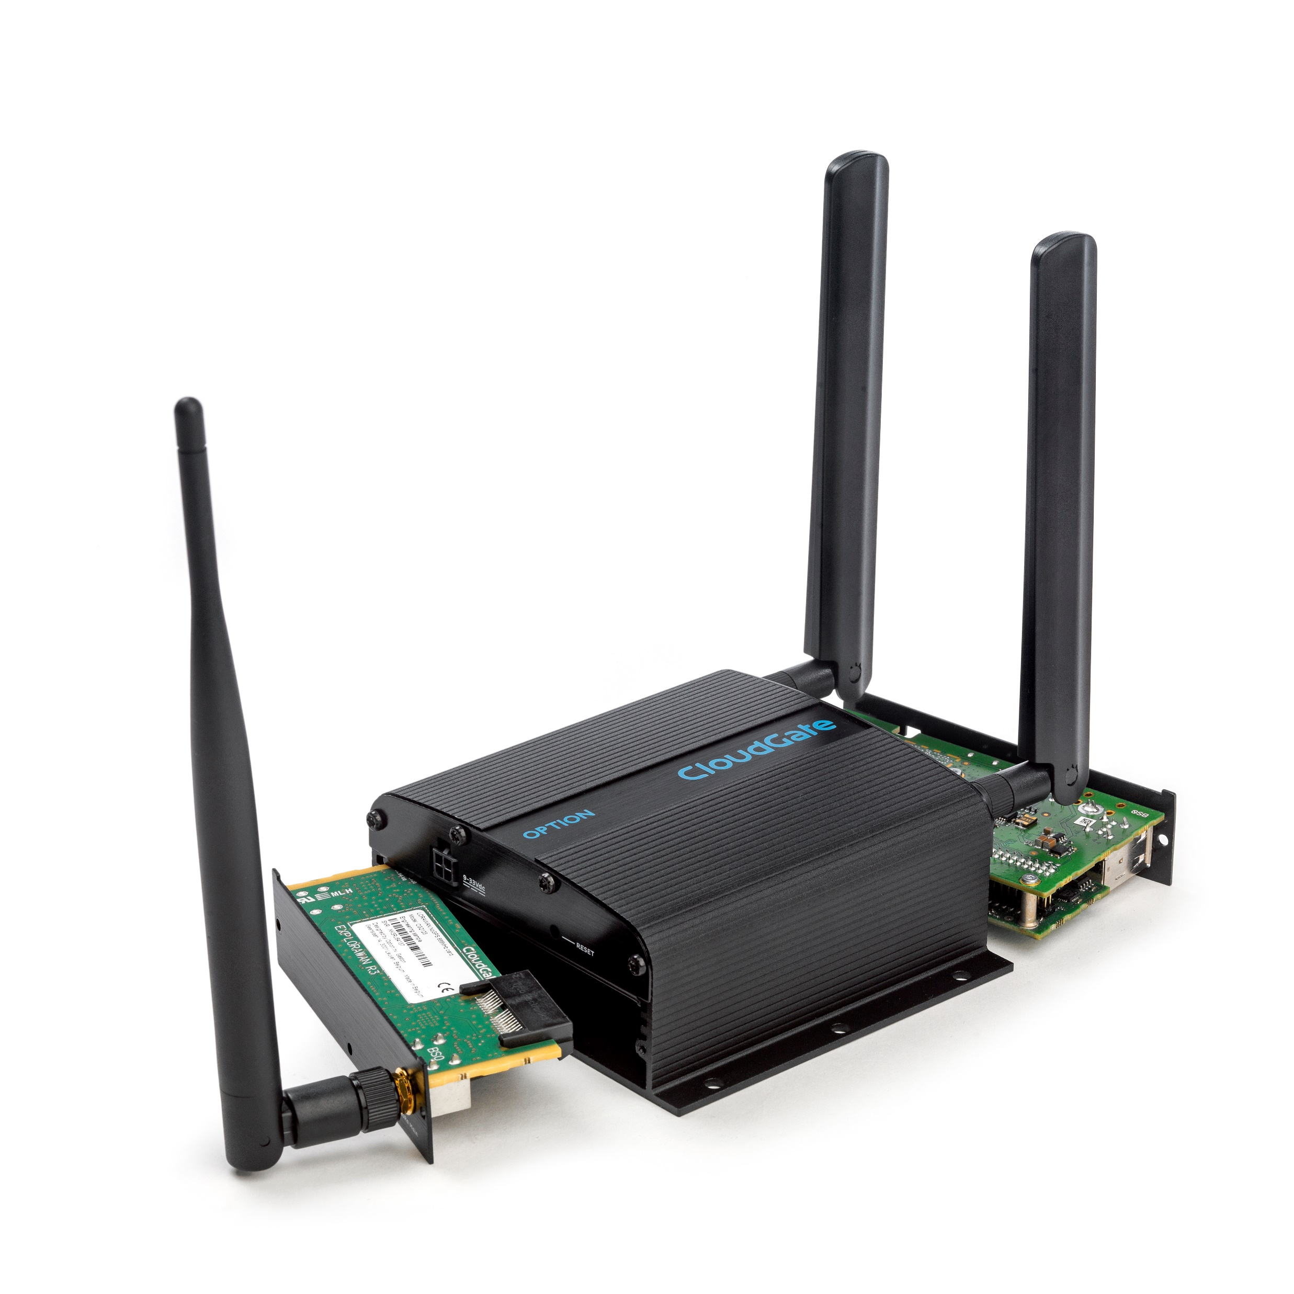
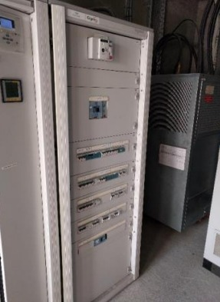
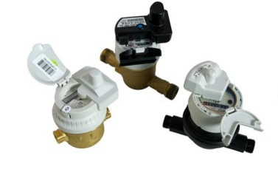
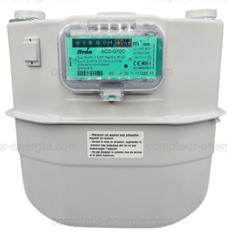
SNCF Remote Meters Reading

Slide 12
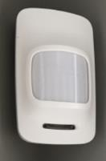
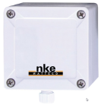
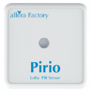
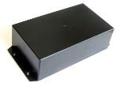
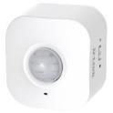
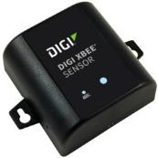
Connected to unlimited range of sensors
LoRaWAN
Remote sensoring
To monitor the local situation of a measurement variable (temp, current, humidity, CO2, complex internal and external air quality...)
To get insight in local condition and ability to alert before problems occur
Solution overview
CloudGate is wireless connected to a number of sensors using wireless protocol
The 5G-A CloudWizzard is gathering sensrs data to the cloud/local platform of choice

Slide 13
Focus on one Vertical solution SAVE-EnergY
End to End solution to measure, pilot control and optimize energy consumption related to heating .
Based on real time temperature monitoring , the SAVE-EnergY platform pilots wireless Thermostatic Valves
Scripting to anticipate WE and Holidays, automatic monitoring up to a pre-defined temperature with no possibility (as an option) to manually force temperature upward
20 up to 30% savings on your energy bills
IoT infastructure ready to add other solutions like SAFE-AiR

Slide 14
SAVE-EnergY
Proven solution, industry grade
Robust components, cutting edge Hardware, less than 0,1% RMA’s
Limited deployment and integration costs, the solution is wireless and preconfigured. Installation can be done by a technician
No maintenance costs, and limited operations costs through remote service functionality
Pay as you use
100% IT security proof, we do not interface with corporate IT

Slide 15
SAVE-EnergY, key points
Based on the Helios Control platform (co-developed), the proposed solution is enriched by the robustness of the CloudGate equipped with the CloudWizzard Software, that allows immediate LoRa Network deployment with pre-configured sensors and ready to use management platform
With SAVE-EnergY save up to 30% of your energy consumption and benefit from a ready to use LoRa network, to develop other low-cost intelligent building management solutions.

Slide 16
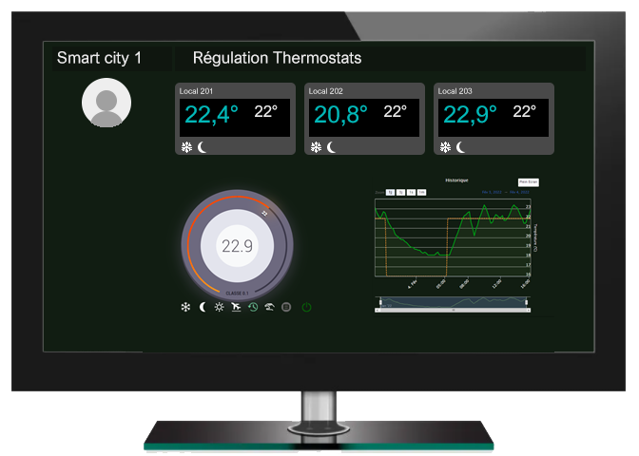
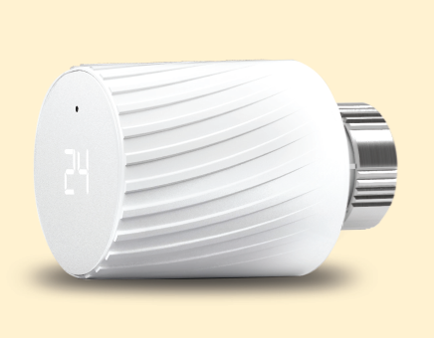
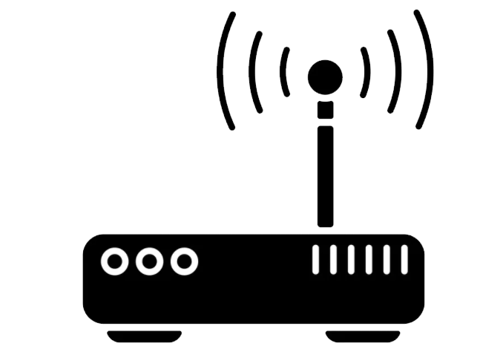
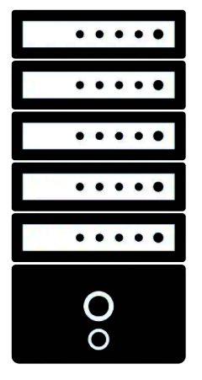
SAVE-EnergY
Temperature data is sent room by room
T° Sensors
LoRa valves
Room 1
Long Range indoor transmission
Up to 10 Years battery life
Room 2
Room 3
internet
Room ….
CloudGate
AI
LoRa Valves are regulated room by room
Data center

Slide 17
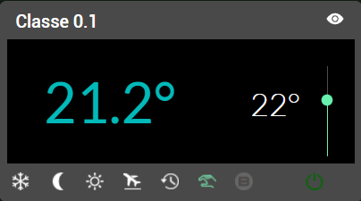
SAVE-EnergY
Simultaneous piloting of several thermostatic valves room by room
LOCAL 0.1
Local 0.1
Ext 10°
PID

Slide 18
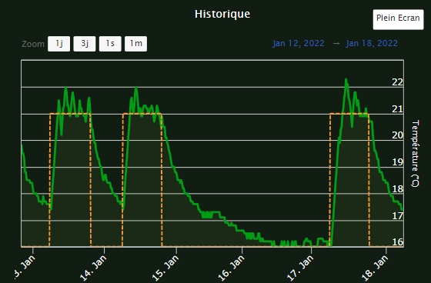
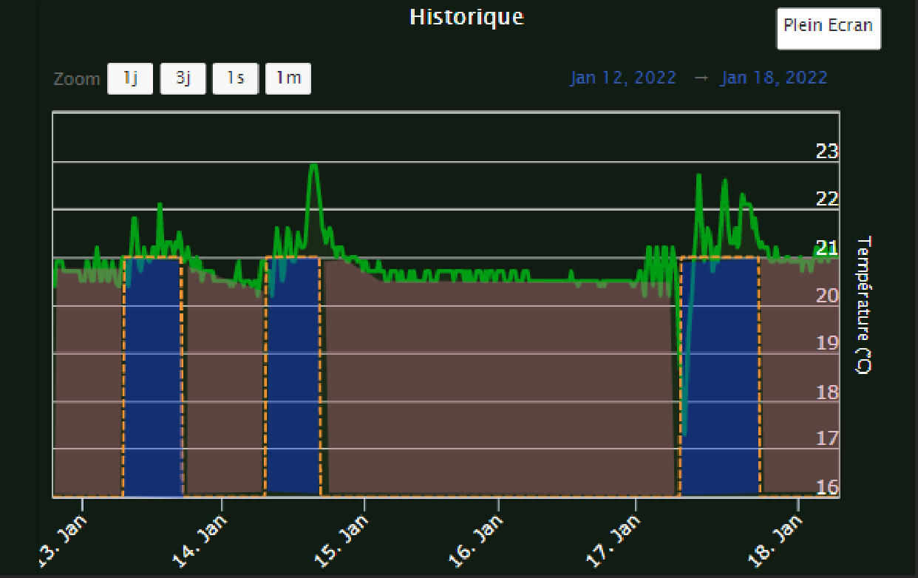
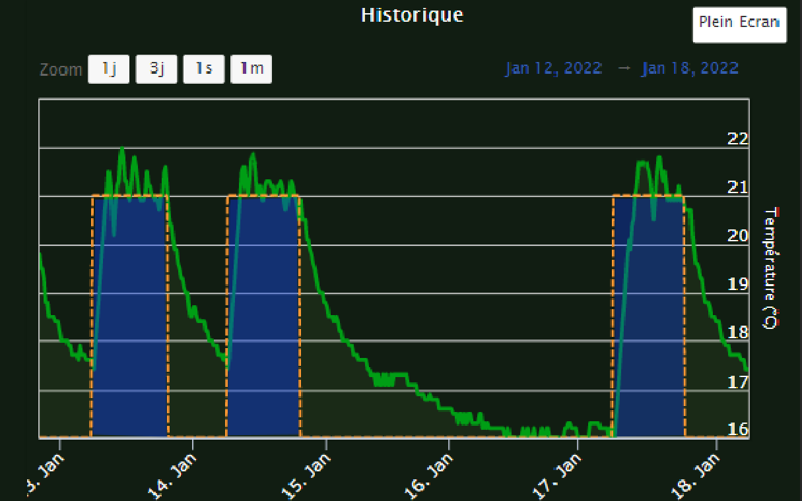
School in Belgium
One Week class room behavior with normal thermostatic valves and no regulation
One Week class room behaviour with LoRa regulated thermostatic valves
Continuous Heating
Heating needed
smartville.be
18

Slide 19
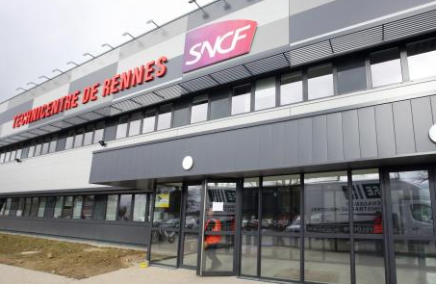
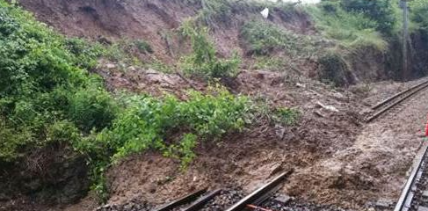
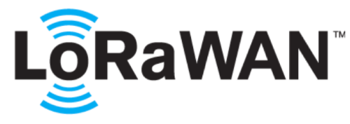
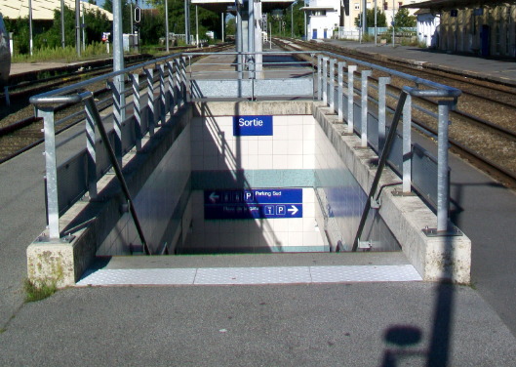
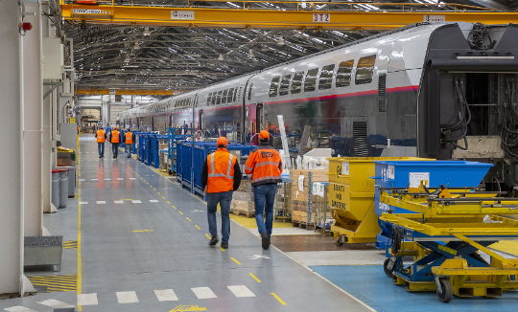
References
SNCF : multiple cases
Air quaity in class room’s
CO2 / Temperature monitoring
Heating Control with thermostatic valves with HELIOS
Décret tertiaire : 40 % savings 2030 – Heating Control
Landslide detection: prevention, security , alert Technical centers (21): Gas, Electricity maonitoring
Undergrounds: Lift Pomp management .
AVISE : One Gateway per IR train, door opening sensors.
560 gateways, more than 2500 sensors.
Robert DEBRE Paris
CO2 / Température Monitoring
Heating control (pilot wire) for electrical heating Control
Done by BMS in bacNET, HVAC regulation
Bureaux partagés
9 Parameters monitoring for air quality
Presence management for better workspace management

Slide 20
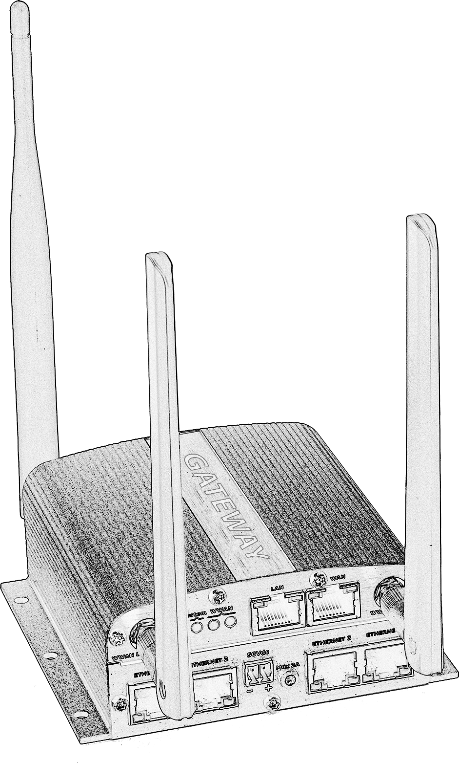
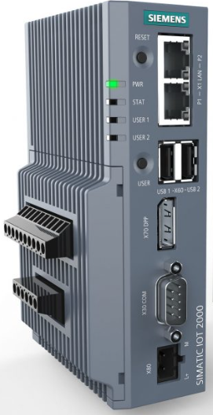
Electricity consumption: Measure-Control
Master
Robert Debré Hospital
Each room is monitored separately.
Master Gateway converges all data gathered by Slave gateways
Helios platform analyze and control pilot wire and thermostatic valves
Infrastructure ready for other applications like presence, air quality, workspace and parking management
T°, Humidity
Pilot Wire and thermostatic valves

Slide 21
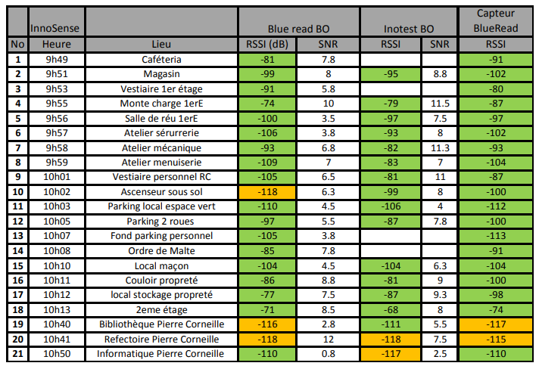
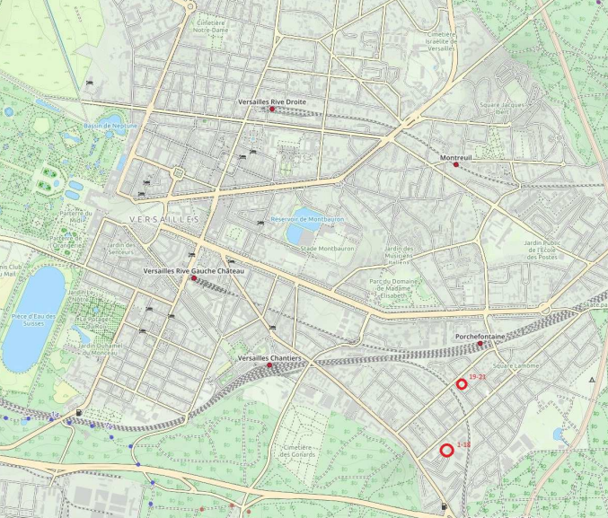
Smart City of Versailles
LoRa NW Audit to best position the Gateways
Un réseau privé a base de cloudgate pour remonter des capteurs de toutes sortes.
Just 6 Gateways needed for full municipality coverage, 6 added for redundancy purposes
Sensors : Temperature, Humidity, Air : CO2 / COV
Water and Gas Consumption
Public Lighting control; Public watering control
…

Slide 22
Other meaningful references
Management of public fountains in Brussels
Several customers via a partner: Energy monitoring to export towards specific platform in audit mode, before migrating to an Energy as A Service Model
Grands Chais de France, level monitoring and controllers alerting (Alcool level….)
Municipality in Rambouillet. Conservatory building , energy control
Selected in the SMARTVILLE portfolio with Save-Energy, HELIOS, thermostatic valves

Slide 23
Other meaningful references
Remote control for a major HVAC integrator in Luxembourg (POC)
Integration with BIM editor in Luxembourg (POC)
Monitoring and regulation of benign bacteria for cleaning purposes (POC)
Total Energy: Toilets cleaning level
Renault Flins: energy and water consumption monitoring
Sony 170 offices , presence monitoring to optimize cleaning services.
VIP Lounges Iberia, presence, air quality, workplace management

Slide 24
Return on Experience, Best practices
IoT is a Business project, a citizen agenda not a technical one: customer awareness, Collaboration, leadership visibility
IoT is an Industry grade project, not an academic one: Audit, Robust HW and SW
IoT is not a one shot: IoT Roadmap, future proof to welcome additional functionalities
Deploy the best communication layer: fit for purpose, no dogma
- Find the right specialized partner with an ecosystem
Knowledge transfer

Slide 25
Thanks !
5G-A Sàrl S
9 Rue du Laboratoire
L-1911 Luxembourg
luc.verschaffel@5abox.com
+352 691 404 730

Slide 26
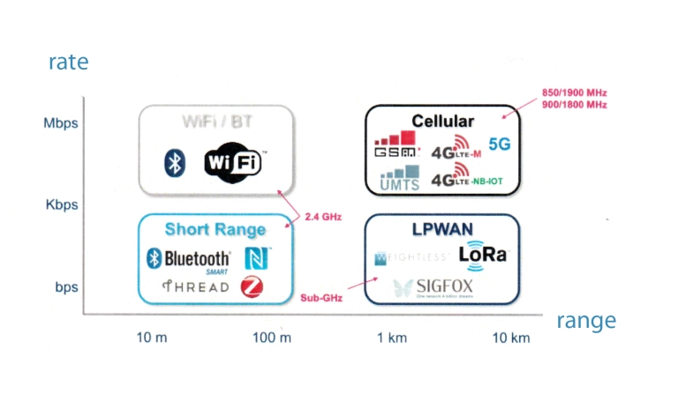
Several data transport networks

