Slide 1


CHOOSE CORSICA
A strategic choice in the heart of the Mediterranean region

Slide 2
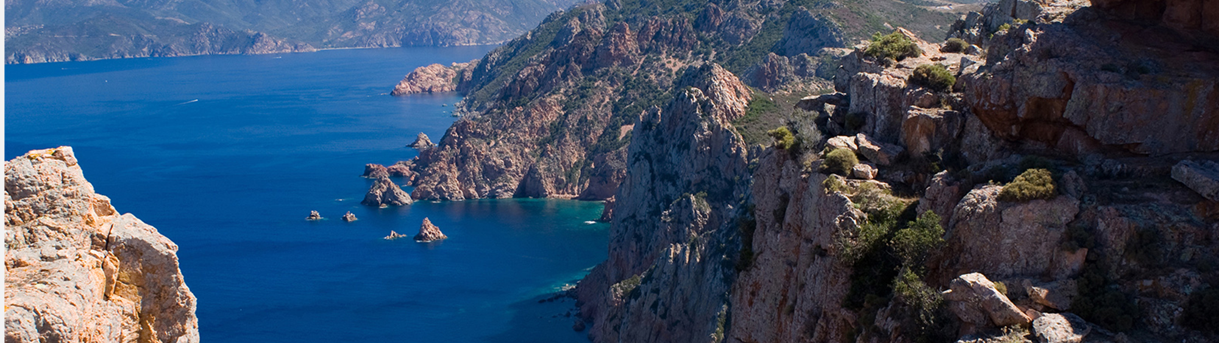
CORSICA
8 722 km²
1 000 km
350 000
A strategic choice
in the heart of the Mediterranean region
3rd BIGGEST ISLAND IN THE MEDITERREAN SEA
After Sicily and Sardinia
OF COASTLINE
Offering a lot of possibilities for blue and maritime economy
INHABITANTS
+5,7% in 5 years
The most significant increase in France
A growing intern market

Slide 3
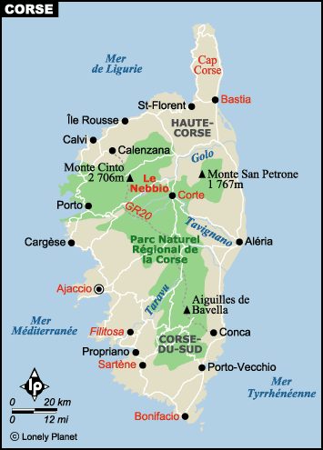
Geography and environment
Environmental protection is key to Corsica’s development. The Island is already cooperating with European partners to become a model for the future of green and sustainable societies.
» 45 % of the Island is covered by the Regional Natural Park of Corsica.
» 7 Natural reserves covering 86 624 hectars of protected area on the sea and on the land.
» 1 International maritime reserve the Straits of Bonifacio, between Corsica and Sardinia, in collaboration with the National Italian Park of la Maddalena.

Slide 4
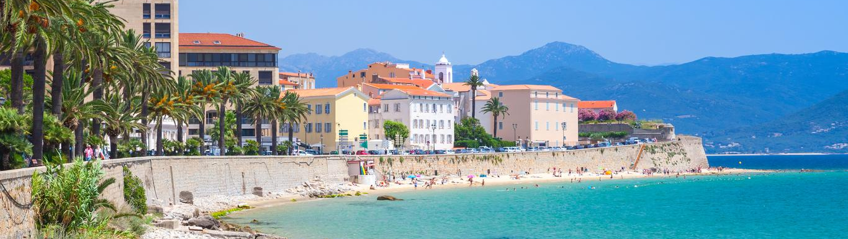
AJACCIO
72 647 Inhabitants
1 international airport
1 harbor
1 marina
18 primary schools
6 colleges
5 high schools
The Regional administrative capital and political center of Corsica.
Ajaccio has developed its economy around tourism and a sustainable use of the sea.
As a political and administrative center, Ajaccio gathers many economic and financial actors as well as innovation centers.
They are settled in Ajaccio
Regional incubator INIZIA – Ajaccio’s office
Economic Development Agency of Corsica (ADEC)
HQ of the Regional political Authority – Collectivité de Corse
Scientific Platforms MYRTE / PAGLIA ORBA
M3E – Local initiative to support entrepreneurship

Slide 5
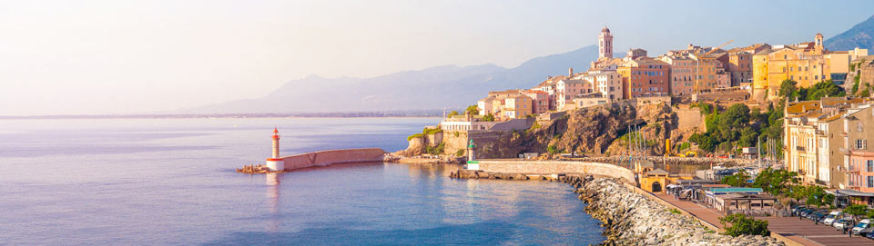
BASTIA
Economic center and first harbor of Corsica with direct connection to Italy.
The location of the city, in the North-East part of the Island, and its proximity with the Italian costs make Bastia the primary harbor of the Island.
Thanks to this activity, Bastia is considered the economic center of Corsica.
48 296 Inhabitants
1 international airport
1 harbor
1 marina
14 primary schools
5 colleges
5 high schools
They are settled in Bastia
INIZIA – regional incubator Bastia’s offices
Scientific plateform STELLA MARE
AVVIA – local initiative to support entrepreneurship
Bastia’s FABLAB

Slide 6
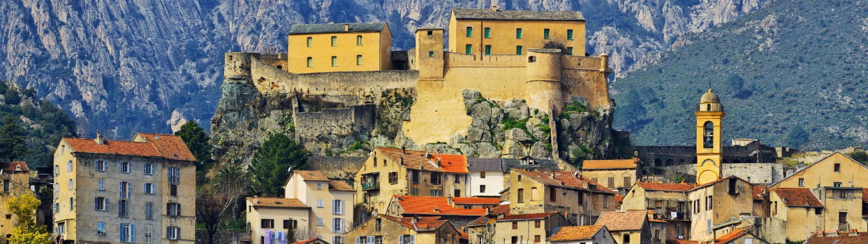
CORTE
At the center of Corsica, the historical and cultural capital and University city.
Located between Ajaccio and Bastia, Corte is the heart of all the innovative ecosystems of the Island as the University of Corsica is settled here since 1755.
7 546 Inhabitants
5 000 students
Center of Corsica
Railway station
2 primary schools
5 colleges
1 high schools
1 University
They are settled in Corte
University of Corsica
The University Foundation – the link between students and businesses
The FabLab

Slide 7
Economic datas
Corsica’s economic growth has been the most dynamic of all French regions over the past 20 years.
+2,50%
9,4 M €
50%
44 162
Economic Growth over the past 20 years
GDP in value in 2022
Part of SMEs in the economic fabric
Companies in Corsica
Services are at the forefront Corsica’s GDP composition
Corsica’s economy is characterized by a strong entrepreneurial spirit supported by Regional authorities.
An important local B2B market
French average : 1,3%
Tourism : a source of opportunity
With 2.5 M tourists per year, tourism is one of the pillars of Corsica’s economy.
It also represents many opportunities as the sector aims to become more and more sustainable.
Corsican tourism actors are seeking partners to help them through their ecological transition.

Slide 8



University of Corsica
Founded in 1755, a local talent pool for companies
2 Research platforms
STELLA MARE : fundamental reasearch in marine bio-economy and sustainability
MYRTE/PAGLIA ORBA : Solar energy storage, hydrogen, sustainable energies
Located in Corte, the center of the Island, the University of Corisca is a major actor in R&D as well as an important talent pool for companies to ensure their need of a skilled and qualified workforce.
Engineering School – Paoli Tech
Paoli Tech Engineering School is training students on 3 main topics
Energy Engineering
Smart Grids , Hydrogen sustainability
Sustainable construction
Environmental quality in the Mediterrean
Tech Engineering
Digital sciences
300 international students
60 different nationalities
5 000 students
100 majors
8 institutes
1 engineering school

Slide 9
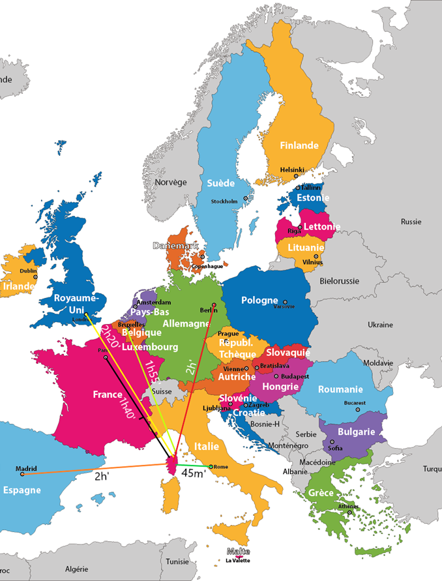
Accessibility
Airports
Corsica’s strategic place in the middle of the Western Mediterranean area allows passengers to come and go from all of Europe in less than 2 hours
4 Airports
38 European cities
AJACCIO – Southwest
BASTIA – Northeast
CALVI – Northwest
FIGARI – Extreme South
REACHABLE IN MAX 2 HOURS
PERMANENT FLIGHTS TO EUROPEAN CAPITALS AND MAIN FRENCH CITIES
Multiple daily connections to Marseille, Paris, Nice, Lyon …

Slide 10

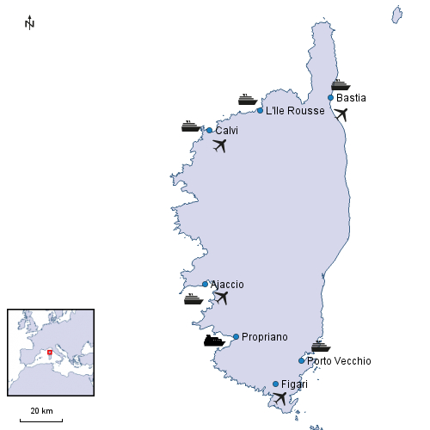
Accessibility
Ports
7 ports
AJACCIO, BASTIA, CALVI, ILE ROUSSE, PROPRIANO, BONIFACIO, PORTO VECCHIO
8 destinations
MARSEILLE, NICE, TOULON, GENOA, LIVORNO, SAVOA, Sta TERESA-DI-GALLURA, PORTO TORES
DAILY CONNECTIONS

Slide 11
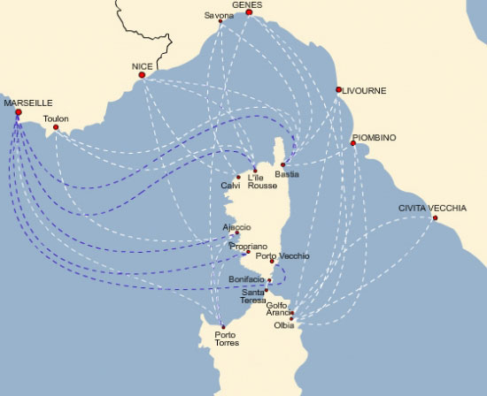
A central position in the French-Italian region
Corsica is a strategic choice for companies that want to strengthen their position in both the South of France, Western Italy and Sardinia.
With daily ferry and flight connections, the Island is eqsily qccessible to both countries.
Also, the proximity with Sardinia and the accessibility to the two islands gives Corsica a central place in exchanges within the region.
The Collectivité de Corse (regional authority) is engaged in strenghening links with its Italian partners.
Corsica is also involved in many European and transborder projects with Italian regions and nearby islands to build bridges for companies and develop economic, cultural and academic exchanges.
DAILY CONNEXIONS

Slide 12




Choose Corsica
Incentives
Partners for your project
Increased support for R&D
Support for skilled employment
Internationalization support

Slide 13
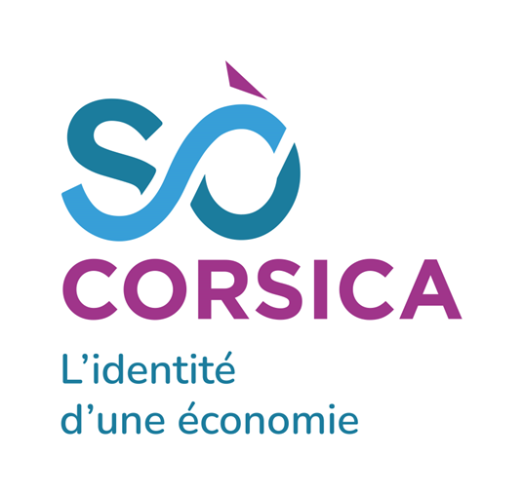
ADEC your partner for settling in Corsica
The Economic Development Agency of Corsica (ADEC) is the main partner for all companies in Corsica. As a public and regional entity, the Agency offers free services to help companies in their development.
Through supporting and implementing innovation in the island as well as to promote international partnerships, the agency is taking an important part in funding R&D projects, especially those focusing on solutions to the island’s main challenges.
Developing local production of G&S
Reducing Corsica’s dependencies on the main-land
Investing in innovation
Improving skills
Helping companies go global
Our Missions
What we do
Financial support
Federating ecosystems
Promoting ecological transition
Supporting digital transition
Building international partnerships
Attract foreign investors

Slide 14

INIZIA - regional incubator
A tool in the heart of innovative ecosystems
As an innovative projects catalyst, INIZIÀ is in the heart of a strong network of local, national and international experts and partners.
The main objective of the incubator is to support and stimulate growth of projects in Corsica.
INIZIA provides all its resources to project owners to guide them towards success !
Individualized support
Every project owner will benefit from personalised support from a project engineer specialized in innovation management. The expert will follow, advice and introduce the project owner to INIZIA partners.
Moreover, INIZIA supports start-ups while settling in Corsica.
R&D
INIZA has developed partnerships with the University of Corsica and the Fab Labs of Bastia and Corte to provide incubated companies with the equipment, facilities, and resources necessary for their R&D work.
Funding
INIZIA supports start-ups in their fundraising, providing access to a large network of public and private finance opportunities as well as its investor community

Slide 15
INIZIA – A strong network
Through its extended network in Corsica, mainland France, Europe and abroad, INIZIA helps start-ups develop their projects from stage 1 to international expansion.
A National and International Community
INIZIA’s expertise is certified by the French Ministry for Research and Innovation.
The presence of the Incubator in many international networks embodies the dynamism of INIZIA and the will to accelerate innovation in Corsica.
RETIS Network : The federation of local innovative support actors
Entreprise Europe Network : Pan-European network to support European cooperation and European projects action.
Technological transfer accelerator network
Capenergie : sustainable energy cluster
Training
Business Club and networks
Third Places: to gather citizens, companies, authorities and academics working together for a more sustainable economy

Slide 16
Opportunities for your business
Increased demand for sustainable and eco-friendly products.
Skilled workforce available for businesses.
Tax incentives and local economic development programs to support eco-friendly businesses.
An opportunity to tap into sustainable tourism and the local population's commitment to a sustainable lifestyle.
Local networks for product marketing.
Proximity to seaports for international shipments.
Many Corsican industries can represent a potential market for your business. Committed to reducing waste and increasing consumer responsibility, these industries are looking for partners to help them overcome these challenges.
Agrofood
The agrofood sector in Corsica is one of the most supported. The industry is committed to a more sustainable approach by seeking innovations that can help overcome environmental and responsible consumption challenges
Cosmetics
The Corsican cosmetic industry is one of the jewels of the island. Using indigenous essences and ancestral know-how, the industry has been committed for a long time to defending and respecting the Earth. Many Corsican companies in the sector are in demand for new materials to design their product packaging in a cooperative R&D logic.
Tourism
The Corsican tourist industry, and particularly the restaurant industry, is experiencing a major shift towards more environmentally sustainable practices. Tourism and restaurant professionals are looking for partners to support them in their eco-responsible approach.

Slide 17

Increased support for R&D
ADEC has set up, through U Pattu Innovazione (The Innovation Pact), a unique mechanism to promote the R&D activities of companies that have chosen to innovate in Corsica.
The advantages for companies established in Corsica
Fundamental R&D
Innovation R&D
Industrial R&D
80%
ADEC supports up to 80% of eligible expenses for fundamental R&D projects
70%
50%
ADEC supports up to 50% of eligible expenses for Industrial R&D projects
ADEC supports up to 70% of eligible expenses for R&D projects mobilizing less than 200,000€
in public aid over 3 years
Tax credit on R&D : 50% (30% for in-land France)
Tax credit on Innovation : 40% (20% for in-land France)

Slide 18

Support for skilled employment
Support for the employment of young graduates
Lump sum bonus of €8,000 per job to lead an innovative project
A bonus of €2,000 is granted for hiring a Level I (Master 2 or +)
Aid capped at €200,000 for hiring more than 10 employees.
Through U Pattu Impiegu (the employment pact), ADEC offers a system enabling companies, as well as graduates, to find the best working conditions.

Slide 19

Internationalization support
Thanks to U Pattu Impresamondu (the business world pact), ADEC offers a unique aid system for the internationalization of companies and acts as a privileged partner for development
30 to 50 %
30.000€
600€
1200€
Coverage of eligible costs
Allocated to companies by operation
Travel costs per person
Travel costs per person
Excluding travel expenses
As part of the EUROMED package for travel to France, Europe or the Mediterranean area.
As part of the Open Sea package for travel to all other areas.
Example of eligible aid
Participation in international fairs and exhibitions
Carrying out international prospecting missions
Costs related to the professionalization of the process of prospecting foreign customers
Intangible investments made by a specialist service provider in the sector to support the company in its internationalization process

Slide 20
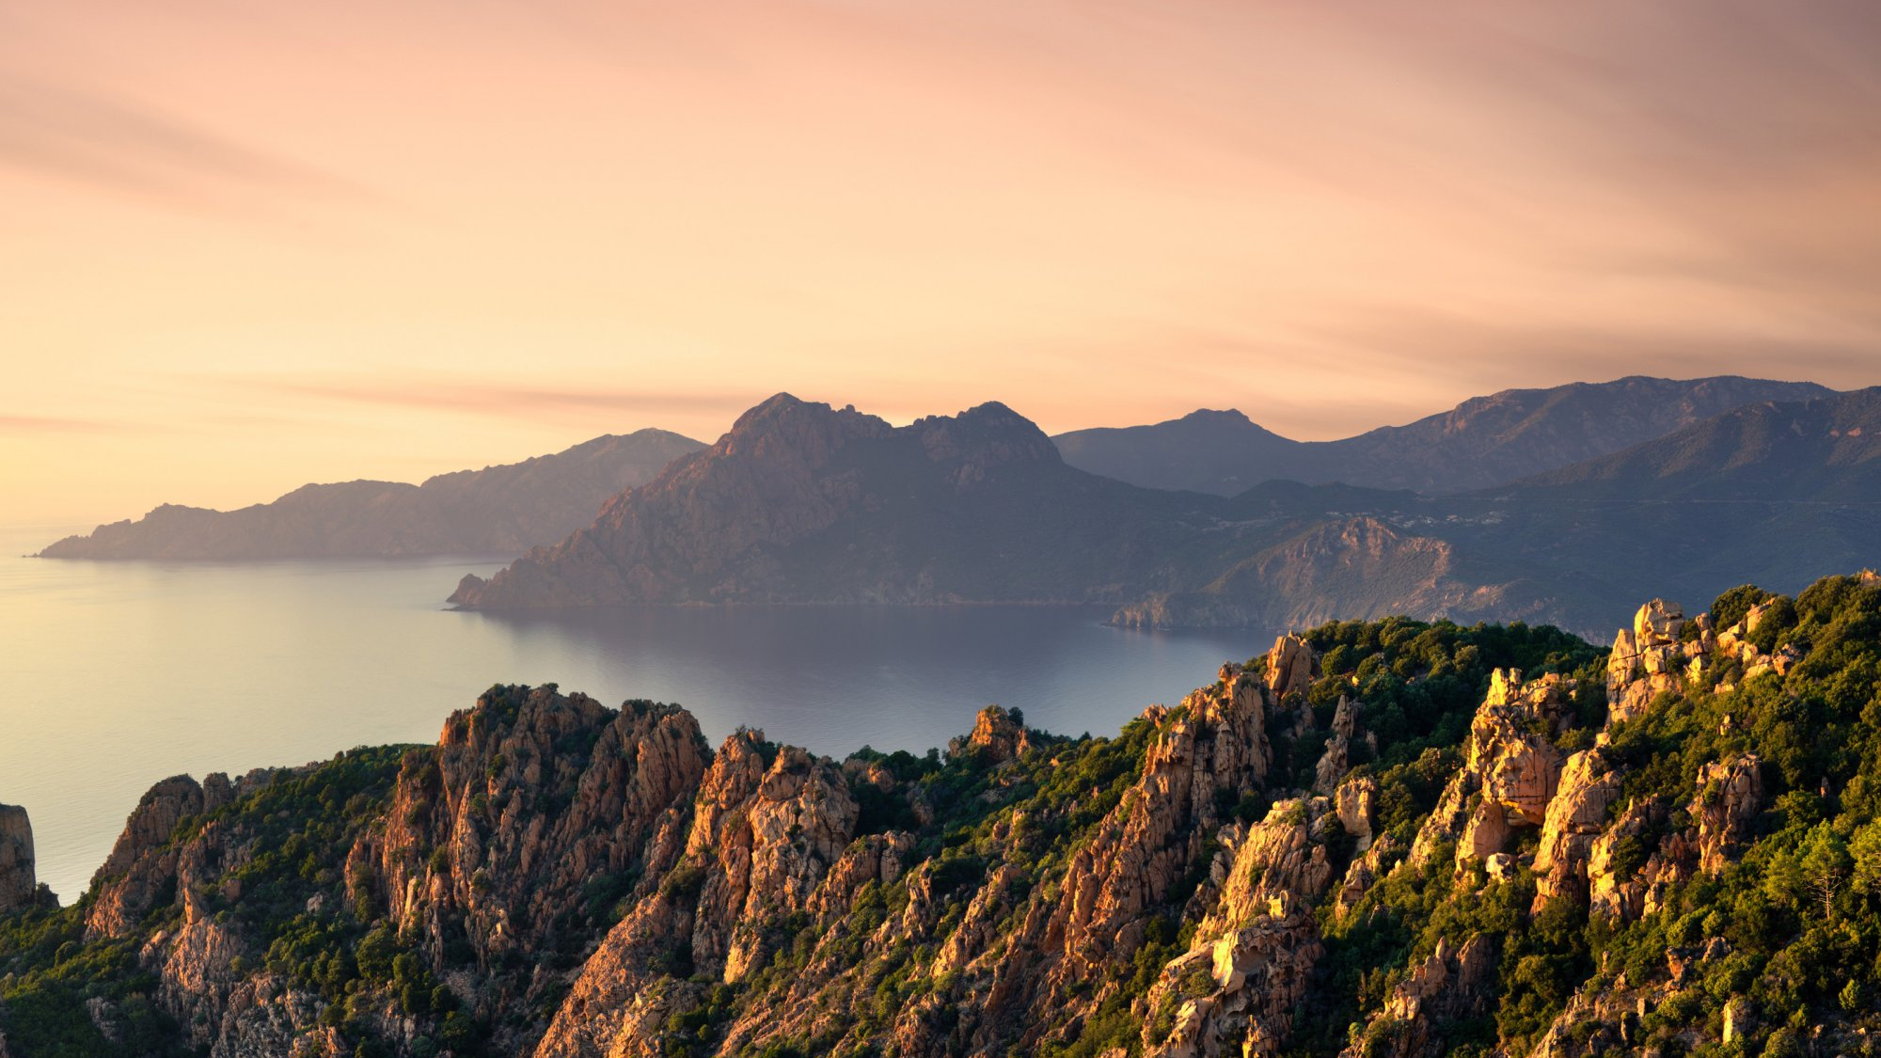
Your Contacts
Page 20
Mme Michèle CRISTOL
Head of the Export mission
+33 (0) 04 95 50 91 22
michele.cristol@adec.corsica
Mr Laurent BATTISTELLI
Special Envoy for Corsica in Europe
+33 (0) 6 31 92 85 63
laurent.battistelli@adec.corsica

