Slide 1
Global Presentation
Tapez pour saisir une légende.

Slide 2
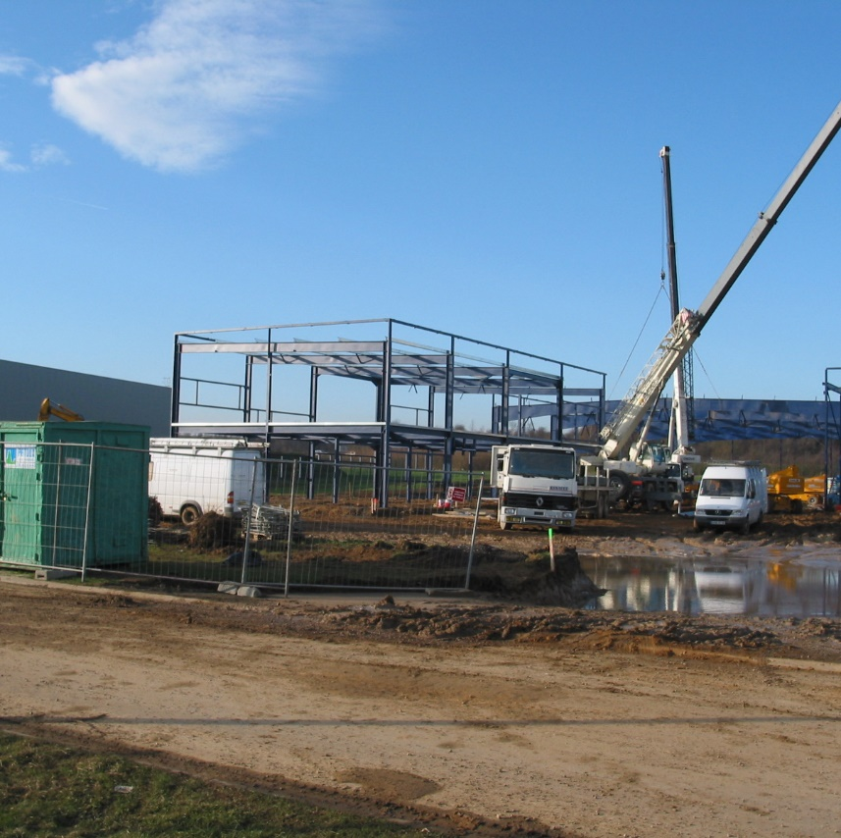
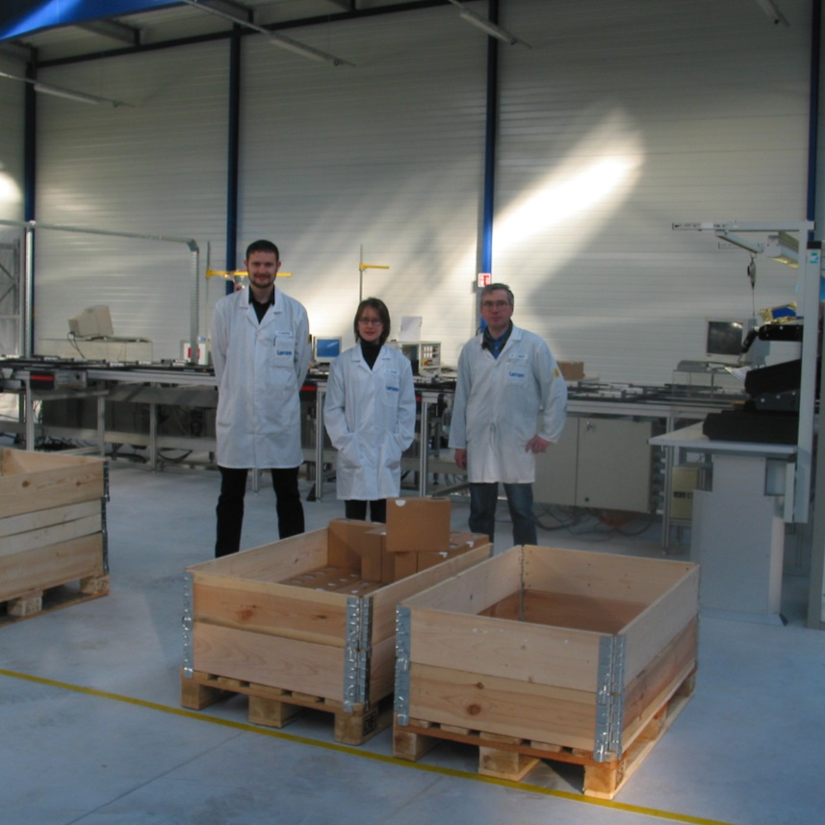
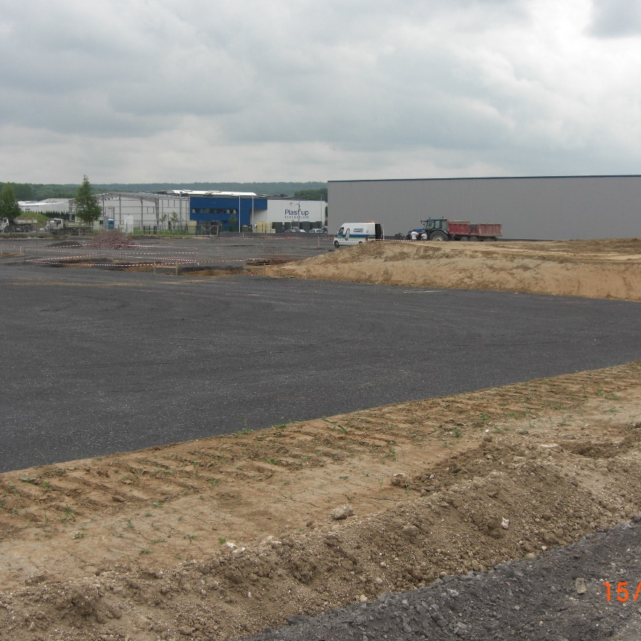
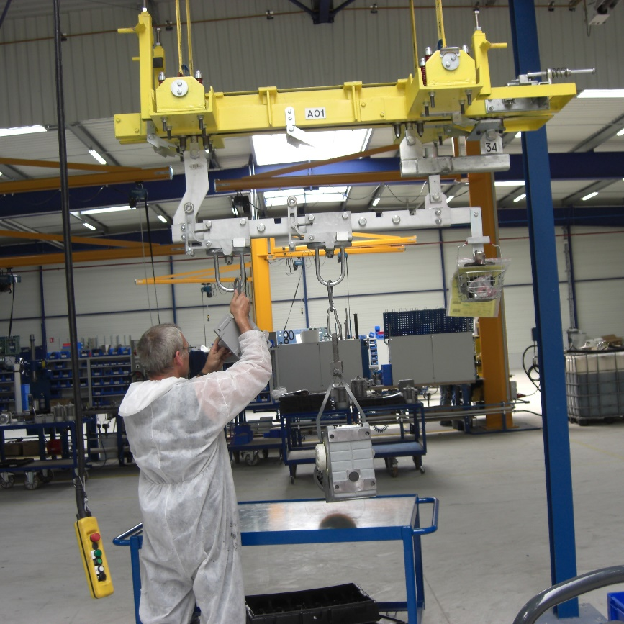
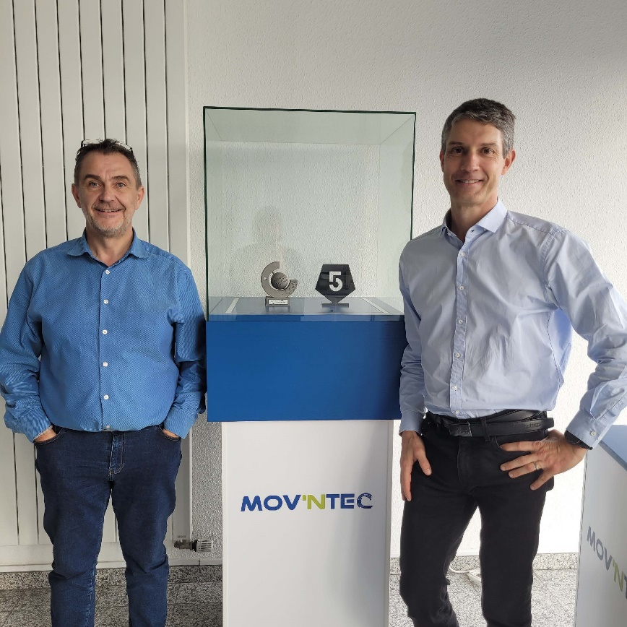
A young company
But with
20 years experience
2003
Set-up of Lenze manufacturing plant
May 2004
Start of Electronics Manufacturing
FOCUS 2030
Be an unavoidable actor
of decarbonation
in e-mobility
2008
Work in progress for the
building of the extension
2009
Mechatronics Assembly
Aug. 2022
Takeover of the site as MBO
By Antoine & Francis

Slide 3
Our mission
Take part in the reduction of carbon footprint by providing technological and pragmatic equipments covering current expectations.

Slide 4
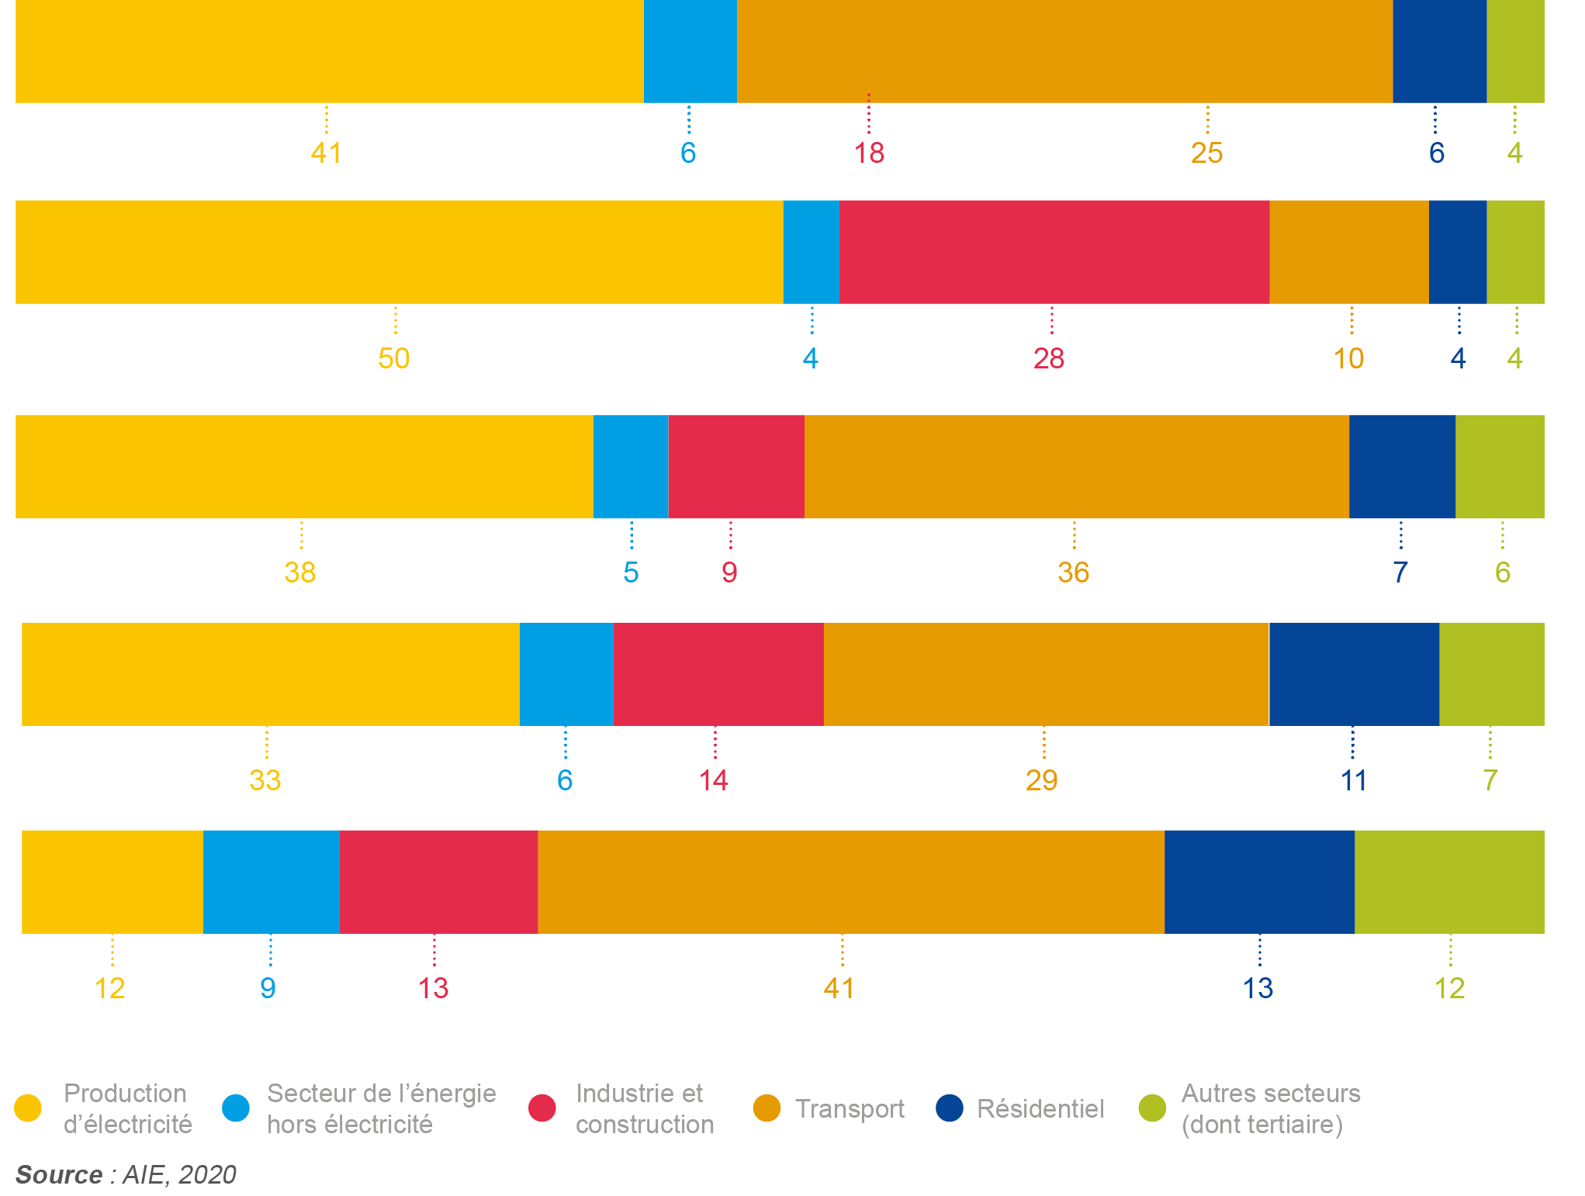
Source of co2 emission
Energy combustion rate in 2018
World
Facts
China
United States
Transport, industrial activities and energy production take part for more than 75% to CO2 emissions..
Europe (27)
France
Electricity
production
Energy Sector
w/o electricity
Industry &
buiding
Transport
Residential
Others

Slide 5
MOBILITY TRANSPORT
GENERAL INDUSTRY
ENERGY
INDUSTRIE
Our focus industries

Slide 6
MOBILITY TRANSPORT
GENERAL INDUSTRY
ENERGY
INDUSTRIE
Our focus industries
Be the reference equipment
supplier of the driving chain
In the new mobilities
Be a supplier of sets or subsets to improve performance and energy footprint in industrial equipments
Take part to the global improvement of energetic footprint, using our expertise in power electronics

Slide 7
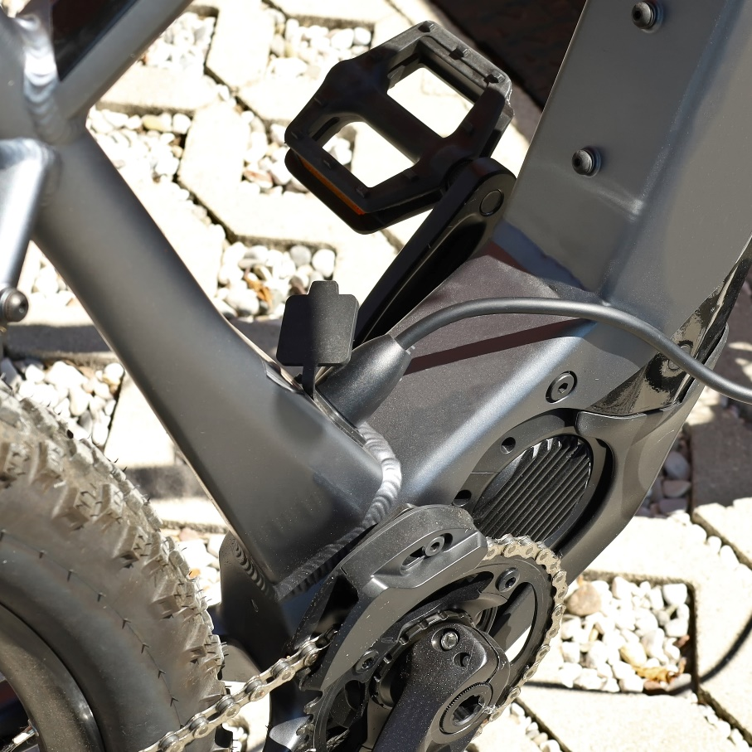
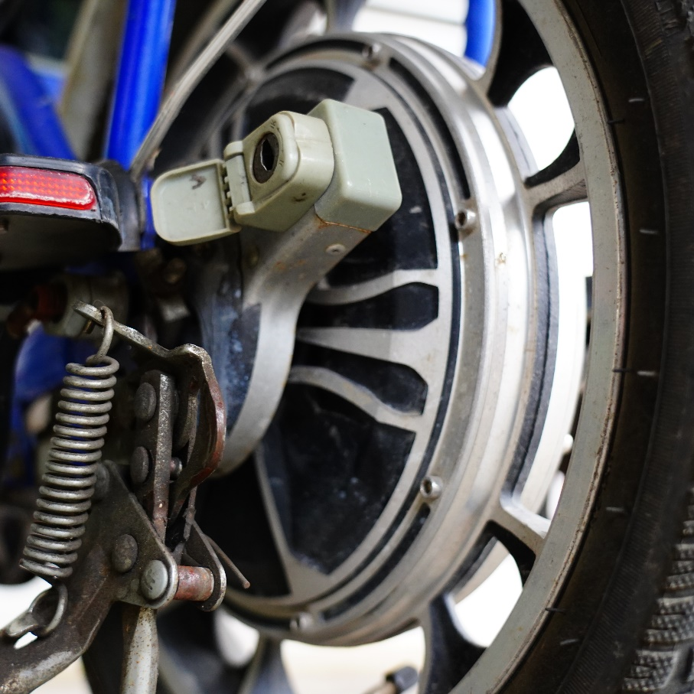
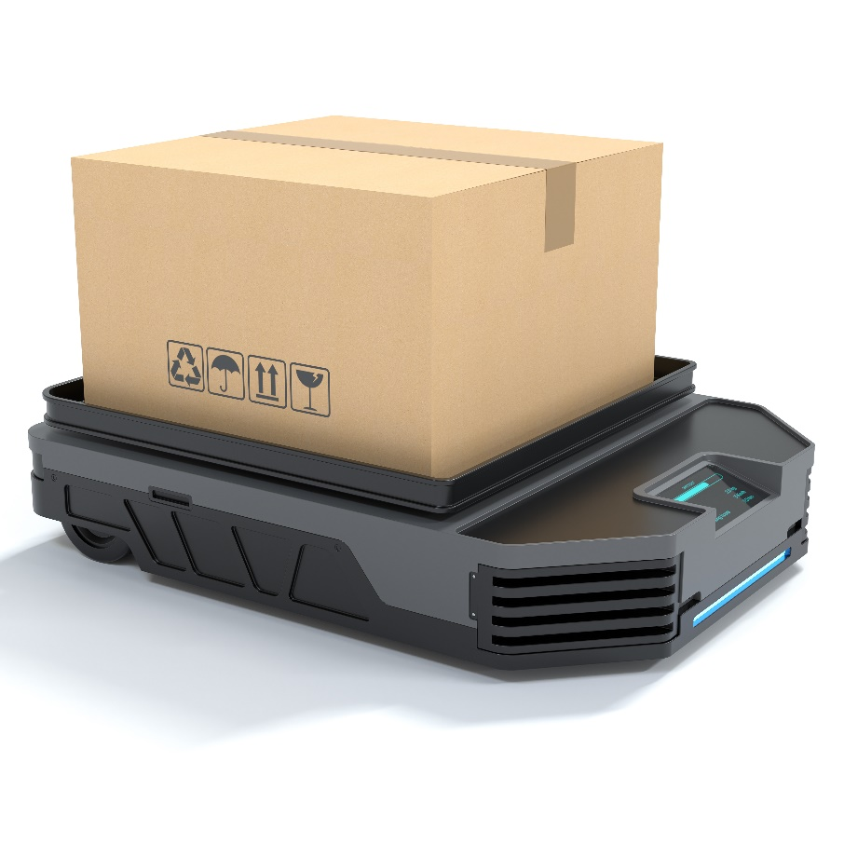
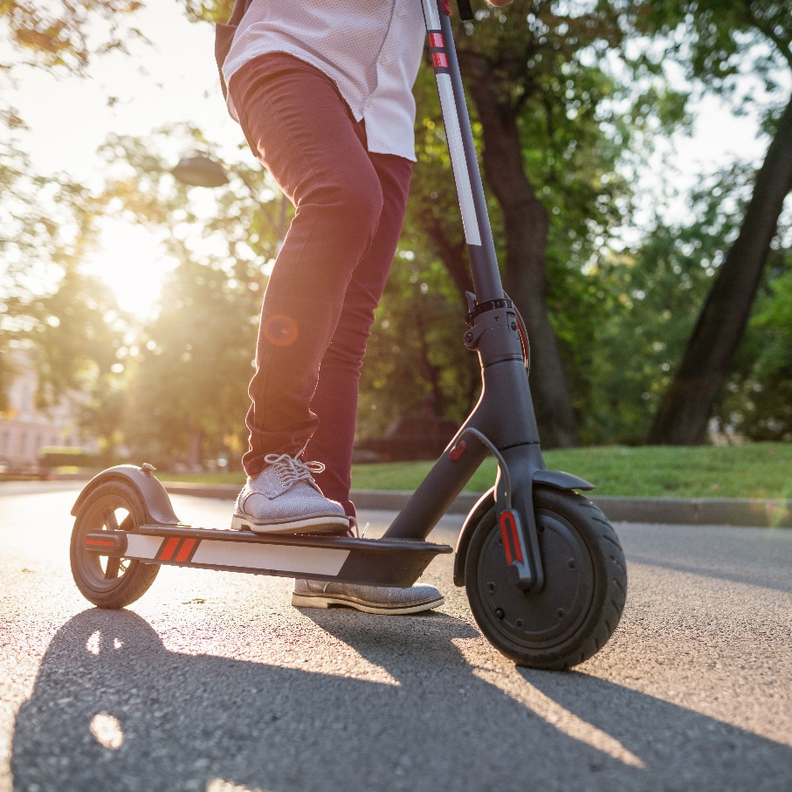
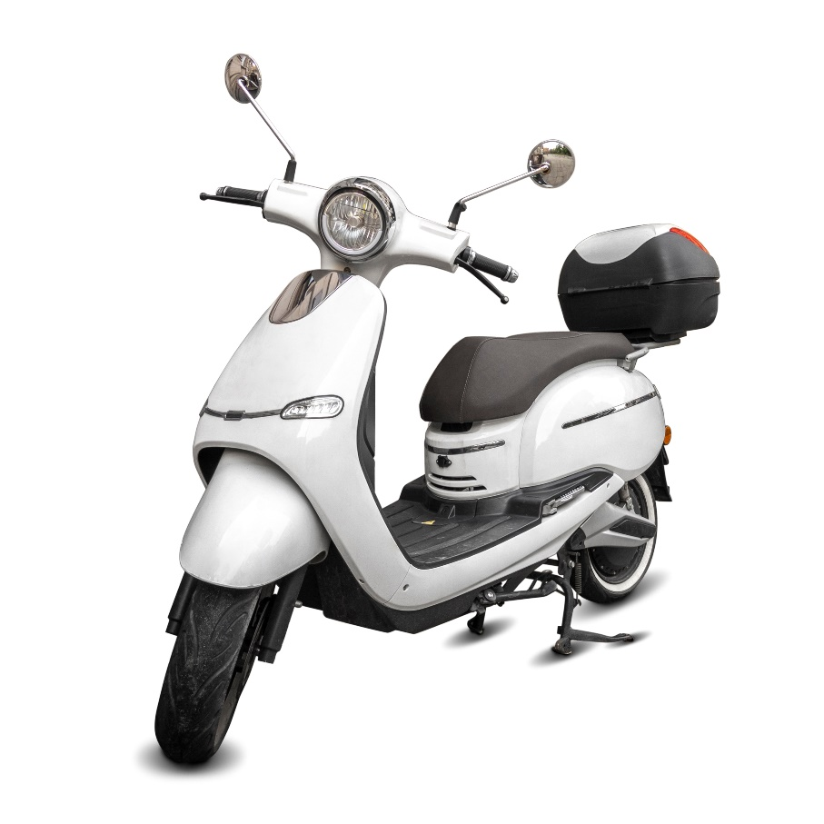
LIGHT MOBILITY
Projects
for Mobility
& Transport

Slide 8
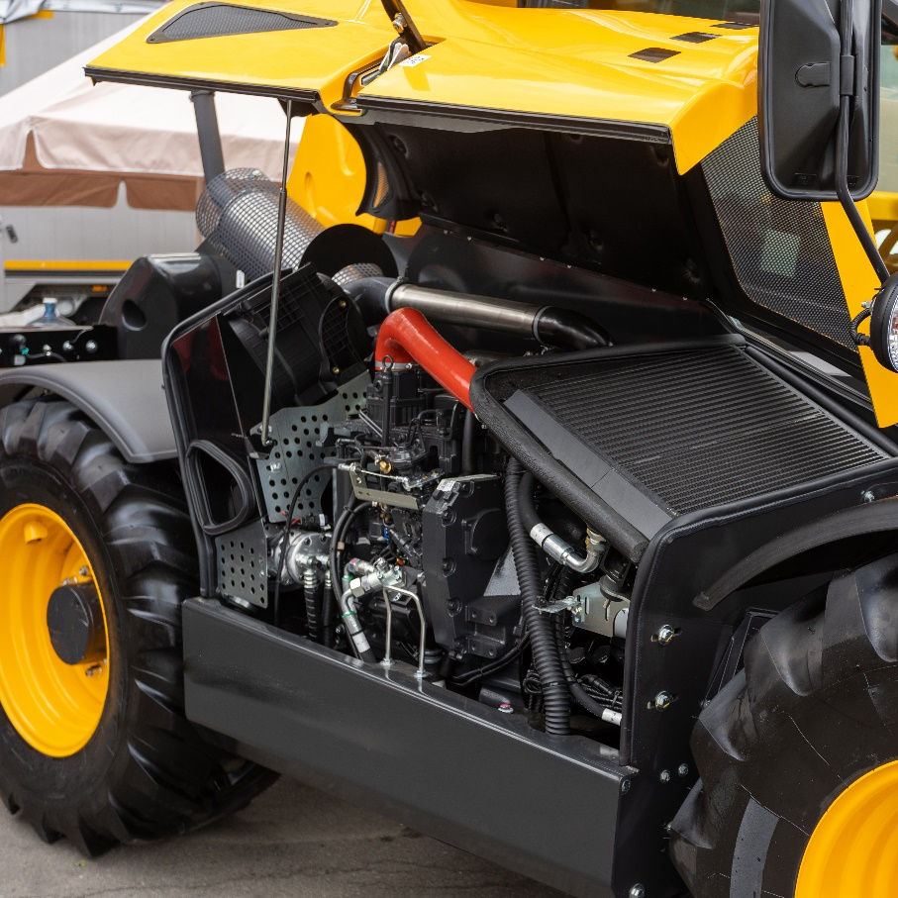
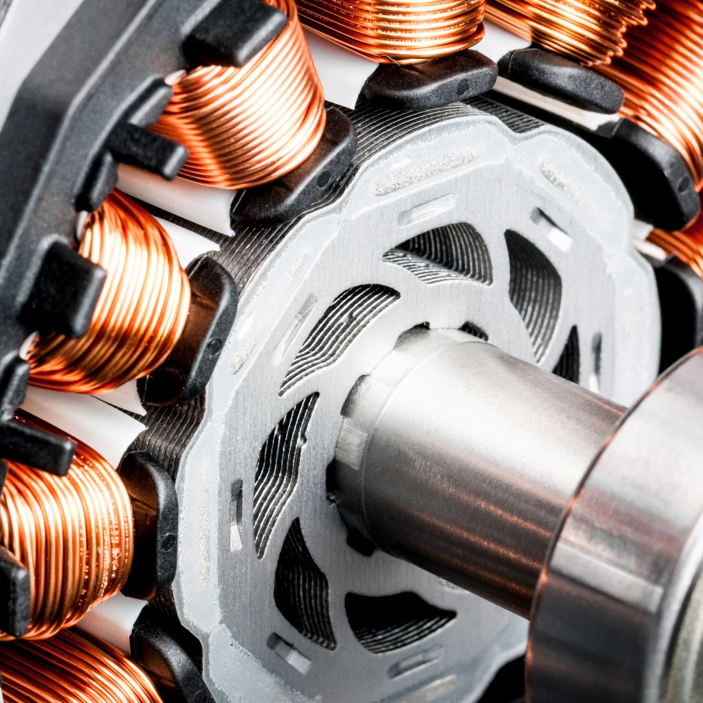
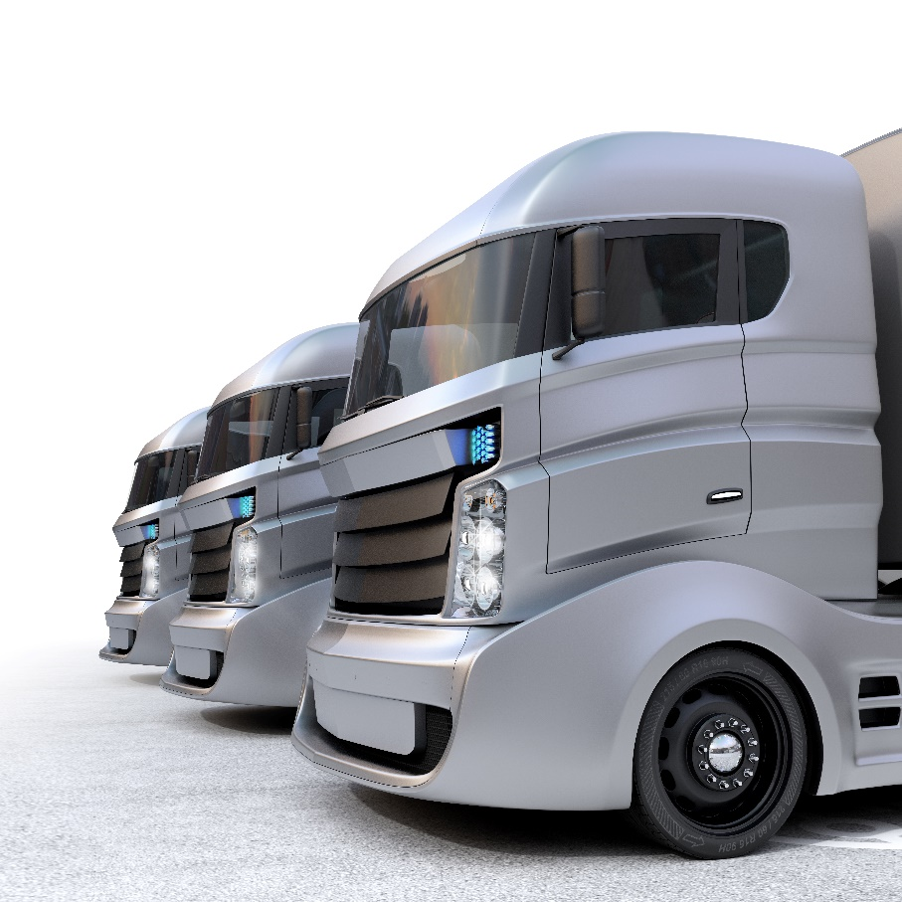
HEAVY MOBILITY
Projects
for Mobility
& Transport

Slide 9
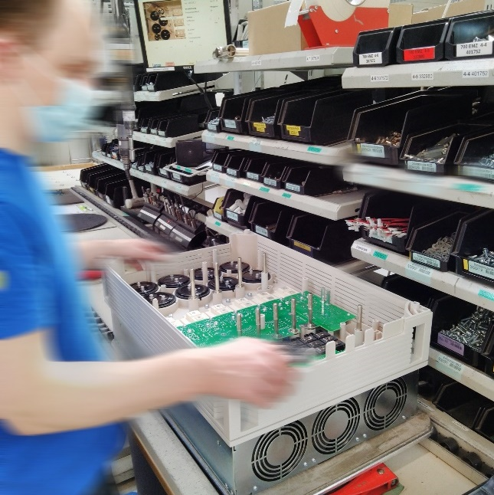
Projects for
general Industry

Slide 10
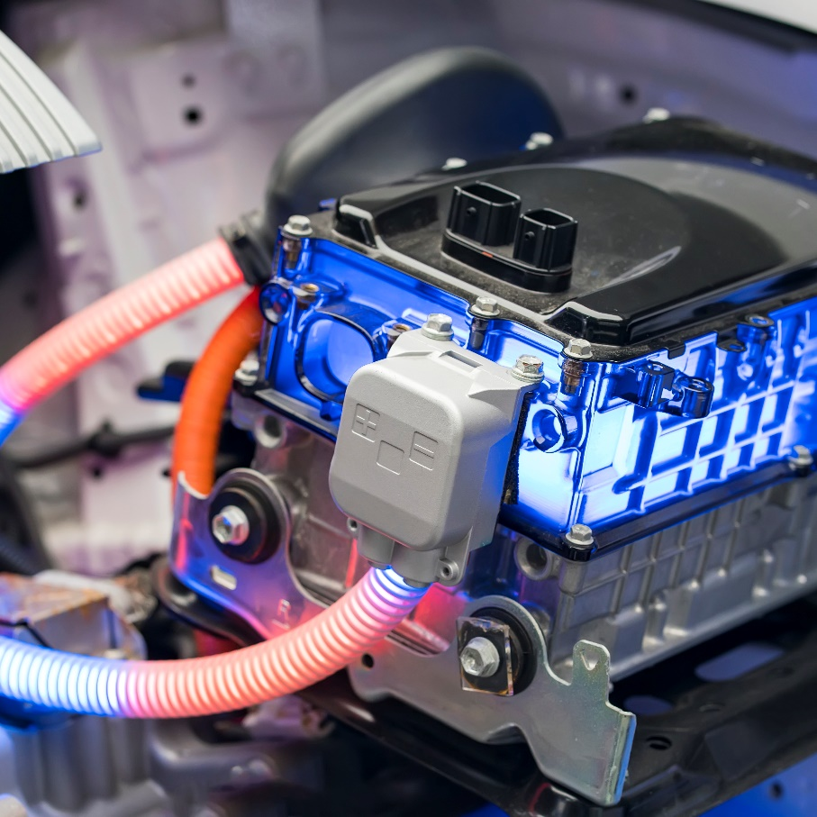
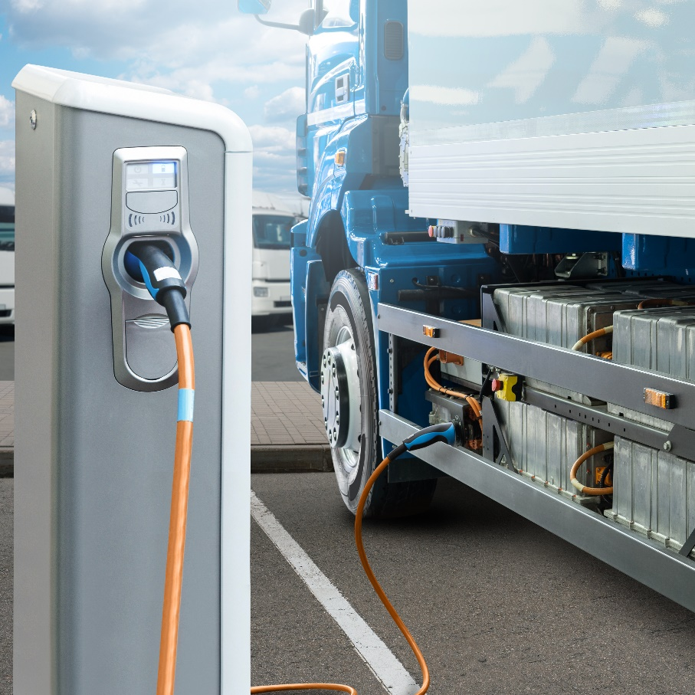
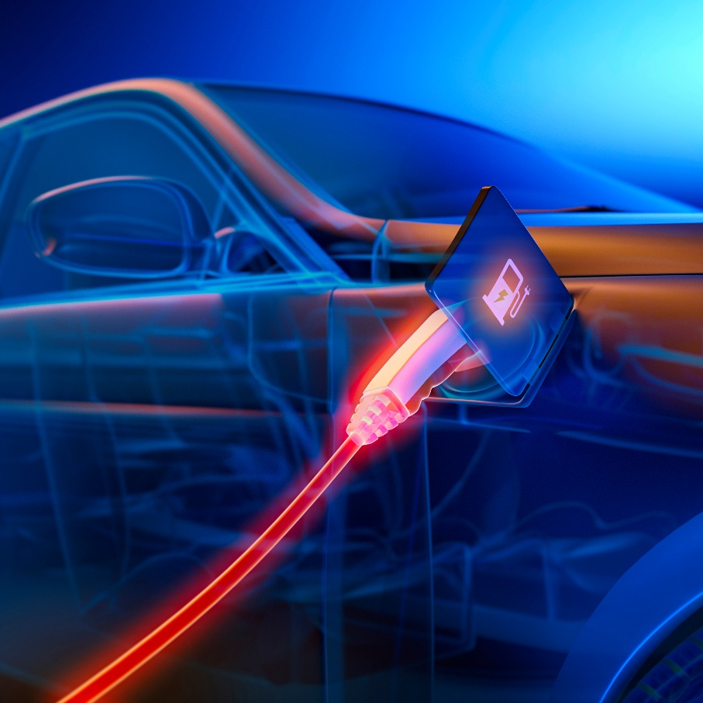
Projects
for Energy

Slide 11
An industrial set-up
experienced and
flexible
Labelled "Vitrine INDUSTRIE DU FUTUR »
Premium membership
2004
Foundation
14 000 m²
Site awarded
“Industrie du futur”
140
Skilled
Employees
37 yrs
Average
age
280 000
Pieces produced
per year
ERP

Slide 12
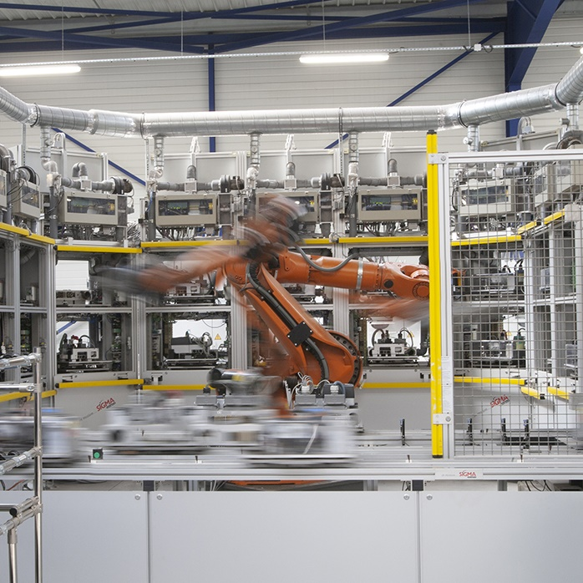
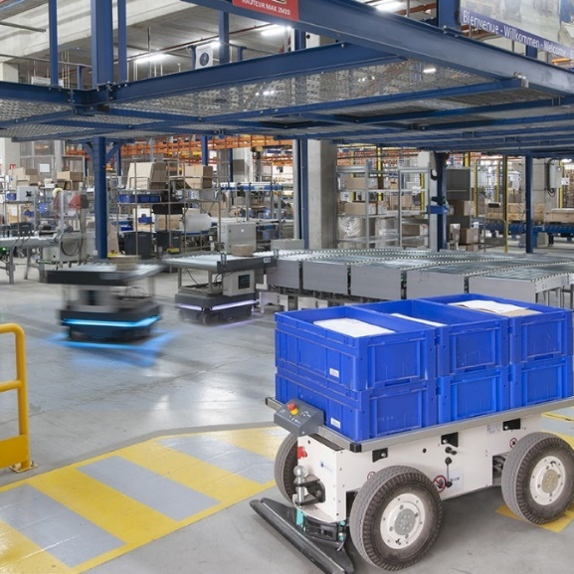
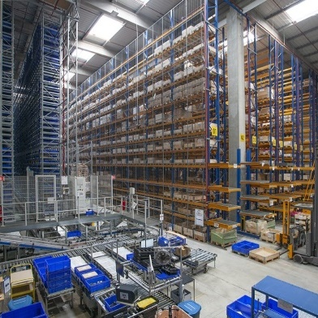
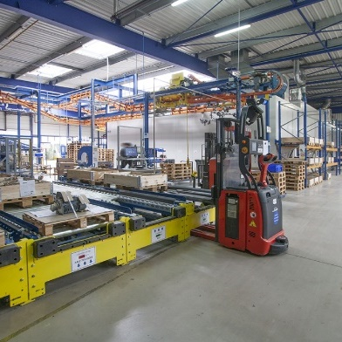
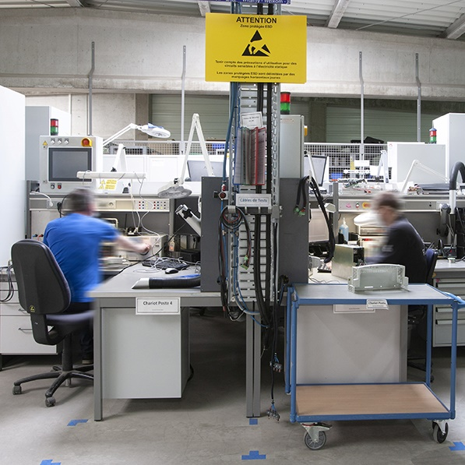
Our production
means

Slide 13
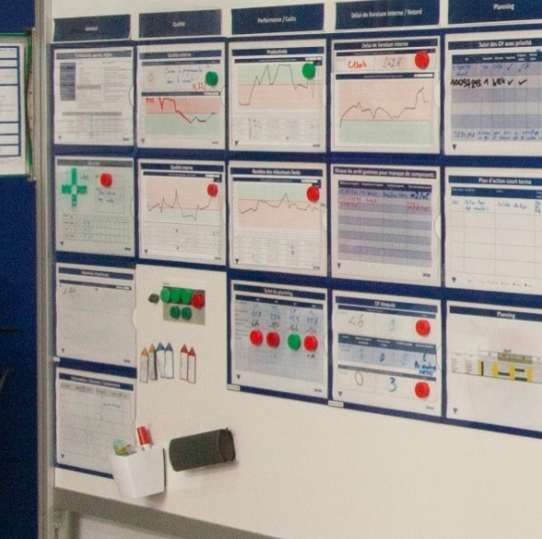
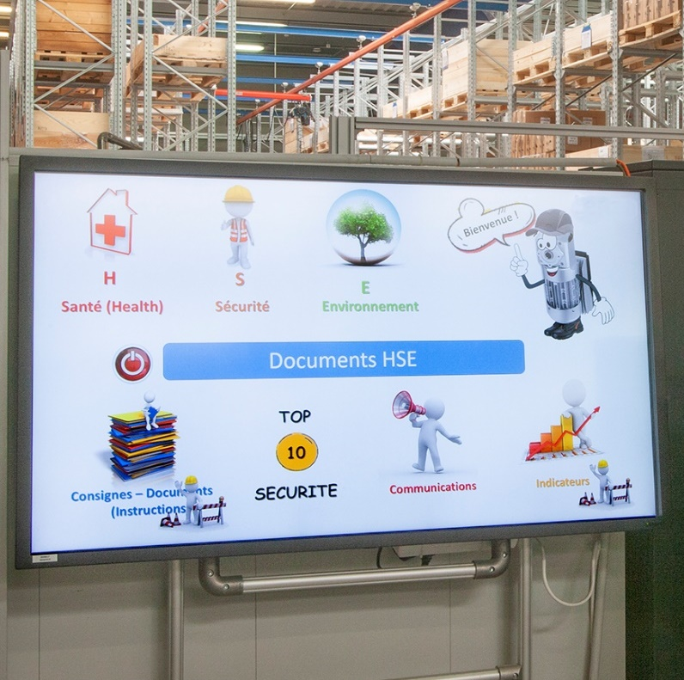
Our management
processes

Slide 14
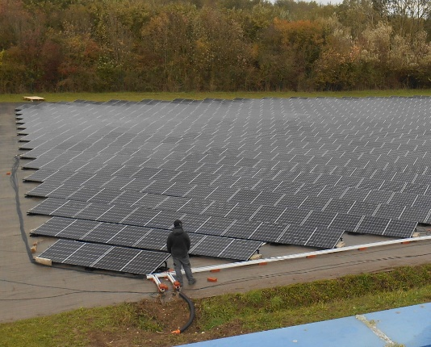
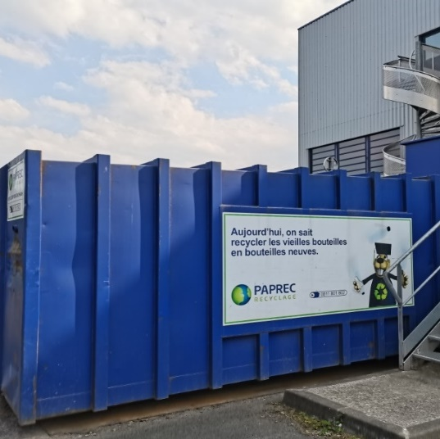
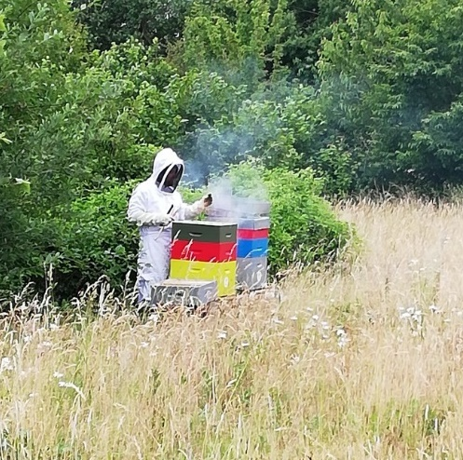
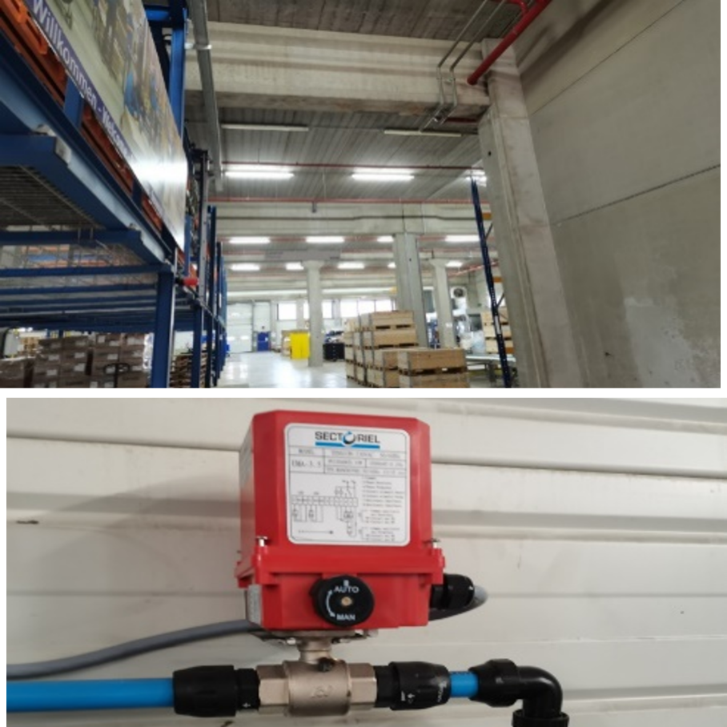
Sustainability
ENERGY
INDEPENDANCY
RECYCLING
BEEHIVES
Target to carbon emission neutrality in 2030
ENERGY
LOW CONSUMPTION

Slide 15
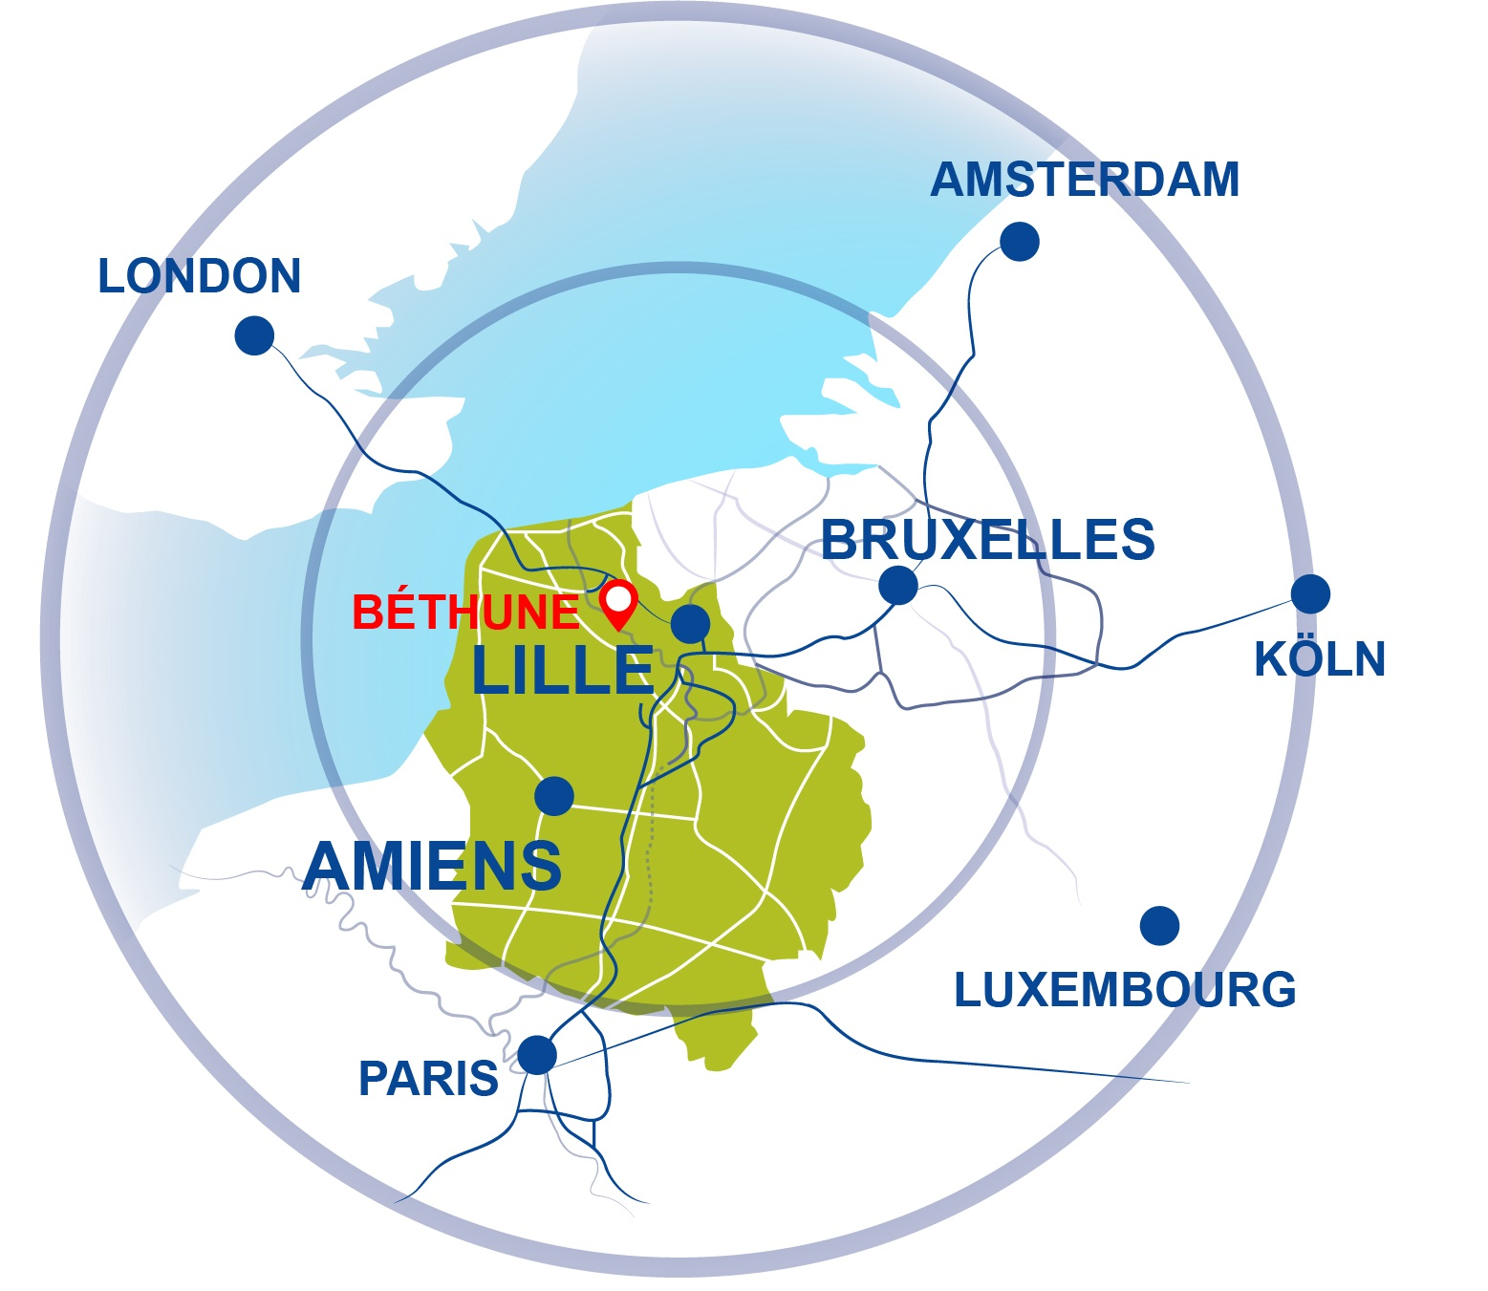
A strategic
localization in
Europe

Slide 16
A COMPLETE VALUE CHAIN
SPECIALIZATION
MASTERING TECHNOLOGY
Your equipment provider
and integrator to serve
new mobilities
SUPPLY-CHAIN MANAGEMENT
MULTIPLICATION OF COMPETENCES
A FULL INVOLVEMENT OF THE ENTIRE STAFF

Slide 17
contact@movntec.com
03 91 80 15 30

