Slide 2
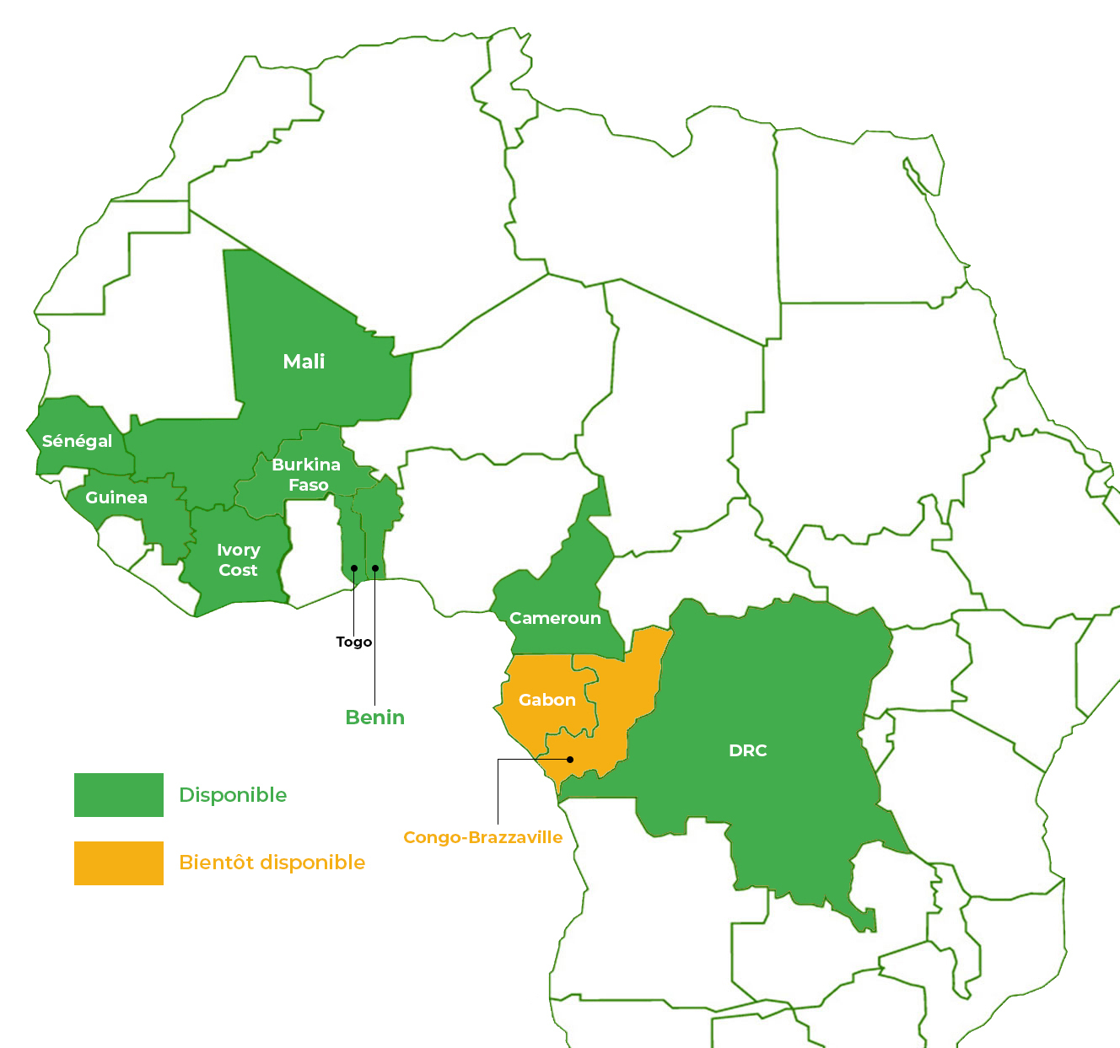
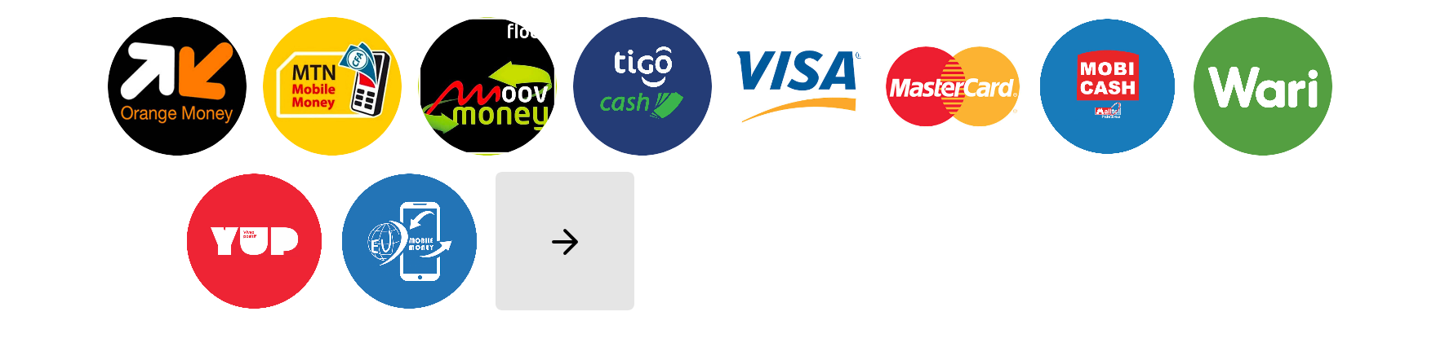
Who we are ?
CinetPay is an African fintech company that develops digital payment and money transfer solutions, via mobile money, bank cards (Visa, Mastercard) and electronic wallets.
We support companies in French-speaking Africa in the growth of their activities by assisting them in the digitalisation of their collection and payment process. In an ecosystems where cash remains the main method for financial exchanges, our solutions offer new business opportunities that are more efficient, secure and capitalise on the emergence of the latest electronic payment innovations such as Mobile Money.
Means of payment available
+15
means of payment accessible from our platform
4

Slide 3
Key figures
+ 14 Billion
+ 2 000 000
+20 000
+40
of FCFA exchanged each month via our platform
secure transactions, on average per month
merchants trust us
Means of payment
3

Slide 4
Our Partners
Financial companies
Public companies
Other partners
The partner payment solution for your growth.
17

Slide 5
Our Offers
Expand your potential with our digital payment solutions
CinetPay Online payment (Pay in)
CinetPay Money Transfer (Pay out)
CinetPay Payment Terminal
CinetPay Dashboard
CinetPay SMS
CinetPay Shopping
CinetPay Airtime

Slide 6
CinetPay Online Payment (Pay in)
A full-scale solution to support your company's growth

Slide 7
DESCRIPTION
CinetPay Online Payment is the easiest way to collect payments from your customers anywhere in the world. On the web and on mobile (android and iOS).
One agreement
One API Integration
One Back Office (All in one)
One agreement to access all payment methods.
One API integration to access all payment methods
Easy transaction management, real-time traceability and accessibility of sales and customer data
A PCI-DSS certified payment and money transfer solution for a total security of our merchants' transactions.
2

Slide 8
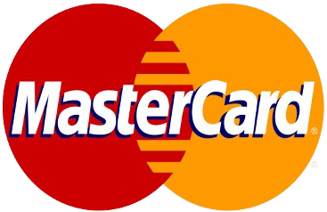
Online Payment
Collect payments in 9 French-speaking African countries and 195 countries worldwide
With CinetPay, offer your customers the possibility to make mobile money payments in Senegal, Ivory Coast, Cameroon, Burkina Faso, Mali, Togo, Guinea Conakry, Benin and DRC in 4 currencies: XOF, XAF, GNF, CDF on a bilingual payment gateway (French/English)
Accept all major credit cards from customers around the world with one click.
2

Slide 9
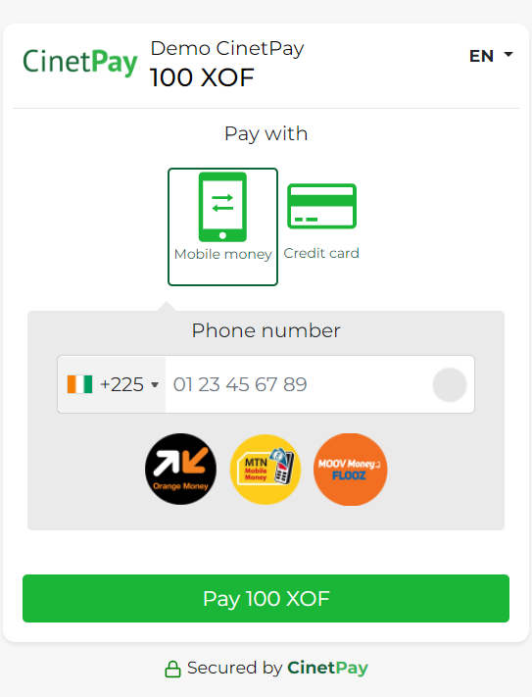
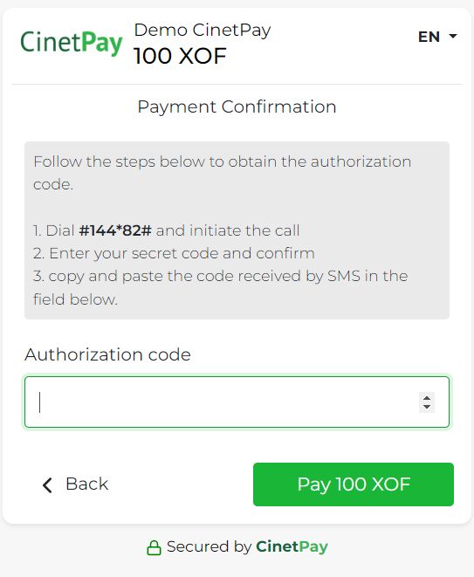
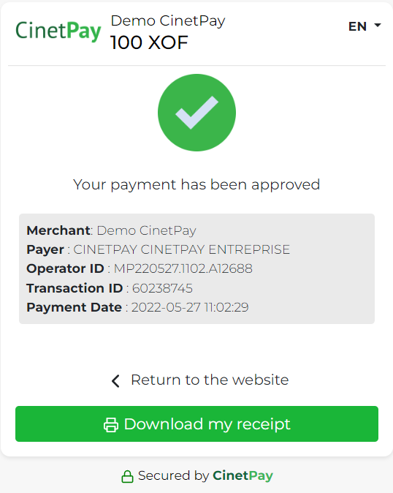
Online Payment_Customer Experience with Orange Money Ivory Coast
Enter your mobile money number
Enter your Authorization Code to confirm payment
Get payment status and print your payment receipt
The partner payment solution for your growth.
9

Slide 10
CinetPay Money transfer (Pay out)
A full-scale solution to support your company's growth

Slide 11
CINETPAY MONEY TRANSFER
Transfer money easily to Mobile Money wallet from your merchant account.
Send money in a few clicks to your suppliers, partners, providers or employees, etc.
Simplify your expenses management
Pay your employees' salaries by mobile money, directly to them from your back office.
One account for all your transactions
Top up your transfer account directly from your CinetPay balance, in real time and in a few clicks, from your backoffice.
Free yourself from change problems
Give your customers change directly into their mobile money account.
Money transfer process
1
Create your account
2
Top up your pay out account
3
Add contacts and amounts
4
Validate payment

Slide 12
CinetPay Payment Terminal
a sleek and elegant design, to make each payment a unique experience

Slide 13
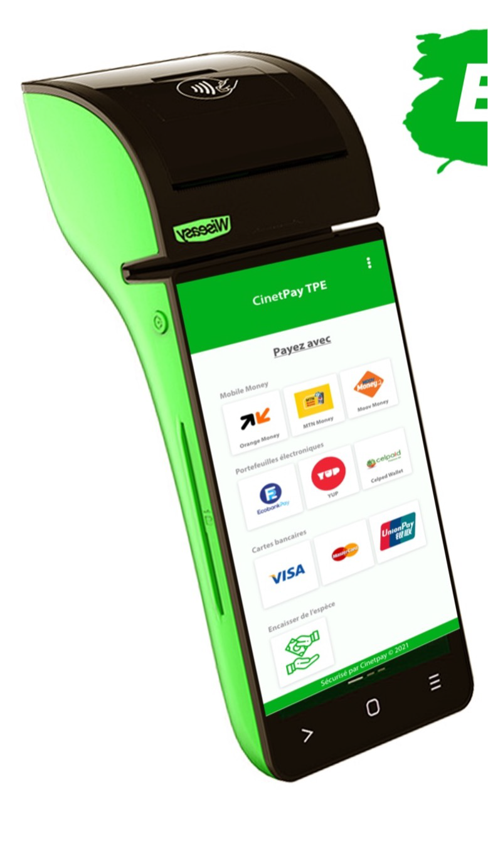
CINETPAY PAYMENT TERMINAL
Secure your online payments in your business space with CinetPay Terminal
Secure your income by dematerializing them
Your income and expenses are directly recorded in your online account. You can access their history from the backoffice
Pay here with your mobile money wallet or Bank Cards
Free yourself from currency problems
Thanks to the "return-currency" feature, you can transfer the transaction balance directly to the customer's Mobile Money account
Increase the productivity of your physical stores
Enjoy a smoother payment experience

Slide 14
CinetPay Dashboard
Manage your business from the dashboard

Slide 15
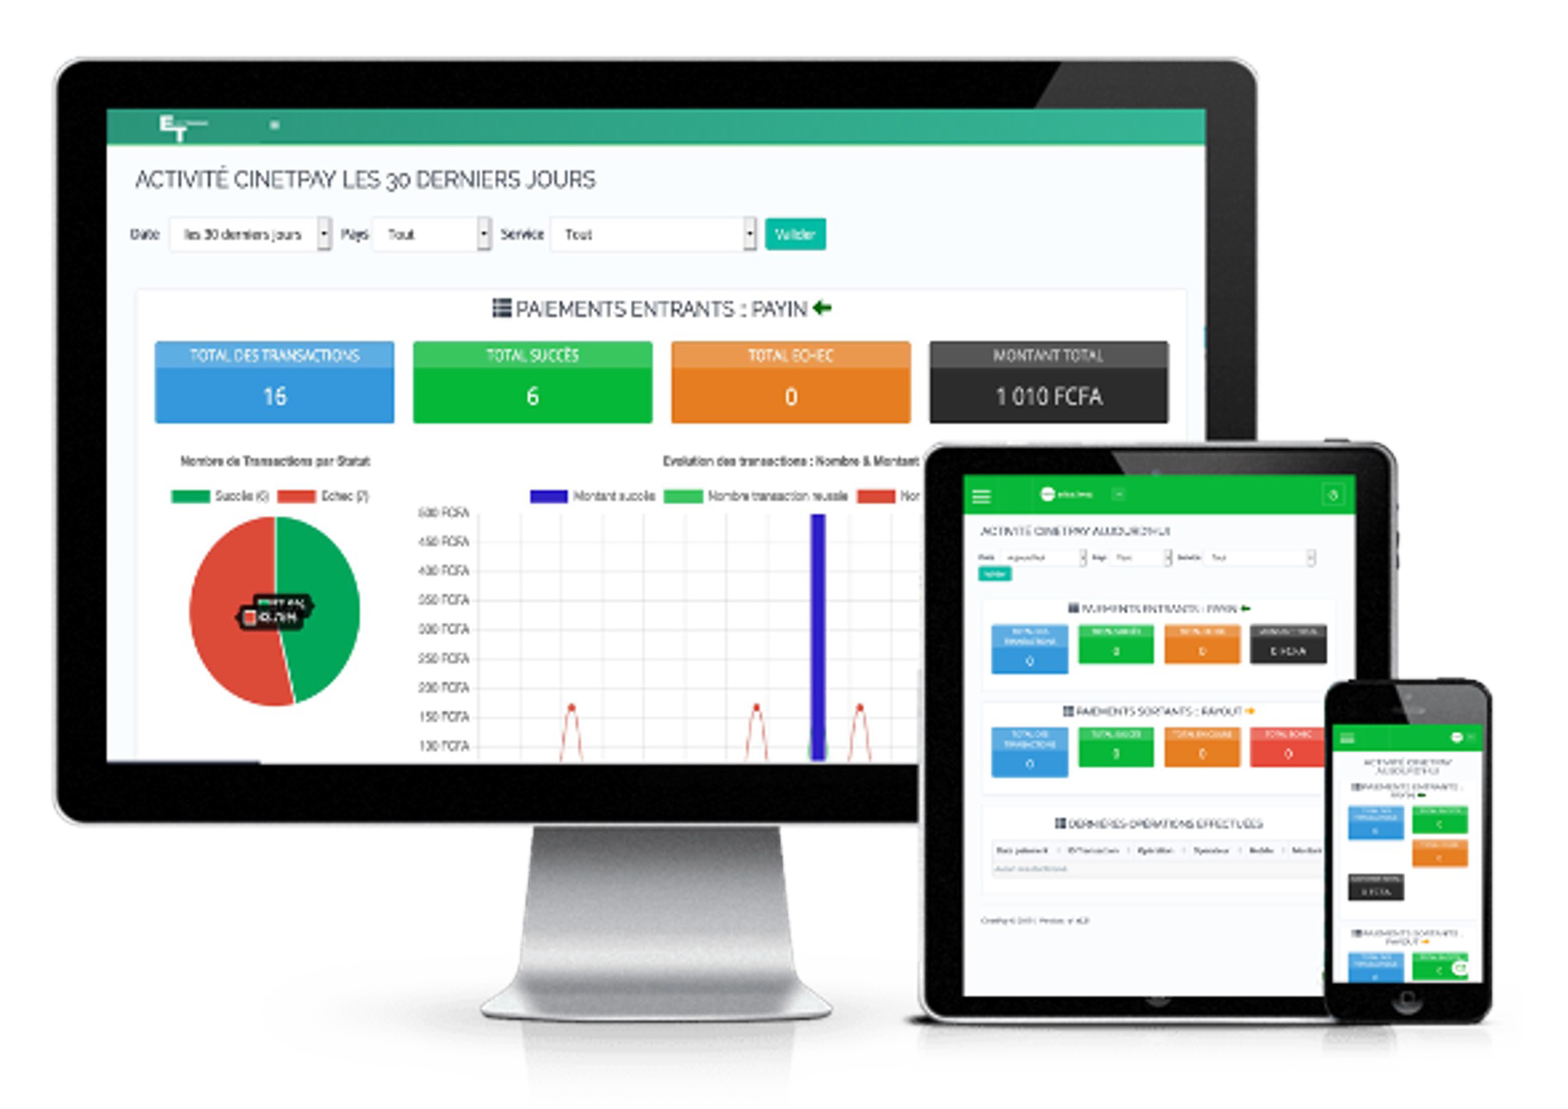
DASHBOARD
Track your payments in real time
Access your sales, customer and expense data in your back office for real-time tracking
Track all transactions in real time
Funds Settlement
Request a settlement of your balance in one click, every 24 hours
.
Simplified accounting
Detailed, real-time reports on successful, abandoned and failed transactions
Analyze customer payment patterns
Export your data directly from your back office.
All in one
Manage all your transactions (cash-outs, transfers, top-ups, airtime, SMS, payouts) from a single interface

Slide 16
CinetPay SMS
Choose the right SMS pro solutions for your strategy

Slide 17
CINETPAY SMS
Benefits
Encrease your sales
Launch innovative marketing campaigns via SMS,
Develop your company's brand awareness via an innovative means of communication,
Increase customer satisfaction by using our system to send delivery confirmations and sales reports via SMS,
Expand your business with SMS marketing campaigns,
Increase customer loyalty with promotional offers
Translated with www.DeepL.com/Translator (free version)
Optimize your customer relationship with professional SMS
Keep your customers informed of your activities or collect information easily with our platform connected to more than 30 operators.
Dashboard
Get real-time analysis of your results.
Track accuseś of receṕ tion, so you can track the statuś of your messages.
Access the information you need to report on your return on investment

Slide 18
CinetShop
A full-scale solution to support your company's growth

Slide 19
CINETSHOP
Start selling online today
Share a single link on all social media, sell on facebook, whatsapp, twitter, instagram...and accept all mobile money, bank cards and e-wallets on a single interface.
1
2
3
Social Shop Page
Create your personalized sales page and fill in your different items.
Personalized link
Sell your products and/or services via a unique and personalized link.
Ex: https://cinetpay.me/nafat-group4Kysk6
Means of payment
Receive your payments via mobile money, credit cards, etc.

Slide 20
CinetPay Airtime
Discover our prepaid phone credit sending platform

Slide 21
AIRTIME
Send prepaid credit in a few clicks or in an automated way to your customers or employees.
Simple et flexible
Recharge Credit fleet of your staff
Opt for the automated management of the recharging of your fleet.
Easy to use
Mass transfer
Platform available 7 days a week, 24 hours a day
Efficiency and assistance
Reward your customers
Build customer loyalty by offering them communication credits.
Send credit in bulk
Excellent deliverability rate
Time saving
24/7 customer support
Credit distribution
CinetPay help you offer products adapted to the habits and expectations of companies and local populations.
Dashboard
Get real-time analysis at your fingertips
Track receipt confirmation, so you can follow
the status of shipments

Slide 22
Contact
YAO Y. INNOCENT
Business Development Manager
innocent.yao@cinetpay.com
Mobile : +225 0707593137
www.cinetpay.com

