Slide 1
NEW NATURAL FIBER (NNF) PRODUCT DEVELOPMENT
Raj Group is committed to being environmentally conscious and was the first home furnishing company in India to be Fair Trade certified.

Slide 2
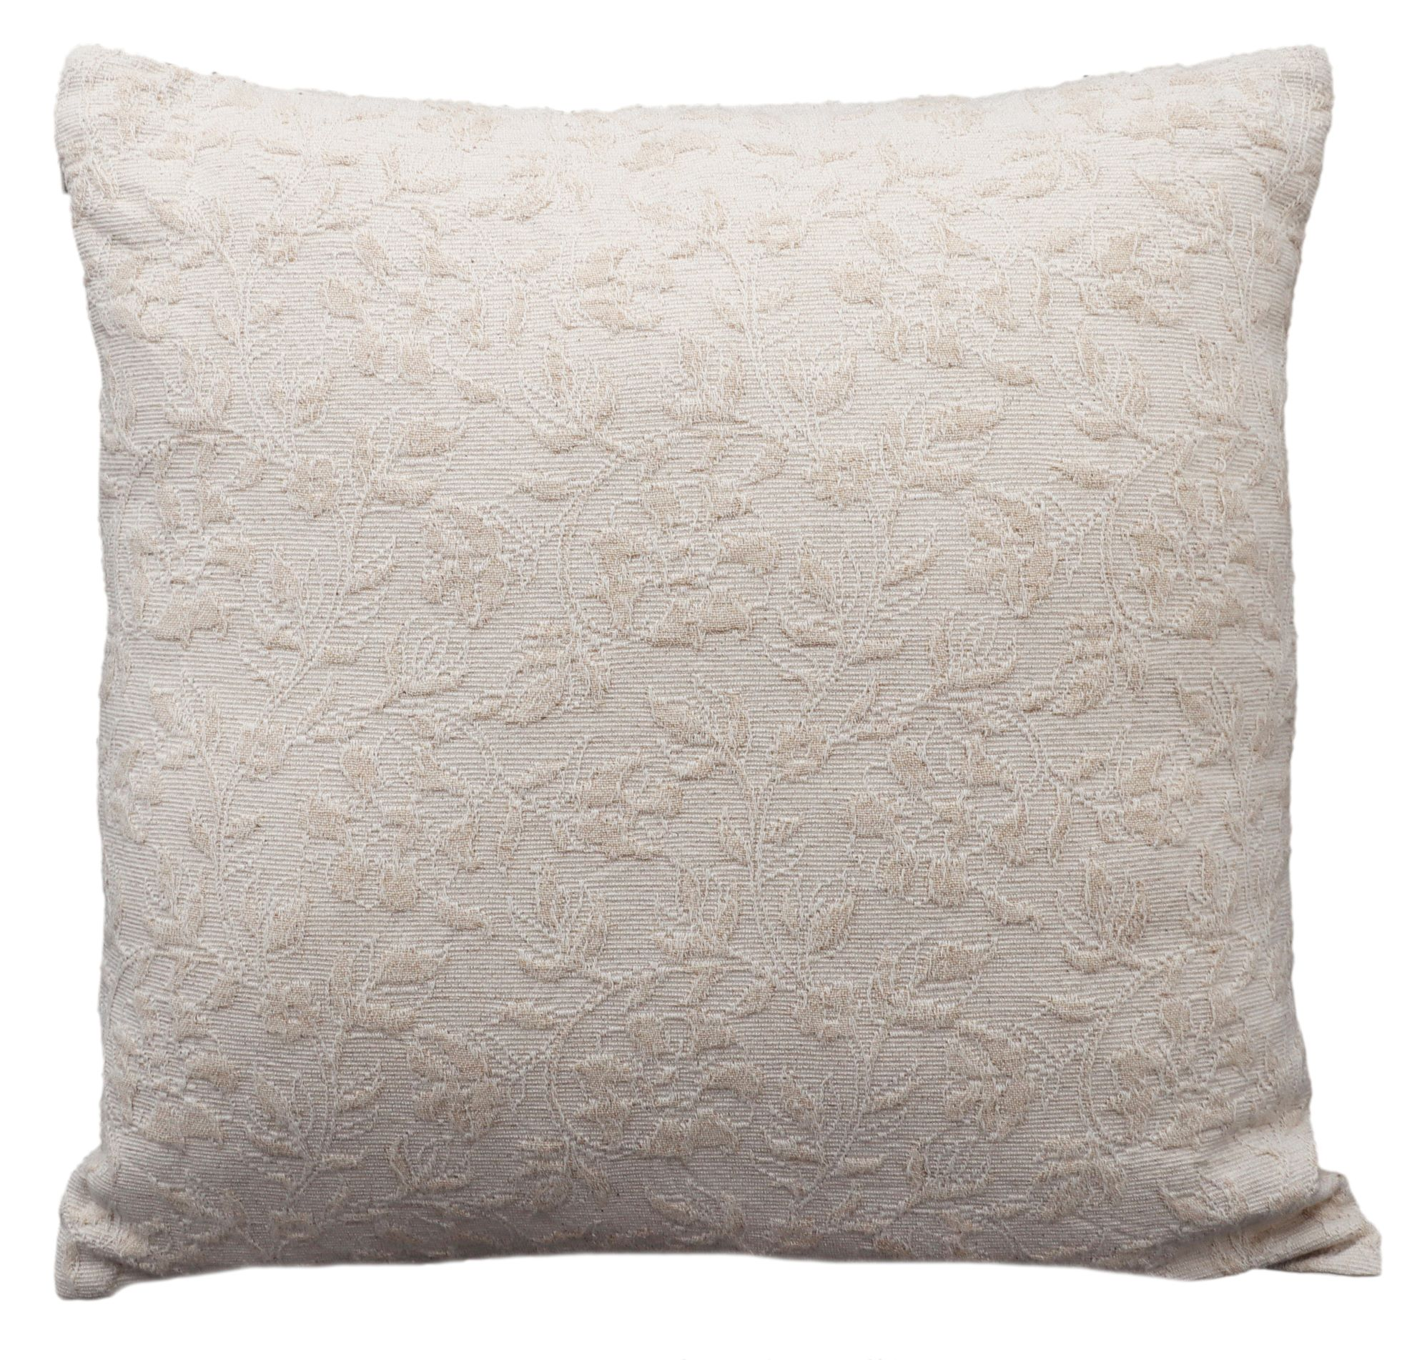
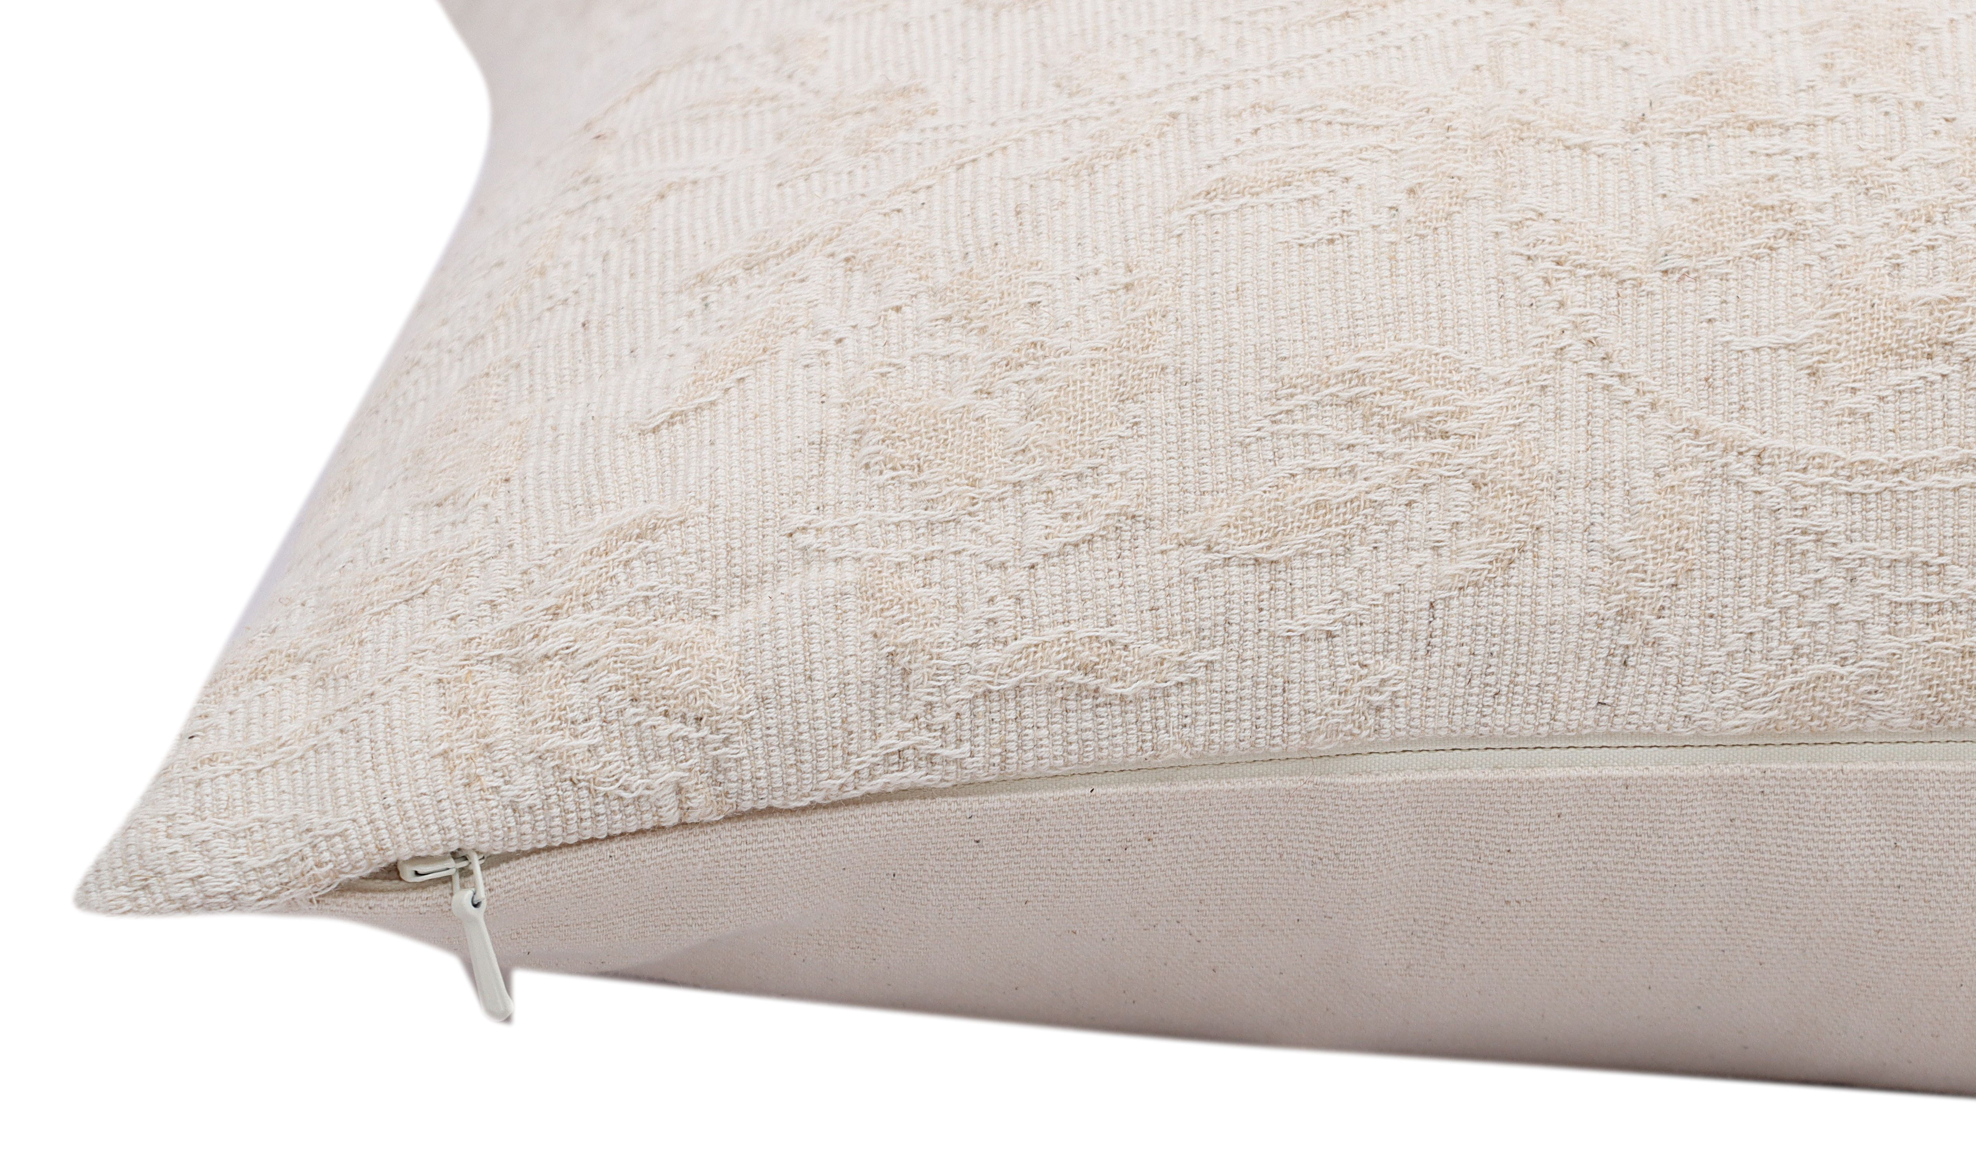
CUSHIONS
ITEM | Decorative Jacquard Cushion cover
STYLE | ROVR-1018
DESCRIPTION | Made using new NNF Himalayan Grass cotton (Blend of Himalayan Grass 35% and Cotton DCH-65%)-24ne
CONTENTS | Front-90% Cotton, 10% Himalayan Grass fiber. Back- 100% Cotton. Unfilled
SIZE | 20x20” / 50x50cms
Colors | Natural
Zipper | Concealed Zipper
PRICE USD FOB/PC | $4.50
PACKAGING | Care label and Tags
CARE INSTRUCTIONS | Machine Wash cold, Line dry/tumble dry low
MOQ / COLOR / SIZE | 1000 Pcs
SAMPLE LEAD TIME | 21 days
PRODUCTION LEAD TIME | 90 days
CERTIFICATIONS | Oekotex

Slide 3
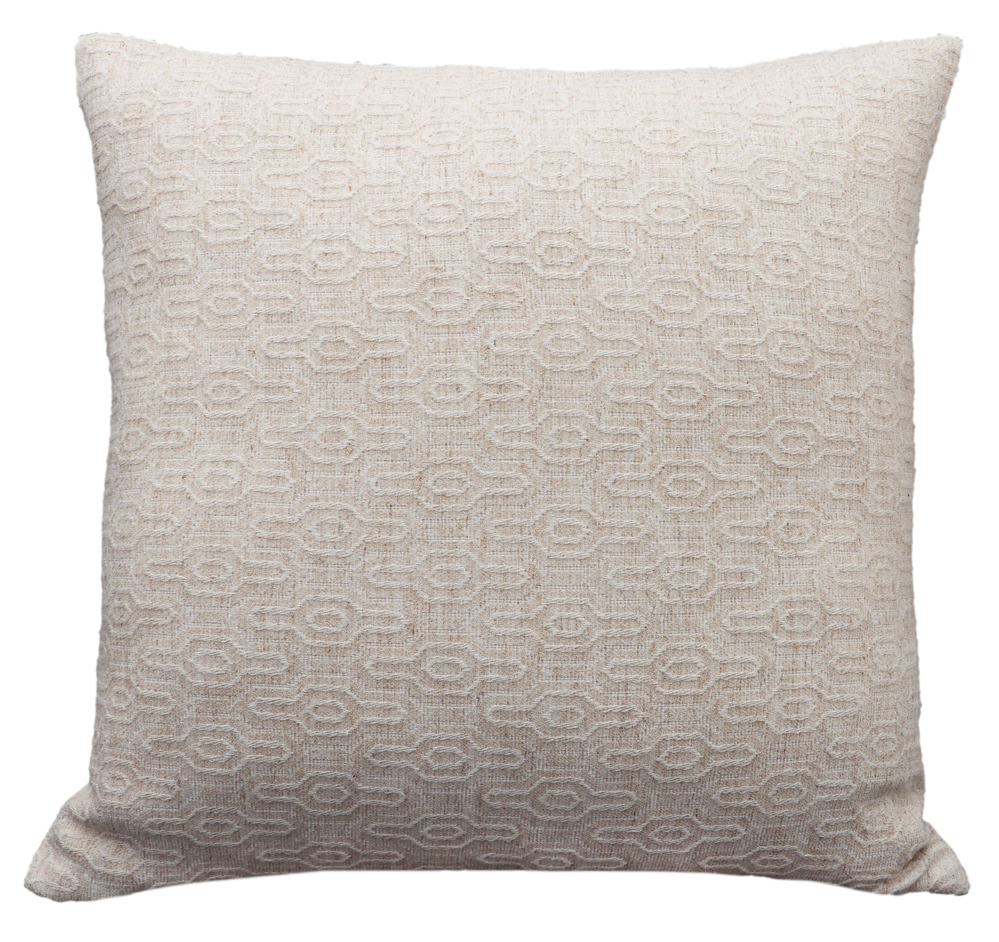
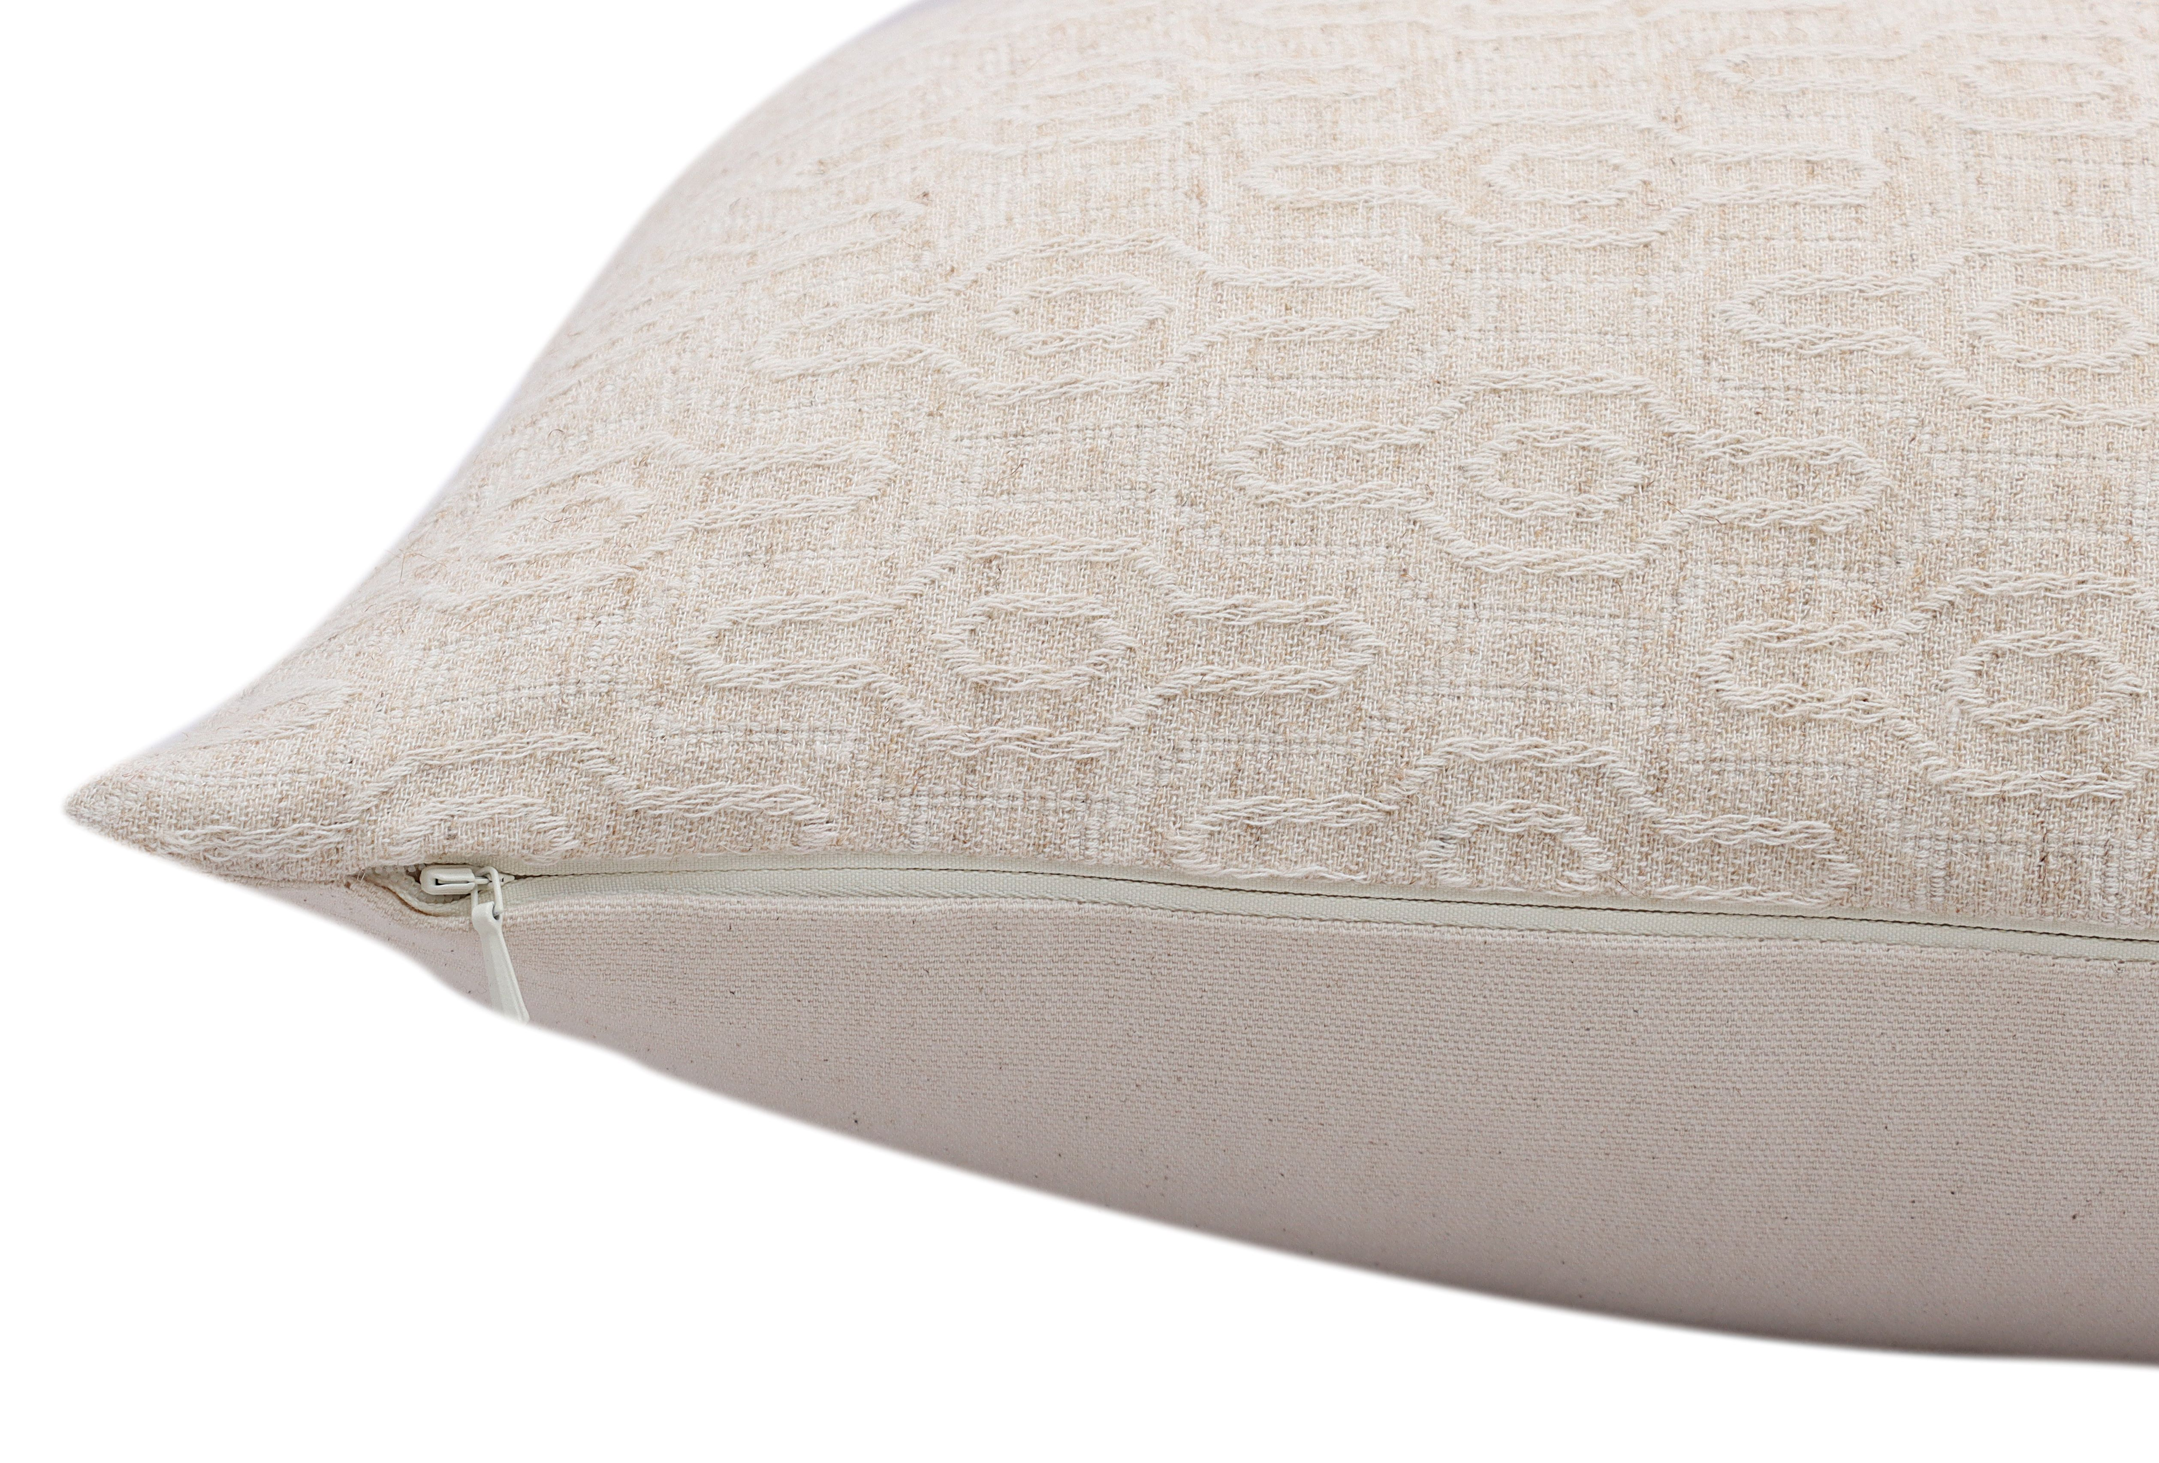
CUSHIONS
ITEM | Decorative Jacquard Cushion cover
STYLE | ROVR-1019
DESCRIPTION | Made using NNF Himalayan Grass (Blend of Himalayan Grass 65% and Liva Reviva-35%)-12Ne
CONTENTS | Front-70% Cotton, 18% Himalayan Grass fiber, 12% Liva Reviva. Back- 100% Cotton. Unfilled
SIZE | 20x20” / 50x50cms
Colors | Natural
Zipper | Concealed Zipper
PRICE USD FOB/PC | $4.50
PACKAGING | Care label and Tags
CARE INSTRUCTIONS | Machine Wash cold, Line dry/tumble dry low
MOQ / COLOR / SIZE | 1000 Pcs
SAMPLE LEAD TIME | 21 days
PRODUCTION LEAD TIME | 90 days
CERTIFICATIONS | Oekotex

Slide 4
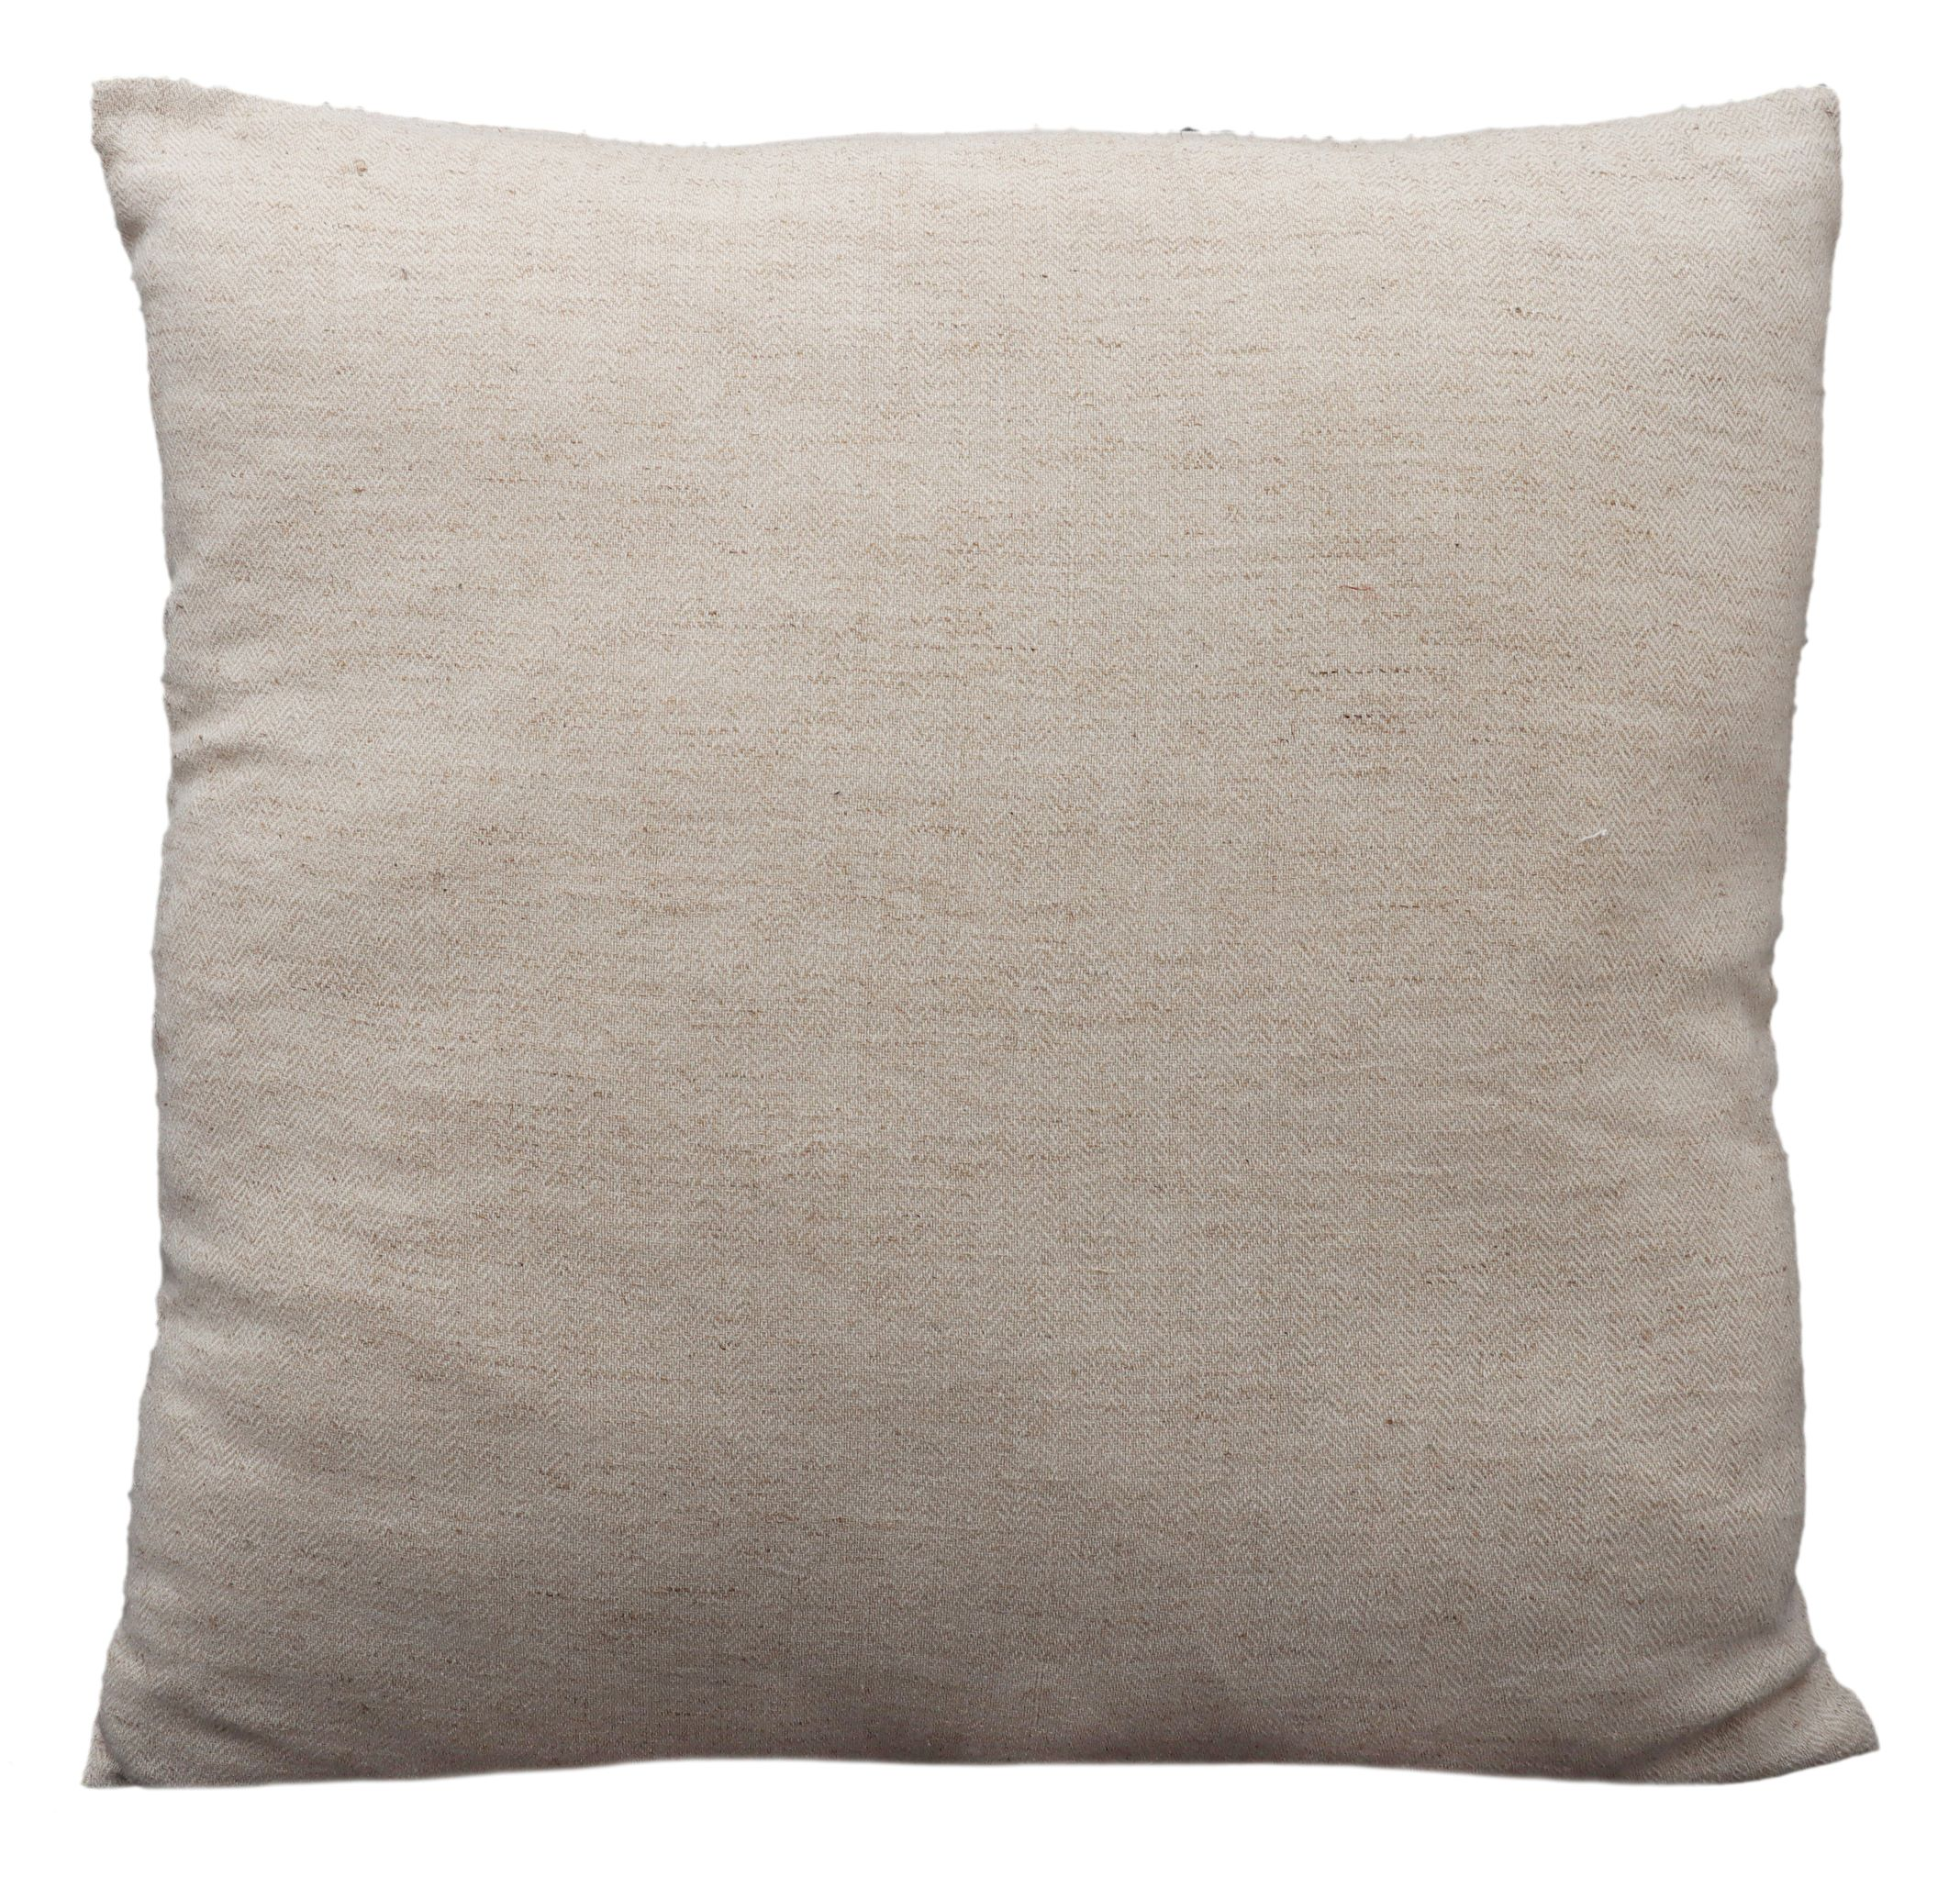
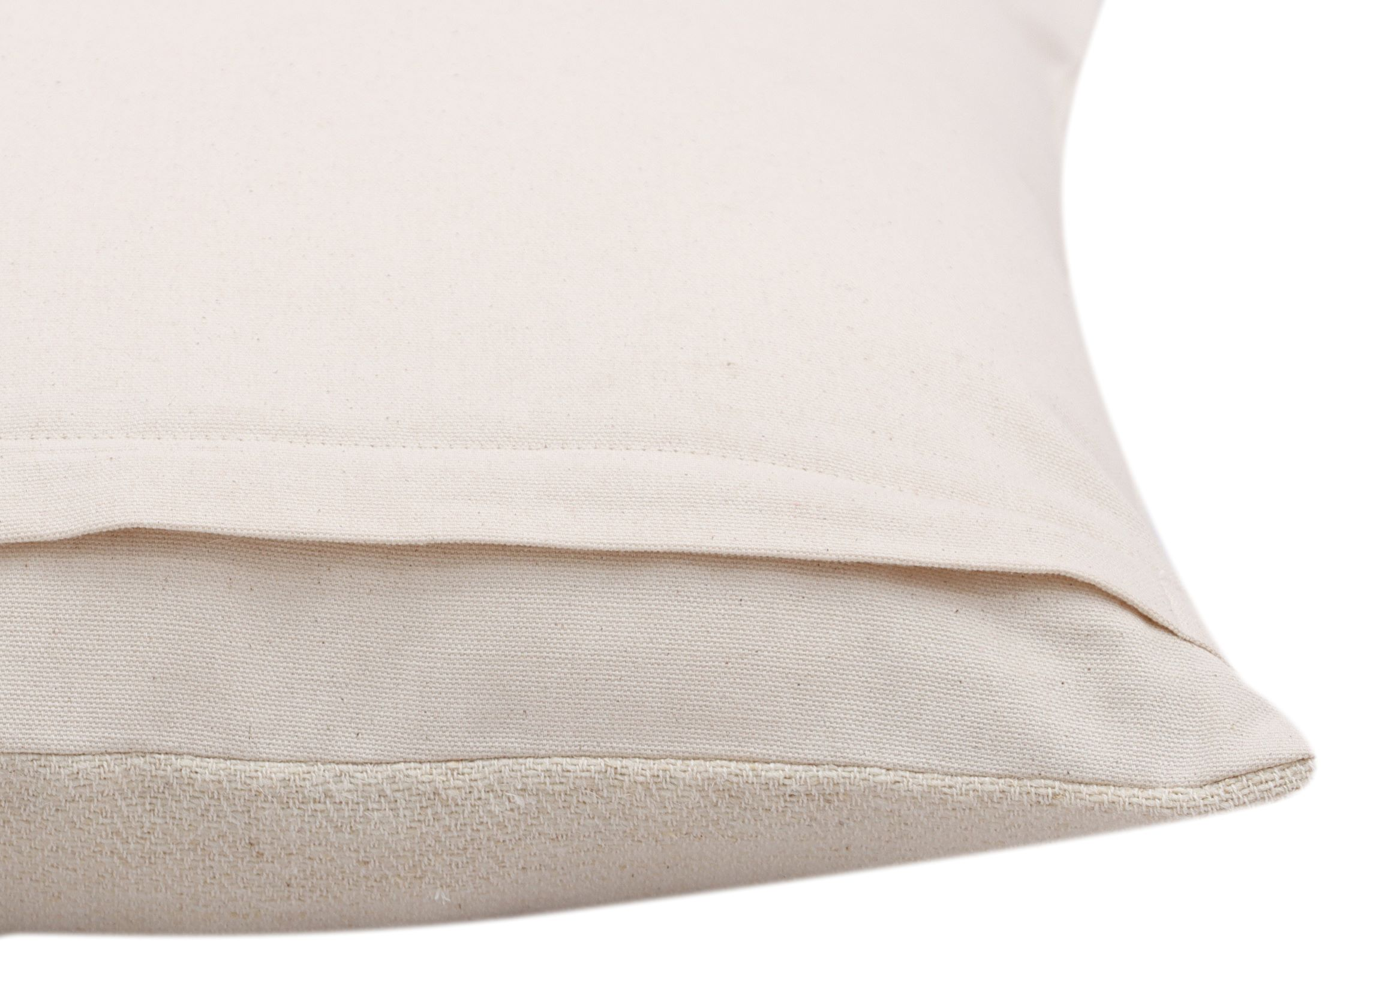
CUSHIONS
ITEM | Decorative handwoven Cushion cover
STYLE | RO-23-TW-3298
DESCRIPTION | Made using NNF Himalayan Grass (Blend of Himalayan Grass 35% and Liva Reviva -65%)-12ne
CONTENTS | Front-60%Cotton, 30% Liva Reviva & 10% Himalayan Grass. Back-100% Cotton. No filling
SIZE | 20x20” / 50x50cms
Colors | Natural
Zipper | Backflap Zipper
PRICE USD FOB/PC | $5.00/PC
PACKAGING | Care label and Tags
CARE INSTRUCTIONS | Machine Wash cold, Line dry/tumble dry low
MOQ / COLOR / SIZE | 1000 Pcs
SAMPLE LEAD TIME | 21 days
PRODUCTION LEAD TIME | 90 days
CERTIFICATIONS | Oekotex

Slide 5
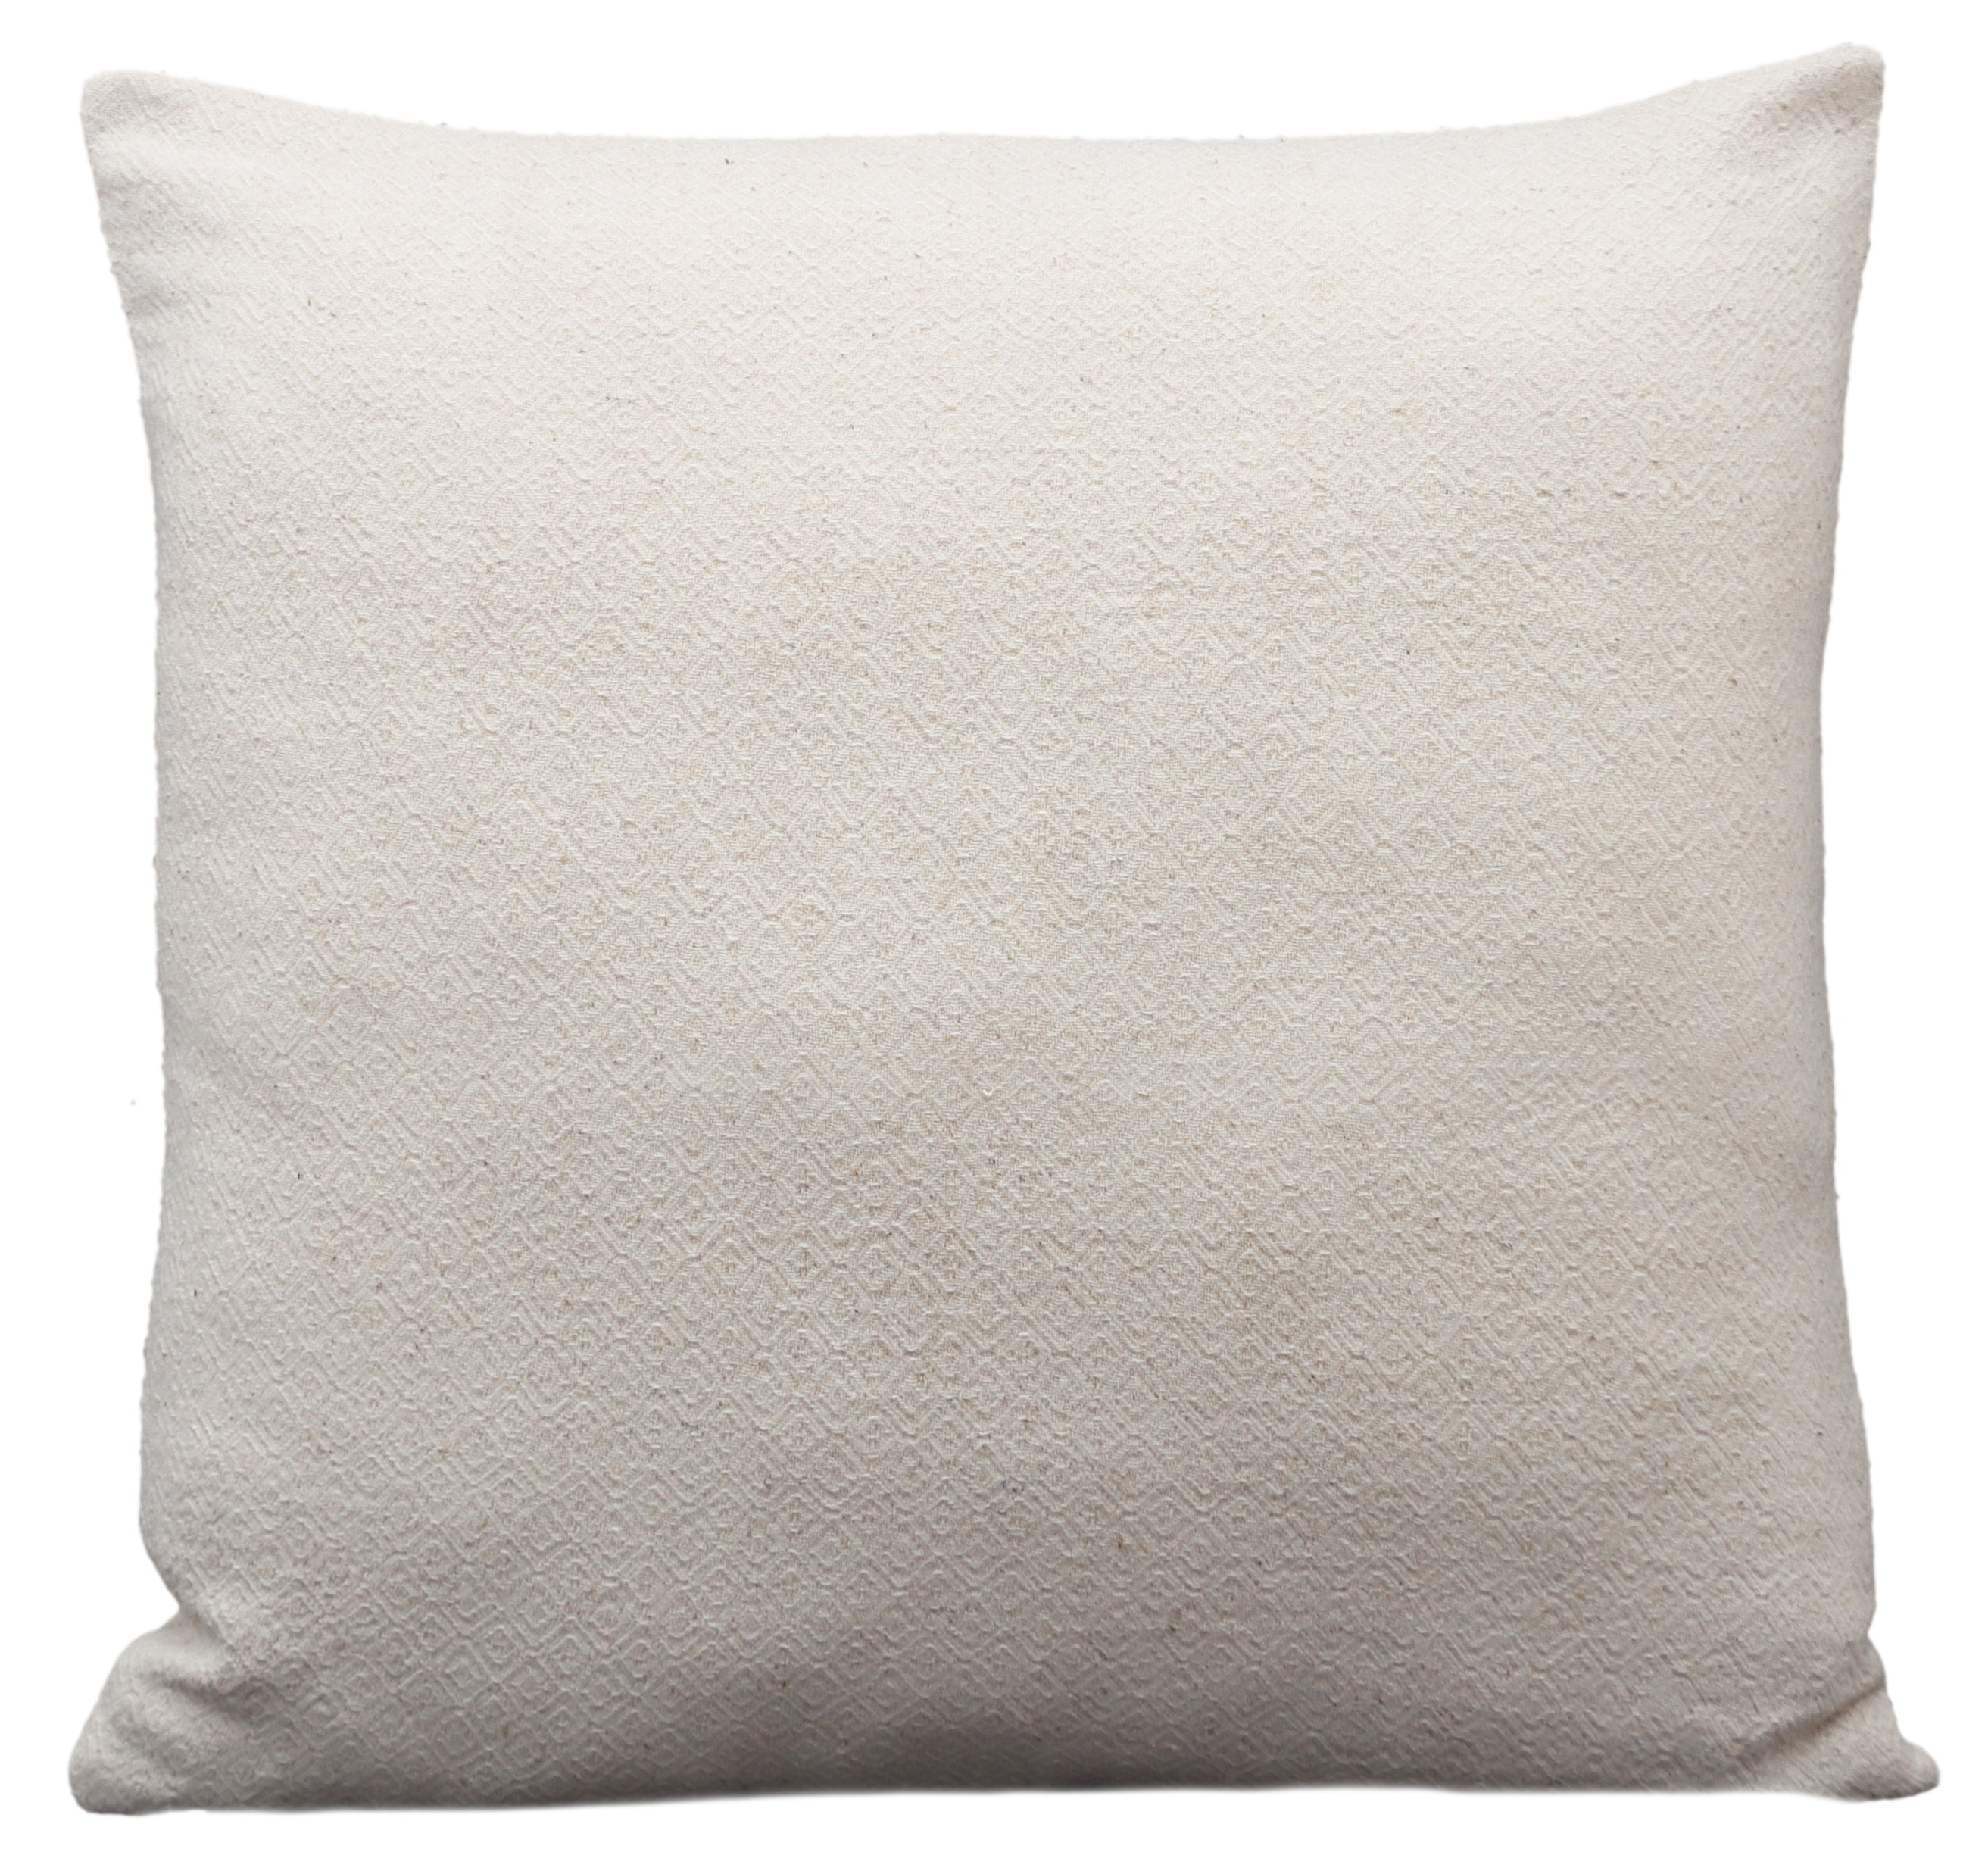
CUSHIONS
ITEM | Decorative handwoven Cushion cover
STYLE | RO-23-TW-3297
DESCRIPTION | Made using NNF Himalayan Grass (Blend of Himalayan Grass 65% and Liva Reviva -35%)-6Ne
CONTENTS | 60% Cotton, 25% Himalayan grass fiber, 15% Liva Reviva. Back 100% Cotton. No filling
SIZE | 20x20” / 50x50cms
Colors | Natural
Zipper | Backflap Zipper
PRICE USD FOB/PC | $5.00/PC
PACKAGING | Care label and Tags
CARE INSTRUCTIONS | Machine Wash cold, Line dry/tumble dry low
MOQ / COLOR / SIZE | 1000 Pcs
SAMPLE LEAD TIME | 21 days
PRODUCTION LEAD TIME | 90 days
CERTIFICATIONS | Oekotex

Slide 6
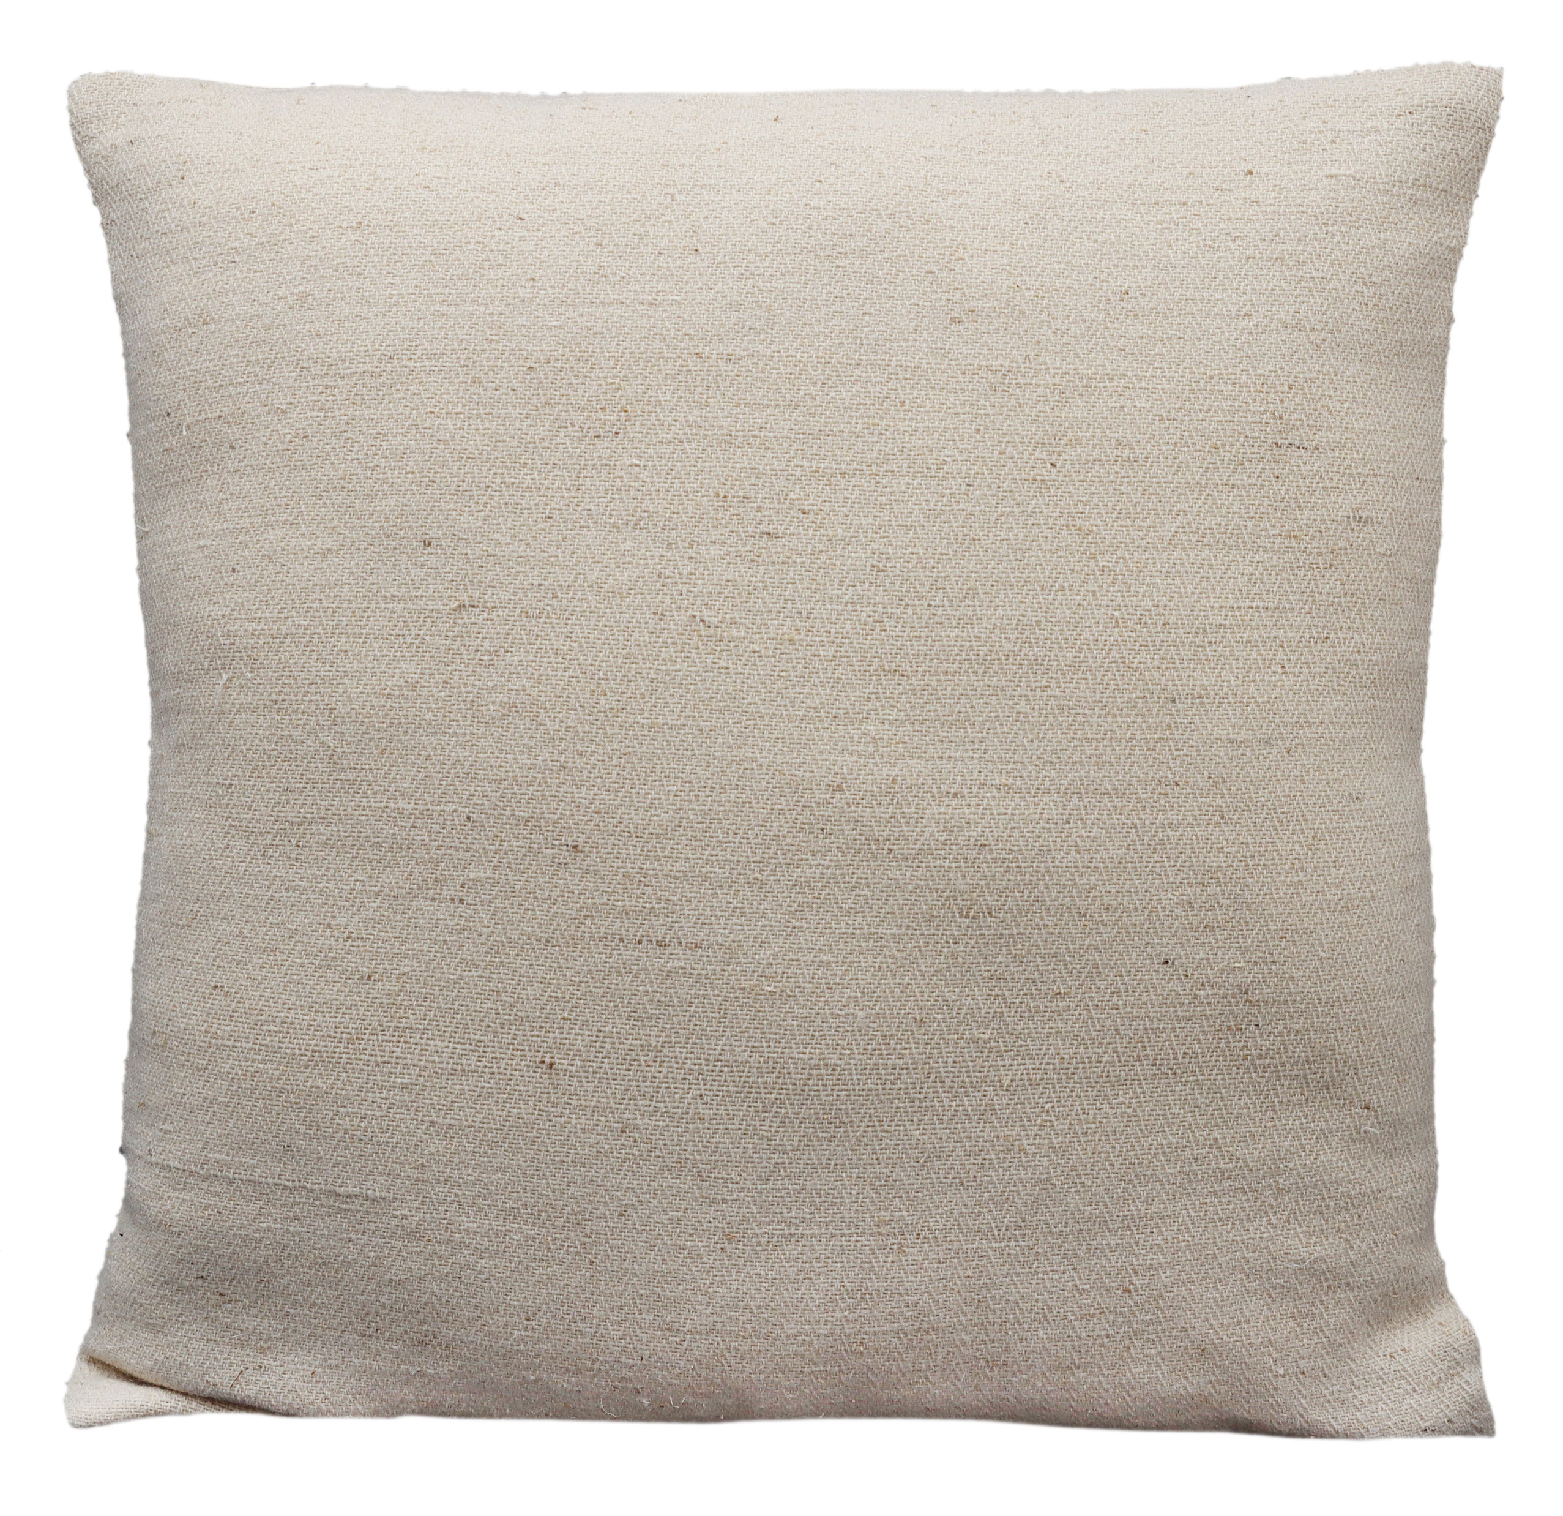
CUSHIONS
ITEM | Decorative handwoven Cushion cover
STYLE | RO-23-TW-3296
DESCRIPTION | Made using NNF Himalayan Grass (Blend of Himalayan Grass 45% & Wool-55%)-4nm
CONTENTS | Front-40% Wool, 22% Cotton, 18% Himalayan grass fiber. Back-100% Cotton, No filling
SIZE | 20x20” / 50x50cms
Colors | Natural
Zipper | Backflap Zipper
PRICE USD FOB/PC | $5.00/PC
PACKAGING | Care label and Tags
CARE INSTRUCTIONS | Machine Wash cold, Line dry/tumble dry low
MOQ / COLOR / SIZE | 1000 Pcs
SAMPLE LEAD TIME | 21 days
PRODUCTION LEAD TIME | 90 days
CERTIFICATIONS | Oekotex

Slide 7
Since establishment, our factories have produced some of the world’s most beautiful floor and décor furnishings. From the first unit that was set up in 1939, where yarn was spun from raw wool, to the various other factories where it is dyed, dried, woven and finished to create carNylons, kilims, rugs, durries, bath rugs, printed carNylons, throws, cushions, pillows, poufs, wall hangings and storage baskets. We currently have 17 fully functional factories in Panipat, each of which is operated with state-of-the-art technology and processes.
We are RWS, GRS,GOTS, BCI, OCS, Oekotex, SA 8000, Craftmark, Good Weave and Fair Trade certified.
We are committed to being environmentally conscious, and currently 3 of our facilities use up to 70% solar energy in daily operations. We are the first home furnishing company to be fair trade certified and have around 600 workers who benefit from the program. We are also the only company in India to be exclusively using responsibly sourced wool for manufacturing carNylons.

