Slide 1
This is Smart Glass & Film Solution
+82) 31-360-7196 contact@difon.co.kr 701, 82, Anyangpangyo-ro, Uiwang-si, Gyeonggi-do, Korea
Notes:
열차단 및 투과율 조절이 가능한 Low-e 스마트 필름 개발 및 상품화를 통해 에너지절감, 프라이버시 보호 등 새로운 가치를 부여할 것입니다.

Slide 2
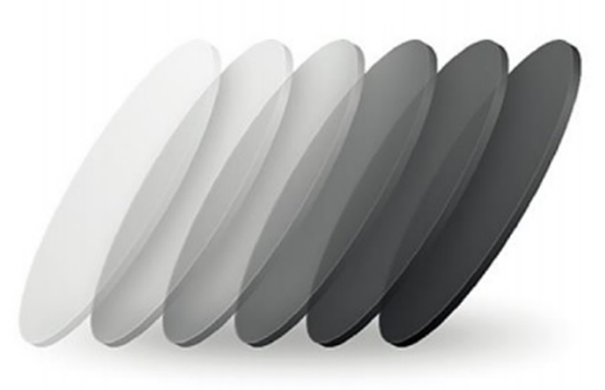
Difon Inc.
Difon Inc. is a company spun off from Hyundai Motor Company in 2021 to grow into a company that provides spatial light source solutions. We strive to add value to users in the space through our products. Furthermore, we will grow into a total space solution company by developing an energy management system that can control the environment of a space through integrated control of air conditioning systems, lighting, and smart film.
Foundation: Jun 8th, 2021
Address: 701, 82, Anyangpangyo-ro, Uiwang-si, Gyeonggi-do, Korea
Employee: 11 people
Capital: 127M KRW
CEO: Sungwoo Lee

Slide 3
Vision
company that space want
Mission
Leading new changes through the combination of space and technology
Ideology
Creating social values through challenges

Slide 4
Smart Window Solution Line Up
1. PDLC (Polymer Dispersed Liquid Crystal)
2. R-PDLC (Reverse PD Liquid Crystal)
3. VPLC (Variable Polarized Liquid Crystal)
4. High efficient low emission Low-E Film (Low-Emissivity)
5. Optional Privacy Film
6. Transparent heating film / Glass defrosting system

Slide 5
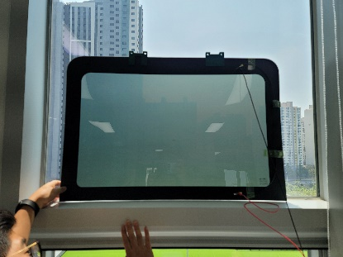
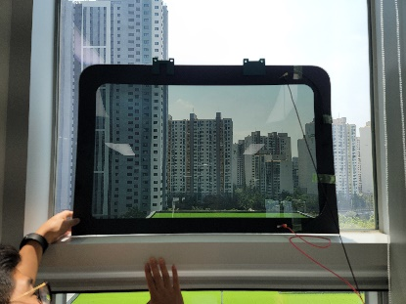
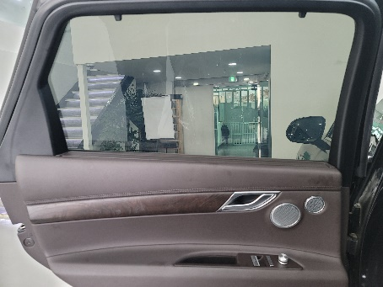
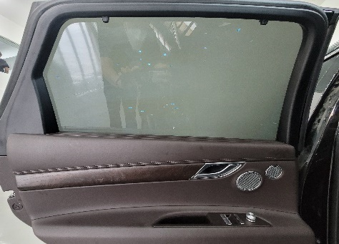
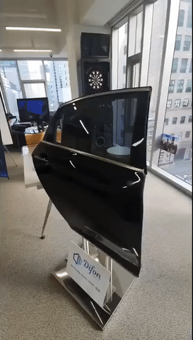
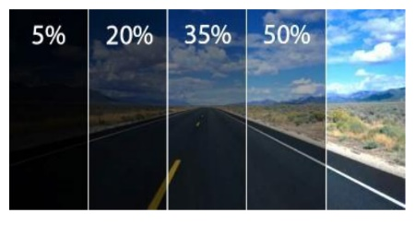
1. Product Line-up : Active Smart Window
a. PDLC (Polymer Dispersed Liquid Crystal)
Technology that can control the scattering rate of light, attach to the window to block the view from the outside. Opaque when OFF, transparent when ON, used for vision roof
b. R-PDLC (Reverse PD Liquid Crystal)
Reverse mode of PDLC, transparent when OFF, opaque when ON. Smart window with Polyimide Deposited Alignment Film
c. VPLC (Variable Polarized Liquid Crystal)
Controls the polarized light and the high molecular weight according to
the voltage. Next-generation film that linearly controls transmittance
through phase control.
- Smart tinting ~ perfect privacy (0.1%) function
- High brightness, no haze → Provides clear vision
- Linear transmittance fine adjustment of the concentration desired by the user

Slide 6
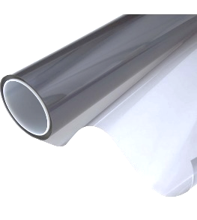
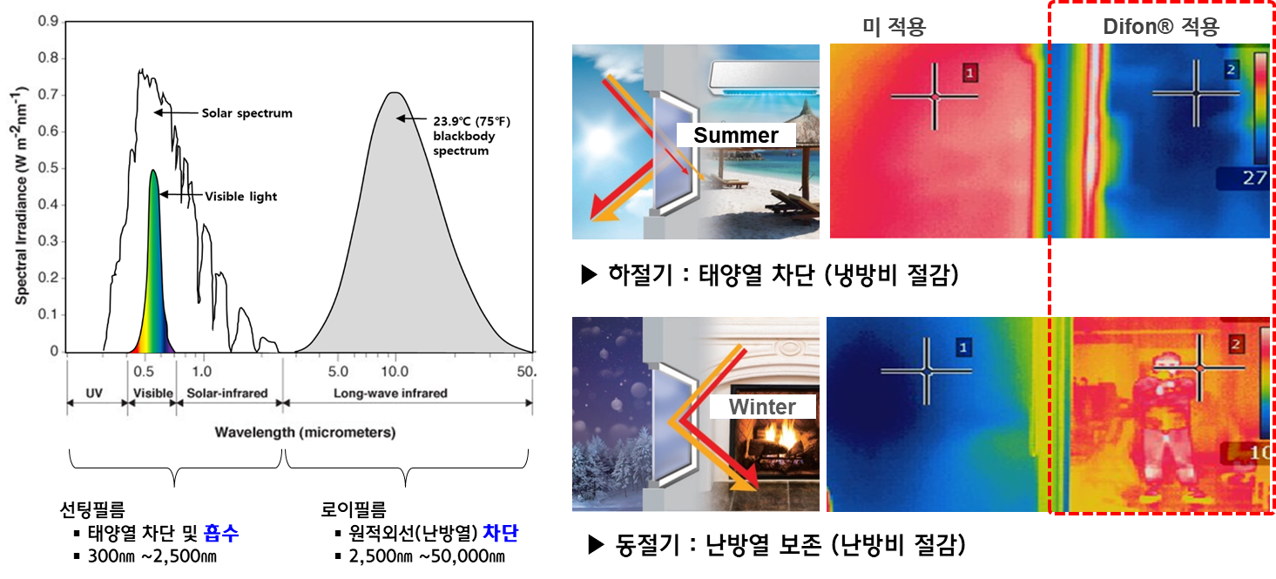
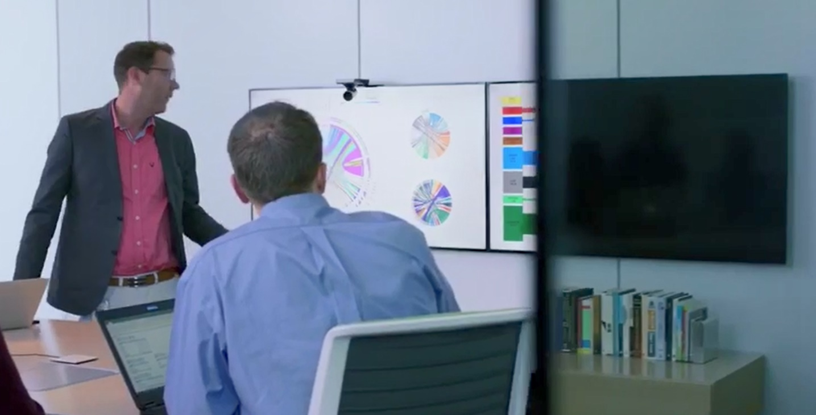
4. Product Line Up : High-efficiency low-emission Low-E cooling /heating energy saving film
Low-Emissivity, A film that reflects thermal energy through a metallic coating with high infrared reflectance and low emissivity
Summer temp. & power consumption
Not applied
Difon applied
Summer: Sun-Block(cooling cost saving)
26%
Energy saving effect
Normal glass
Winter temp. & power consumption
Winter: Preserve heat(heating cost saving)
Normal glass
5. 2nd generation optional privacy film display active shielding
What is Difon Privacy Film
Provides selective privacy using polarized light source film
Features: Security conference room, control room
2nd generation optional privacy film supports display-only privacy regardless of viewing angle

Slide 7
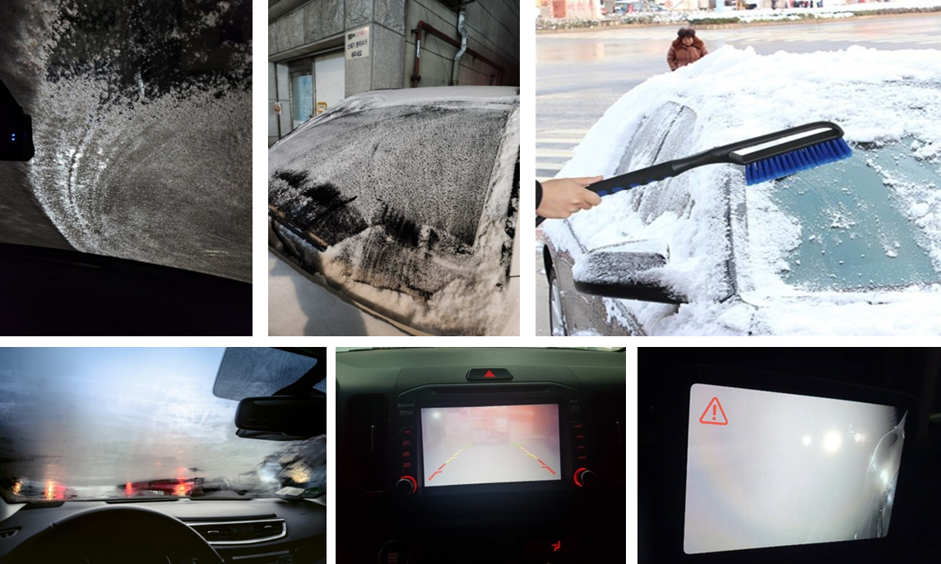
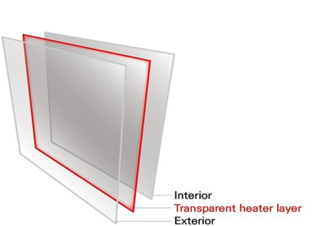
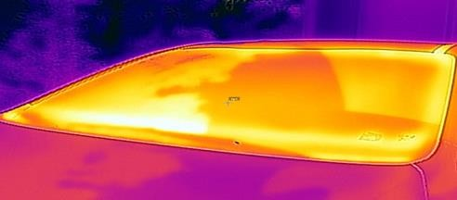
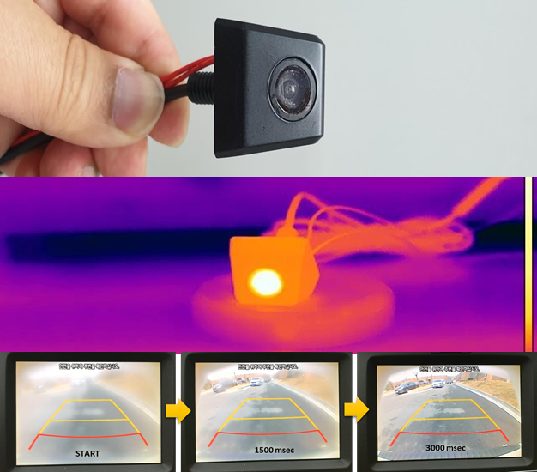
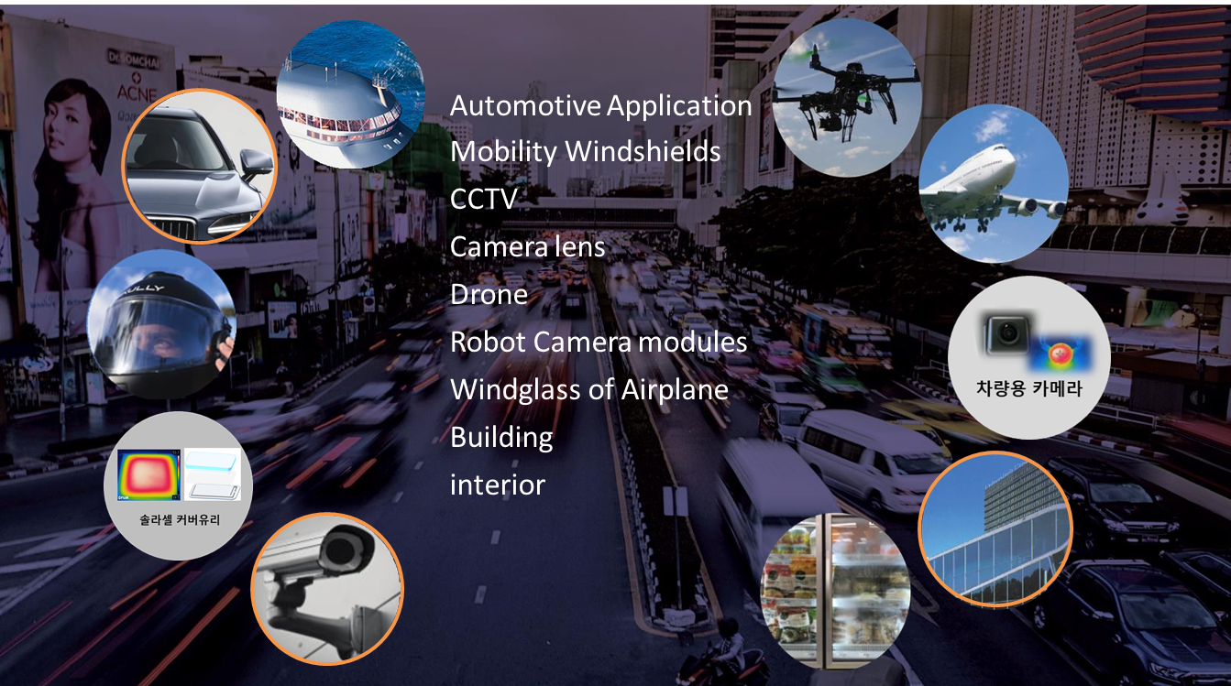
6. Transparent surface heating film/Transparent glass defrosting system
Using a transparent conductive film, it is possible to control thermal energy in a transparent state, and the efficiency of self-driving sensors and electric vehicles is increased.
Application that can be ‘applied everywhere’ and ‘sustained expansion’ with a transparent surface heating film

Slide 8
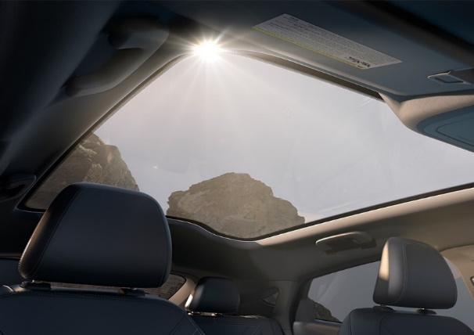
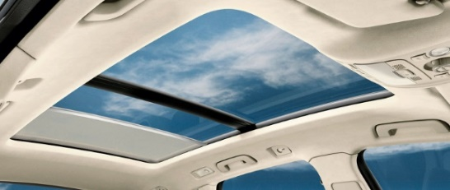
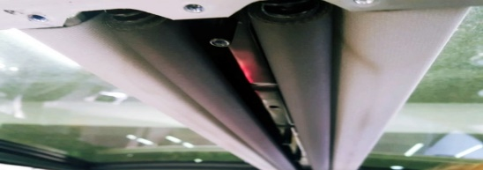
Smart window film application case: Mobility
Smart Window Solution (Low E + PDLC, R-PDLC, VPLC) : Real-vehicle test in Hyundai
Low-E applied smart window to control light transmittance and implement insulation/heat shielding effect
Space saving and integrated thermal management energy reduction(TTS total energy transmittance) effect by applying smart windows
Vision roof
Smart Window Mobility optimization
Transmittance switchable glass roof
Provides the best insulation performance regardless of the season
Providing a wide living space → Additional head space secured
Reduce vehicle production cost and body weight

Slide 9
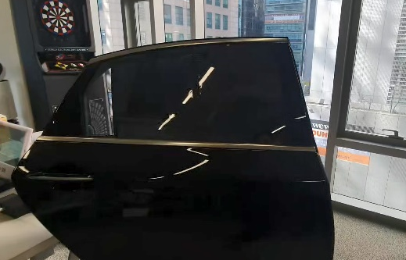
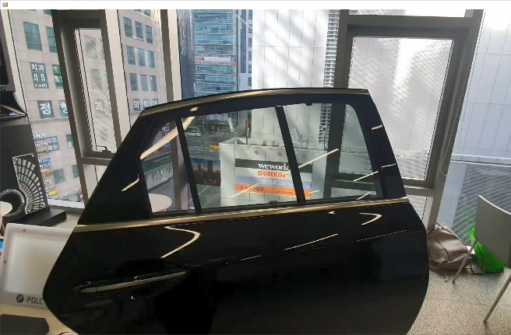
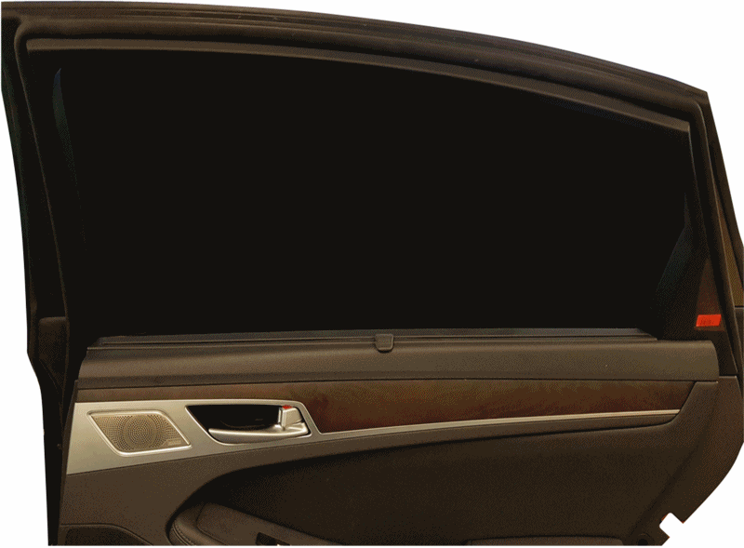
Smart window film application case: Mobility
Video clip
https://www.youtube.com/
@difon_official4785
Smart window mobility application(VPLC)
Vehicle tinting, electric curtain replacement → Smart tinting, heat blocking, variable transmittance
[ G80 RDW VPLC ON]
[ G80 RDW VPLC OFF ]
[ Smart Tinting]
[ Tinting transmittance change step by step at Door window ]
VPLC (Variable Polarized Liquid Crystal)
Next Generation ‘VPLC’ which is linearly controls the transmittance by adjusting the phase of the polymer according to the voltage
Perfect privacy(0.1%), clear view with high brightness, fine adjustment of linear transmittance

Slide 10
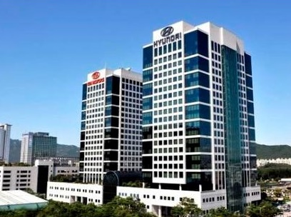
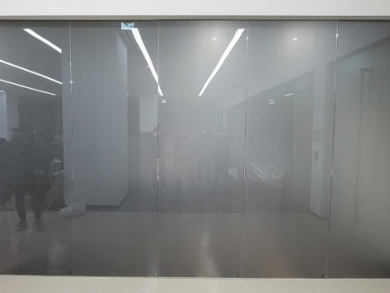
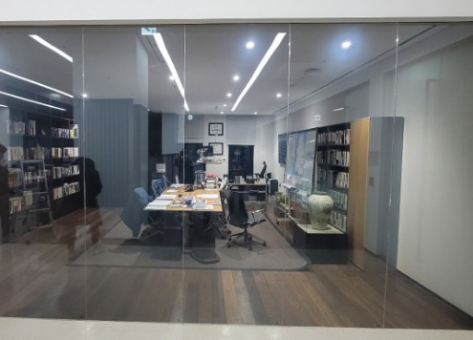
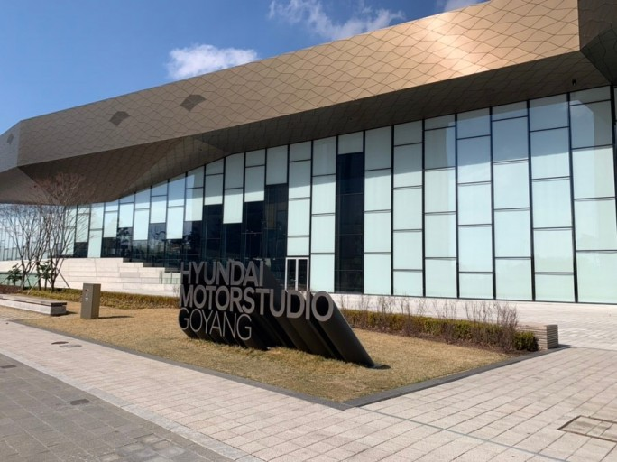
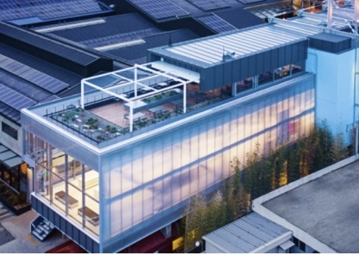
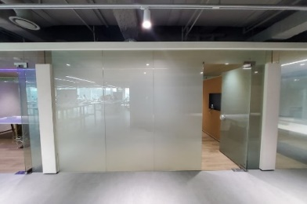
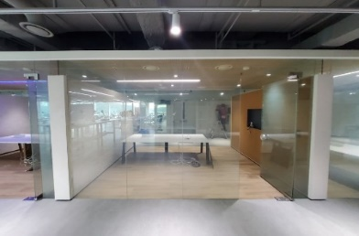
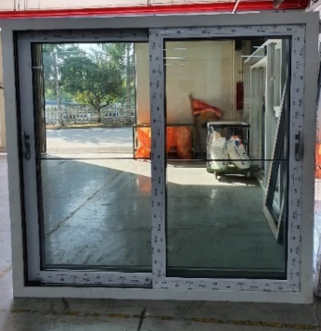
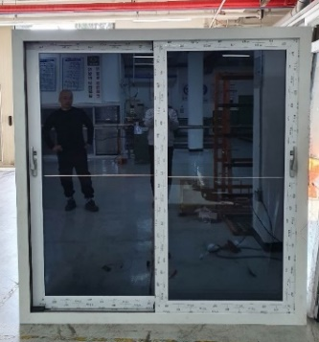
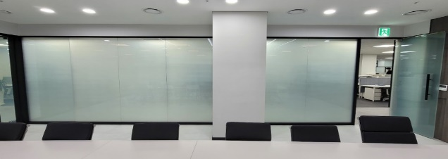
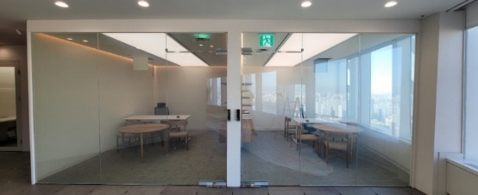
Smart window film application case: Construction
Application of construction company energy efficiency improvement solution through KOLAS certification
Automatic privacy support, harmful UV rays and heat blocking, carbon reduction energy saving
Short construction, maximum cooling/heating effect by attaching smart window film without window replacement
Skin damage caused by harmful rays, heat blocking, carbon reduction energy saving
OFF
ON
[ Low-E cooling/heating energy saving film ]
[ PDLC smart window office ]
OFF
ON
OFF
ON
OFF
ON
[ VPLC smart window sash ]

Slide 11
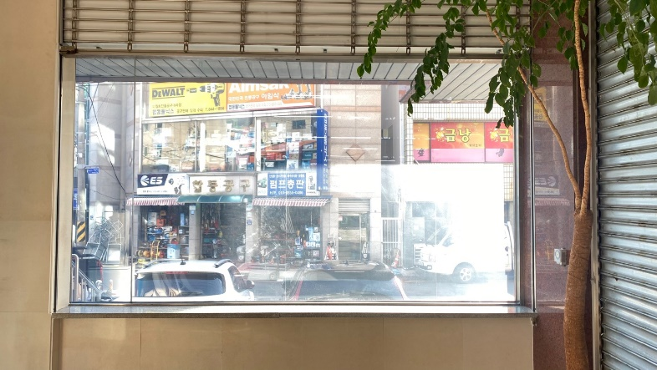
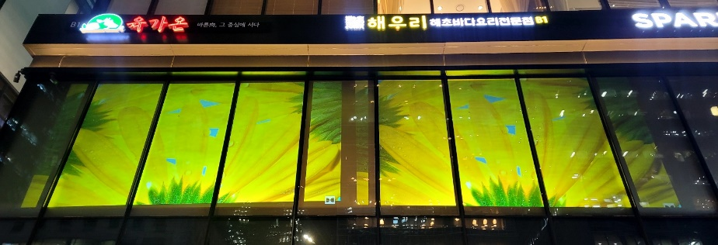
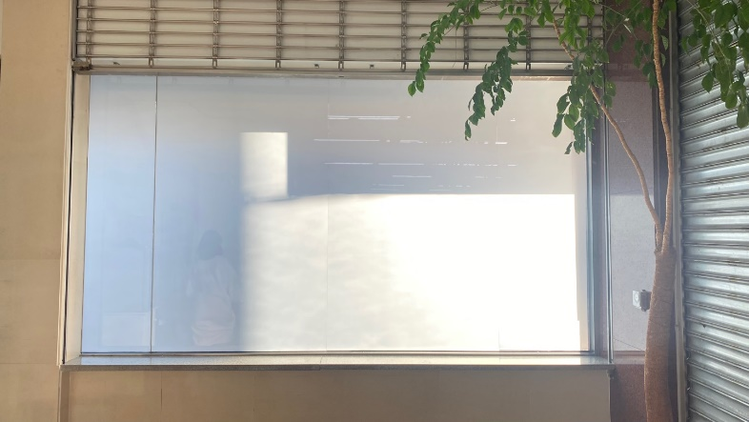
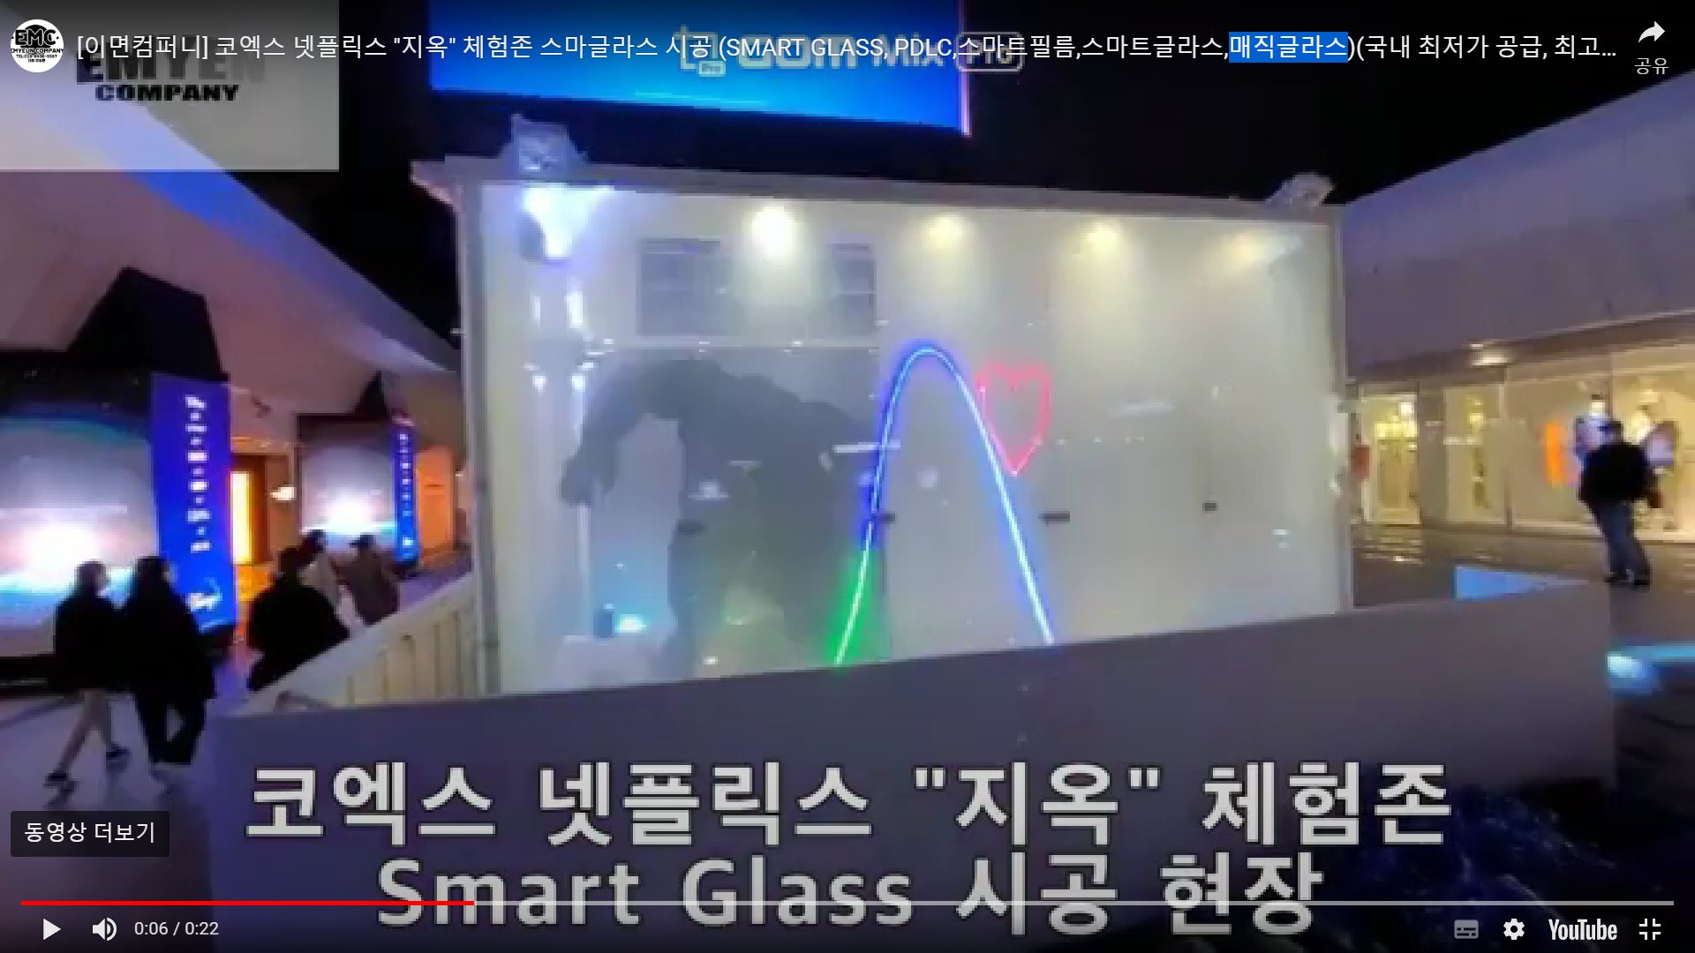
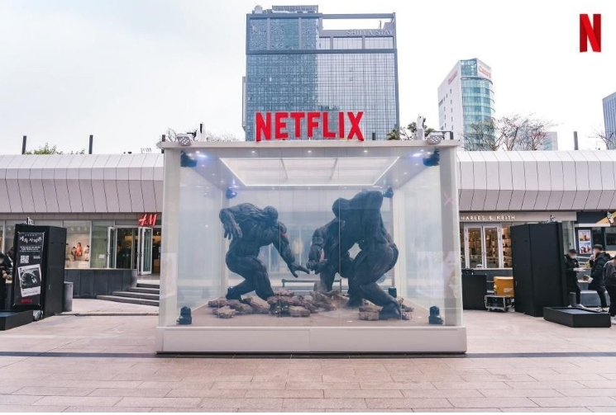
Smart window film application case (w/signage)
Display mall, shopping mall, Arcade showcase : Advertising solutions through external windows
Transmittance ON/OFF & Beam projector
[OFF]
[ON]
[ Advertising at Gym]
[ Indoor studio]
[video
clip]
[ Event mall ]
[Advertising at commercial building]

Slide 12
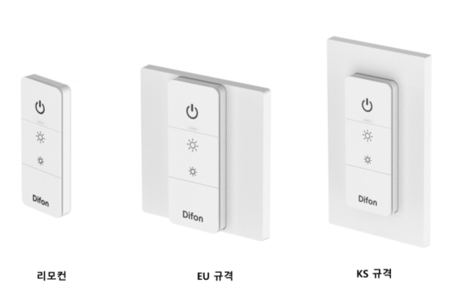
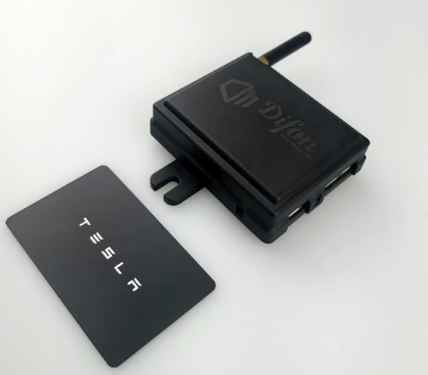
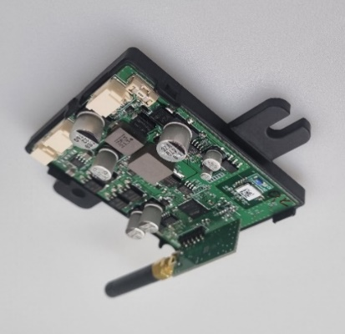
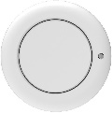
Smart window control solution
Features : 140mm X 70mm semiconductor power FET structure
Realization of dimming function that can adjust the transmittance as desired by FET bridge semiconductor control
Compatibility that can be immediately connected to existing systems with automotive (CAN, LIN support), architectural(RS485) physical switches, tough switches, and wireless communication(RF,Wifi/BT) control
Remote
control
EU standard
KS standard
Remote control & Controller
Satisfied with KS(US), EU(JP) standard
Remote control and wall switch can be used by magnetic attachment method
In additional to smart windows, it can be used for various purposes such as lighting control

Slide 13
Difon's strengths
Strategic partnership with Korea's No. 1 glass company
Difon strives to grow the smart glass market through strategic investment and strong partnerships with Korea's largest glass company, KCC Glass.
Smart films should be laminated on glass for application in buildings and vehicles. Difon has a variety of adhesive solutions and a stable glass supply chain through partnership with KCC Glass.
Possessing high technology through 2 years of business development within Hyundai Motor Company
Difon is a company founded by engineers at Hyundai Motor Company R&D and spun off after technological advancement within company for 2 years. By developing technology based on the company's full support and accumulated data, Difon able to exhibit better performance compared to others and have price & quality competitiveness.
In addition, even in the early stages of the business, Difon can stably mass-produce.
Reasonable pricing policy for portfolio composition
Difon has a small amount of portfolio as it is in the early stages of its business. Therefore, in order to increase the portfolio, we will sell our products at a reasonable price, which will be the most competitive price in the world. Don't worry about the quality just because the price is low. Difon possesses sufficient technology and can verify the quality by passing durability tests including QUV.

Slide 14
“ Smart Window” solution for a better future
Various product portfolio - Normal transparent, opaque, black, heat blocking, heat generating, privacy
Smart privacy protection → motion detection sensor, increased convenience in connection with Home IoT
UV Block 99.9% & 26% cooling/heating energy saving
Sound insulation performance, noise reduction → replacement of double-glazed sound insulation glass, quiet space value
Building energy saving smart window solution using new technology applied to automobiles
User-friendly UX/UI: remote control, touch control solution
Dimming control step-by-step → Provides the transmittance desired by the user

Slide 15
Contact
Do you have any inquiries or suggestions regarding Difon’s products or business partnership with us?
Please contact us using the contact information below and we will be happy to advise you.
Address | 82, Anyangpangyo-ro, Uiwang-si, Gyeonggi-do, Republic of Korea
Phone | +82-31-360-7196
E-mail | contact@difon.co.kr
Notes:
열차단 및 투과율 조절이 가능한 Low-e 스마트 필름 개발 및 상품화를 통해 에너지절감, 프라이버시 보호 등 새로운 가치를 부여할 것입니다.

