Slide 1


A LEADER IN E-COACHING CREATING SUSTAINABLE KNOWLEDGE HABITS
Investor Presentation | June 2023

Slide 2

KNOWLEDGE IS AVAILABLE!
Lifelong learning is the basis for success
Knowledge transfer in companies is one of the biggest challenges for HR
Technology allows us to work more and more efficiently
However, a lot of potential falls by the wayside

Slide 3


TECHNOLOGY BEATS THE ABILITY TO LEARN
Technologie
Microsoft
CoPilot
Velocity of change
Lifelong learning is the basis for success
Knowledge transfer in companies is one of the biggest challenges for HR
ChatGPT
Microsoft
Teams
Zeit

Slide 4

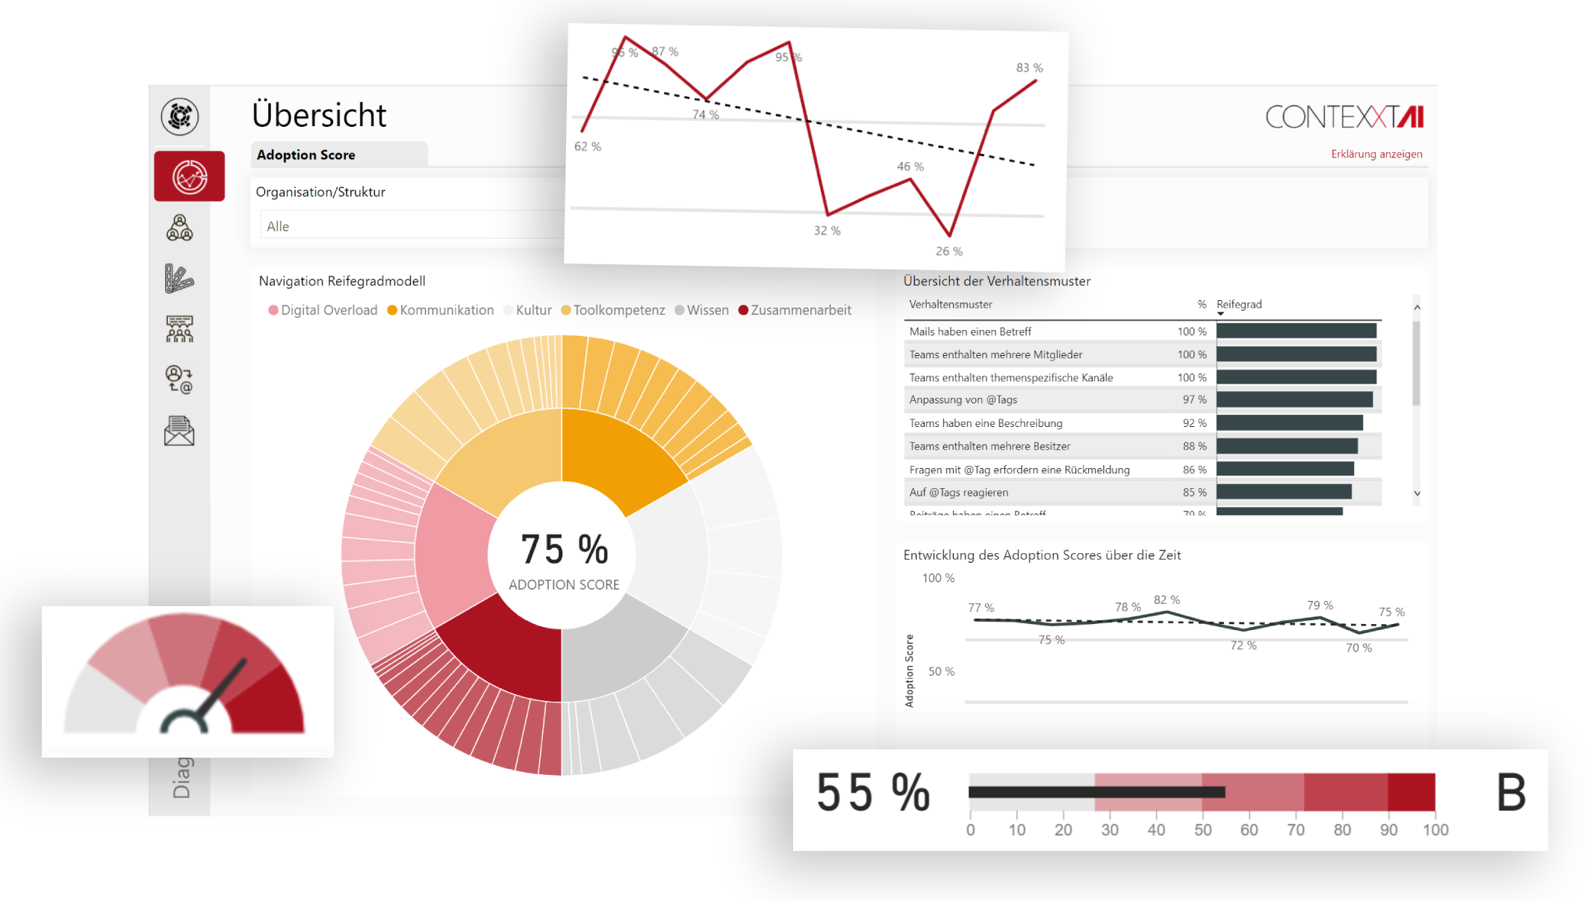

OUR SOLUTION
E-Coaching: Individual, sustainable and context-based
1
Measure and interpret
We analyze how people work, identify best practices, recognize changes in behavior.
Recognizing learning potential
2
Algorithms recognize individual maturity levels, determine priorities and resistance to change.
Coach!
3
Our AI coach delivers "learning interventions", targeted learning "nuggets" in the employee's language.

Slide 5

SIMPLE, SUSTAINABLE, GOAL-ORIENTED LEARNING
Technologie
Significant productivity gains are achievable
Menschliche Adaptionsfähigkeit
Zeit

Slide 6



OUR SOLUTION - TECHNOLOGY
Secure and GDPR compliant
Inclusive & Individual
Works council and GDPR-compliant, consideration of individual employee protection rights
Privacy
Scalable Technology
Works council and GDPR-compliant, consideration of individual employee protection rights
Works council and GDPR-compliant, consideration of individual employee protection rights

Slide 7




OUR SOLUTION - TECHNOLOGY
Secure and GDPR compliant
Independent Audit
One of only 90 apps worldwide to receieve certification.
Tested against established security requirements such as SOC 2, PCI DSS and ISO 27001
Data Integrity
A proven highest level of data security through independent attestation for our SaaS solutions.

Slide 8

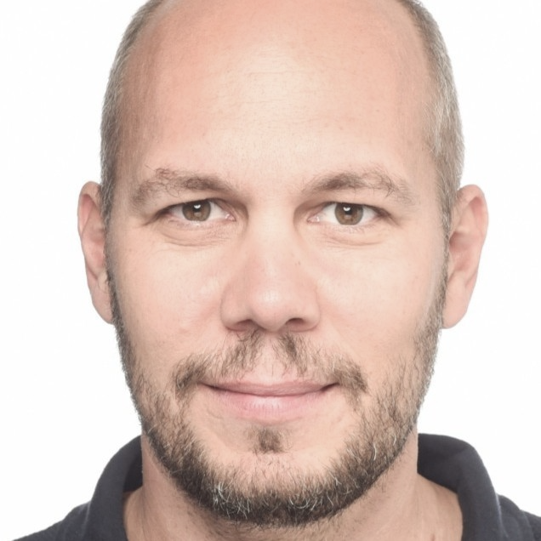
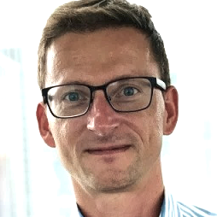

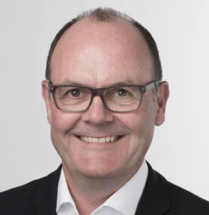
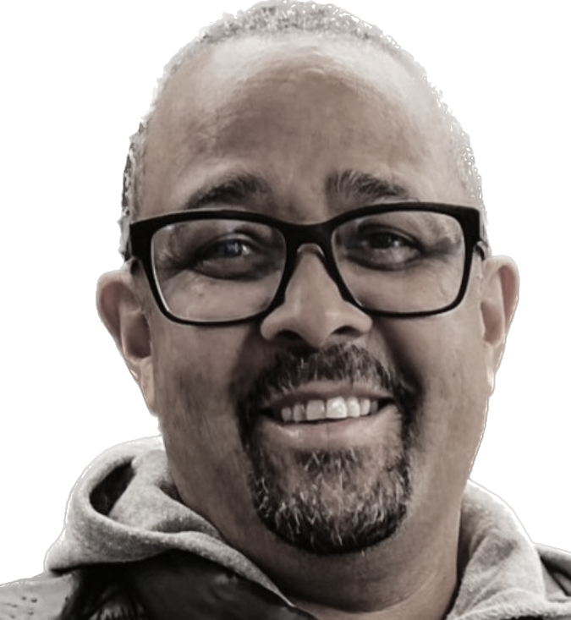
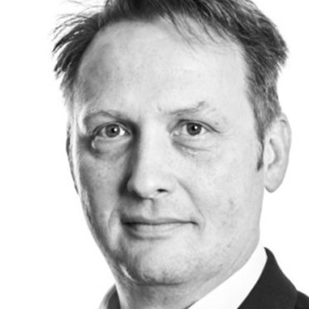
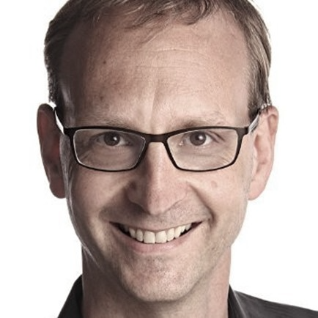
MANAGEMENT AND FOUNDING TEAM
On board: Many years of experience in all relevant areas
Torsten Katthöfer
Robert Mulsow
Advisory Support
Expert in business informatics, data analytics, and machine learning
22 years' experience:
Building business solutions
Assembling highly efficient development teams
Microsoft MVP for M365 Apps & Services
15 years international experience:
New technology integration
Sales
Data Security
Ralf Zastrau
Entrepreneur
Director Entrepreneurship
University of Saarland
CEO, CTO
CRO, CISO
Martin Kundt
Vorstand
KnowHow! AG
Chris Dorsey
r
Rainer Jehl
Expert in business informatics, data analytics, and machine learning
22 years' experience:
Building business solutions
Assembling highly efficient development teams
Finance, Controlling, Accounting
20 years' experience:
Growing organizations finance divisions
Transforming customer activity into cashflow
Tim Bosenick
UX Legend
Founder Uintent, ReSight Global
CMO
COO, CFO

Slide 9
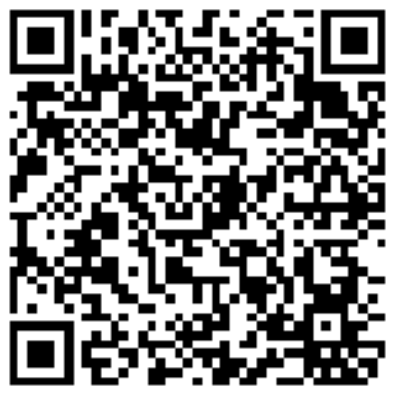
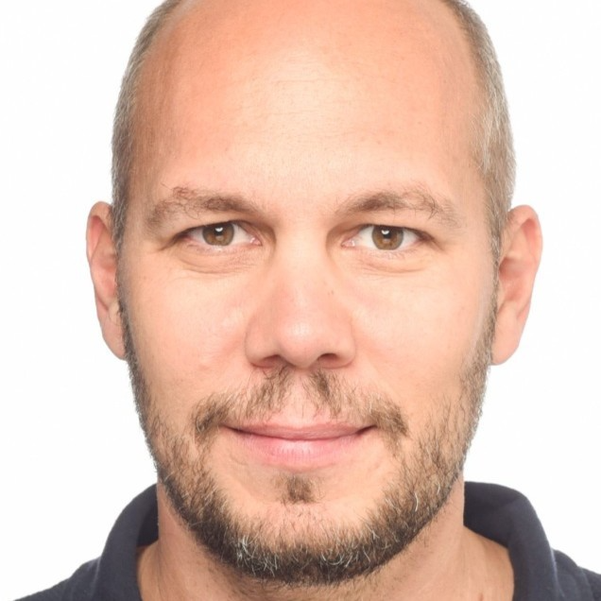
GET IN THE RACE!
Passion for technology and data, as well as the possibilities of AI and the potential of digital transformation, drive us to change the world.
Torsten Katthöfer
CEO
https://contexxt.ai
tk@contexxt.ai
+491772269276
Linkedin

Slide 10
THANK YOU

