Slide 1
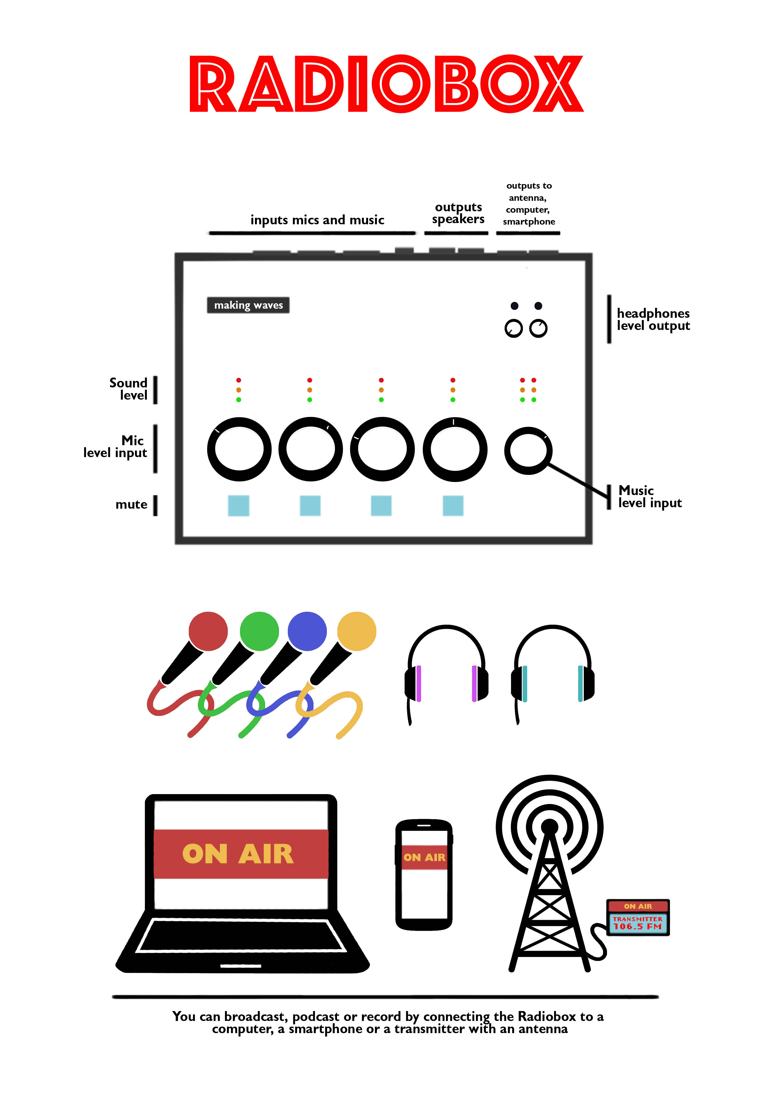
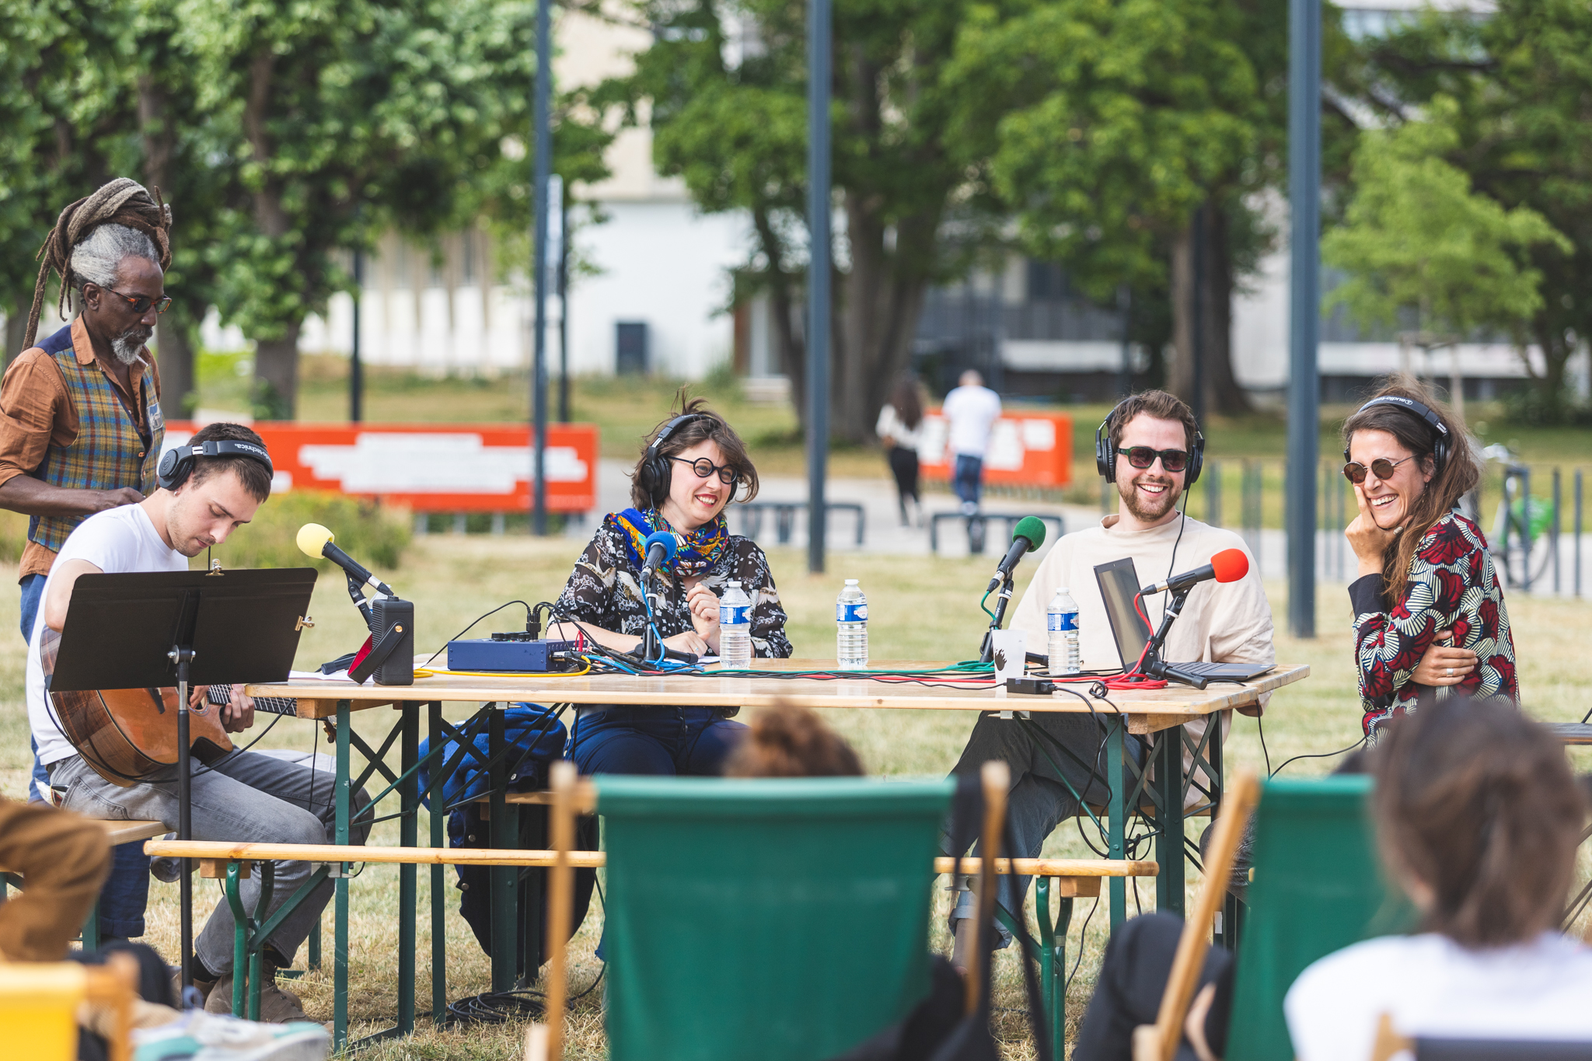
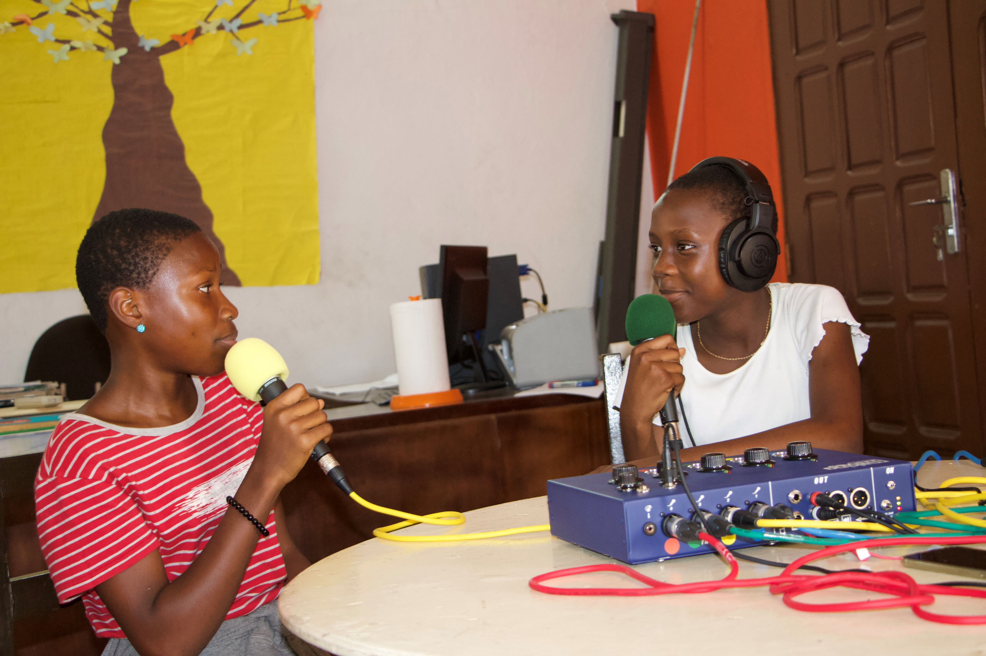
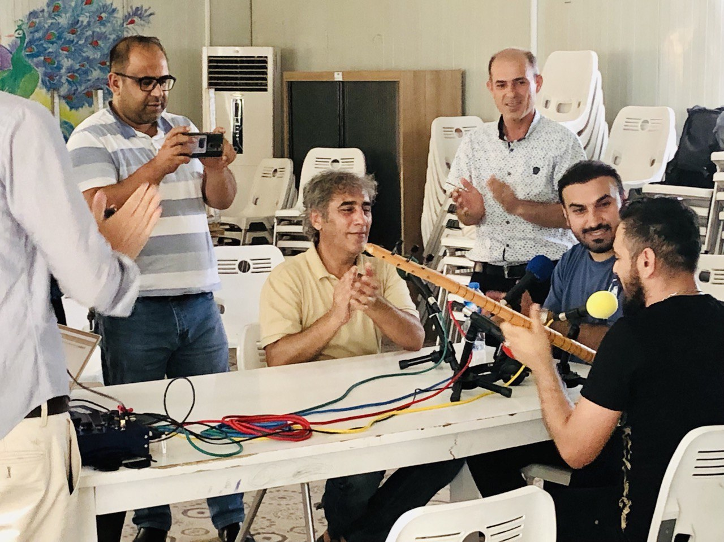
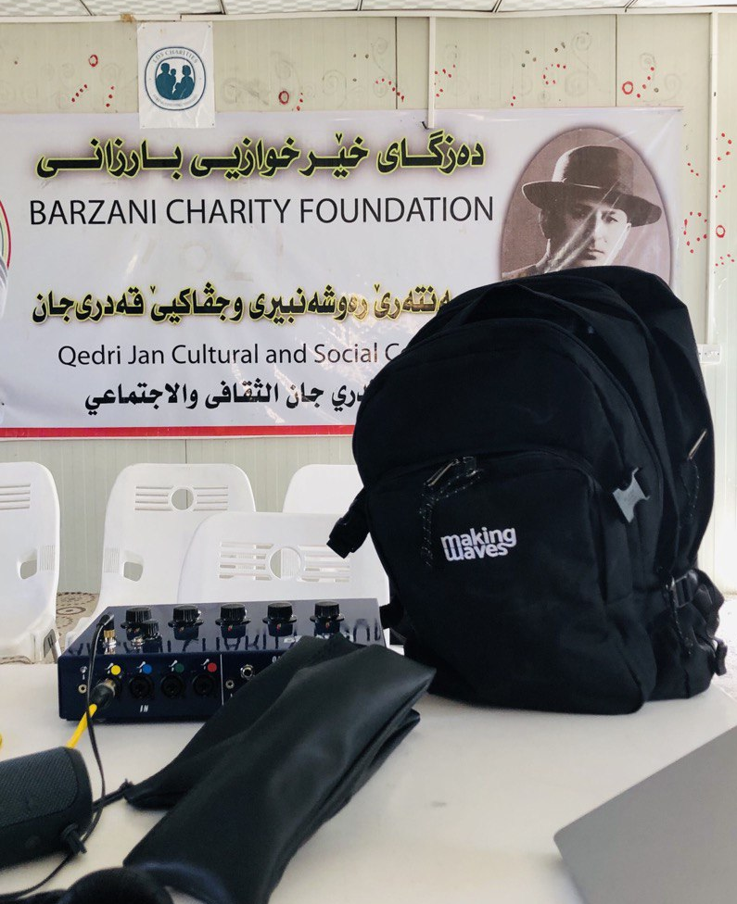
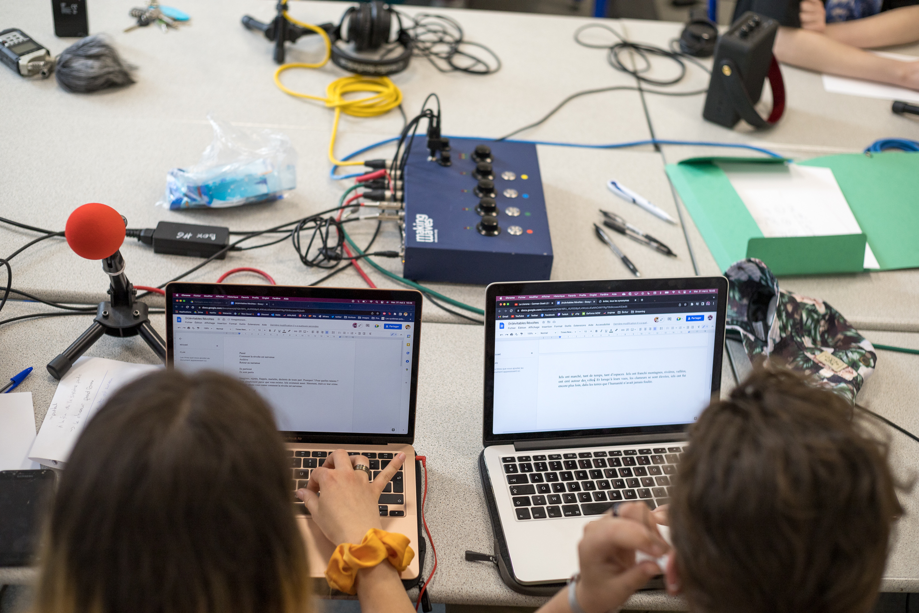
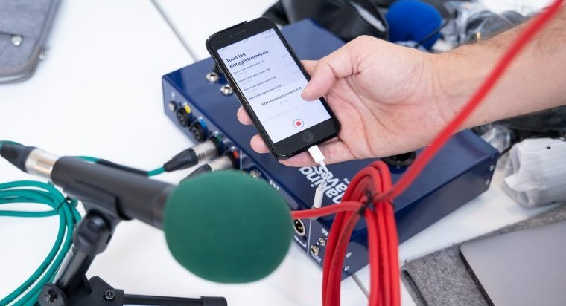
Live and public radio show during a theater festival in Strasburg – 2022
A radio workshop with Ivorian children in Abidjan – 2021
Illustrations of the
Radiobox various uses and users around the world
Iraqi musicians recording music with the Radiobox after it was installed in a refugee camp – 2022
Radiobox diagram
Radiobox can be connected both to smartphone or computer to record, broadcast and podcast

Slide 2
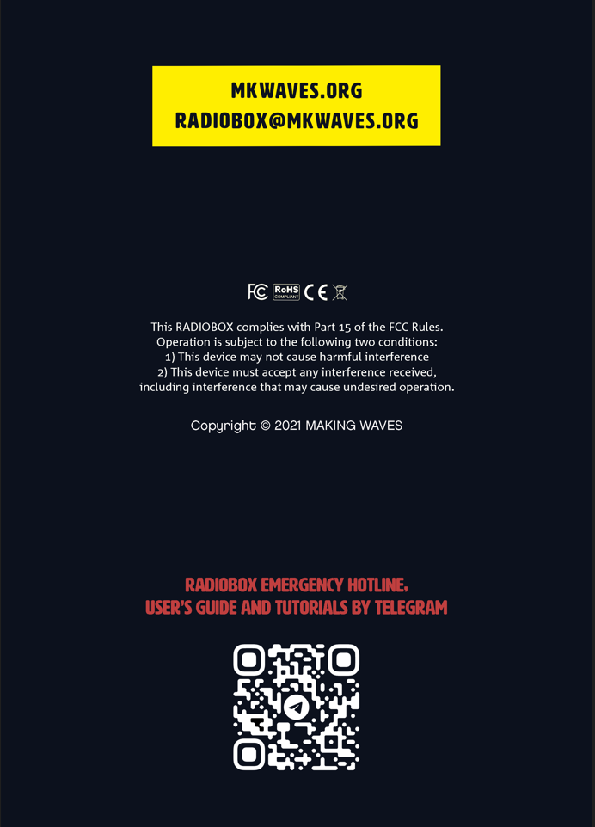
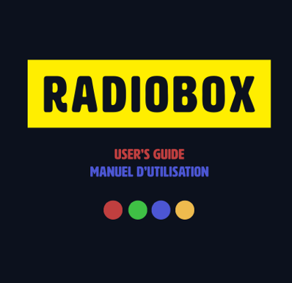
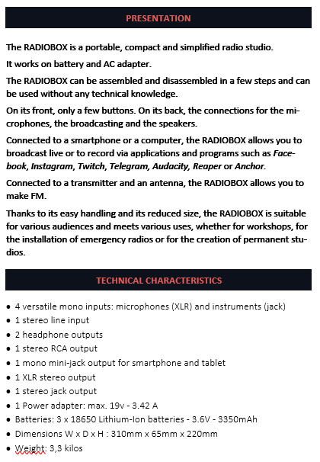
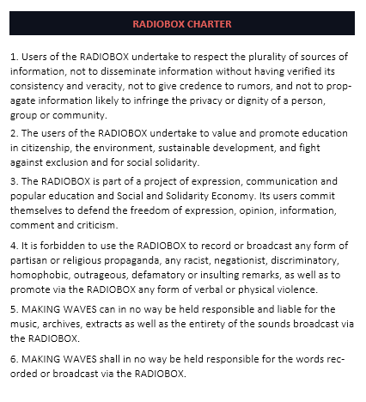
Extracts from the Radiobox user’s guide

Slide 3
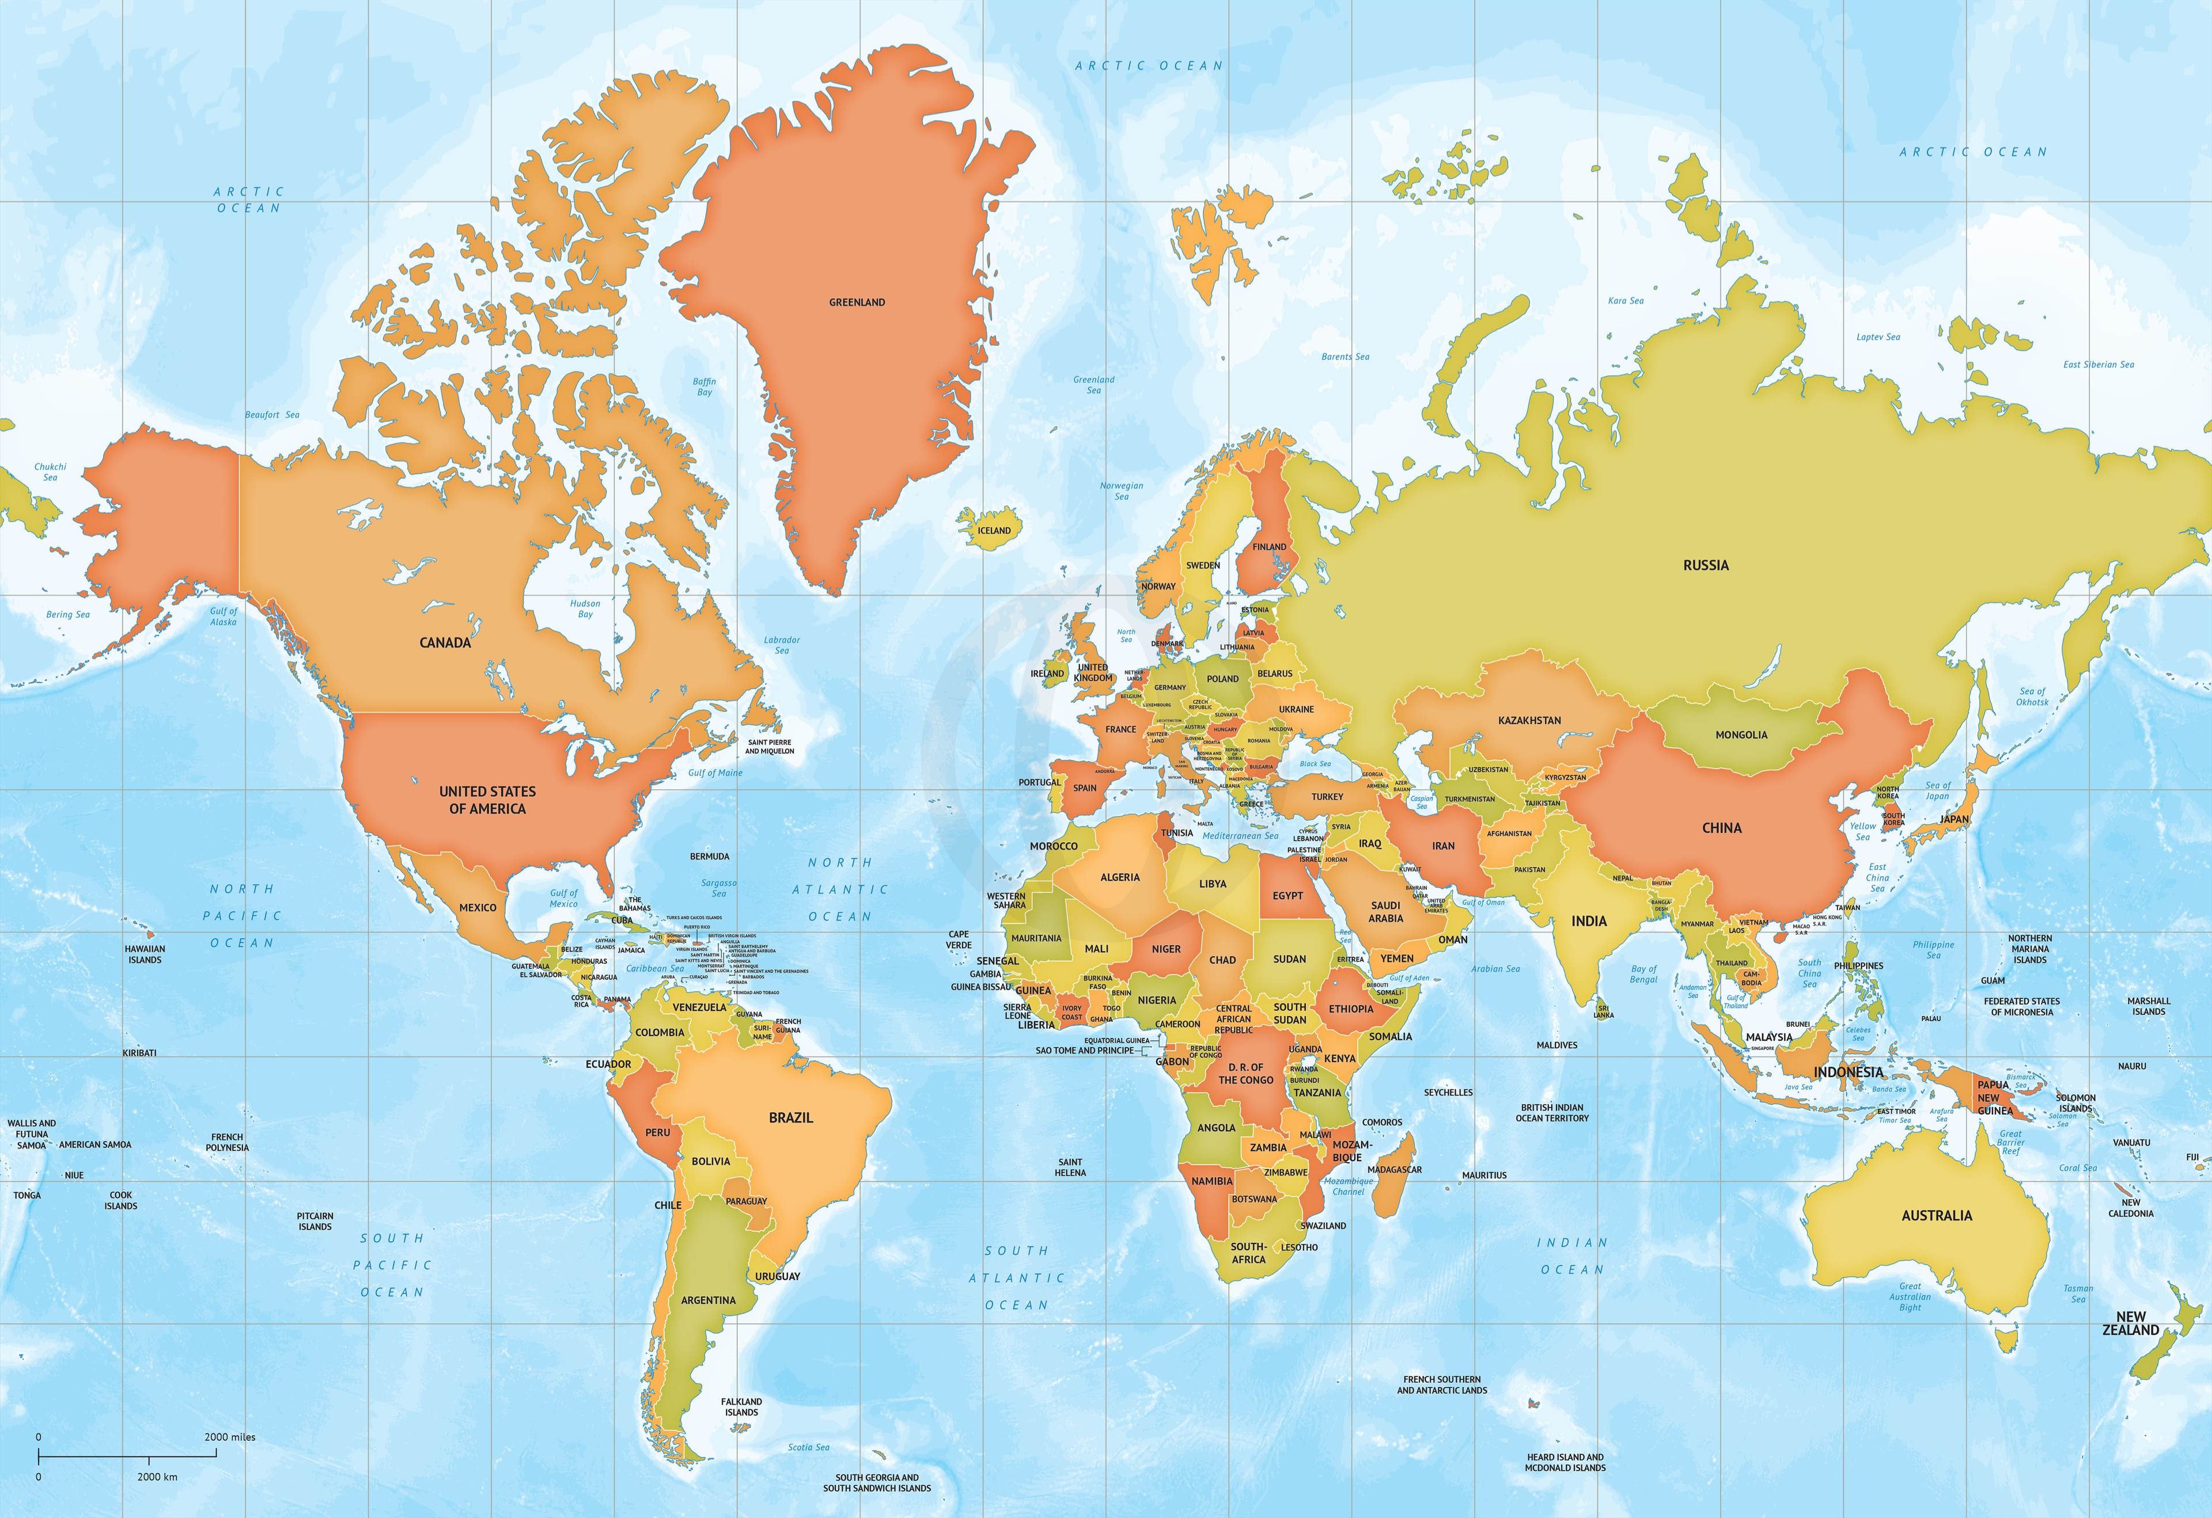

Countries where Radioboxes are located today

