Slide 1
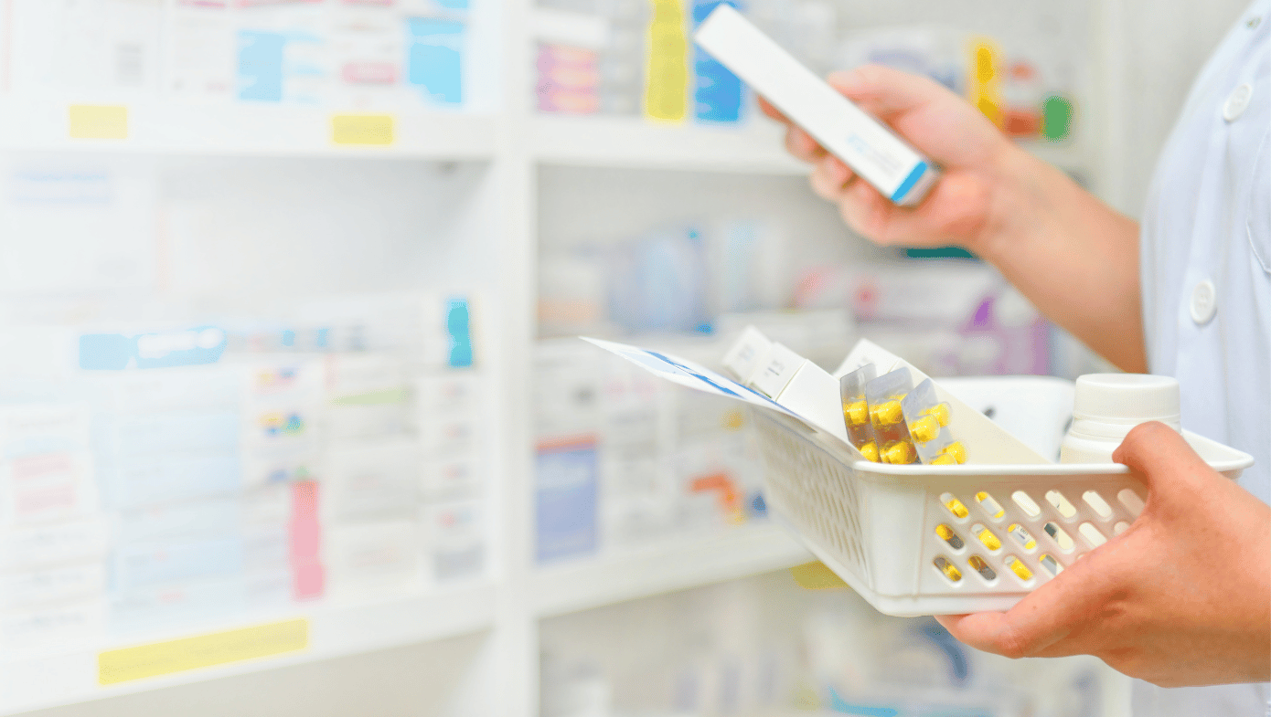
Your medication when and where you want

Slide 2
Problem
Information on the availability of drugs in pharmacies is hardly accessible.
Notes:
Allow me to introduce you to my lovely cousin, here name is Mira. Mira almost died three years ago from an asthma attack while her father was scouring pharmacies for his medication. He wasted so much time that when he returned, his daughter was barely breathing.
Mira's story is just one of many. In fact, in the DRC, millions of people see their illness worsen and others even die simply because they were not able to access information on the availability of their medication in pharmacies in time.

Slide 3
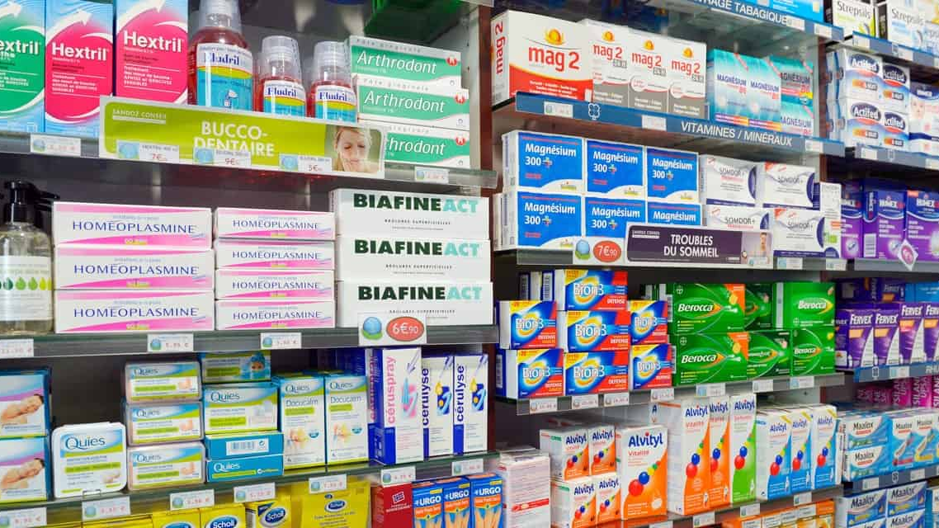
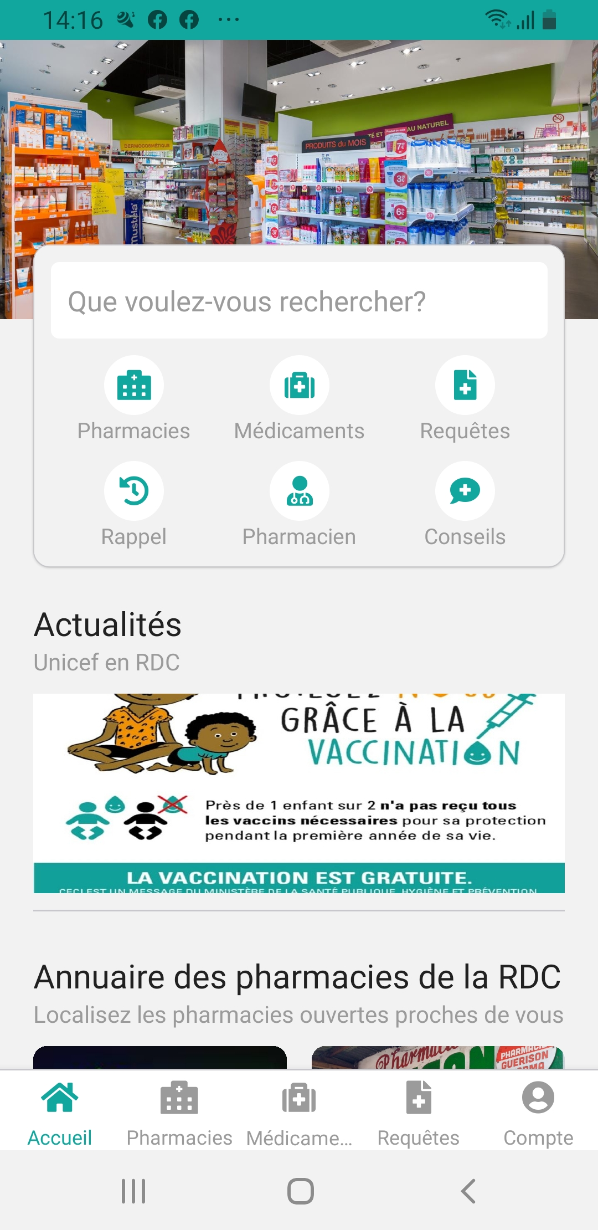
Solution
LukaPharma mobile App
Drug availability (6 min)
and Price
Pay remotely
Delivery
Notes:
So to reduce the time of searching for drugs, we have developed the LukaPharma mobile application which helps you to find in less than 6 minutes the nearest pharmacy where your drugs are available at the best price, to pay remotely and have them delivered.

Slide 4
Business model
Commission
5% paid by the pharmacist
Freemium
Advertising for free use and $0.5 ticket for each request in premium mode
Pharmacy certification
In partnership with the government, pharmacies pay a subscription fee to remain visible on the platform
Notes:
We earn money by retaining 5% commission from pharmacies for each product sold.

Slide 5
-
Market Size
Global E-Pharmacy Market
$60.8B
TAM
Annual turnover of 1224 pharmacies in DRC
$80.4M
TOM
$1.1M + $1.6M
$2.7M
1/4 passes through LukaPharma then we apply 5%
SOM
Notes:
So by deducting 5% commission on a quarter of the turnover of the 1224 regular pharmacies in Kinshasa, we could achieve an annual turnover of more than $1.1M in DRC.
$1,6M = (Nombre d’adultes possédant un téléphone x Coût d’une requête [0,5$] en dollars) x 12 Mois

Slide 6
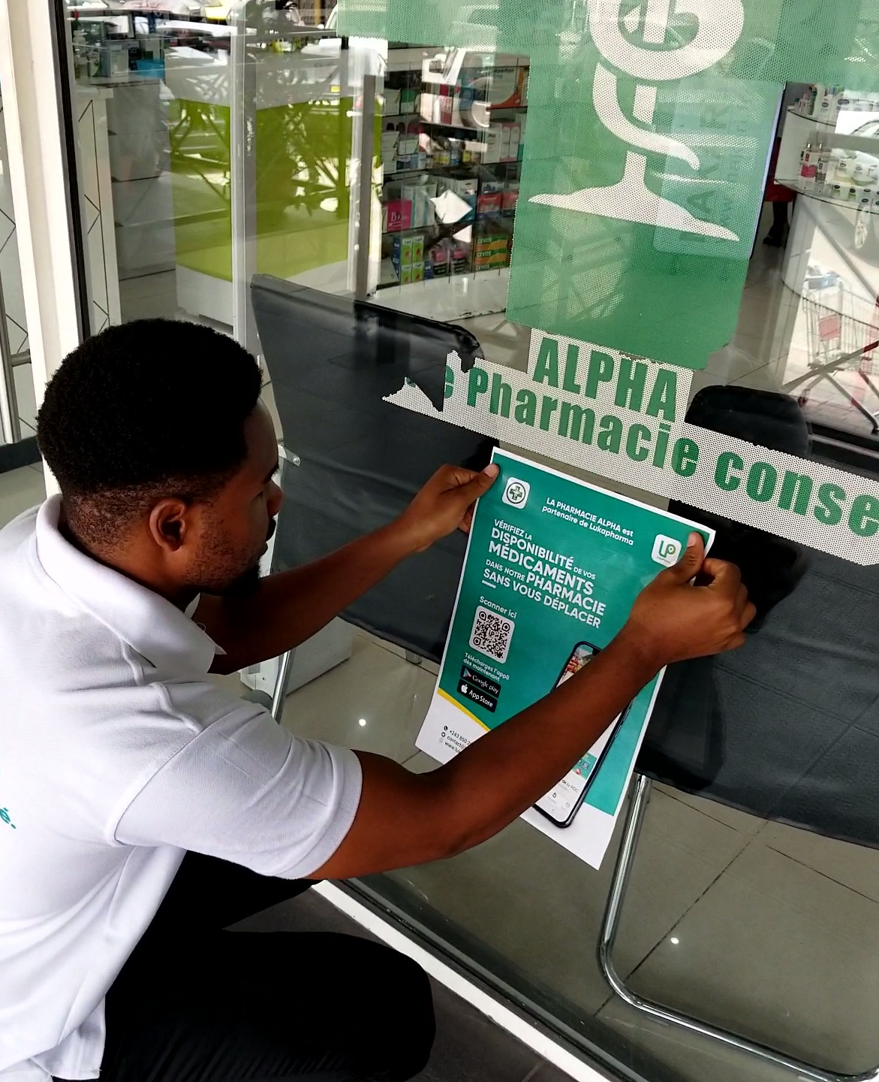
Traction
 | Today | By 2026
Partner pharmacies | 40 | 500
Requests treated | +200 | +219k
Turnover | $500 | $548k
Notes:
During the pilot phase of the project a year ago, we have obtained partnerships with 40 pharmacies, we have successfully treated more than 100 requests with a turnover of 500 USD.
Our goal by 2026 is to realize a turnover of 2k USD by helping more than 110k people to quickly find their medication.

Slide 7
Need
Update the App (10%)
Call center (20%)
Hiring (30%)
Marketing and communication (40%)
Raising
$400K
Notes:
This is why we are raising 400k USD which will be used for:
Launching the 2nd version of the application
Install a call center
Recruit 1 developer and 2 telepharmacists
Launch a communication campaign

Slide 8
Team

Slide 9
Invest in a real social impact project
Notes:
Do you remember my daughter cousin Mira? She was barely saved in a local hospital.
But millions of children may not be so lucky. It could be your child!
Ladies and gentlemen, here is your opportunity to invest in a real social impact project.
So what are you waiting for? Join us now.

