Slide 1
Learn More

Slide 2
OS-Climate Agenda
Introduction
Physical Risk & Resilience
Sector Alignment / Implied Temperature Rise
Transition Analysis
Climate Risk Data Mesh
Data Commons
Data Exchange
Supporting Tools
Data Extraction
Entity Matching

Slide 3
Members & Partners
PREMIUM MEMBERS
OS-Climate
Members & Partners
GENERAL MEMBERS
ASSOCIATE MEMBERS
PARTNERS & DATA PROVIDERS
World Resources Institute

Slide 4
Introduction
May 2023

Slide 5
Physical Risk & Resilience Intro

Slide 6
Physical Risk & Resilience Tool and Demo

Slide 7
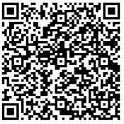
Sector Alignment (Implied Temperature Rise)

Slide 8
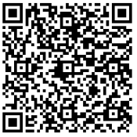
Transition Analysis

Slide 9
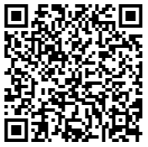
Climate Risk Data Mesh
Data Commons
Data Exchange
Data Extraction

Slide 10
Entity Matching

Slide 11
Contact Us

